Slide 1
Paper discussion: Steffi, Sasha, Rhythima
25 Nov 2022

Slide 2
Timeline - Method
Dates | Work task | Overall Deadlines/ Review
25 Nov | Model: all views have all parameters allocated Model: environments reactivated | Discussion (SSR): Section 2.1 + Figure 1 + Table 1
27 – 28 Nov | Work on the model: string to integer table fix columns
28 Nov | Writing: Check figure 2 and add all available buildings Check, maybe remove Table 3
29 Nov | Meeting Rene (discuss final results) Work on the model Writing: Write Section 2.2. Model (Explain Figure 1) Fix Table 2 (move to SI) , Move SI to excel | Sasha checks Writings on Section 2.2,
30 Nov | (re) Write Section 2.2.1 Process User Inputs Write Section 2.2.2. Calculate U Values
1 Dec | Model locate how to ventilation parameters fix (for writing) Figure 1 + new: Ventilation flow chart concept Finish Section 2.2.3 Space heating demand -------------------------------------------------------------------------------------- (re) Write Section 2.3. Case study (and Table 3) Write Section 2.3.2. Scenario assessment , Section 2.3.1 | Sasha checks writing Check LCA calculations (KBOB sources) and adapt writing 2.2.3
2 Dec | Write Section 2 Methodology intro Improve Section 2.3
4 Dec | Proofreading | Send the draft to Steffi on Section 2

Slide 3
Timeline – Results
Dates | Work task | Overall Deadlines
5-6 Dec | Fix timeline Comments on the paper writing | Discussion (SSR): Section 2
7-8 Dec | Leave
9 Dec | Figure on U Values (Figure 2) Model: Convert string and integers PGadmin
12 Dec | Model: Check new results with ventilation Check / edit figure 3, table 5
13 Dec | Check Figure 4 : add operational and embodied LCA KBOB calculations / Viola’s results | Check paper comments based on the new edits to section 2 Figure 1, table 1, alignment of tables/figs in the doc, final comment check
14 Dec | Section 5.1 U values writing | Send Steffi Results (and explanation) Section 5.1+5.2 review
15 Dec | Section 5.2 Heating demand writing Section 5.3 LCA | Section 5.3 review
16 Dec | Section 5.4 Scenarios Check model scenario setup: Figure 5 , table 2 | Section 5.4 review
17-18 Dec | Discussions & Outlook | Conclusion Abstract

Slide 4
Title of the paper
Keywords
LCA of buildings
User tool
Material data integration
--------------------
New
Integration of materials in operational and embodied building impacts: tool for future renovation scenarios
Integration of materials in life cycle assessment (LCA) of buildings: tool for future renovation scenarios
------------------------
Old: Combined material-energy building environmental footprint model: assessment of future renovation scenarios

Slide 5
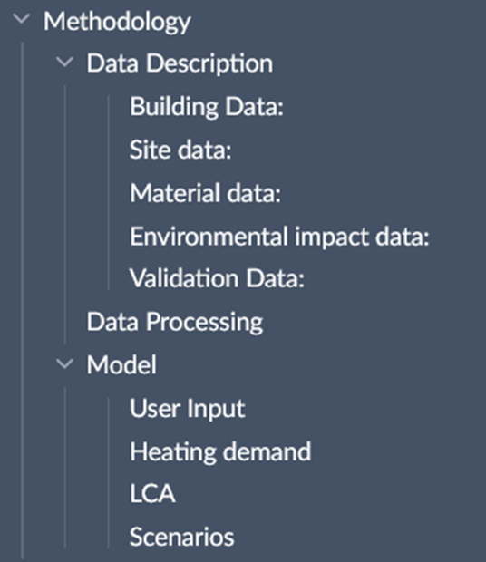
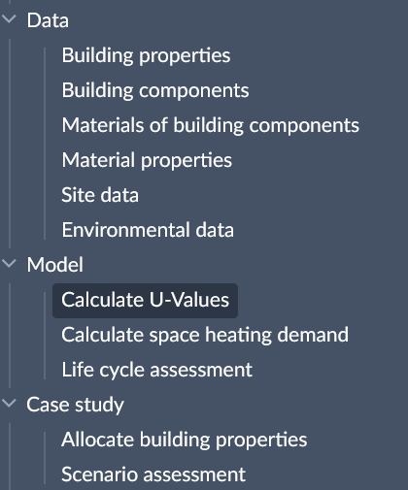
Paper – Methodology structure

Slide 6
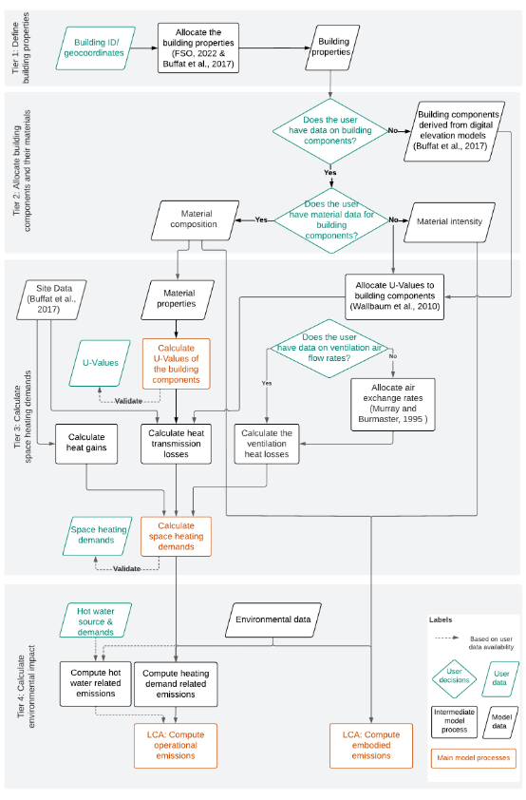
Paper – Method structure (diagram)

Slide 7
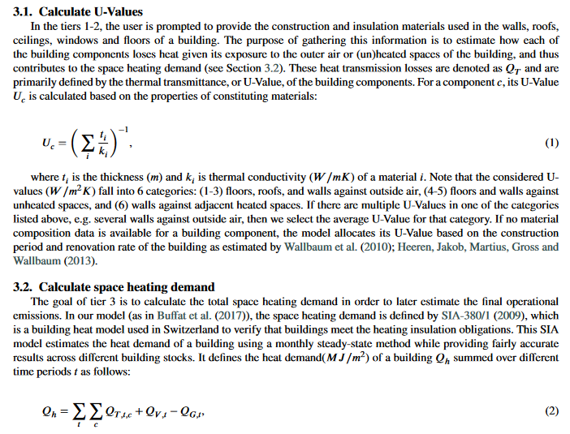
Paper – Model (writing)

Slide 8
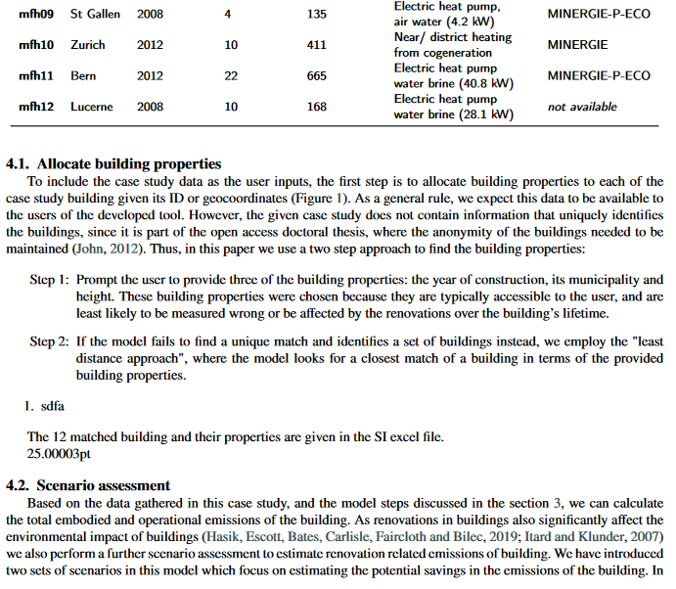
Paper – Case study (writing)

Slide 9
Agenda
Old plan till 24 Nov
Paper
Model & Results

Slide 10
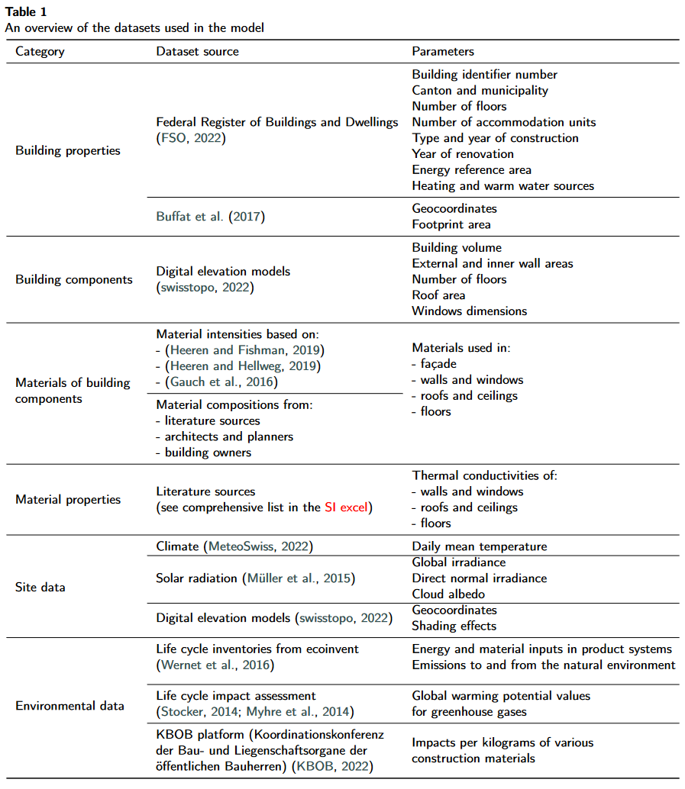
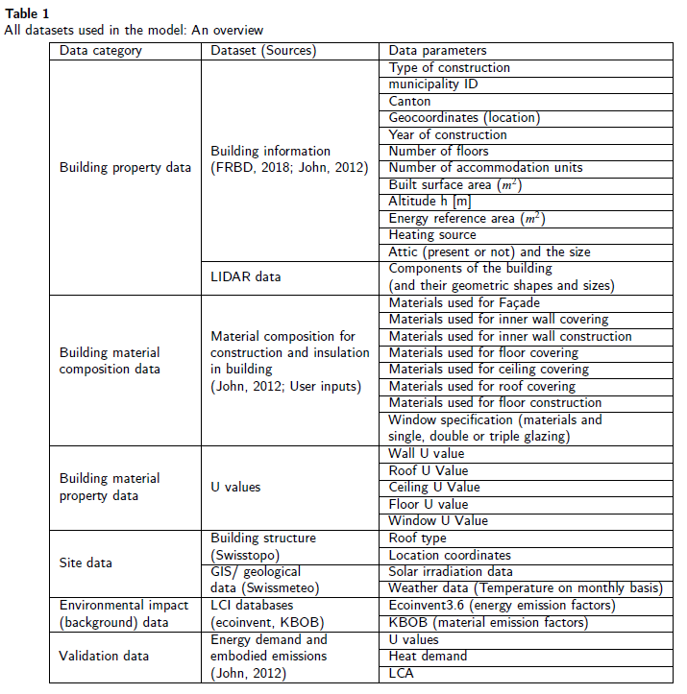
Paper – Data description (table)

Slide 11
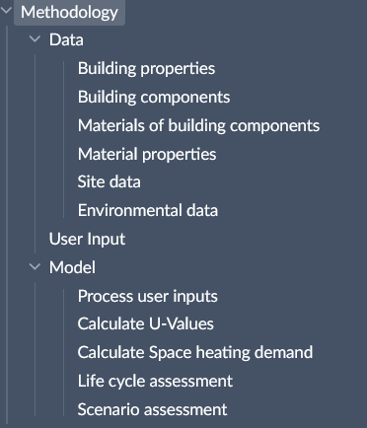
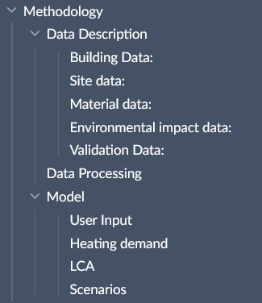
Paper – Methodology structure

Slide 12
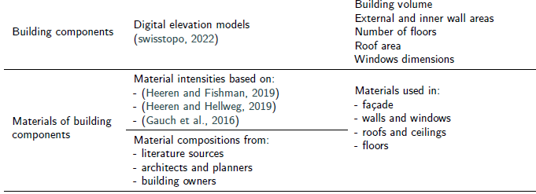
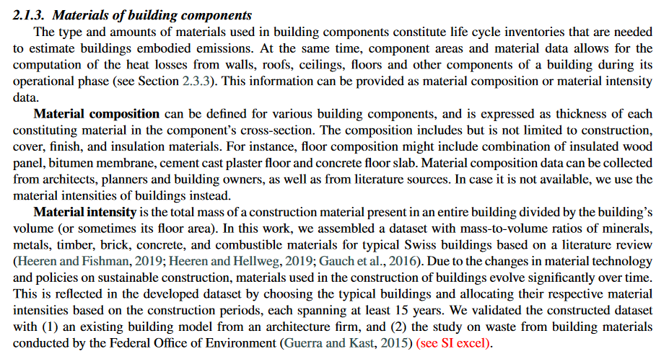
Paper – Data description (writing)

Slide 13
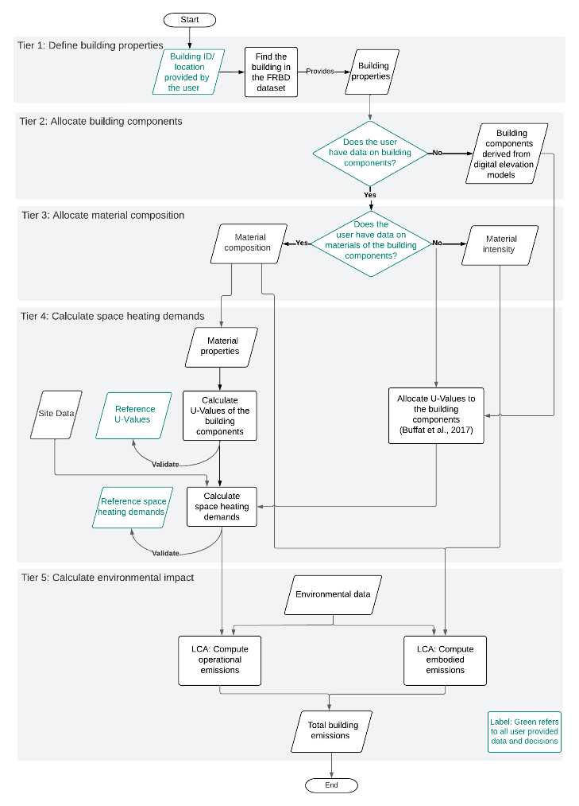
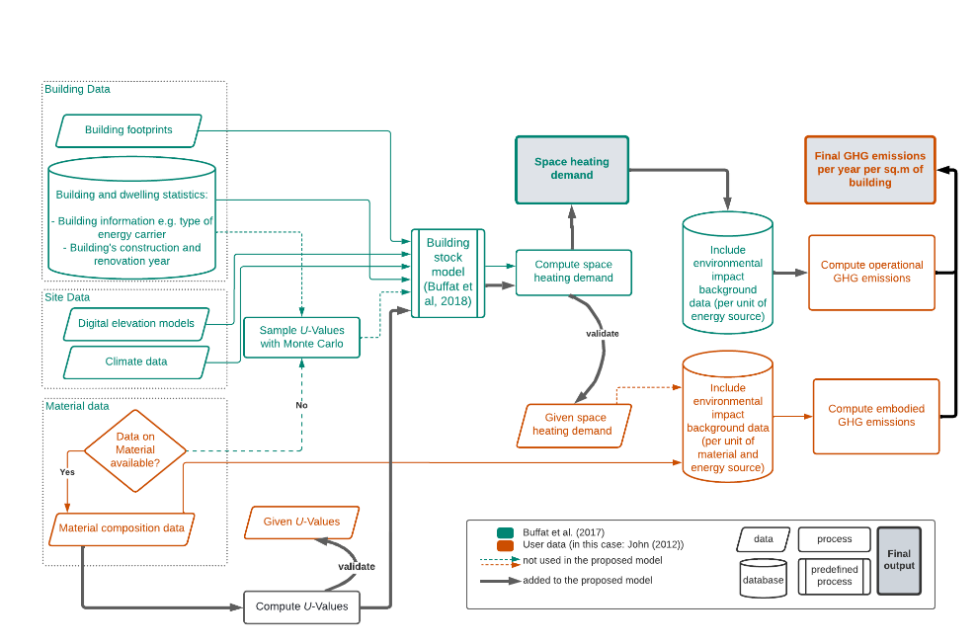
Paper – Method structure (diagram)

Slide 14


Slide 17
Model / Results - edits
Heat demand
Fixed the views on the server database and dependencies
Ventilation effects and window configurations discussed
LCA
Introduced embodied and operational

