Slide 1

AthenaSquare
ATHENA HACK
1

Slide 2
TEAM NAME AND MEMBER DETAILS
Team name | Member names | Education institute name
DENSE ECLIPSE | Deep Bansal | Maharaja Agrasen Institute Of Technology
 | Rhythm Bhatia | Maharaja Agrasen Institute Of Technology
 | Ridam Garg | Maharaja Agrasen Institute Of Technology
 | Ritesh Arora | Maharaja Agrasen Institute Of Technology

Slide 3
PROBLEM STATEMENT
Create an e-commerce website.
UX and UI: Designed for a user experience that rivals even the top commercial platforms.
Dashboard: Administrators have total control of users, processes, and products.
Orders: A comprehensive system for orders, dispatch, and refunds. Payments.
Flexible API architecture allows integration of any payment method. It comes with Braintree support out of the box.
You can create it for a single store as well as for multiple stores and multiple users.

Slide 4
SOLUTION
We have developed an e-commerce website named Ebuy through which buyers can buy products and seller can sell products. This website contains all the functionalities that found in an e-commerce website for secure and smooth transactions. We have integrated Razorpay gateway through which transactions can be performed securely. It has an interactive UI so that every user can use it easily. This website is also mobile friendly so that people who are more engaged on mobiles rather than laptops are able to perform the functionalities from mobile only. Both sellers & buyers can see their details and make necessary changes as and when required.

Slide 5
TECH STACK
Technologies that we are going to use in this project are:-
Nodejs for back-end.
React for Front-end .
MongoDB for database management.
Razorpay gateway for payments.
Redux for state management.
Passport.js for authentication & authorization.

Slide 6
Using our app
Creating a profile
The user creates an identity on the app with minimal information such as name, e-mail and password. User after creating his/her profile can also register himself as a seller by providing basic details such as store name, category of products he is going to sell, address of store, GST number and profile picture.
2. Adding the products
Seller can add the products by simply clicking on Add Product link present in navbar by providing details like product name, price, display picture and a short description.

Slide 7
3. Cart Section
In this section the user can see the total of all the values that he is going to purchase and also manipulate the quantities according to his need and delete them if not required. By clicking on proceed to checkout button user will be directed to payment gateway where he can make payment using a variety of options like netbanking , debit card, UPI ,wallet. He also has the option to pay later.
4. Products Page
On this page buyer can see all the products that are currently in stock on our website. A huge variety of products are present over here from books to electronics and much more. To know about a product user needs to click on the product and a description page will appear with all the information entered by the user initially.
5.UI/UX Design
Our main focus for this project is to make this site user friendly as much as possible so that user can make purchases without any hassle.

Slide 8
HOW IS THE SOLUTION INNOVATIVE ?
Innovation can be seen in the way we implement things. Clean UI & user security are our top most concerns. We have given these two points our topmost priority in this project. We are going to use Passport.js for secure login and Razorpay gateway for all the transactions. To make the UI simple yet attractive, we have used Material-UI. User will have the option to cancel the orders after placing them.

Slide 9
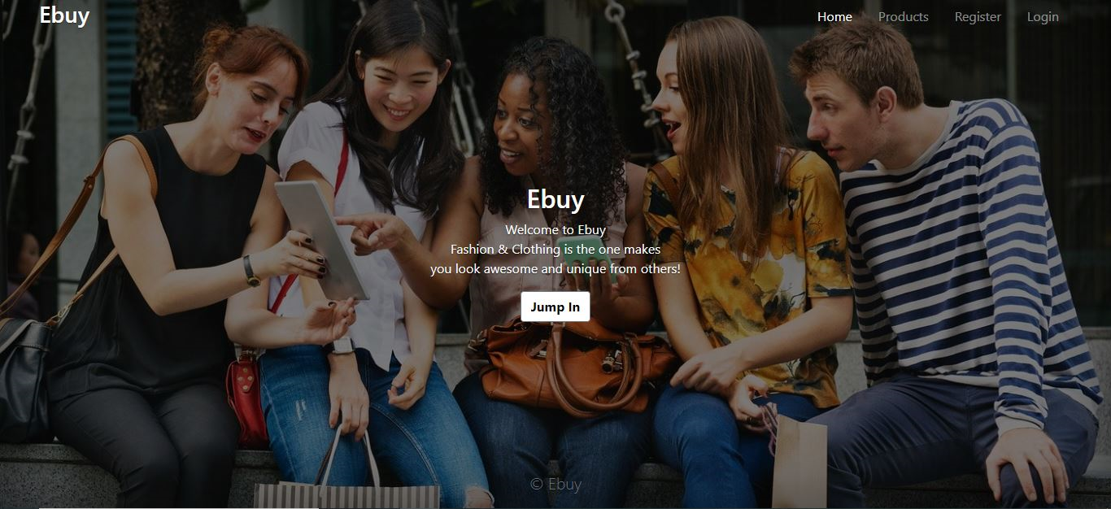
SOME SCREENSHOTS

Slide 10
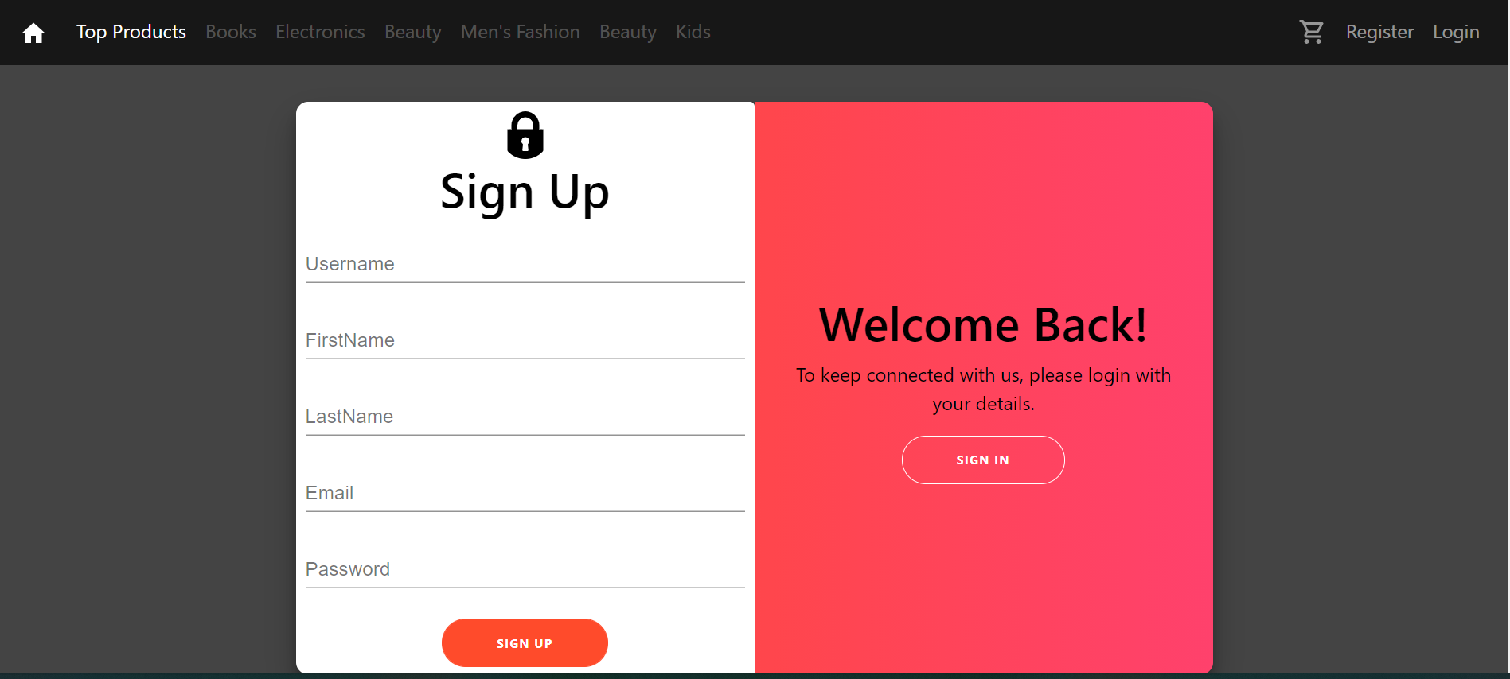
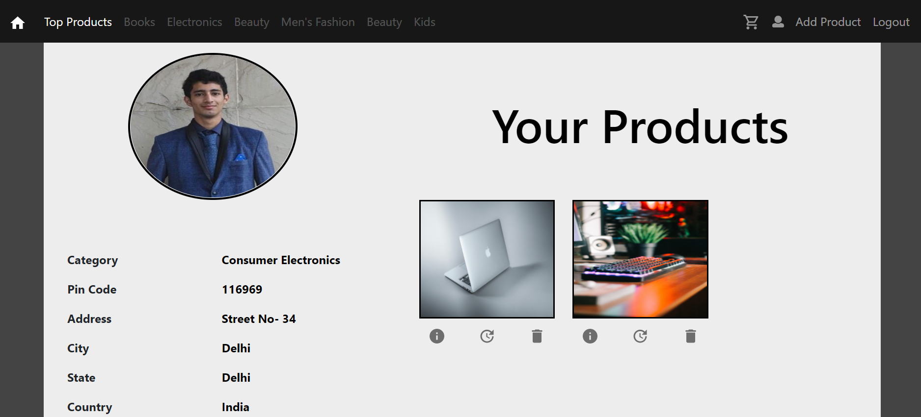
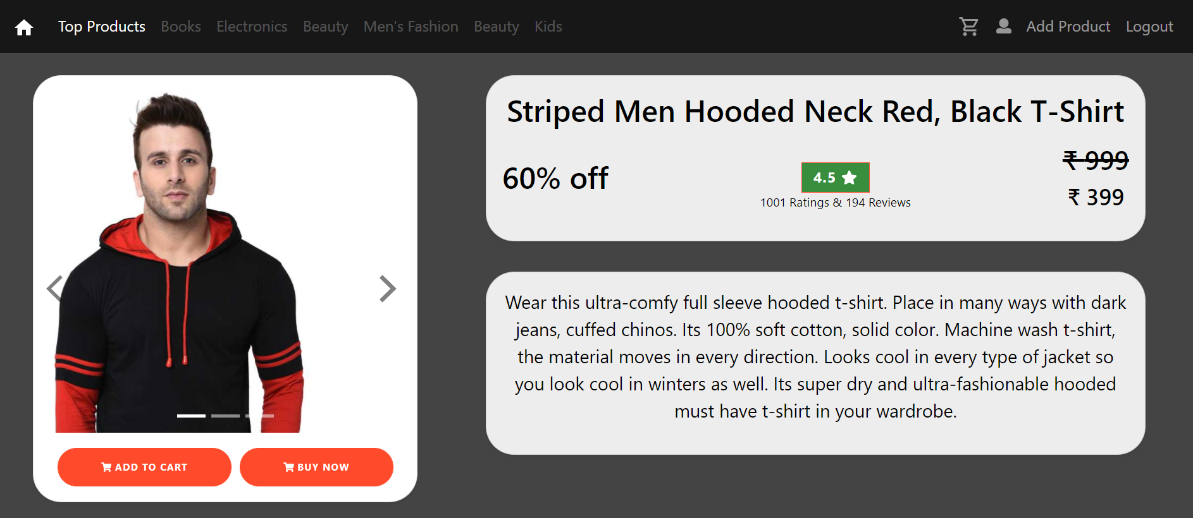

Slide 11
Thank you!

