Slide 2
Encoding Technique visualization using Aurdino (Open-source electronic prototyping platform)

Slide 3
What is encoding technique?

Slide 4

Why we need encoding technique ?

Slide 5
Lots of encoding technique

Slide 6
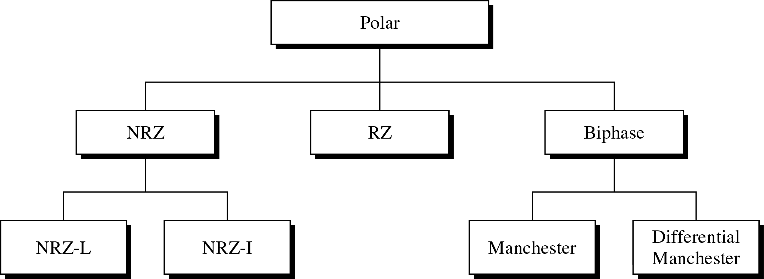
Digital to digital encoding technique

Slide 7
Unipolar
Basic rule:
Bit 0 no line signal
Bit1 +ve polar
The signal is dependent upon the state of the bit

Slide 8
Unipolar continues
Basic rule:
Bit 0 no line signal
Bit1 +ve polar
The signal is dependent upon the state of the bit

Slide 9
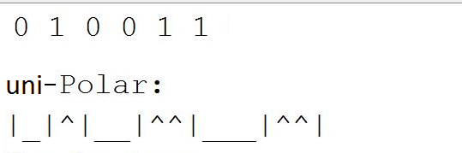
unipolar continues
Sample Visualization from project with the same bit pattern

Slide 10
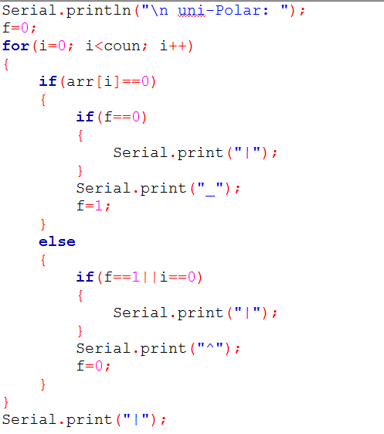
Program code: unipolar

Slide 11
Nonreturn to Zero-Level (NRZ-L)
Basic rule:
Bit 0 +ve polar
Bit1 -ve polar
The signal is dependent upon the state of the bit

Slide 12
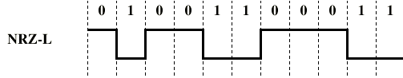
NRZ-L continues
Basic rule:
Bit 0 +ve polar
Bit1 -ve polar
The signal is dependent upon the state of the bit

Slide 13
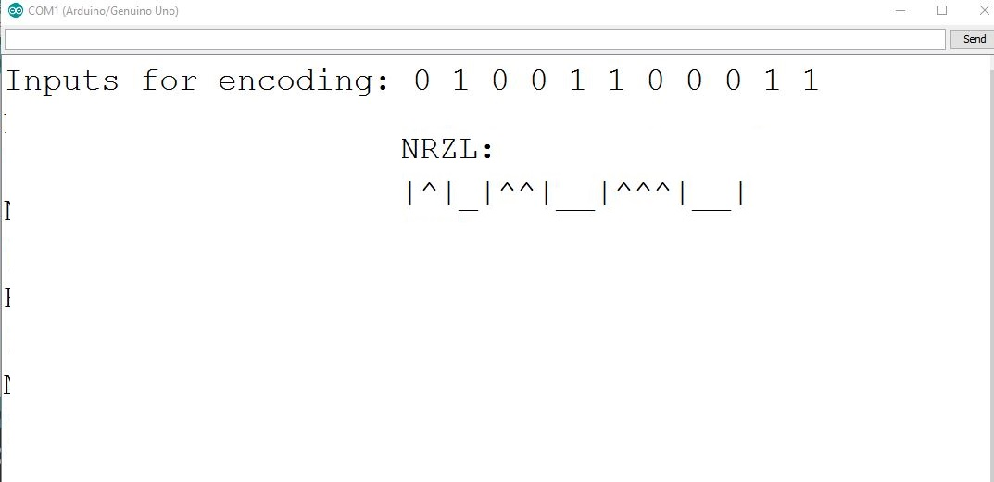
NRZ-L continues
Sample Visualization from project with the same bit pattern

Slide 14
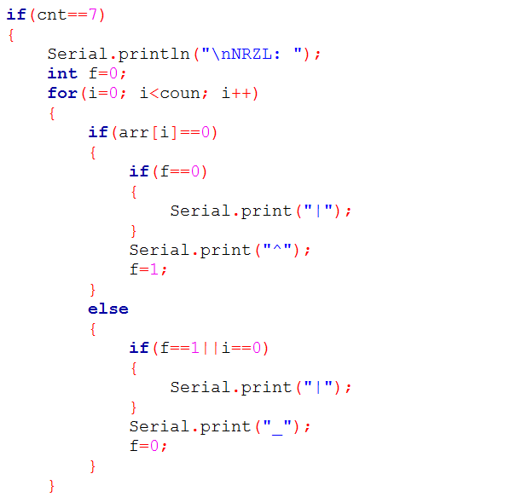
Program code: NRZ-L

Slide 15
Nonreturn to Zero Inverted (NRZ-I)
Basic rule:
Bit 0 no transition
Bit1 Only One transition
The signal is dependent upon the state of the bit

Slide 16
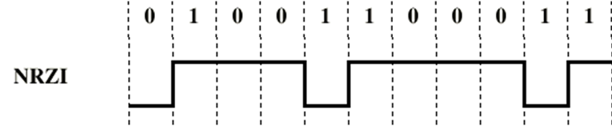
Bit 0 no transition Bit1 Only One transition
NRZ-I continues

Slide 17
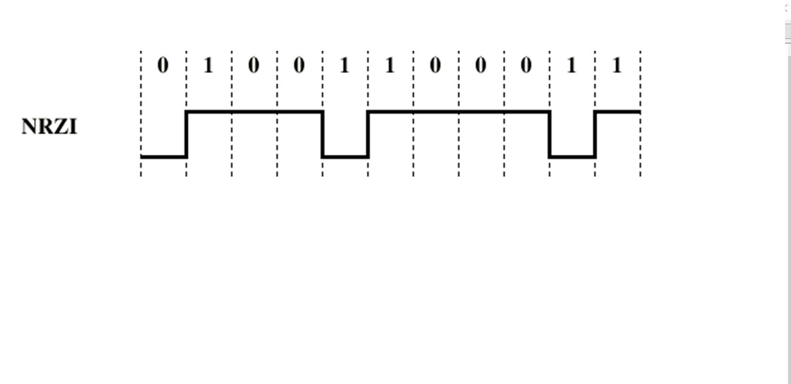
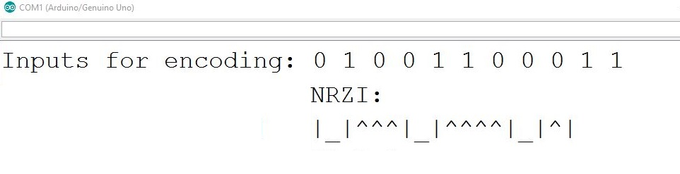
NRZ-I continues
Sample Visualization from project with the same bit pattern

Slide 18
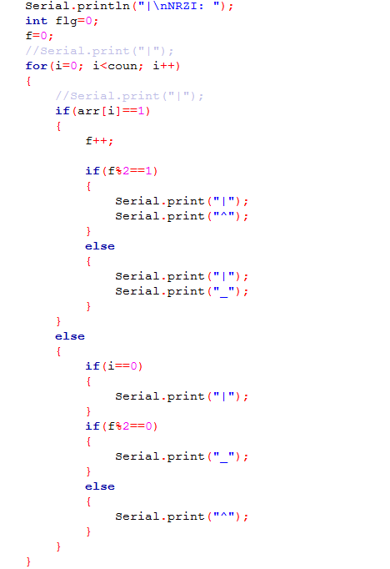
Program code: NRZ-I

Slide 19
Manchester encoding
Basic rule:
Bit 0 High to Low transition
Bit 1 Low to High transition

Slide 20
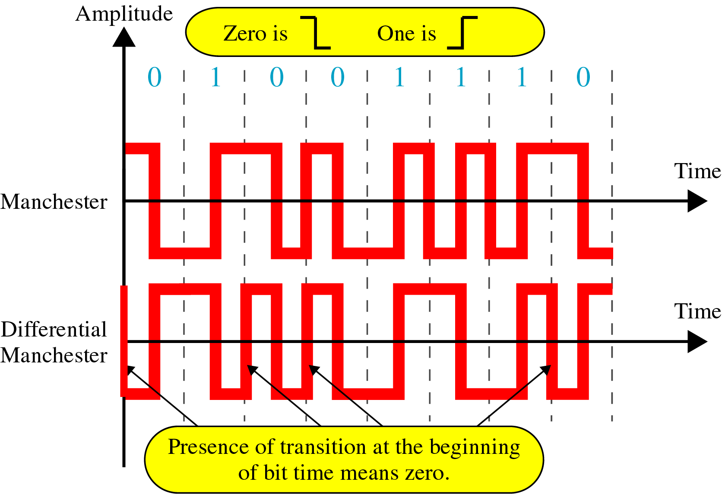
Manchester continues
Bit 0 High to Low transition
Bit 1 Low to High transition

Slide 21
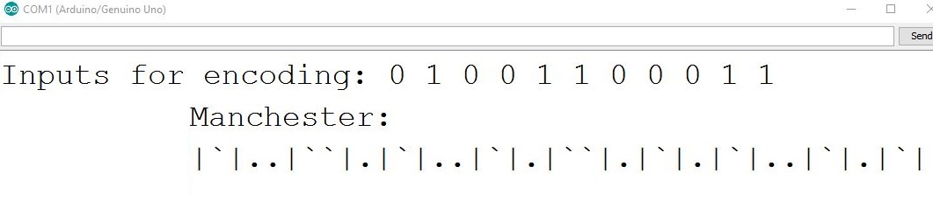
Manchester continues
Sample Visualization from project with the same bit pattern

Slide 22
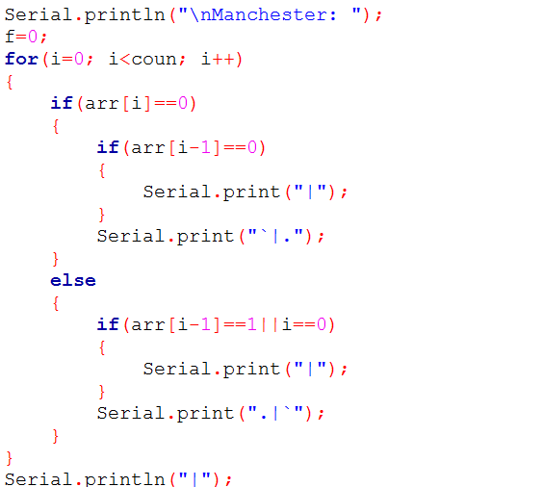
Program code: Manchester

Slide 23
Our project implementations
Knowing Arduino
what is Arduino???

Slide 24
Arduino is an open-source platform
A physical programmable circuit board
a piece of software, or IDE (Integrated Development Environment) that runs on your computer

Slide 25
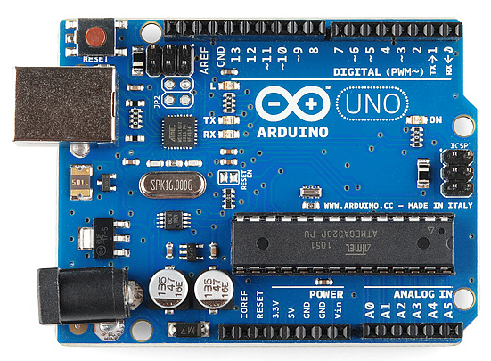
Arduino physical look

Slide 26
Why using arduino ?
Eliminates a number of gates .
Easy to use .
Much more Reliable .

Slide 27
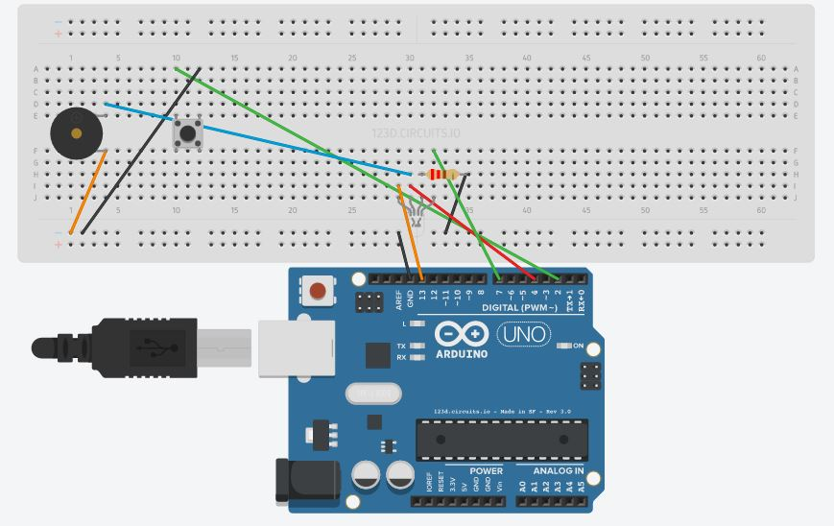
Looking under the hood

Slide 28
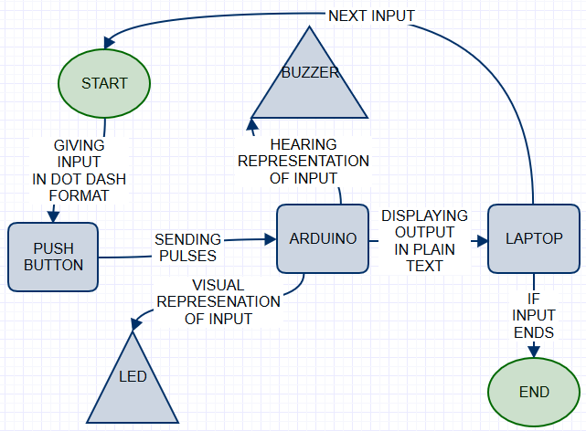
WOrking process

Slide 29
Limitations:
Needs months of practice to send accurate data .
Long distance transmission requires constant electricity.
All other medium are used in short distance.

Slide 30
Practical use of the project:
It can be specially used in transferring systems
In case of national emergencies like Natural Calamities, Curfew, War etc. when major communication systems are disabled; our project can be used to establish a backup method of communication.
We can also use this project in foggy weather by using light as medium.

Slide 31
Conclusion:
Throughout this semester we learned about different types of encoding technique. By doing this project we have learned how real life encoding can be shown with the help of digital logics and circuits. We also learned some coding technique to visualize digital data.

Slide 32
Project Demonstration

Slide 33
Any question
Or Suggestions??

Slide 35


