Slide 1
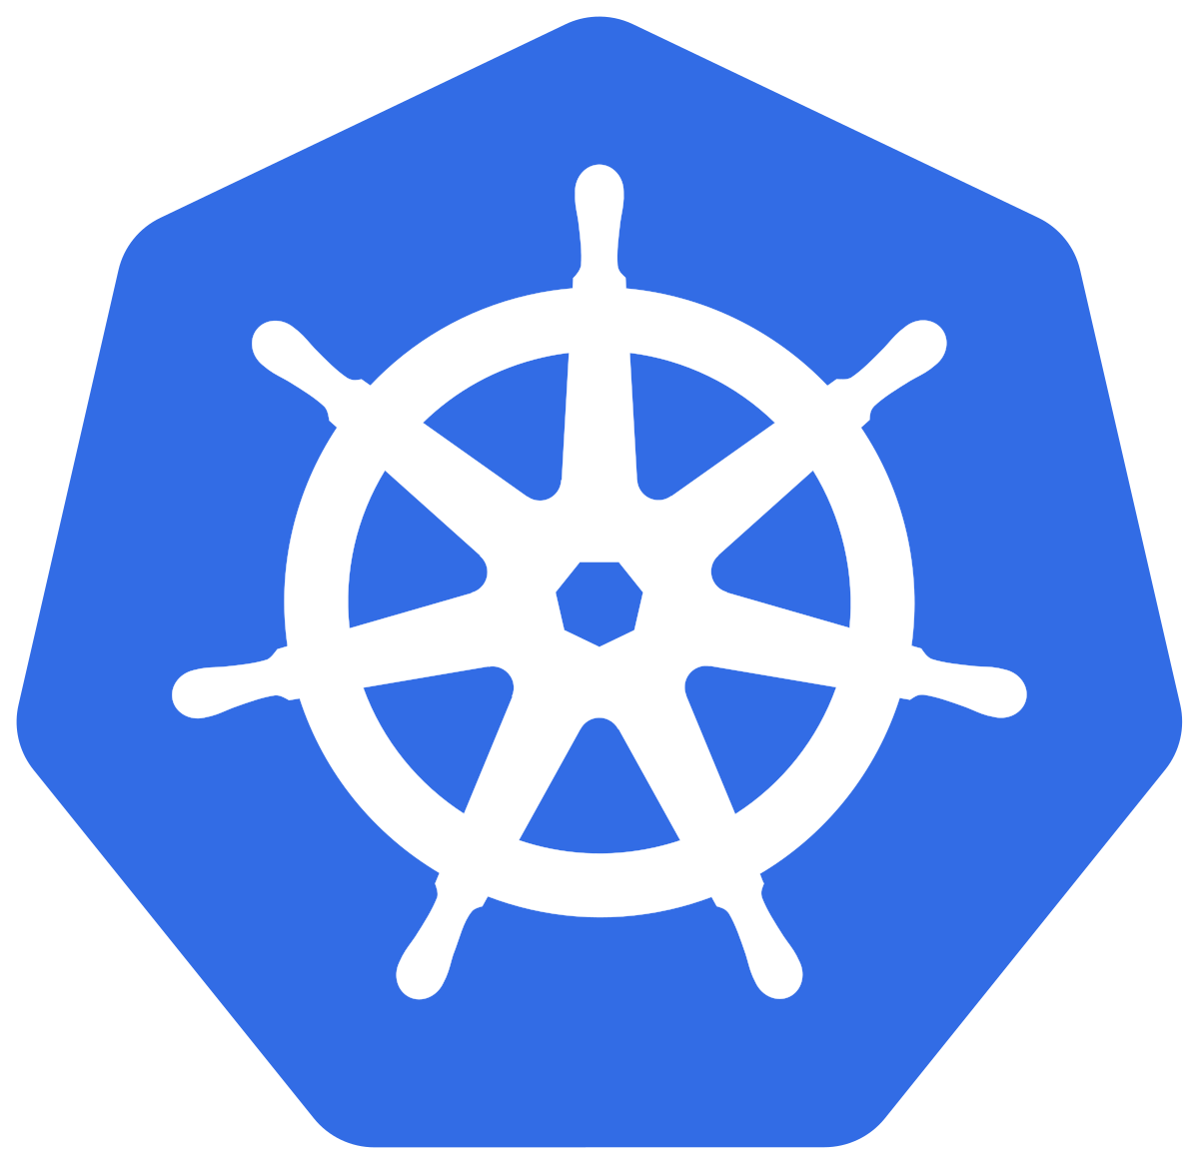



DESIGN BY
RHYTHM BHIWANI
MASTER NODE
KUBERNETES
kube-API
server
kube-schedular
Control Plane
kube-controller manager
Developer
cloud-controller manager
Cloud
MINION
NODE
MINION
NODE
kubelet
kubelet
kube-proxy
kube-proxy
POD
POD
Container Runtime
Container Runtime
POD
POD
Network Bridge (calico , flannel etc.)

