Slide 1

Node.js Introduction

Slide 2
Agenda
Node brief instroduction
Node Installation
REPL
Node libraries
Examples(tcp/http, chat server, nodepad)
Debugging
Performance

Slide 3
What is node?
Official site: http://nodejs.org/
Server-side Javascript
Built on Google’s V8
Evented, non-blocking I/O
8000 lines of C/C++, 2000 lines of Javascript.
In node everything runs in parallel, except your code.

Slide 4
Installation
Install node(http://nodejs.org/):
  https://github.com/joyent/node/wiki/Installation
Install npm(http://npmjs.org/):
  # curl http://npmjs.org/install.sh | sh
Install libraries using npm:
  sudo npm install express
Node resources:
  https://github.com/joyent/node/wiki/Resources

Slide 5
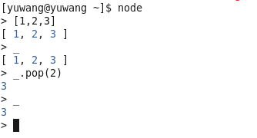
REPL(http://nodejs.org/docs/v0.4.12/api/repl.html)
Read-Eval-Print-Loop (REPL)
REPL provides a way to interactively run JavaScript and see
the results. It can be used for debugging, testing, or just
trying things out.
  underscore
  .clear

Slide 6
Node Built-in Libraries
http://nodejs.org/docs/v0.4.12/api/
  Http, https, dns, net
  Url, querystring
  File system
  Basic dubugging, cosole logging, REPL
  Timers
  Events
  And a lot more...

Slide 7
Node Modules
require

Slide 8
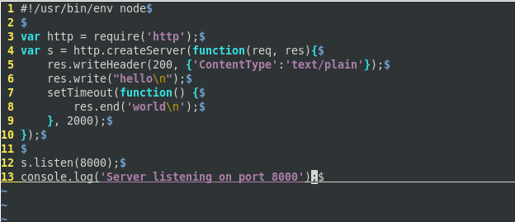
A “Hello World” HTTP server

Slide 9
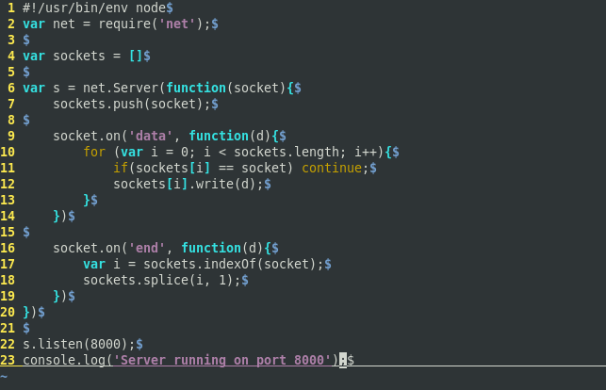
A chat server

Slide 10
node_chat
Ryan's implementation for a chat server:
chat.nodejs.org

Slide 11
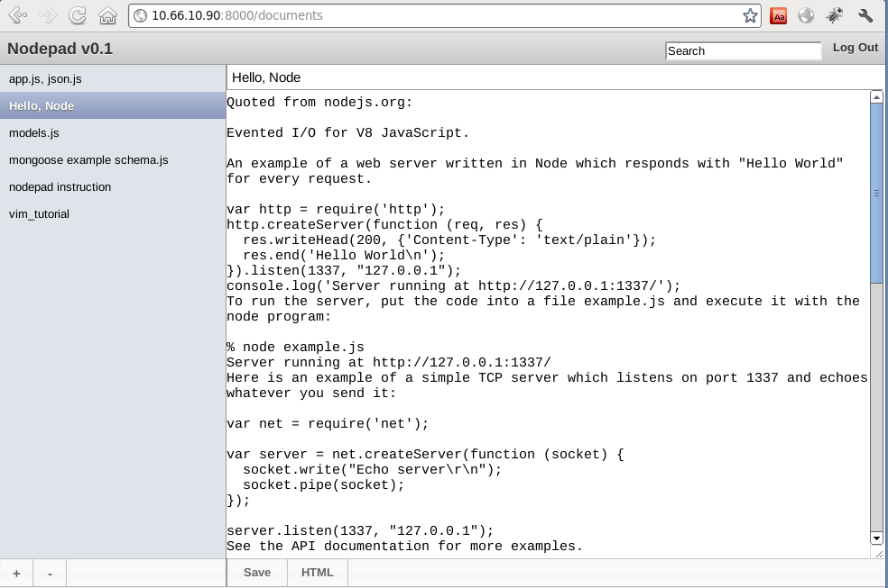
nodepad

Slide 12
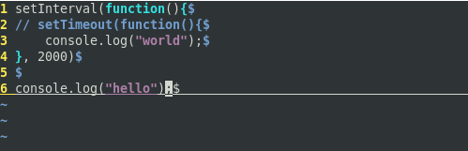
Performance
Example from Ryan Dahl (Author of Node)
ab -n 1000 -c 100 http://127.0.0.1:8000/

Slide 13
Implementation of Node
Single threaded
Non-blocking
V8 (JS Engine used in Chrome)
Event-based(Asynchronous)

Slide 14
Blocking vs. Non-blocking
Way to code in most other
languages:
get(object_id) / readfile('...')
doSomething()
In node
get(object_id, function(err, object{})
read(.., err, function(err, data){
  doSomeThing})
node.js design philosophy:
To receive data from disk, network or another process there
MUST be a callback.

Slide 15
Debugging
Node-inspector
(http://github.com/dannycoates/node-inspector)
Chromedevtools
(http://wiki.github.com/ry/node/using-eclipse-as-node-applications-debugger)

Slide 16
Talk to Database
RDBMS VS NoSQL

Slide 17
Node and MongoDB
Speak JavaScript
JSON Documents
Fast

Slide 18
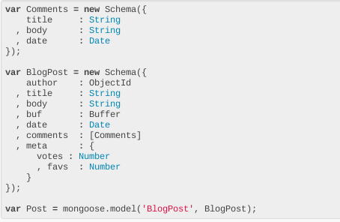
Node and MongoDB
mongoose: https://github.com/learnboost/mongoose

Slide 19
What is node good for
Node.js is well-suited for building sites that require real-time,
synchronous interaction.
A variety of different interacting systems.
High concurrency.
Real-time systems.
  Twitter, Taobao, chat apps, collaborative apps.
http://www.ibm.com/developerworks/opensource/library/os-nodejs/index.html

Slide 20
Disadvantages
writing code with callbacks (the essential construct in this kind of programming) can become troublesome.
Some 3rd party packages pre-mature.
How big is the project? Small projects should be fine. Big projects should evaluate carefully (available libraries, resources to fix a bug or two upstream, etc.).

Slide 21
Challenges
Event driven programming
Anonymous functions

Slide 22
Node resources
https://github.com/ry/node/wiki/Resources
mongoose: https://github.com/learnboost/mongoose
express: http://github.com/visionmedia/express

Slide 23
Q&A

Slide 24
TODOS:
Performance screenshot
NoSQL VS RDBMS etc.

