Slide 1
Maro
Building A Programming Language from scratch

Slide 2
Overview
Maro is a fully-functional programming language built entirely from scratch in Java. It implements every stage of a real language pipeline, such as lexing, parsing, and AST, and tree-walk execution The language supports variables, closures, lists, maps, recursion, and 21 built-ins functions.
Dynamically typed -any stored variable can hold any value at runtime.
First-Class functions – store, pass, and return functions like any value
Closures – inner functions capture their surrounding scope
Recursive descent parser - grammar rules map directly to Java methods

Slide 3
Overview (Outline)
9
9
9
4
21
2473
Java Source Files
Pipeline Stages
Built-In Functions
Lines of Java Code
Lexer
Parser
AST
Interpreter

Slide 4
Use Cases
EDU
Computer Science Education
LAB
Language Design Experimentation
Maro was built as a teaching tool for me to learn how creating a new program works from start to finish, walks through every concept in building a real interpreter. Could also be used as reference guide.
The clean 4-stage pipeline makes it easy to experiment , add a new keyword, change the syntax, or extend the grammar. Maro is a sandbox for language design ideas.
Understand lexers, parsers, and ASTs hands-on
Add new keywords in TokenType.java
See how scoping and closures actually work
Extend grammar in Parser.java
Approachable beginner Java code throughout
New built-ins in Interpreter.java
SCR
Scripting & Automation
RES
Compiler & PL Research
Maro's clean syntax . Similar to Python, meaning that it makes usable as a lightweight scripting language for small automation tasks and data processing.
The tree-walk interpreter is a natural starting point for adding a type checker, bytecode compiler, or JVM backend , making Maro a practical research prototype.
Clean for-in loops over lists and maps
Add static type checking layer
String manipulation with split/join/upper
Compile AST to JVM bytecode
Math utilities: sqrt, pow, floor, ceil
Extend with modules or classes

Slide 5
Solo Team
Lead Developer & Language Designer
Interpreter & Runtime Developer
AST & Data Structures
Showcase & Documentation
Language architecture & design
Interpreter (tree-walk executor)
AST node design (sealed interface)
Error Showcase
Lexer implementation
Environment / scope chain
Node.java records
Math Showcase
Parser (recursive descent)
Built-in function library
MaroFunction closure design
Reference documentation
Project coordination
Testing & debugging
Code documentation
Presentation design

Slide 6
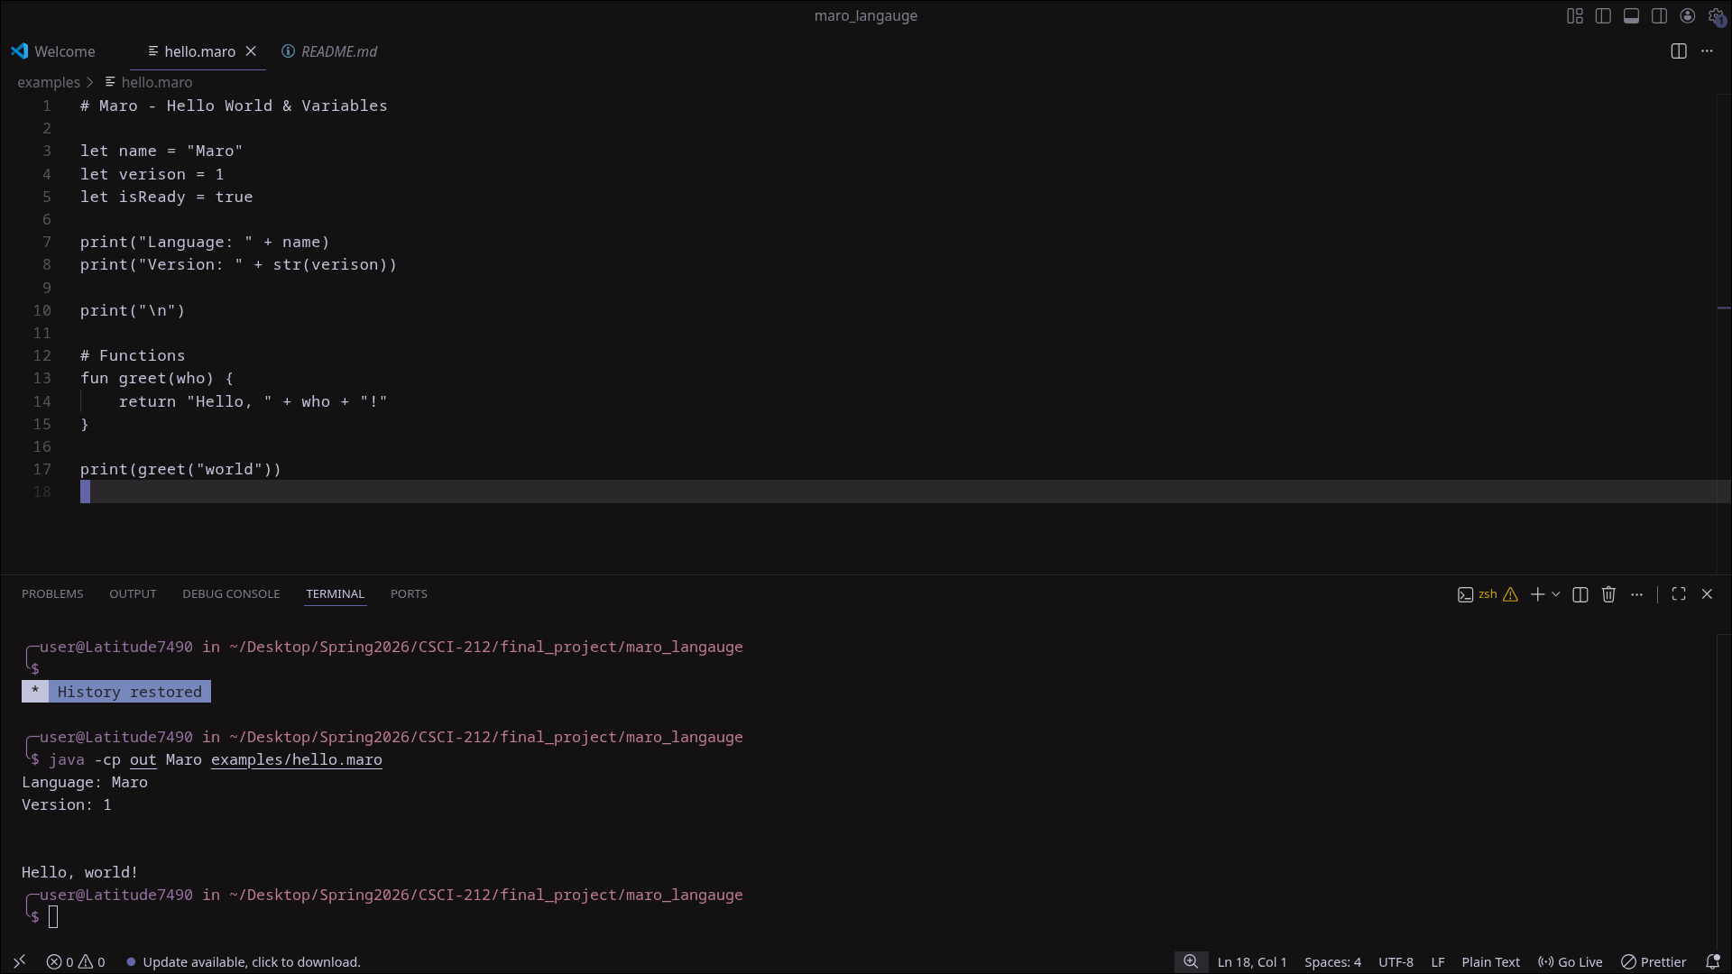
Screenshot – Variables & Functions
hello.maro
let keyword
Declare any variable.
No type needed.
fun keyword
Define a function with
params and a body.
Output panel
Results appear below
the code editor.

Slide 7
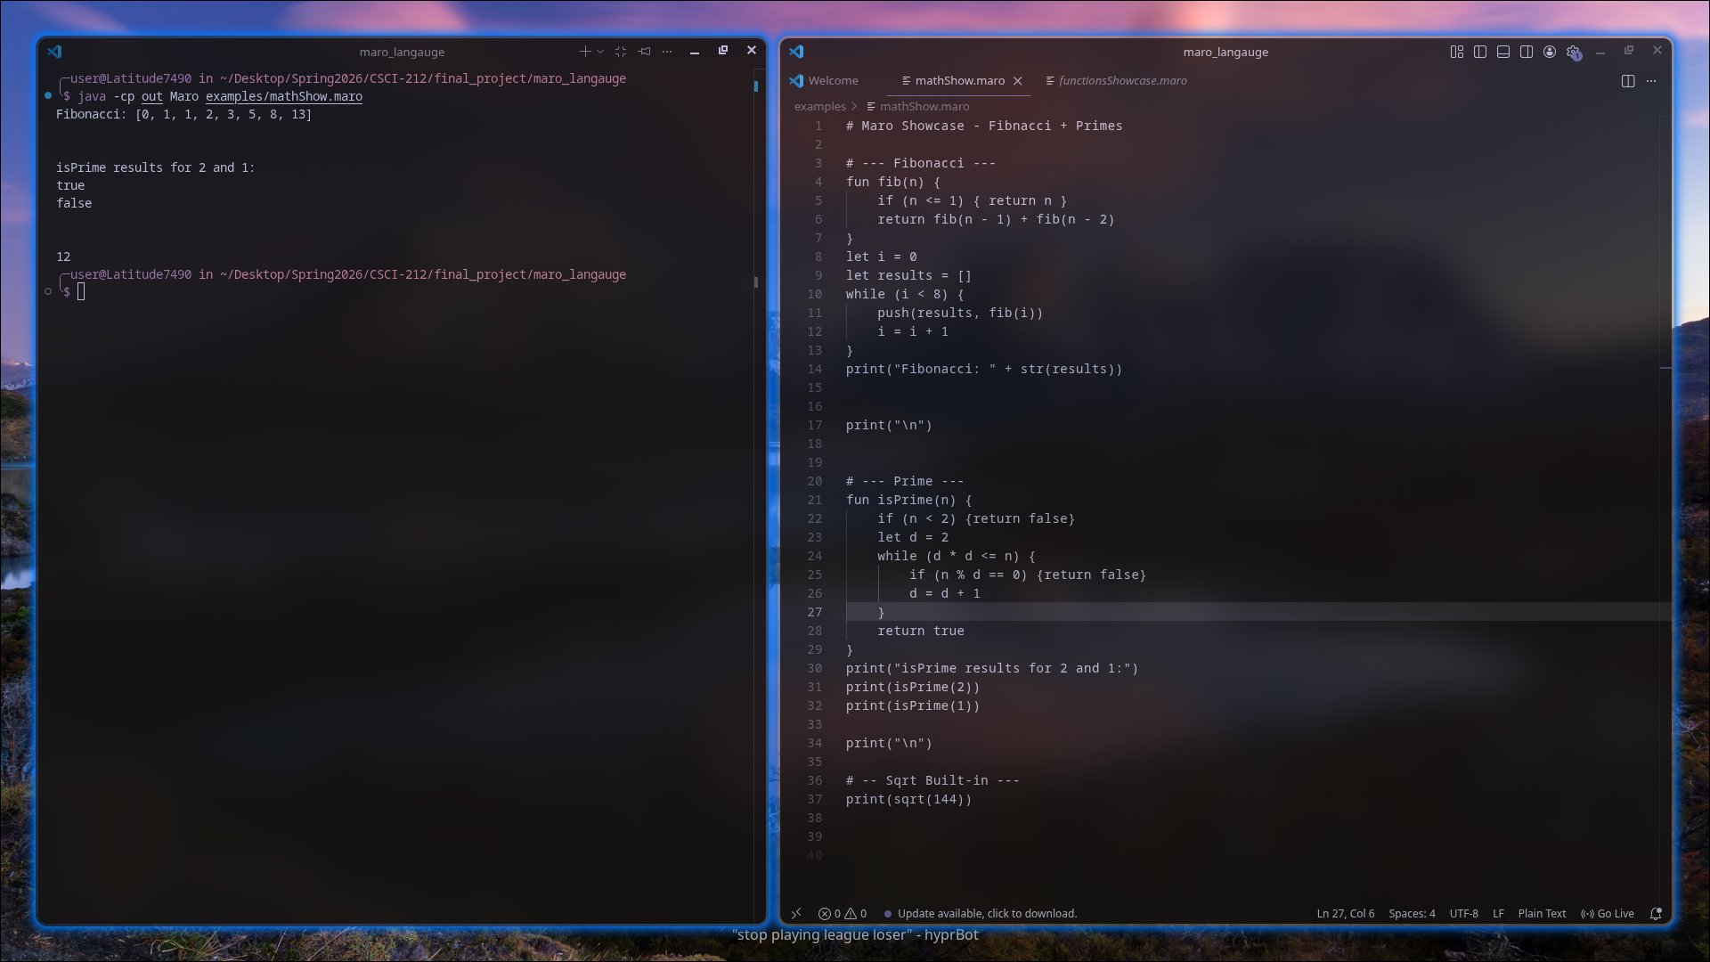
Screenshot – Math Showcase
MathShow.maro
Recursion
Fib() calls itself to build the sequence.
isPrime()
Check if the number is prime or not. In this case 2 is prime number and 1 is not.
Sqrt()
Built-In Function for Sqrt numbers.

Slide 8
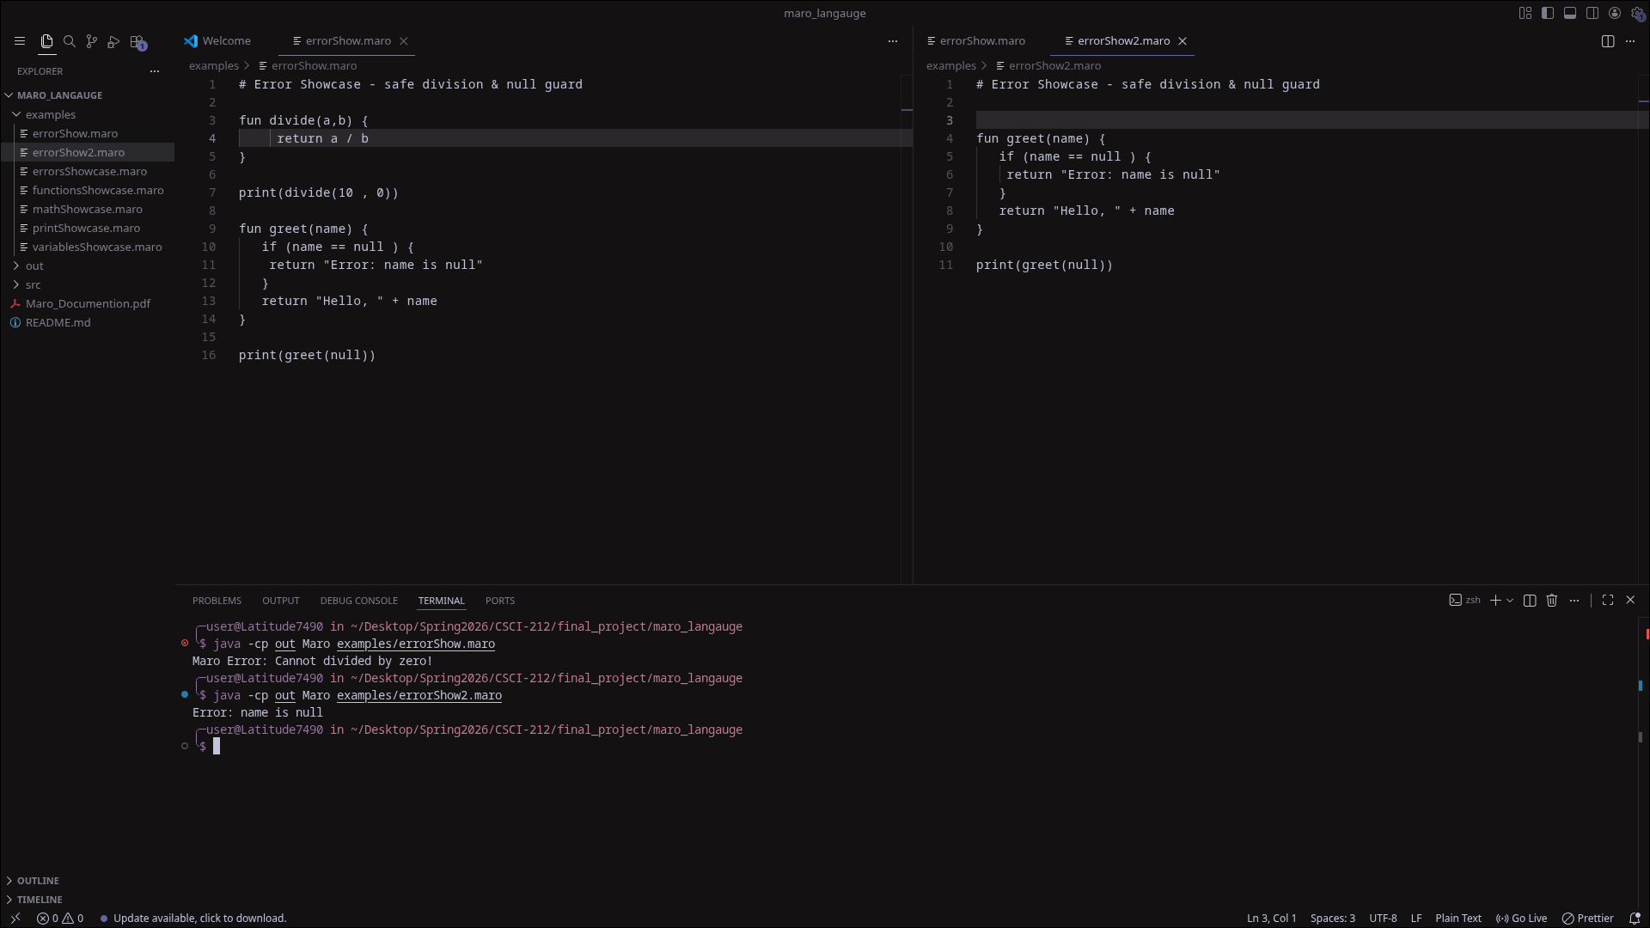
Screenshot – Error Handling
errorShow.maro
Guard clause
Check condition first, return error message.
Null safety
Always validate before using a value
Output
Output shows error. Notice that it only shows the very first error to be seen. Once comment, scan for the next error.

Slide 9
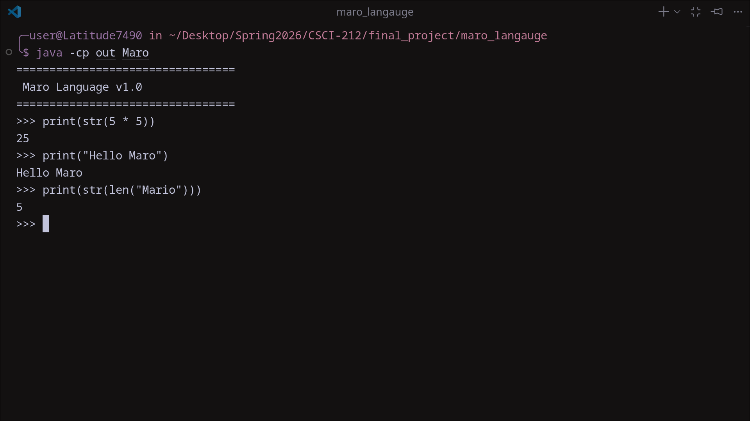
Screenshot – REPL & Pipeline

Slide 10
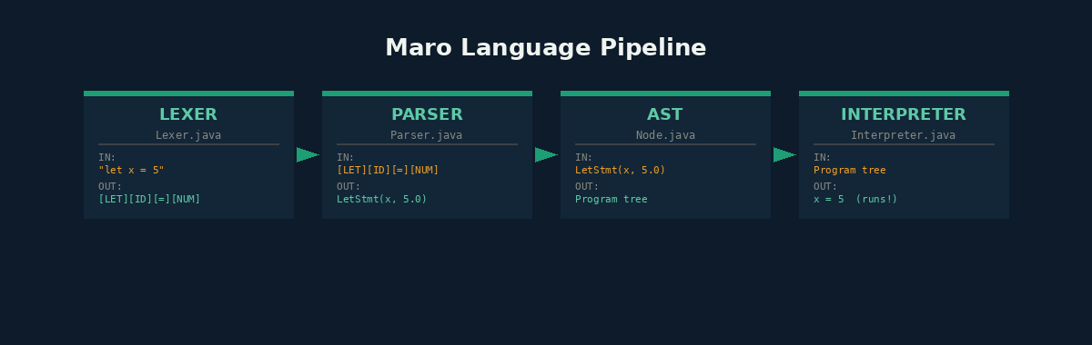
4-stage pipeline diagram
01
Lexer scans source text into typed tokens
02
Parser builds the Abstract Syntax Tree
03
AST stores the full program as nested nodes
04
Interpreter walks the tree and executes

Slide 11
Member Contributions
Designed the full language architecture and pipeline
Built the entire tree-walk interpreter (700+ lines)
Implemented the Lexer , scans source text into 30+ token types
Implemented the linked Environment scope chain
Wrote the main entry point with REPL and file-runner modes
Coded all 21 built-in functions (len, range, push, etc.)
Designed AST node types using sealed interfaces + records
Wrote errorShowcase.maro — 7 sections of error demos
Implemented the recursive-descent Parser (600+ lines)
Wrote mathShowcase.maro — 11 math algorithm sections
Handled operator precedence climbing for correct math
Produced all documentation including the Word reference doc

Slide 12
Conclusion
Building Maro from scratch gave our group a deep, hands-on understanding of how programming languages really work — not just in theory, but in actual working Java code. Every decision, from token design to scope chains to the return-signal pattern, was made deliberately and documented for future learners.
Next Steps
What we achieved:
A fully working programming language in Java
Classes & objects
4-stage pipeline: Lexer → Parser → AST → Interpreter
Error handling (try/catch)
9 Java source files with 2,473 lines of annotated code
String interpolation
21 built-in functions including math, strings, and lists
Closures, recursion, first-class functions, and dynamic typing
JVM bytecode compiler
Three showcase programs demonstrating the language
Standard library

Slide 13
Thank You!

