Slide 1


www.studymafia.org
Seminar
On
Business Environment
Submitted To: Submitted By:
www.studymafia.org www.studymafia.org
Notes:
1
1

Slide 2
Content
Introduction
Definition of Business Environment?
Why Study Business Environment
Components of Business Environment
Types of Business Environment
Approach of Business Environment
Significance of Business Environment
Business Challenges
Conclusion

Slide 3
Introduction
Business Environment is the most important aspect of any business.
The forces which constitute the business environment are its suppliers, competitors, media, government, customers, economic conditions, investors and multiple other institutions working externally.

Slide 4
Definition of business environment?
Definition of Business Environment is sum or collection of all internal and external factors such as employees, customers needs and expectations, supply and demand, management, clients, suppliers, owners, activities by government, innovation in technology, social trends, market trends, economic changes, etc.
These factors affect the function of the company and how a company works directly or indirectly. Sum of these factors influences the companies or business organisations environment and situation.

Slide 5
Why Study Business Environment
Development of broad strategies to ensure sustainability
To foresee the impact of socio-economic changes at the national and international levels on firm’s ability
Analysis of competitor’s strategies and formulation of effective counter measures
To keep oneself dynamic

Slide 6
Components of Business Environment
Internal - It combines the factors that exist within the company. These are –
Human resources
Value system
Vision and mission
Labour union
Corporate culture
External - An external Environment includes those outside factors that exercise an influence on a business’s operations. It is further classified into two segments.
Macro - Socio-cultural, political, legal, and global factors fall into this category.
Micro - This environment has a direct and immediate impact on a business. It consists of customers, investors, suppliers, etc.

Slide 7


Slide 8
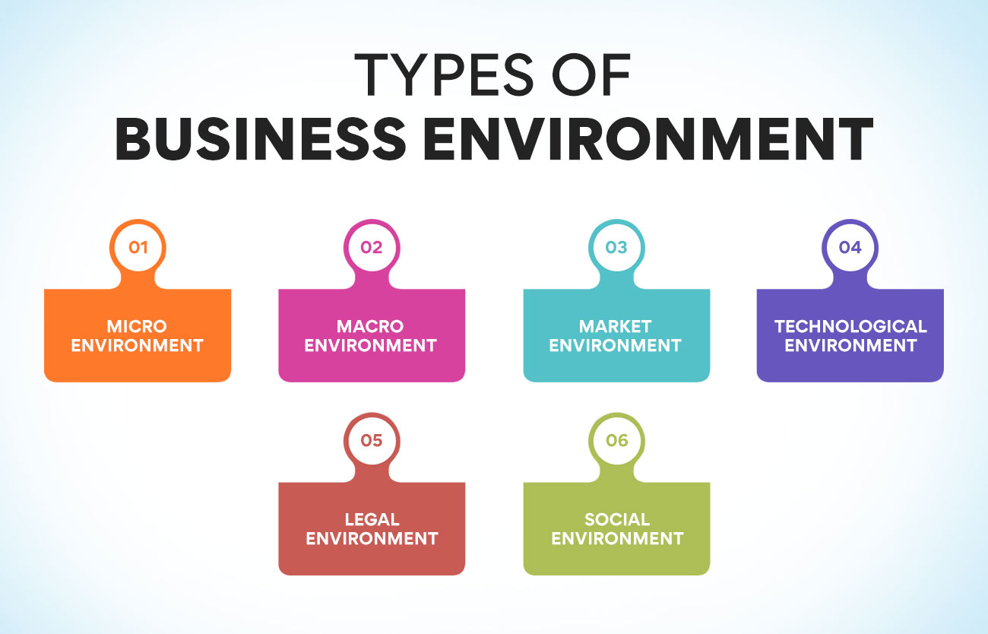

Slide 9
Approach of Business Environment
System Approach
Social Responsibility Approach
Creative Approach

Slide 10
Significance of Business Environment
Help to understand internal Environment
Help to Understand Economic System
Help to Understand Economic Policy
Help to Understand Market Conditions

Slide 11
BUSINESS CHALLENGES
Managing Bottom line
Meeting stakeholders expectations
Developing and retaining top talent
Creating a customer responsive organization
Diminishing time to market
Market agility
Pricing and quality

Slide 12
Conclusion
In conclusion, knowing the various components that make up a business environment helps organisations create viable plans that enable them to capitalise on opportunities and respond effectively when faced with challenges.
Dive into the importance and techniques of environment analysis to gain valuable insights for strategic decision-making and business growth

Slide 13
References
www.google.com
www.wikipedia.com
www.studymafia.org

Slide 14
Thanks

