Slide 1

StudyMafia.Org
Uses Of Internet
Submitted To: Submitted By:
Studymafia.org Studymafia.org

Slide 2
Table Contents
Definition
Introduction
Uses of Internet
Conclusion
2
Notes:
SAY: Before we wrap up the course, let’s review what we have learned today.
During this course, we have
<READ the bullets from the slide.>
GO to next slide.

Slide 3
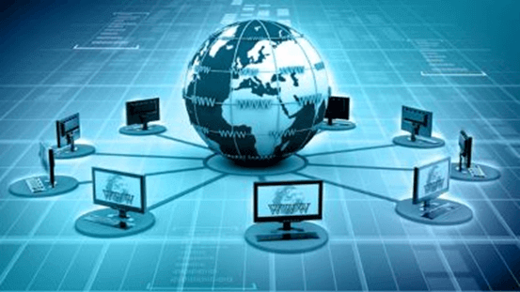
Definition
Internet is the foremost important tool and the prominent resource that is being used by almost every person across the globe.
3
Notes:
SAY: Before we wrap up the course, let’s review what we have learned today.
During this course, we have
<READ the bullets from the slide.>
GO to next slide.

Slide 4
Introduction
The internet came in the year 1960 with the creation of the first working model called ARPANET (Advanced Research Projects Agency).
It allowed multiple computers to work on a single network that was their biggest achievement at that time. ARPANET use packet switching to communicate multiple computer systems under a single network.
4
Notes:
SAY: Before we wrap up the course, let’s review what we have learned today.
During this course, we have
<READ the bullets from the slide.>
GO to next slide.

Slide 5
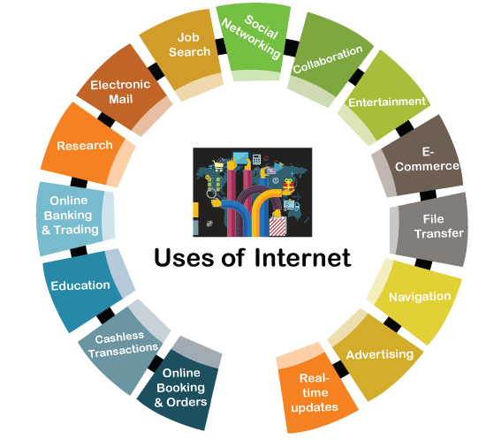
5
Notes:
SAY: Before we wrap up the course, let’s review what we have learned today.
During this course, we have
<READ the bullets from the slide.>
GO to next slide.

Slide 6
Uses of Internet
The Internet is a global networking system that can be used on most devices nowadays and has become an essential part of our lives. In today's technological era, most of the companies are getting their operations done over the Internet.
There are various uses of the Internet by which companies and individuals are making their daily tasks more productive and more comfortable.
●●●
6
Notes:
SAY:
The purpose of epidemiology in public health practice is to
discover the agent, host, and environmental factors that affect health;
determine the relative importance of causes of illness, disability, and death;
identify those segments of the population that have the greatest risk from specific causes of ill health; and
evaluate the effectiveness of health programs and services in improving population health.
GO to next slide.

Slide 7
Uses of Internet
Online Booking & Orders
The Internet has made it a lot easier for people to book tickets for buses, trains, flights (domestic and international) directly using their devices from anywhere.
People can also book a taxi by choosing their current location, and they will be picked up or dropped at a specified location. Now no one needs to wait in long queues for their turn to book tickets at the ticket counter.
●●●
7
Notes:
SAY:
The purpose of epidemiology in public health practice is to
discover the agent, host, and environmental factors that affect health;
determine the relative importance of causes of illness, disability, and death;
identify those segments of the population that have the greatest risk from specific causes of ill health; and
evaluate the effectiveness of health programs and services in improving population health.
GO to next slide.

Slide 8
Uses of Internet
Cashless Transactions
Most countries are promoting cashless transactions and digital payments. This helps people not carry much cash. People can pay their bills through debit or credit cards using POS devices.
These devices are connected to the payment gateway on the Internet. Besides, People can also use their smartphone and the Internet for processing transactions on UPI (Unified Payment Interface).
●●●
8
Notes:
SAY:
The purpose of epidemiology in public health practice is to
discover the agent, host, and environmental factors that affect health;
determine the relative importance of causes of illness, disability, and death;
identify those segments of the population that have the greatest risk from specific causes of ill health; and
evaluate the effectiveness of health programs and services in improving population health.
GO to next slide.

Slide 9
Uses of Internet
Education
Most of the devices nowadays are connected through the Internet. The Internet has the availability of broad educational content on any topic with different types.
People can study the relevant topic just by spending a couple of minutes over the Internet. Internet Search engines help people quickly find the relevant study material in multiple formats (such as images, videos, documents, etc.).
●●●
9
Notes:
SAY:
The purpose of epidemiology in public health practice is to
discover the agent, host, and environmental factors that affect health;
determine the relative importance of causes of illness, disability, and death;
identify those segments of the population that have the greatest risk from specific causes of ill health; and
evaluate the effectiveness of health programs and services in improving population health.
GO to next slide.

Slide 10
Uses of Internet
Online Banking & Trading
The way of banking has changed after the introduction of the Internet. The Internet has made banking online where people can manage their bank accounts while sitting at home or traveling abroad.
Nowadays, most of the features of banking are right in people's hands.
●●●
10
Notes:
SAY:
The purpose of epidemiology in public health practice is to
discover the agent, host, and environmental factors that affect health;
determine the relative importance of causes of illness, disability, and death;
identify those segments of the population that have the greatest risk from specific causes of ill health; and
evaluate the effectiveness of health programs and services in improving population health.
GO to next slide.

Slide 11
Uses of Internet
Research
The Internet is playing a significant role in the field of research. Before the use of the Internet, it was quite hard to look for information about anything.
People had to go through hundreds of books for references to find the desired information.
Uses of the Internet in research have incredibly beneficial for the researchers.
●●●
11
Notes:
SAY:
The purpose of epidemiology in public health practice is to
discover the agent, host, and environmental factors that affect health;
determine the relative importance of causes of illness, disability, and death;
identify those segments of the population that have the greatest risk from specific causes of ill health; and
evaluate the effectiveness of health programs and services in improving population health.
GO to next slide.

Slide 12
Uses of Internet
Electronic Mail
Email or electronic mail is one of the first significant uses of the Internet. The email has enabled faster communication between people on the Internet. Using email, people can quickly share information, data files, such as images, audio, video, and other types of files.
The use of email has significantly reduced paper use, which was the primary source of communication in the olden days.
●●●
12
Notes:
SAY:
The purpose of epidemiology in public health practice is to
discover the agent, host, and environmental factors that affect health;
determine the relative importance of causes of illness, disability, and death;
identify those segments of the population that have the greatest risk from specific causes of ill health; and
evaluate the effectiveness of health programs and services in improving population health.
GO to next slide.

Slide 13
Uses of Internet
Job Search
Getting a job is a lot easier than before. Any person can view relevant job information using the Internet.
Earlier, people had to go through each company individually to know if a position was vacant or not. However, the Internet has enabled people to find employment sitting at home to suit their interests.
●●●
13
Notes:
SAY:
The purpose of epidemiology in public health practice is to
discover the agent, host, and environmental factors that affect health;
determine the relative importance of causes of illness, disability, and death;
identify those segments of the population that have the greatest risk from specific causes of ill health; and
evaluate the effectiveness of health programs and services in improving population health.
GO to next slide.

Slide 14
Uses of Internet
Social Networking
Social networking sites have connected people around the world. Social networking is an essential part of the Internet.
With the help of the Internet, people have got the ability to form social groups where they can share information, thoughts and ideas about anything.
●●●
14
Notes:
SAY:
The purpose of epidemiology in public health practice is to
discover the agent, host, and environmental factors that affect health;
determine the relative importance of causes of illness, disability, and death;
identify those segments of the population that have the greatest risk from specific causes of ill health; and
evaluate the effectiveness of health programs and services in improving population health.
GO to next slide.

Slide 15
Uses of Internet
Collaboration
Due to the Internet, communication has become easier and better. You can easily connect with anyone on the Internet, either texting, calling or video calling. It has created new cooperation opportunities for the people.
There are several online chat software and websites that help people create group discussions or meetings.
●●●
15
Notes:
SAY:
The purpose of epidemiology in public health practice is to
discover the agent, host, and environmental factors that affect health;
determine the relative importance of causes of illness, disability, and death;
identify those segments of the population that have the greatest risk from specific causes of ill health; and
evaluate the effectiveness of health programs and services in improving population health.
GO to next slide.

Slide 16
Uses of Internet
Entertainment
The Internet is the most effective means of entertainment. There are various options available on the Internet, which people can try, such as watching movies, playing online games, listening to songs, etc.
The Internet has also made it easy for people to download entertainment items to their local storage.
●●●
16
Notes:
SAY:
The purpose of epidemiology in public health practice is to
discover the agent, host, and environmental factors that affect health;
determine the relative importance of causes of illness, disability, and death;
identify those segments of the population that have the greatest risk from specific causes of ill health; and
evaluate the effectiveness of health programs and services in improving population health.
GO to next slide.

Slide 17
Uses of Internet
E-Commerce
The Internet is not just limited to ordering things; it can also be used to sell products. Many e-commerce websites allow businesses and individuals to sell their products.
Products are purchased by these e-commerce companies, stored in their warehouses, packaged in their brand packaging, and distributed by themselves.
●●●
17
Notes:
SAY:
The purpose of epidemiology in public health practice is to
discover the agent, host, and environmental factors that affect health;
determine the relative importance of causes of illness, disability, and death;
identify those segments of the population that have the greatest risk from specific causes of ill health; and
evaluate the effectiveness of health programs and services in improving population health.
GO to next slide.

Slide 18
Uses of Internet
File Transfer
The Internet has made file transfer between systems or devices easier. With FTP (File Transfer Protocol), data can be securely exchanged over the Internet.
FTP is mainly beneficial when large files need to be transferred because email allows sharing files with limited size.
●●●
18
Notes:
SAY:
The purpose of epidemiology in public health practice is to
discover the agent, host, and environmental factors that affect health;
determine the relative importance of causes of illness, disability, and death;
identify those segments of the population that have the greatest risk from specific causes of ill health; and
evaluate the effectiveness of health programs and services in improving population health.
GO to next slide.

Slide 19
Uses of Internet
Navigation
The navigation mechanism is one of the most beneficial uses of the Internet. Once a user put the location in the online maps (such as Google maps), it provides all the details about that location.
Users can even find the best route to visit that particular location.
●●●
19
Notes:
SAY:
The purpose of epidemiology in public health practice is to
discover the agent, host, and environmental factors that affect health;
determine the relative importance of causes of illness, disability, and death;
identify those segments of the population that have the greatest risk from specific causes of ill health; and
evaluate the effectiveness of health programs and services in improving population health.
GO to next slide.

Slide 20
Uses of Internet
Advertising
Because most people use the Internet, it is the best means of promoting something or advertising.
There are options for paid promotion as well as free promotion. There are many advertising platforms on the Internet that help promote products or businesses online.
●●●
20
Notes:
SAY:
The purpose of epidemiology in public health practice is to
discover the agent, host, and environmental factors that affect health;
determine the relative importance of causes of illness, disability, and death;
identify those segments of the population that have the greatest risk from specific causes of ill health; and
evaluate the effectiveness of health programs and services in improving population health.
GO to next slide.

Slide 21
Uses of Internet
Real-time updates
The Internet is helping people to keep up with what is happening around the world.
Many news and information websites provide real-time updates on various categories, such as politics, history, news, geology, leisure, sports, technology, marketing, and more.
21
Notes:
SAY:
The purpose of epidemiology in public health practice is to
discover the agent, host, and environmental factors that affect health;
determine the relative importance of causes of illness, disability, and death;
identify those segments of the population that have the greatest risk from specific causes of ill health; and
evaluate the effectiveness of health programs and services in improving population health.
GO to next slide.

Slide 22
Conclusion
Due to the countless benefits of the Internet, it has become a necessity for everyone today.
On the other hand, many people are also using it in the wrong way, which is also promoting many cybercrime incidents including online fraud, theft, website hacking.
22
Notes:
SAY:
The purpose of epidemiology in public health practice is to
discover the agent, host, and environmental factors that affect health;
determine the relative importance of causes of illness, disability, and death;
identify those segments of the population that have the greatest risk from specific causes of ill health; and
evaluate the effectiveness of health programs and services in improving population health.
GO to next slide.

Slide 23
Thanks To StudyMafia.org

