Slide 1

COMPUTER BASICS
Munmun Das
Assistant Professor,
Department of IT,
Women’s College, Agartala

Slide 2
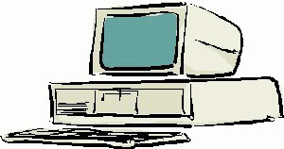
What is a Computer?
An electronic device that stores, retrieves, and processes data, and can be programmed with instructions. A computer is composed of hardware and software, and can exist in a variety of sizes and configurations.

Slide 3
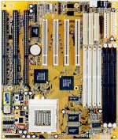
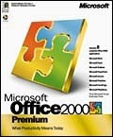
Hardware & Software
The term hardware refers to the physical components of your computer such as the system unit, mouse, keyboard, monitor etc.
The software is the instructions that makes the computer work. Software is held either on your computers hard disk, CD-ROM, DVD or on a diskette (floppy disk) and is loaded (i.e. copied) from the disk into the computers RAM (Random Access Memory), as and when required.

Slide 4
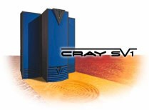

Types of Computers
Mini and Mainframe Computers
Very powerful, used by large organisations such an banks to control the entire business operation. Very expensive!
Personal Computers
Cheap and easy to use. Often used as stand-alone computers or in a network. May be connected to large mainframe computers within big companies.

Slide 5
Hardware Components
Input Devices -- "How to tell it what to do“
A keyboard and mouse are the standard way to interact with the computer. Other devices include joysticks and game pads used primarily for games.
Output Devices -- "How it shows you what it is doing"
The monitor (the screen) is how the computer sends information back to you. A printer is also an output device.

Slide 6

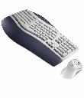
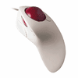
Hardware Components
INPUT DEVICES
The Mouse
Used to ‘drive’ Microsoft Windows
The Keyboard
The keyboard is still the commonest way of entering information into a computer
Tracker Balls
an alternative to the traditional mouse and often used by graphic designers

Slide 7
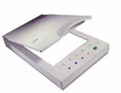
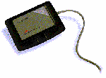
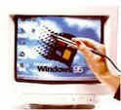
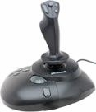
Hardware Components
INPUT DEVICES
Scanners
A scanner allows you to scan printed material and convert it into a file format that may be used within the PC
Touch Pads
A device that lays on the desktop and responds to pressure
Light Pens
Used to allow users to point to areas on a screen
Joysticks
Many games require a joystick for the proper playing of the game

Slide 8
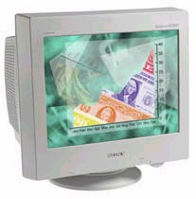


Hardware Components
OUTPUT DEVICES
VDU
The computer screen is used for outputting information in an understandable format
Printers
There are many different types of printers.
In large organizations laser printers are most commonly used due to the fact that they can print very fast and give a very high quality output.

Slide 9
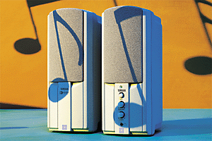
Hardware Components
OUTPUT DEVICES
Plotters
A plotter is an output device similar to a printer, but normally allows you to print larger images.
Speakers
Enhances the value of educational and presentation products.
Speech synthesisers
Gives you the ability to not only to display text on a monitor but also to read the text to you

Slide 10


Hardware Components
Storage Devices -- "How it saves data and programs“
Hard disk drives are an internal, higher capacity drive which also stores the operating system which runs when you power on the computer.
"Floppy" disk drives allow you to save work on small disks and take the data with you.

Slide 11
Hardware Components
Hard Disks
Speed:
Very fast!
The speed of a hard disk is often quoted as "average access time" speed, measured in milliseconds. The smaller this number the faster the disk.
Capacity:
Enormous! Often 40/80 Gigabytes. A Gigabyte is equivalent to 1024 Megabytes.
Cost:
Hard disks costs are falling rapidly and normally represent the cheapest way of storing data.

Slide 12

Hardware Components
Diskettes (Floppy Disks)
Speed:
Very slow!
Capacity:
Normally 1.44 Mbytes.
Cost:
Very cheap.

Slide 13
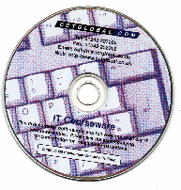
Hardware Components
CD-ROM Disks
Speed:
Much slower than hard disks. The original CD-ROM speciation is given a value of 1x speed, and later, faster CD-ROMs are quoted as a multiple of this value.
Capacity:
Around 650 Mbytes and more

Slide 14
Hardware Components
DVD Drives
Speed:
Much faster than CD-ROM drives but not as fast as hard disks.
Capacity:
Up to 17 Gbytes.
Cost:
Slightly higher than CD-ROM drives.

Slide 15
Main Parts of Computer
Memory -- "How the processor stores and uses immediate data“
RAM - Random Access Memory
The main 'working' memory used by the computer.
When the operating system loads from disk when you first switch on the computer, it is copied into RAM.
As a rough rule, a Microsoft Windows based computer will operate faster if you install more RAM. Data and programs stored in RAM are volatile (i.e. the information is lost when you switch off the computer).

Slide 16
Hardware Components
Memory
ROM – Read Only Memory
Read Only Memory (ROM) as the name suggests is a special type of memory chip that holds software that can be read but not written to.
A good example is the ROM-BIOS chip, which contains read- only software.
Often network cards and video cards also contain ROM chips.

Slide 17
Hardware Components
How Computer Memory Is Measured
Bit
All computers work on a binary numbering system, i.e. they process data in one's or zero's. This 1 or 0 level of storage is called a bit.
Byte
A byte consists of eight bits.
Kilobyte
A kilobyte (KB) consists of 1024 bytes.
Megabyte
A megabyte (MB) consists of 1024 kilobytes.
Gigabyte
A gigabyte (GB) consists of 1024 megabytes.

Slide 18
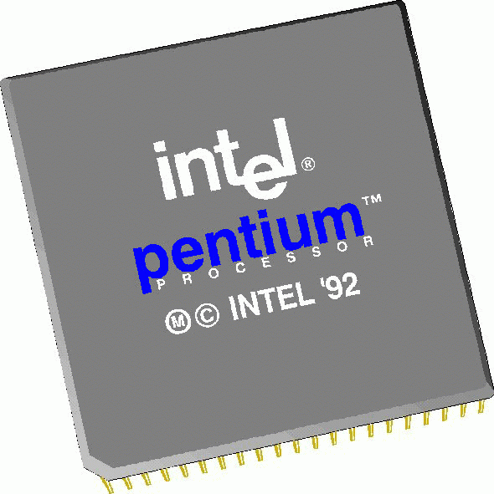
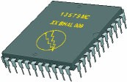
Hardware Components
Microprocessors -- "The brain of the computer“
PCs primarily use microprocessors (sometimes called the chip). The older Intel versions include the 386, 486 and now the Pentium line.
The CPU (Central Processing Unit) is normally an Intel Pentium (or equivalent) and it is one of the most important components within your computer.
It determines how fast your computer will run and is measured by its MHz speed.
Thus a 600 MHz Pentium is much faster than say a 400 MHz Pentium CPU.
It is the CPU that performs all the calculations within the computer.

Slide 19

Hardware Components
Some of the Factors
That Impact on a Computer's Performance
CPU speed
RAM size
Hard disk speed and capacity

Slide 20
Software Component
Operating systems software
The operating system is a special type of program that loads automatically when you start your computer.
The operating system allows you to use the advanced features of a modern computer without having to learn all the details of how the hardware works
The link between the hardware and you, the user
Makes the computer easy to use without having to understand bits and bytes!

Slide 21
Software Component
Applications software
An application program is the type of program that you use once the operating system has been loaded.
Examples include word-processing programs, spreadsheets and databases

Slide 22
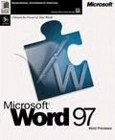
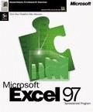
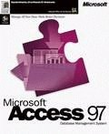
Software Component
Application Software
Word processing applications
Microsoft Word
Lotus Word Pro
WordPerfect
Spreadsheets
Microsoft Excel
Lotus 123
Database
Microsoft Access
Lotus Approach

Slide 23
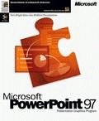
Software Component
Application Software
Payroll
Sage software
Presentation tools
Microsoft PowerPoint
Lotus Freelance
Desktop publishing
Abode Photoshop
Multimedia applications
Microsoft's Encarta CD-ROM based encyclopaedias

Slide 24
Information Network
LAN
A LAN (Local Area Network) is a system whereby individual PCs are connected together within a company or organization
WAN
A WAN (Wide Area Network) as the name implies allows you to connect to other computers over a wider area (i.e. the whole world).

Slide 25
Information Network
Uses of Network
If ten people are working together within an office it makes sense for them all to be connected.
In this way the office can have a single printer and all ten people can print to it.
In a similar way other devices such as modems or scanners can be shared.
Even more useful is the ability to share information when connected to a network.

Slide 26
Computer Accessories
Modem
Short for “MODulate/DEModulate”. The modem sends information from your computer across the telephone system.
The modem at the other end of the phone line, converts the signal back into a format that can be used by the receiving computer.

Slide 27

Uses of Computer
PC at Home
Common uses for the computer within the home
Computer games
Working from Home
Banking from Home
Connecting to the Web

Slide 28
Uses of Computer
Computers in Education
CBT (Computer Based Training)
Computer Based Training (CBT) offers a low cost solution to training needs where you need to train a large amount of people on a single subject.
These programs are normally supplied on CD-ROM and combine text, graphics and sound.
Packages range from general encyclopaedias right through to learning a foreign language.

Slide 29
Uses of Computer
Office Applications
Automated Production Systems
Many car factories are almost completely automated and the cars are assembled by computer-controlled robots.
This automation is becoming increasingly common throughout industry.
Design Systems
Many products are designed using CAD (Computer Aided Design) programs to produce exact specifications and detailed drawings on the computer before producing models of new products.

Slide 30
Uses of Computer
Office Applications
Stock Control
Stock control is ideal for automation and in many companies it is now completely computerized.
The stock control system keeps track of the number of items in stock and can automatically order replacement items when required.
Accounts / Payroll
In most large organizations the accounts are maintained by a computerized system.
Due to the repetitive nature of accounts a computer system is ideally suited to this task and accuracy is guaranteed.

Slide 31

Uses of Computer
Computers in Daily Life
Accounts
Games
Educational
On-line banking
Smart ID cards
Supermarkets
Working from home (Tele-working)
Internet

Slide 32

Create a Good Working Environment
Frequent breaks away from the computer
Appropriate positioning of screens, chairs and keyboards
Provision of adequate lighting and ventilation.

Slide 33

Health & Safety Precautions
Make sure that cables are safely secured
Make sure that power points are not overloaded
Also be aware of:
Repetitive Strain Injury (RSI)
Glare from screens
Bad posture

Slide 34
Value of Backup
The most important thing that you store on your computer is information.
Often the contents of a hard disk can represent years of work.
If the hard disk stops working one day you could lose all those years of work.
For this reason it is VITAL that you take regular backups of the information that is stored on the computer.

Slide 35
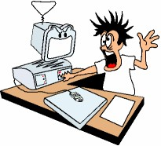
Value of Backup
Organize your computer for more efficient backups
Complete vs. incremental backups
Use 'off-site' storage

Slide 36
Value of Backup
Use passwords
Understand the Importance of shutting down your computer properly
Use a UPS (Un-interruptible Power Supply)

Slide 37
Likes & Dislikes of Computer
Things computer like:
Good ventilation
Clean environment
Stable, vibration free surface
Things computer don’t like:
Dust
Drinking and eating over the keyboard
Heat, Cold or Moisture
Don’t place objects on top of monitors.
Don’t place floppy disks near monitors.

Slide 38
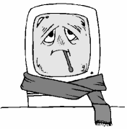
Computer Virus
What are computer viruses?
Viruses are small programs that hide themselves on your disks (both diskettes and your hard disk).
Unless you use virus detection software the first time that you know that you have a virus is when it activates.
Different viruses are activated in different ways.

Slide 39

Computer Virus
How do viruses infect PCs?
Viruses hide on a disk and when you access the disk (either a diskette or another hard disk over a network) the virus program will start and infect your computer.
The worst thing about a computer virus is that they can spread from one computer to another, either via use of infected floppy disk, or over a computer network, including the Internet.

Slide 40
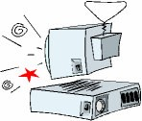
Computer Virus
How to prevent virus damage
There are a number of third party anti- virus products available.
Most of these are better than the rather rudimentary products available within DOS and Windows, but of course you do have to pay for them!
The main thing about your virus checker is that it should be kept up to date.
Many companies supply updated disks on a regular basis or allow you to receive updates through an electronic, on-line bulletin board.

Slide 41

Software Copyright
Be aware on software copyright issues
Freeware
Shareware
What about software that you find on the Internet?
Software site licenses

Slide 42

Software Copyright
If your computer system holds information about individuals then you have a moral and legal duty to treat that information with respect.
In a free society you have a right to ensure that information held about you is not abused.
In many countries this right is enshrined under data protection laws

Slide 43

Thank you

