Slide 1

THIS IS A FEW OF THE
DIFFERENT TYPES of
COMPUTERS
•
Desk top
computer
computer
Lap Top
Hand Held
Computer
computer

Slide 2
Computers Have Two Main Parts
Computer Hardware
Computer Software

Slide 3
DEFINITION
Hardware Vs. Software
If you can touch it, it’s hardware

Slide 4




The Programs that are on the disks are software
Software
Software is a general term for the various kinds of programs used to operate computers and related devices.

Slide 5
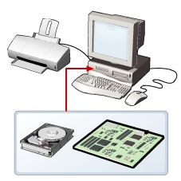
Hardware
Refers to all the physical components of a computer.
Includes all input devices, processing devices, storage devices, and output devices.
Examples of hardware are:
keyboard
mouse
motherboard
monitor
hard disk
cables
printer
Notes:
Hardware refers to all the physical components of a computer. It includes all input devices, processing devices, storage devices, and output devices. The keyboard, mouse, motherboard, monitor, hard disk, cables, and printer are all examples of hardware.
You use hardware to provide input to a computer and also to get the desired output. For example, when you play a musical instrument, such as a piano, you provide input by pressing the keys and get the desired output in the form of music. Similarly, computers also need input and output devices to perform tasks.
You use a keyboard and a mouse to provide input and to select and run programs. You can view the output on a monitor that is similar to a television set, or use the printer to view the output on paper.
Apart from input and output devices, a computer uses processing devices to work on the input data and generate the desired output. The most important processing device is the CPU. The CPU is the brain of the computer. It processes the input to perform calculations and produce output.
A motherboard is a large circuit board that connects input, output, and processing devices. The motherboard circuits provide pathways that allow data to pass through these various components. It also contains chips that determine how, when, and where data can flow through the computer.
Depending on the task that you want your computer to perform, you can choose the appropriate hardware. For example, you can use a NIC to connect your computer to other computers. You can also use expansion cards, such as video cards, to add new features or enhance the performance of your computer. All of these devices are plugged into the motherboard.

Slide 6
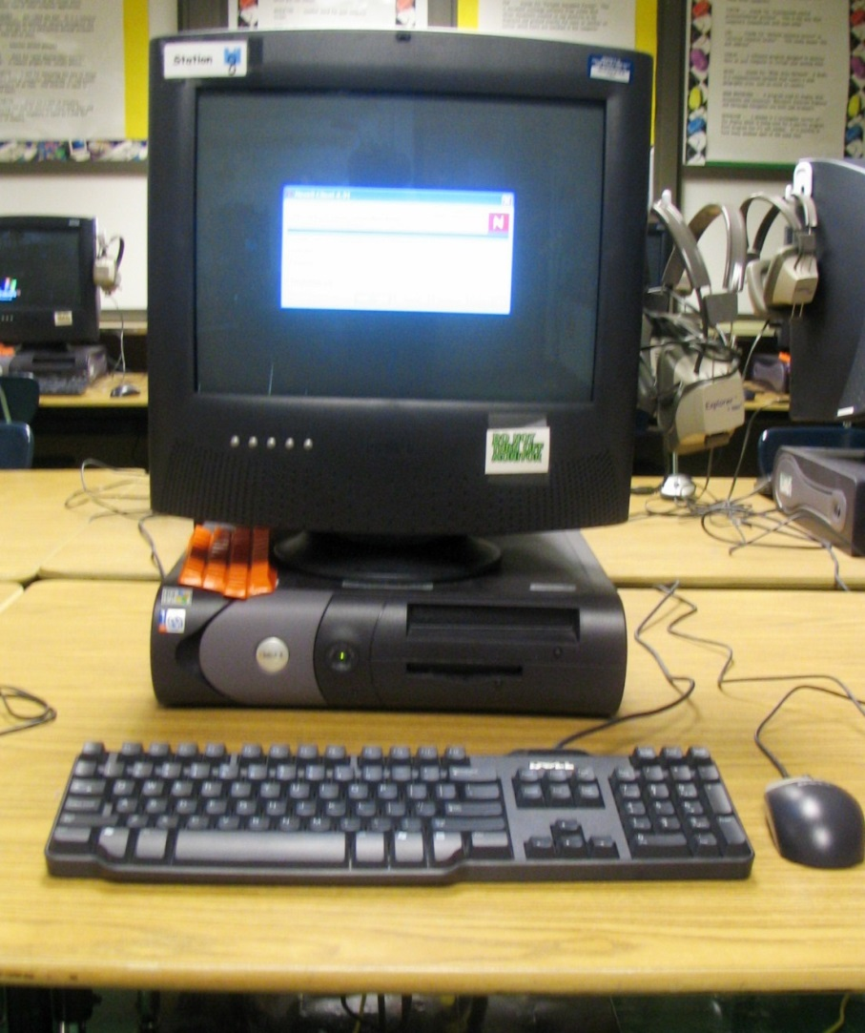
Look at this picture of a computer from our Computer Lab. A computer is made up of many parts. Let’s explore the parts to see if you know what they are called!

Slide 7
The Monitor
The monitor looks like a TV and lets lets you see your work and your files.

Slide 8
CD-ROM Disk Drive
CD-ROM stands for Compact Disk-Read Only Memory. They are flat, shiny disks that store information. Most new computers have CD-RW drives. CD-RW stands for Compact Disk-ReWrite. This type of disk allows you to write information to it, as well as read from it. Most can hold up to 700 megabytes of information.

Slide 9
DVD Drive/Burner
The newest computers come with the option of a DVD drive. A DVD (Digital Video Disc) looks just like a CD, but holds much more information! They can store 4.7 gigabytes of data!

Slide 10
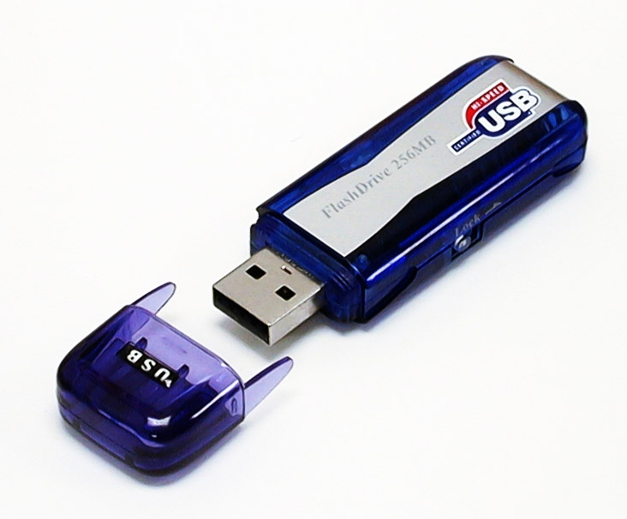
Flash Drive
A Flash Drive is a relatively new storage device. It’s like a mini, portable hard drive! You plug it into the USB (Universal Serial Bus) port on the front of newer computers and you can save to it!

Slide 11
How Do Computers Work?
Input--This is when information is entered into a computer. Some common input devices include the keyboard, mouse and scanner.
Output--This is the information that comes out of a computer after it has been processed. The information comes out on output devices such as a printer or computer monitor.
Processing--This is when the information is handled by the computer’s brain, known as the CPU (Central Processing Unit).

Slide 12
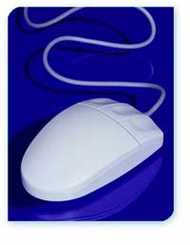
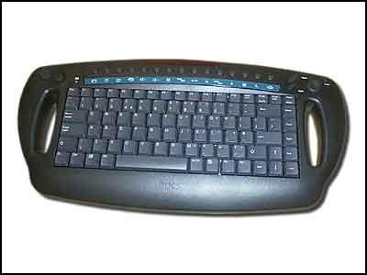
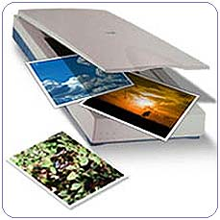
Input Devices

Slide 13
The Keyboard
The keyboard is probably the most used input device. It operates a lot like a typewriter, but has many additional keys that let it do special things a typewriter can’t.

Slide 14
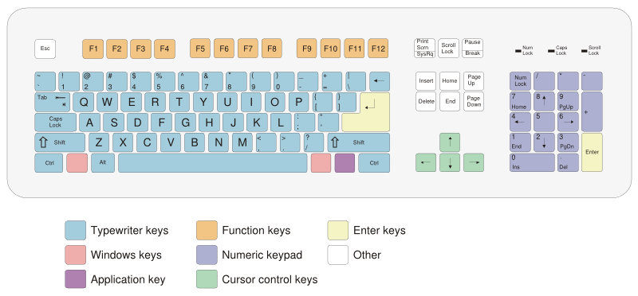
Using a Keyboard
Notes:
Alphanumeric Keys: These keys are used for entering letters and numbers.
Special Keys: Keys such as Control (CTRL), SHIFT, SPACEBAR, ALT, CAPS LOCK, and TAB are special keys. These special keys perform special functions depending on when and where they are used.
Punctuation Keys: Punctuation keys include keys for punctuation marks, such as colon (:), semicolon (;), question mark (?), single quotation marks (‘ ’), and double quotation marks (“ ”).
Command Keys: Keys such as INSERT (INS), DELETE (DEL), and BACKSPACE are command keys. You use these keys to insert and delete text and objects. You can turn the INSERT key either ON or OFF. When turned ON, the INSERT key helps you overwrite characters to the right of the insertion point. When turned OFF, the INSERT key helps you enter text or characters to the right of the insertion point, without overwriting this text or characters. An insertion point is the blinking vertical line that indicates the location at which the inserted text appears. The DELETE key is used to remove typed text, characters, and other objects on the right side of the insertion point. The BACKSPACE key is used to remove typed text, characters, and other objects on the left side of the insertion point.

Slide 15
Special Keyboard Keys
The flashing light on the computer screen is called the cursor. This cursor can be moved up and down or left and right by pressing the 4 keys that have arrows on them. These arrow keys are called cursor keys.

Slide 16
Shift Key
When this key is pressed at the same time you press a letter key, a capital letter appears on your screen. When it is held down when you press a key with a symbol and number, the top symbol appears on the computer screen. There are two shift keys on your keyboard.

Slide 17
The Backspace Key
When this key is pressed, the cursor moves back one space to the left on your computer screen. This key is very helpful when you press the wrong letter or number. You can erase your mistakes!

