Slide 1
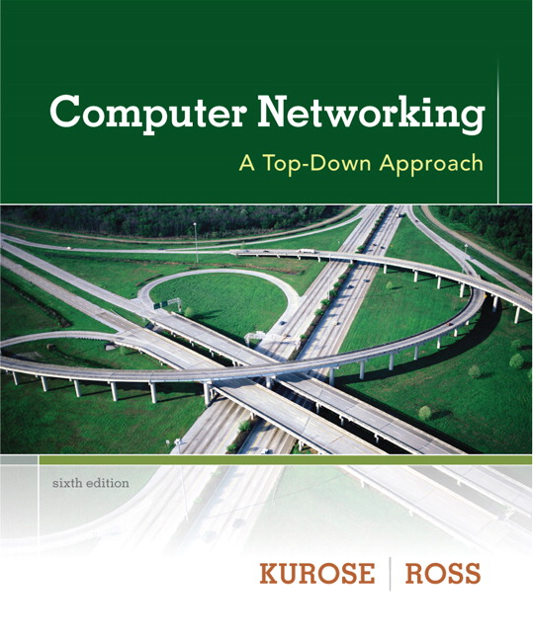

Chapter 1 Introduction
Computer Networking: A Top Down Approach 6th edition Jim Kurose, Keith Ross Addison-Wesley March 2012
A note on the use of these ppt slides:
We’re making these slides freely available to all (faculty, students, readers). They’re in PowerPoint form so you see the animations; and can add, modify, and delete slides (including this one) and slide content to suit your needs. They obviously represent a lot of work on our part. In return for use, we only ask the following:
If you use these slides (e.g., in a class) that you mention their source (after all, we’d like people to use our book!)
If you post any slides on a www site, that you note that they are adapted from (or perhaps identical to) our slides, and note our copyright of this material.
Thanks and enjoy! JFK/KWR
All material copyright 1996-2012
J.F Kurose and K.W. Ross, All Rights Reserved

Slide 2
Chapter 1: introduction
our goal:
get “feel” and terminology
more depth, detail later in course
approach:
use Internet as example
overview:
what’s the Internet?
what’s a protocol?
network edge; hosts, access net, physical media
network core: packet/circuit switching, Internet structure
performance: loss, delay, throughput
security
protocol layers, service models
history

Slide 3
Chapter 1: roadmap
1.1 what is the Internet?
1.2 network edge
end systems, access networks, links
1.3 network core
packet switching, circuit switching, network structure
1.4 delay, loss, throughput in networks
1.5 protocol layers, service models
1.6 networks under attack: security
1.7 history

Slide 4



















What’s the Internet: “nuts and bolts” view
PC
millions of connected computing devices:
hosts = end systems
running network apps
mobile network
server
wireless
laptop
global ISP
smartphone
home
network
communication links
fiber, copper, radio, satellite
transmission rate: bandwidth
regional ISP
wireless
links
wired
links
Packet switches: forward packets (chunks of data)
routers and switches
router
institutional
network
Notes:
4

Slide 5

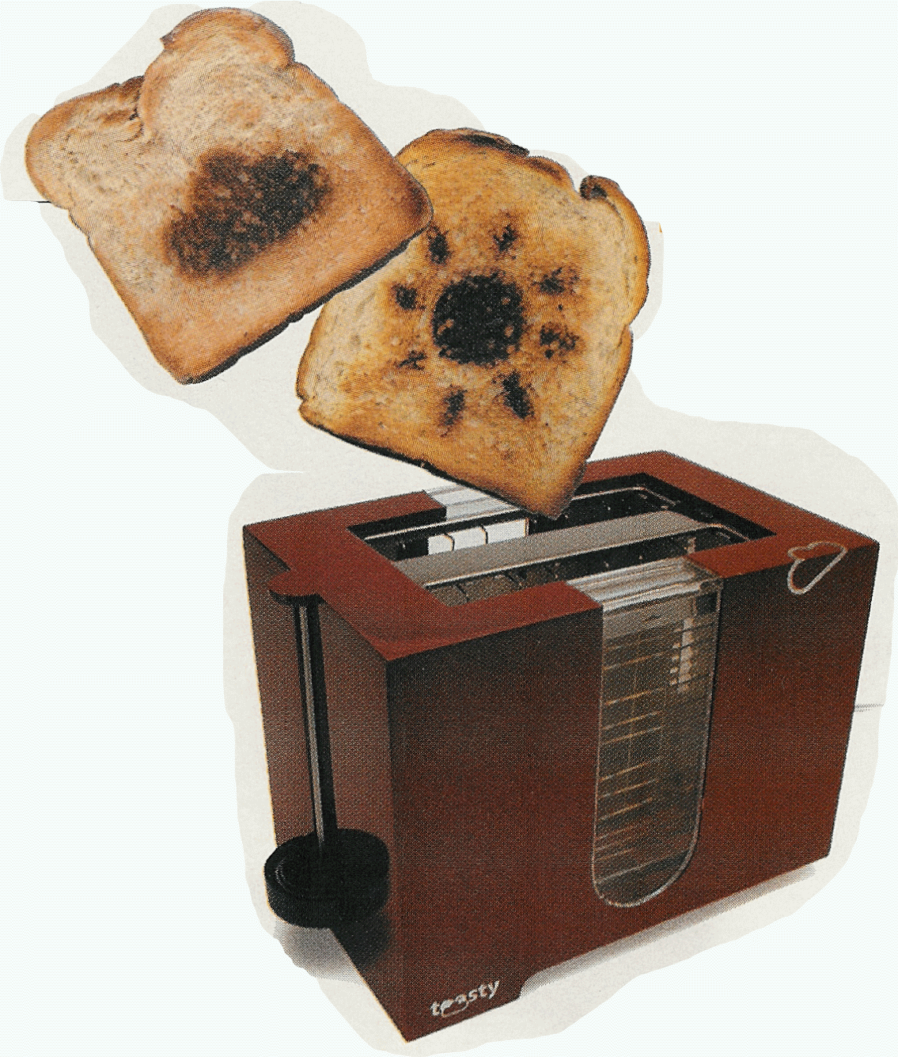
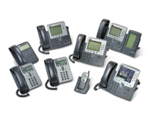

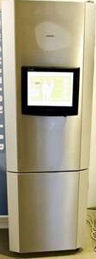
“Fun” internet appliances
Web-enabled toaster +
weather forecaster
IP picture frame
http://www.ceiva.com/
Tweet-a-watt:
monitor energy use
Slingbox: watch,
control cable TV remotely
Internet
refrigerator
Internet phones

Slide 6
What’s the Internet: “nuts and bolts” view
Internet: “network of networks”
Interconnected ISPs
protocols control sending, receiving of msgs
e.g., TCP, IP, HTTP, Skype, 802.11
Internet standards
RFC: Request for comments
IETF: Internet Engineering Task Force
mobile network
global ISP
home
network
regional ISP
institutional
network

Slide 7
What’s the Internet: a service view
mobile network
Infrastructure that provides services to applications:
Web, VoIP, email, games, e-commerce, social nets, …
provides programming interface to apps
hooks that allow sending and receiving app programs to “connect” to Internet
provides service options, analogous to postal service
global ISP
home
network
regional ISP
institutional
network

Slide 8
What’s a protocol?
human protocols:
“what’s the time?”
“I have a question”
introductions
… specific msgs sent
… specific actions taken when msgs received, or other events
network protocols:
machines rather than humans
all communication activity in Internet governed by protocols
protocols define format, order of msgs sent and received among network entities, and actions taken on msg transmission, receipt

Slide 9

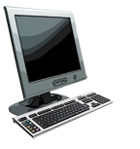

What’s a protocol?
a human protocol and a computer network protocol:
Hi
TCP connection
request
Hi
TCP connection
response
Got the
time?
Get http://www.awl.com/kurose-ross
2:00
<file>
time
Q: other human protocols?

Slide 10
Chapter 1: roadmap
1.1 what is the Internet?
1.2 network edge
end systems, access networks, links
1.3 network core
packet switching, circuit switching, network structure
1.4 delay, loss, throughput in networks
1.5 protocol layers, service models
1.6 networks under attack: security
1.7 history
Notes:
10

Slide 11
The network edge:
end systems (hosts):
run application programs
e.g. Web, email
at “edge of network”
client/server model
e.g. Web browser/server; email client/server
Distributed applications
peer-peer model:
minimal (or no) use of dedicated servers
e.g. Skype, BitTorrent
Notes:
ATA – analog telephone adaptor

Slide 12
Network edge: connection-oriented service
Goal: data transfer between end systems
handshaking: setup a connection for data transfer ahead of time
TCP - Transmission Control Protocol
Internet’s connection-oriented service
TCP service [RFC 793]
reliable, in-order byte-stream data transfer
loss: acknowledgements and retransmissions
flow control:
sender won’t overwhelm receiver
congestion control:
senders “slow down sending rate” when network congested
Notes:
ATM and Frame Relay are connection-oriented but unreliable networks.
Connection-oriented is modeled on the telephone network.

Slide 13
Network edge: connectionless service
Goal: data transfer between end systems
UDP - User Datagram Protocol [RFC 768]:
No handshaking – less work!
Less delay
Internet’s connectionless service
unreliable data transfer
no flow control
no congestion control
Notes:
Connection-less service is modeled on the post office service.
ICMP – error messages
IP

Slide 14
TCP vs. UDP
App’s using TCP:
HTTP (Web), FTP (file transfer), Telnet (remote login), SMTP (email)
App’s using UDP:
streaming media, teleconferencing, DNS, Internet telephony, network games
Notes:
End here???

