Slide 1
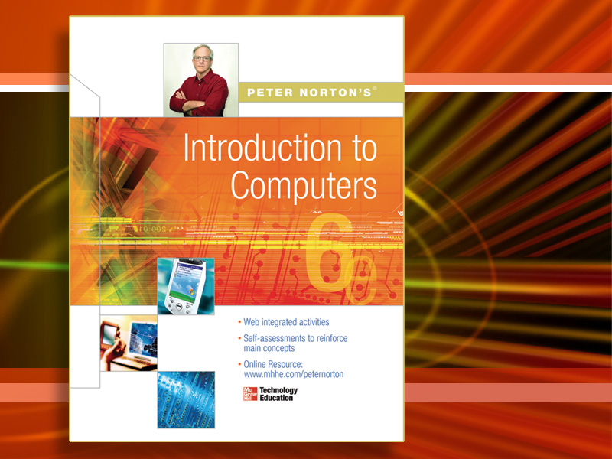
McGraw-Hill Technology Education
Copyright © 2006 by The McGraw-Hill Companies, Inc. All rights reserved.

Slide 2
Chapter 1B
Looking Inside the Computer System

Slide 3
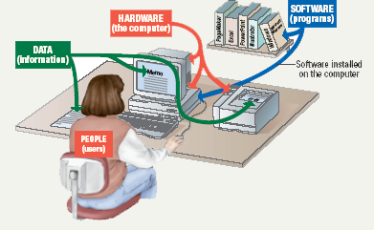
Parts of the Computer System
Computer systems have four parts
Hardware
Software
Data
User

Slide 4
Parts of the Computer System
Hardware
Mechanical devices in the computer
Anything that can be touched
Software
Tell the computer what to do
Also called a program
Thousands of programs exist
Notes:
Teaching tip
Suggest to your students that the majority of people who purchase computers do so because of software. They want to email, or type letters. Nearly every reason given to purchase a computer is based on software needs.

Slide 5
Parts of the Computer System
Data
Pieces of information
Computer organize and present data
Users
People operating the computer
Most important part
Tell the computer what to do
Notes:
Teaching tip
A good exercise to relate the importance of making data meaningful is to list some random numbers on the board. Then ask what they mean. Without a title, the numbers have no meaning. Once a title is presented, the numbers make sense.

Slide 6
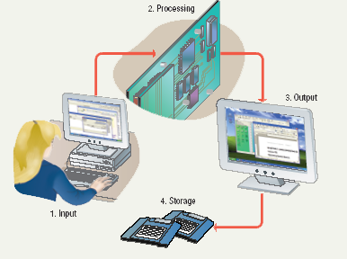
Information Processing Cycle
Steps followed to process data
Input
Processing
Output
Storage
Notes:
Teaching tip
It is helpful to walk through a simple program to demonstrate the cycle. I often use a simple arithmetic problem to show this cycle.

Slide 7
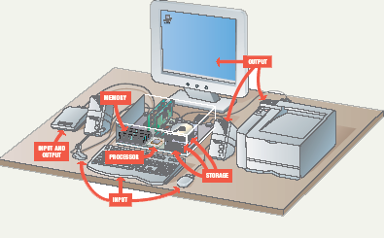
Essential Computer Hardware
Computers use the same basic hardware
Hardware categorized into four types

Slide 8
Essential Computer Hardware
Processing devices
Brains of the computer
Carries out instructions from the program
Manipulate the data
Most computers have several processors
Central Processing Unit (CPU)
Secondary processors
Processors made of silicon and copper
Notes:
Teaching tip
The interaction between a CPU and secondary processors is much like the interaction between a boss and subordinate. The boss tells the subordinate what to do but not necessarily how to accomplish the task. The subordinate only bothers the boss when guidance or more data is needed.

Slide 9
Essential Computer Hardware
Memory devices
Stores data or programs
Random Access Memory (RAM)
Volatile
Stores current data and programs
More RAM results in a faster system
Read Only Memory (ROM)
Permanent storage of programs
Holds the computer boot directions
Notes:
Insider information
Intel, the manufacturer of popular CPUs, originally made RAM for mainframe and minicomputers. Today Kingston is a leading RAM manufacturer.
Chapter 5 discusses ROM and the BIOS. Refer your students to this chapter if they desire more information.

Slide 10
Essential Computer Hardware
Input and output devices
Allows the user to interact
Input devices accept data
Keyboard, mouse
Output devices deliver data
Monitor, printer, speaker
Some devices are input and output
Touch screens
Notes:
Teaching tip
It is helpful to have examples of input and output devices in class. Stories of obscure input output devices are typically well received by the students.

Slide 11
Essential Computer Hardware
Storage devices
Hold data and programs permanently
Different from RAM
Magnetic storage
Floppy and hard drive
Uses a magnet to access data
Optical storage
CD and DVD drives
Uses a laser to access data
Notes:
Insider information
A new CD technology is emerging. A shorter wavelength blue laser beam is being used to burn CD’s. This allows more data to be saved on a disk. The technology is in it’s infancy but should be mature in the near future.
Chapter 11 of the text provides more detail regarding storage devices.
DVD writers are available for purchase. They have not been standardized yet. Several competing formats are vying for acceptance. Of these, the DVD+RW seems to have the strongest support.

Slide 12
Software Runs The Machine
Tells the computer what to do
Reason people purchase computers
Two types
System software
Application software

Slide 13
Software Runs The Machine
System software
Most important software
Operating system
Windows XP
Network operating system (OS)
Windows Server 2003
Utility
Symantec AntiVirus

Slide 14
Software Runs The Machine
Application software
Accomplishes a specific task
Most common type of software
MS Word
Covers most common uses of computers

Slide 15
Computer data
Fact with no meaning on its own
Stored using the binary number system
Data can be organized into files
Notes:
Teaching tip
Chapter 5 in the text explores data processing in greater detail.
Figure 1B.5 shows data in binary format.

Slide 16
Computer users
Role depends on ability
Setup the system
Install software
Mange files
Maintain the system
“Userless” computers
Run with no user input
Automated systems
Notes:
Teaching tip
Most computer problems are caused by user error. Given this fact, it is fun here to teach the student the acronym PEBKAC the Problem Exists Between Keyboard And Chair. A little humor can break up the lecture monotony.

Slide 17
Chapter 1B
End of Chapter

