Slide 1
Insights to the Product Strategy Team in the Banking Domain
Presentation By:- Ria Sangwan

Slide 2


What is a Banking Domain?
The banking domain refers to all the processes, systems, rules and technologies that support how banks operate and deliver financial services. It is one of the largest and most critical domains in It because it deals with money, security, risk and customer trust.
What the Banking Domain includes:
Core Banking- Opening accounts(savings, current), Deposits & withdrawals, funds transfers(neft, RTGS, IMPS)
Loan processing, interest calculation
Payments- upi, Imps, neft, rtgs, debit/credit card transactions, internet banking, mobile wallets(Paytm, Phonepe), pos machines.
Loans & credit- Home loans, personal loans, business loan, credit cards.

Slide 3
Problem Statement
Mitron Bank is a legacy financial institution headquartered in Hyderabad. They want to introduce a new line of credit cards, aiming to broaden its product offerings and reach in the financial market.
AtliQ Data Services came to know about this through an internal link and approached Mitron Bank with a proposal to implement this project. However, the strategy director of Mitron Bank, Mr. Bashnir Rover is skeptical and asked them to do a pilot project with the sample data before handing over them the full project. They provided a sample dataset of 4000 customers across five cities on their online spending and other details.
Peter Pandey is a data analyst at AtliQ Data Services and was asked by his manager to take over this project. His role is to analyse the provided sample data and report key findings to the strategy team of Mitron Bank. This analysis is expected to guide them in tailoring the credit cards to customer needs and market trends.
The successful acquisition of this project depends on Peter's ability to provide actionable, data-driven recommendations and impress Mr. Bashnir Rover & his team. Peter requested support from his manager Tony Sharma, and he provided him with some ideas to generate insights based on the data provided.

Slide 4
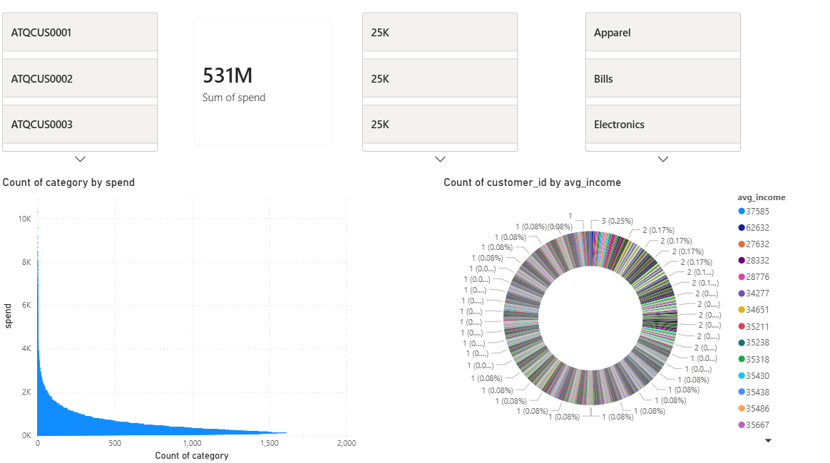
Customer Spending overview
Total customer spend stands at 531M, indicating strong overall spending activity
Spending is highly skewed, with a small set of categories driving most of the value
Customer base spans wide income ranges, showing a diversified but fragmented income profile
High-frequency low-value spends dominate, highlighting volume-led consumption behaviour

Slide 5
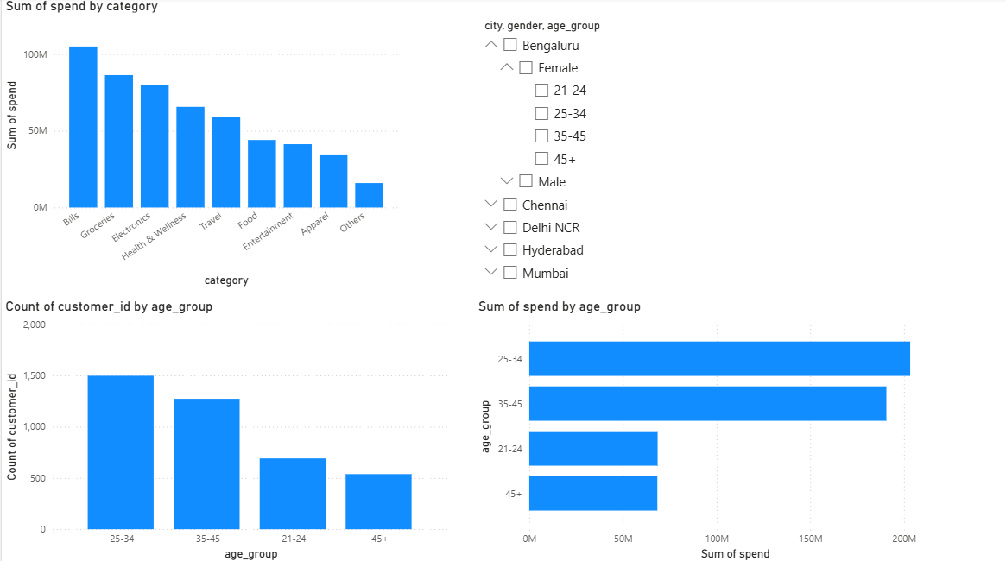
Customer Demographics & Spending Patterns
25–34 age group leads in both customer count and total spend, followed by 35–45
Bills, Groceries, and Electronics are the top spending categories
Younger customers (21–24) show lower spend intensity, while 45+ is smaller but stable
Spending is driven by working-age urban customers, indicating strong lifestyle and utility-led usage

Slide 6
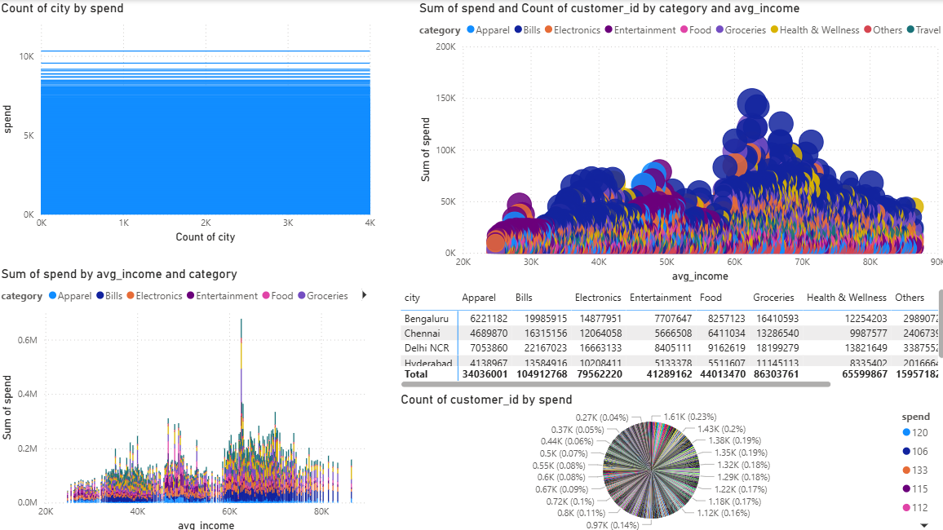
Income-Based Spending & Category Insights
Spending increases with income, peaking in the ₹55K–₹75K range
Bills and Groceries dominate across all income bands, showing essential-led spending
Discretionary categories (Electronics, Travel, Entertainment) rise sharply at higher incomes
Metro cities contribute the bulk of high-income, high-spend customers

Slide 7
Thank You

