Slide 1

Diamond Price Modeling SHAI club training B 2021|level 1
Presented by: riadh , R’CHID , BARAA

Slide 2
Work plan
*Overview
*introduction
*Dataset analysis and visualization
*Data preparing
*Comparison study
*Fine-tune
*Evaluation
*Conclusion

Slide 3
Overview
We are asked to predict the price of a piece of diamond. Which sometimes can be a tricky thing.
indistinguishable Diamonds can look the same at the first look. But it’s the quality that defines the price
Quality??? It’s quite hard to compare two pieces of diamonds. There is no particular definition for “quality” here.

Slide 4
So what we can do to solve this problem?
This is where Machine Learning comes to help.

Slide 5
Framing the problem.
Supervised Learning
As We’ll see soon. We have a set of diamonds with their prices included.
And since we have the prices as the labels, it’s obviously a Supervised Learning problem.
Regression
We’re trying to predict the price of a piece of diamond, Which is a continuous value,
by finding the relationship between price and other variables. This is called regression.
Batch Learning
All of the training is going to happen offline, before the launch. And the model will not be trained to
any new data on the fly

Slide 6
Introduction
Diamonds are among nature’s most precious and beautiful creations. This jeweler would entice every man and woman by marketing it as a necessity for the occasion and as a status symbol, and by calling this pricey and unaffordable item priceless.
But what if you get the power to accurately estimate Diamond's price before negotiating? Won't that be a really cool edge!
This study aim to build a machine learning model able to predict diamonds price base on a specific number of feature.
Type : supervised learning.
specifically “ Regression problem

Slide 7

Dataset Analysis
Dataset Visualization

Slide 8
We took the data from this link Kaggel dataset link
https://www.kaggle.com/shivam2503/diamonds?fbclid=IwAR1sRjFZXVTJ8FyoKvX-I7r6k4QmvaHB_zCm8rtJHaVHwh2RacRCxdGNlQ8

Slide 9
First look
info( ) Method: describe( ) Method:
There is : -price mean value :3932
-11 attributes
-53940 samples -Price median value : 2401
-3 categorical attributes
-No nulls -The minimum value of each of the
attributes (x,y,z) is zero!

Slide 10
So as described, there are 11 attributes
Let’s take a look at them:

Slide 11
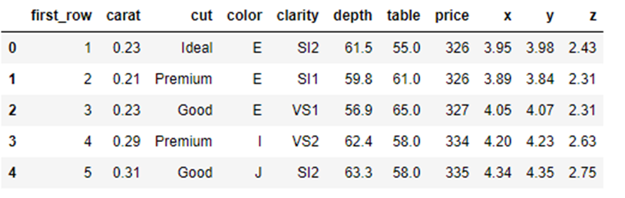
1. first_row
The column named “ first_row ” appears to be an index column. Which We will remove it later since we have no use for it.
the columns cut color and clarity appears to be categorical inputs that should be transformed later
Final observation one output under the name of price.

Slide 12
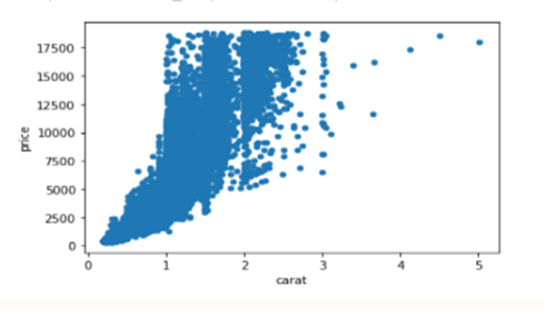
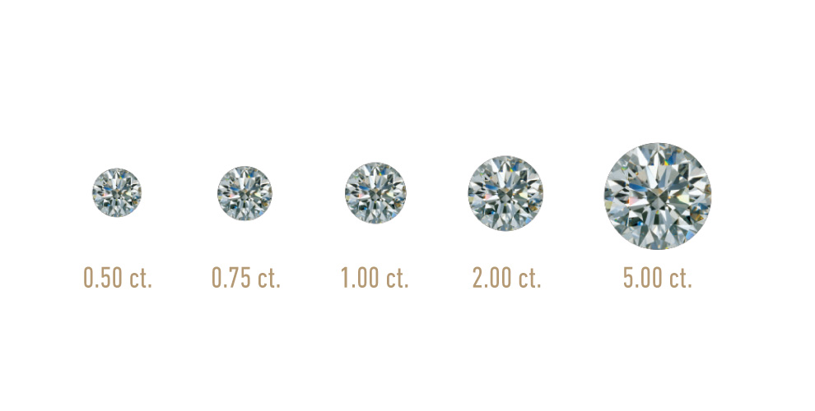
2. Carat
A unit of weight, used commonly between diamonds’ traders..
Numerical
Correlation Highly correlated with the price. 0.92
This is the most correlated column with the price.
Statistics
Min:0.2, Max: 5.01

Slide 13
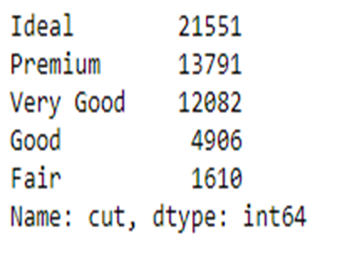
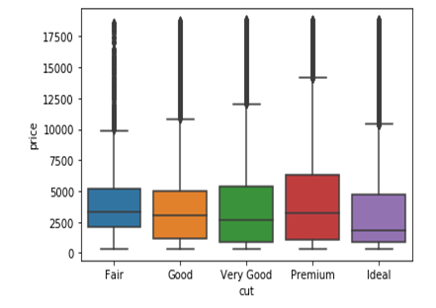
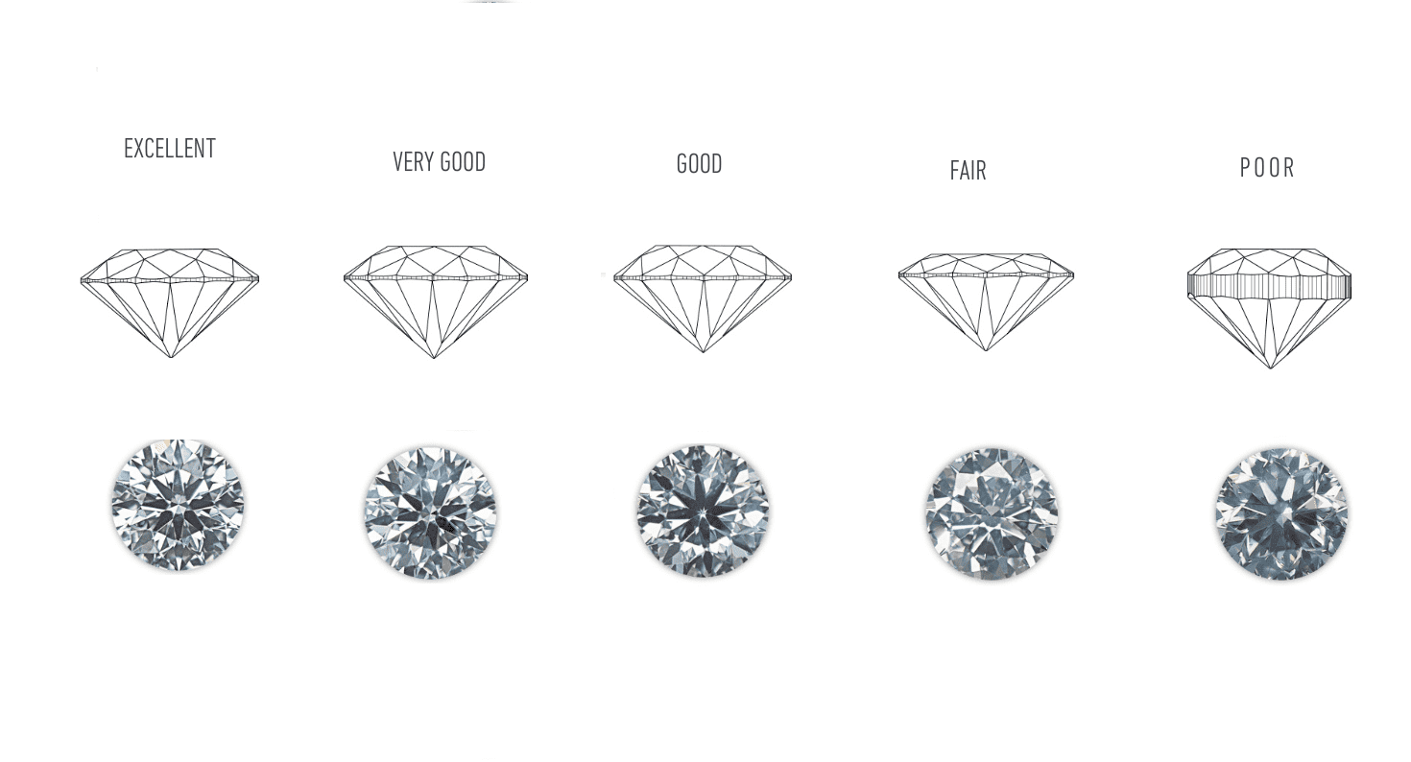
3. Cut
Quality of the cut (Fair, Good, Very Good, Premium, Ideal).
Categorical
At first, we would naturally think that the more perfect the cut the higher the price. But looking at the adjacent boxplot, we observe that there isn’t some really obvious trend!
The median values for all classes are very close, and we can observe that the prices slightly get lower for the more perfect cuts, specially for the “Ideal” class, which surprisingly tends to have lower prices!

Slide 14
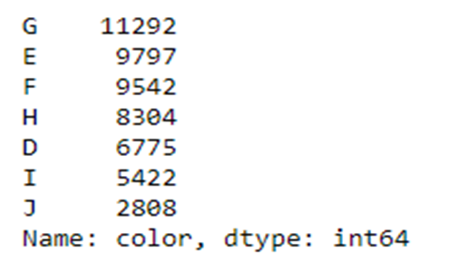
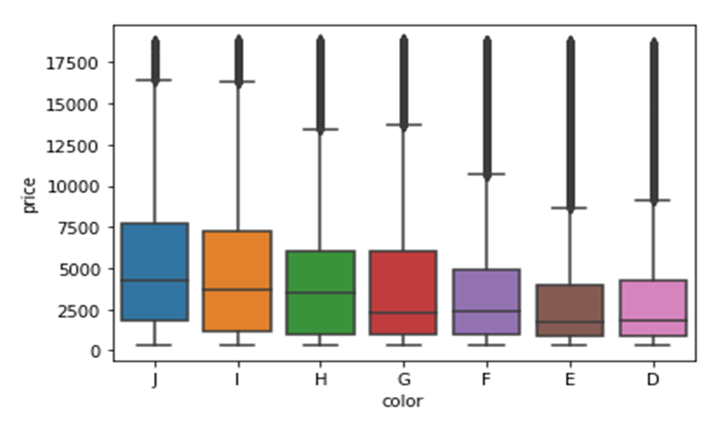
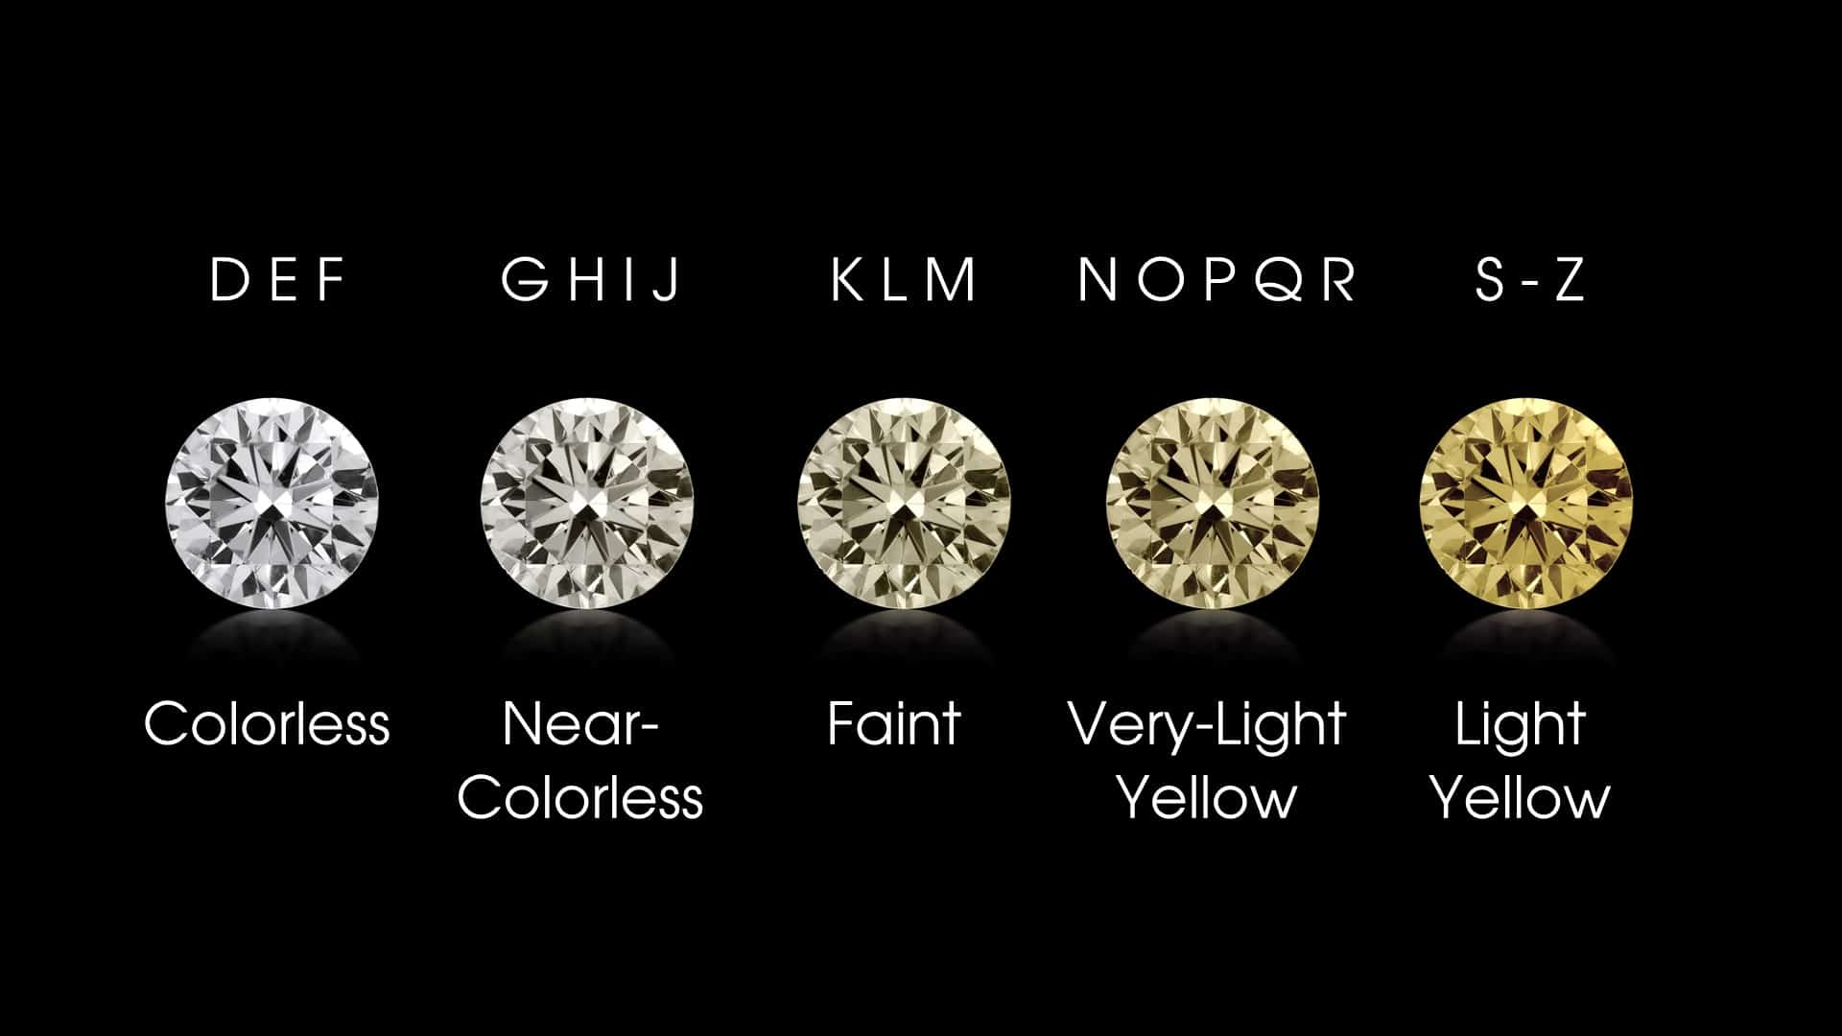
4. Color
Diamond color,
from J (worst) to D (best) (colorless)
Categorical
The adjacent boxplot shows the prices of different colors.
We notice again, unexpectedly, that the more colorless the diamond the cheaper it is!

Slide 15
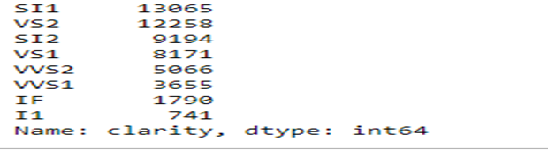
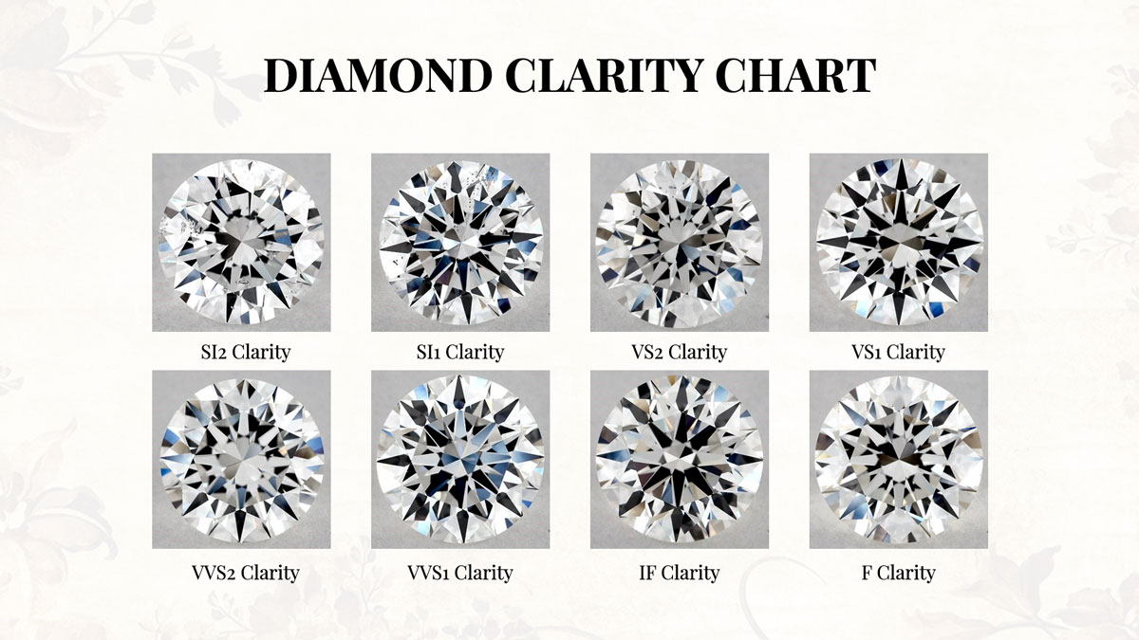
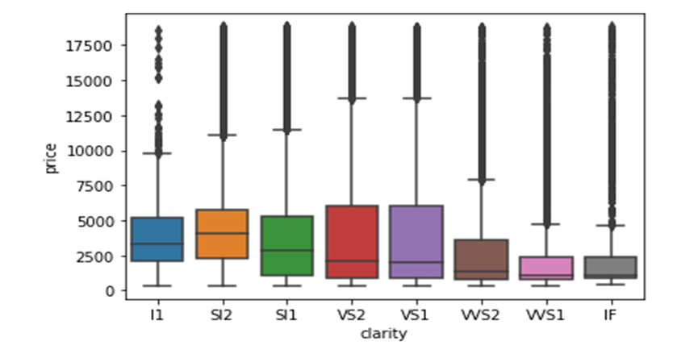
5. Clarity
A measurement of how clear the diamond is (in term of inclusions)
(I1 (worst), SI2, SI1, VS2, VS1, VVS2, VVS1, IF (best))
Categorical
The adjacent boxplot shows the prices of different clarities.
Same trend here, better qualities has lower price median than the worst ones… We will come to this shortly.

Slide 16
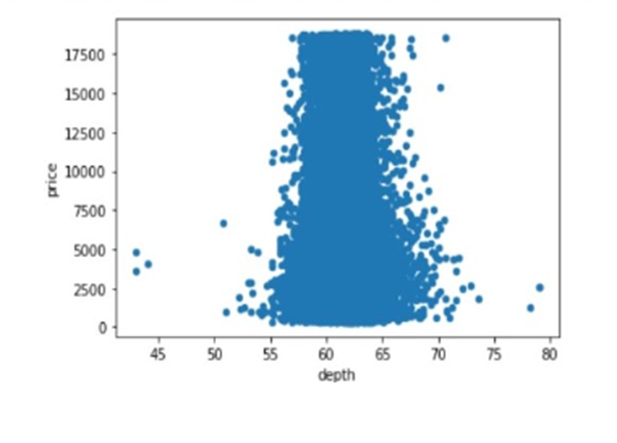
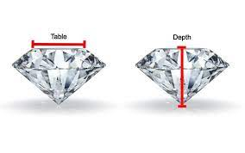
6. Depth
Total depth percentage = z / mean(x, y).
Numerical
Correlation Very low correlation with the price (-0.01).
Statistics
Min:43, Max: 79

Slide 17
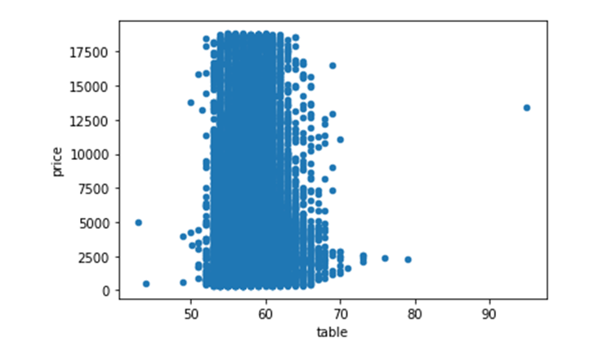
7. Table
Width of top of diamond relative to the widest point.
Numerical
Correlation Has a correlation of 0.12 with the price.
Statistics
Min:43, Max: 95

Slide 18
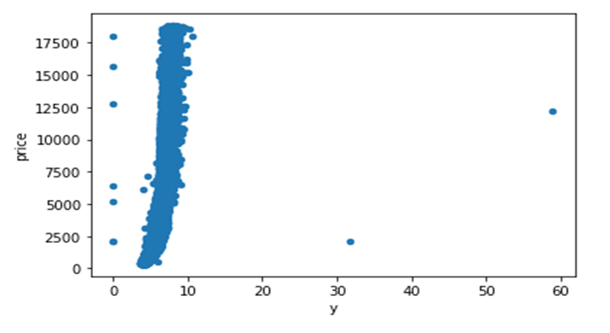
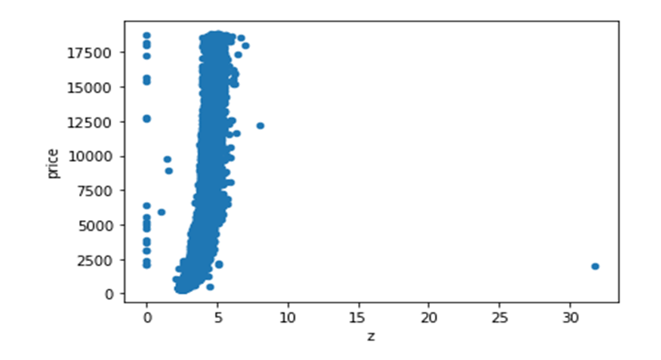
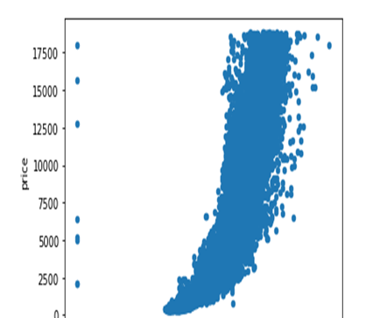
8-10. X, Y, Z
Width, length, depth (dimensions) of the diamond.
Numerical
Correlation They all have a pretty high correlation with the price. (0.88)
Statistics
Min:0, Max: (x)10, (y)58, (z)31

Slide 19
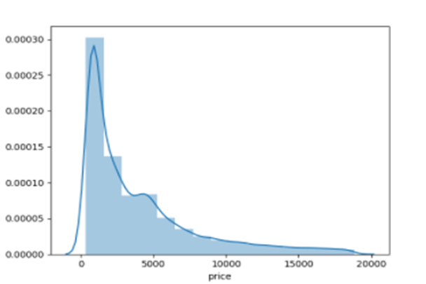
11. Price
Our target column which we want to predict
Numerical
Skewed Which means that the median is the most representative value for it. We’ll use this to evaluate our model.
Statistics
Min:326, Max: 18823

Slide 20
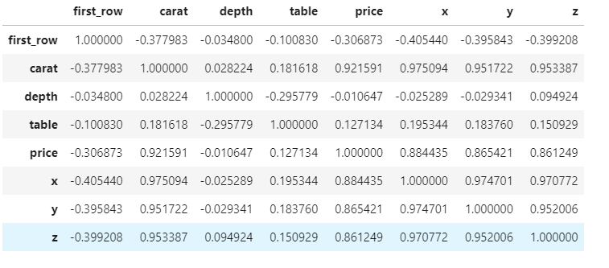
Diamonds.corr()

Slide 21
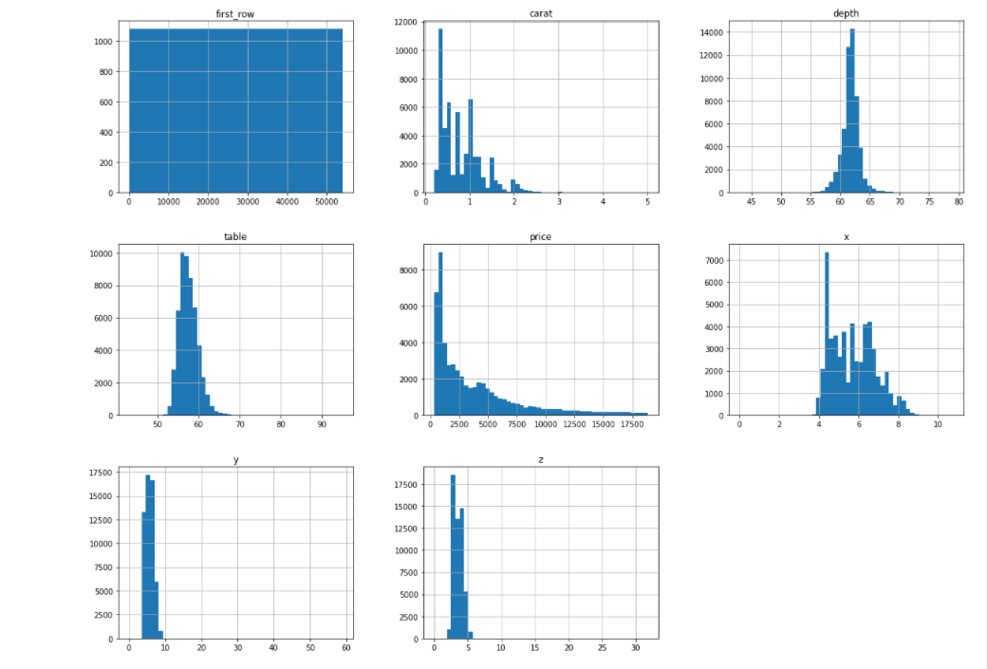
A histogram shows the number of instances for each numerical data

Slide 22
Data Preparing

Slide 23
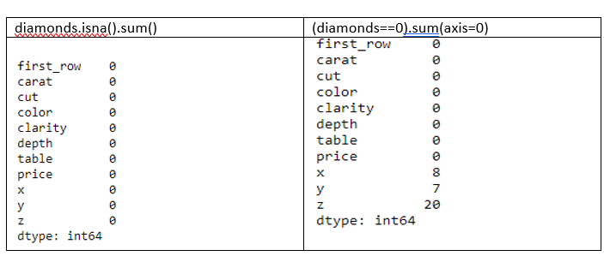
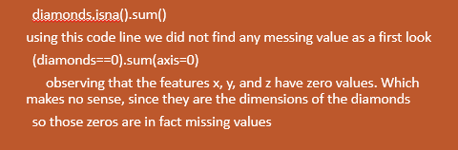

Slide 24
Replacing missing values with the median in x, y and z.
x_median= diamonds["x"].median()
diamonds["x"].mask(diamonds.x ==0,x_median, inplace=True)
y_median= diamonds["y"].median()
diamonds["y"].mask(diamonds.y ==0,y_median, inplace=True)
z_median= diamonds["z"].median()
diamonds["z"].mask(diamonds.z ==0,z_median, inplace=True)

Slide 25
Handily outliers
print('\n', diamonds[diamonds['y'] > 30], '\n')
print(diamonds[diamonds['z'] > 30], '\n')
diamonds.drop(diamonds[(diamonds['z'] > 30) | (diamonds['y'] > 30)].index, axis=0, inplace=True)

Slide 26
split the data into training set (80%) and test (20%) set:
train_set, test_set = train_test_split(diamonds, test_size=0.2, random_state=42)

Slide 27
drop the first_row and price columns for the inputs (x):
diamonds= train_set.drop(["price","first_row"], axis=1)

Slide 28
set the target (y):
diamonds_labels=train_set['price'].copy()

Slide 29
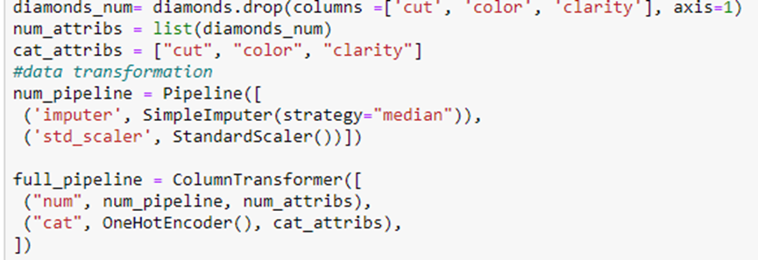
Handling the Categorical and numerical Attributes

Slide 30
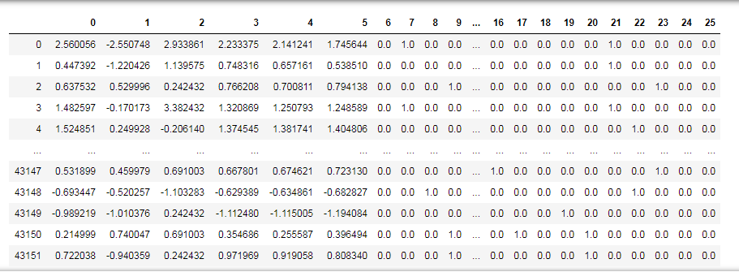
Appling all the transformations to the diamonds data
diamonds_prepared = full_pipeline.fit_transform(diamonds)

Slide 31
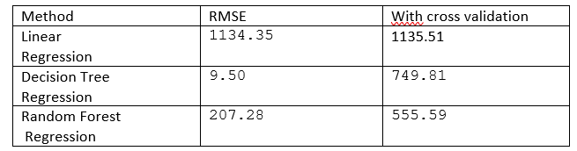
Comparison study
To select the best-fit candidate that can predict better future data a comparison study is necessary.
we select three different algorithms where the cross-validation was employed to check if overfitting is occurring.
the chose will be taken bass on their RMSE.

Slide 32
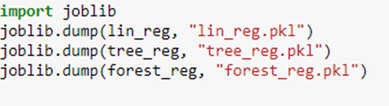
And now we save our three models for latter use

Slide 33
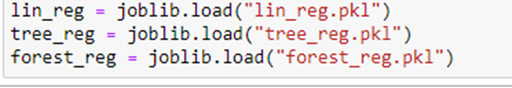
and for abloading them :

Slide 34
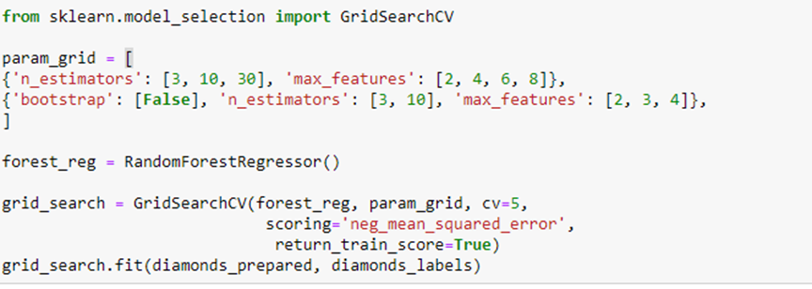
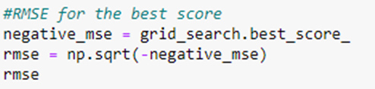
Fine-Tune
Looking at the RMSE of the models it's clearly opinion that the forest_reg is the best fit-candidate. but, due to the fact that the main reason behind this work is to learn. we end up selecting the lin_reg model to fine-tune it in order to learn how to do it first and exploit its capacity on the second hand.
Rmse=571.6601917904563

Slide 35
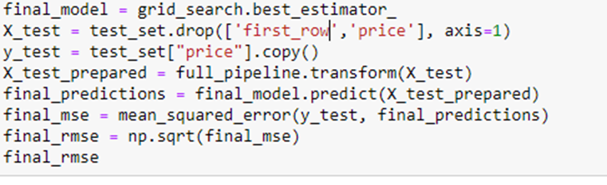
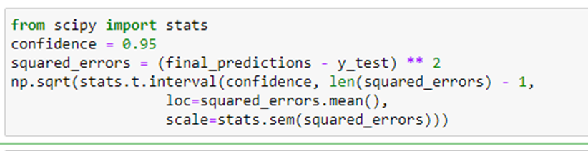
Evaluation
Rmse=540.5501769690312
compute a 95% confidence interval for the generalization error

Slide 36
Conclusion
diamonds price prediction is an important task for the economy and for it selling it has many features that describe each kind of diamond
data visualization comes at first to see and visualize your data and its composing
other fitting and underfitting is a hug problem that faces the data scientist and defining it and dealing with gives a hug impact on the result
we end up selecting the lin_reg model to fine-tune the random forest model which gave the best rmse result .
always save your models for latter use .

