Slide 1
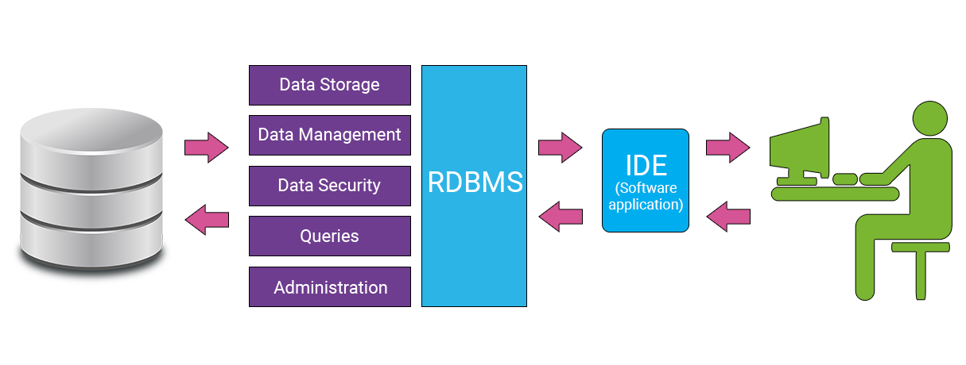
RDBMS PRESENTATION
What is a Relational Database (RDBMS)?

Slide 2
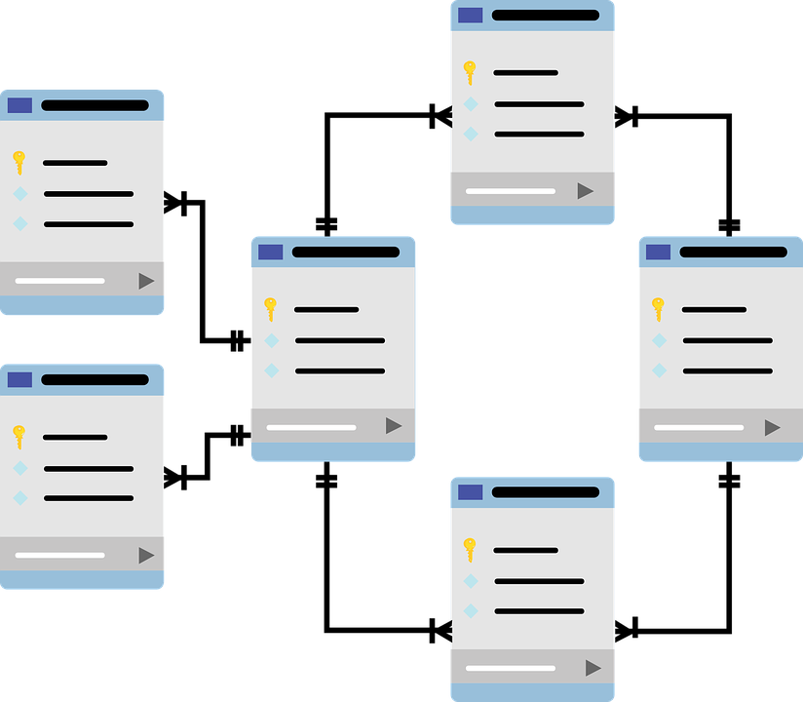
A relational database is a type of database that stores and provides access to data points that are related to one another. Relational databases are based on the relational model, an intuitive, straightforward way of representing data in tables. In a relational database, each row in the table is a record with a unique ID called the key. The columns of the table hold attributes of the data, and each record usually has a value for each attribute, making it easy to establish the relationships among data points.

Slide 3
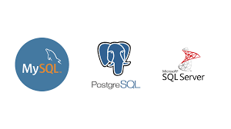
What are the most popular RELATIONAL DATABASES:
This is the list of the top 10 most popular RDBMSs :
Oracle
MySQL
SQL Server
PostgreSQL
IBM DB2
Microsoft Access
SQLite
Maria DB
Informix
Azure SQL

Slide 4
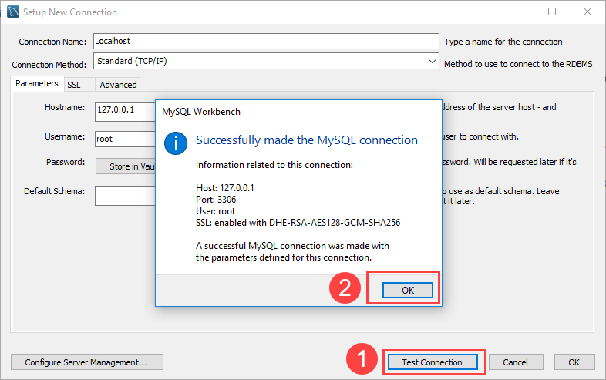
MySQL :
MySQL is the world’s most popular database that is open source and free. MySQL was acquired by Oracle as a part of Sun Microsystems acquisition in 2009.
In MySQL, the SQL part of “MySQL” stands for “Structured Query Language”. SQL is the most common standardized language used to access databases. Depending on your programming environment, you might enter SQL directly (for example, to generate reports), embed SQL statements into code written in another language, or use a language-specific API that hides the SQL syntax.
Features of MySQL:
MySQL is a database management system.
MySQL databases are relational.
MySQL software is Open Source.
The MySQL Database Server is very fast, reliable, scalable, and easy to use.
MySQL Server works in client/server or embedded systems.

Slide 5
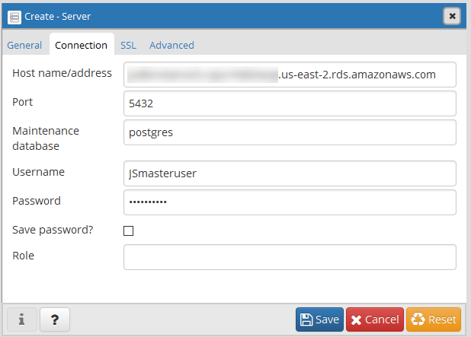
PostgreSQL:
PostgreSQL is a powerful, open-source object-relational database system that uses and extends the SQL language combined with many features that safely store and scale the most complicated data workloads. The origins of PostgreSQL date back to 1986 as part of the POSTGRES project at the University of California at Berkeley and have more than 30 years of active development on the core platform. The current version of PostgreSQL is 11.4 was released on 20 June 2019. PostgreSQL is written in C language and managed by the PostgreSQL Global Development Group.
Features of PostgreSQL:
PostgreSQL is known for its architecture, reliability, data integrity, robust feature set, extensibility, and the dedication of the open-source community behind the software to consistently deliver performant and innovative solutions.

Slide 6
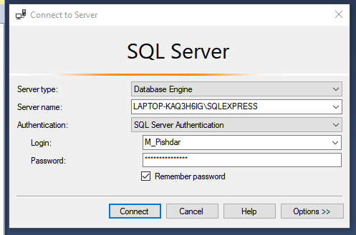
SQL SERVER:
SQL Server database developed by Microsoft is one of the most popular databases in the world. Initially launched in 1989 and written in C, C++, SQL Server is now widely used among major companies. SQL Server is also a part of Microsoft’s Azure cloud as Azure SQL Server. The current version of SQL Server is SQL Server 2019.
Features of SQL SERVER:
Intelligence across all your data. Break down data silos.
Choice of language and platform. Run SQL Server anywhere.
Industry-leading performance.
Most secured data platform. Fewest vulnerabilities for nine years.
Unparalleled high availability.
End-to-end mobile BI.
SQL Server on Azure.

Slide 7
COMPARISON BETWEEN MySQL, PostgreSQL, SQL SERVER:
FEATURE | MySQL | PostgreSQL | SQL SERVER
Install/Maintenance Process | Easiest | Medium | Hardest
Cost | Open source / Owned by Oracle and has several paid editions | Completely free / Open source | SQL Server Express is a free edition, but it is limited to using 1 processor, 1 GB memory and 10 GB database files.
Memory to store tables | MySQL has got an ability to store tables in memory. | Does not offer any in-memory engine. | In-memory OLTP is integrated into SQL Server’s database engine
JSON data type | MySQL has JSON data type support and also supports in place partial updates. | PostgreSQL supports JSON data type and supports partial updates. | SQL Server supports JSON data type and supports partial updates.
Language | Written in C, has a few C++ modules | Written in C | Mostly C++ with a few exceptions
Join algorithms | MySQL executes joins between tables using only a nested-loop algorithm or variations of it. | Supports nested-loop joins, Hash joins and merge joins algorithms. | Supports nested-loop joins, hash joins and merge joins algorithms.
Vacuum / Defragmentation | Vacuuming and index compaction are very efficient. | Vacuum performs full tables scans to find the deleted rows and quite heavy process/might impact users’ workload. | In-memory garbage collector might add max ~15% overhead, usually much less.

