Slide 1
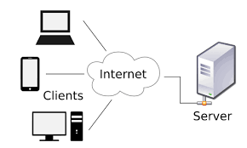
Request message to the server and copy the web sites

Slide 2

Understunding lagunages

Slide 3
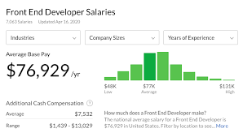
get money

