Slide 1
Early Threat Warning Via Speech and Emotion Recognition from Voice Calls
Ifaz Ishtiak 15101118
Mohammad Mazedur Rahman 15101043
Md.Razaul Haque Usmani 14241005
Supervised By
Hossain Arif
Assistant Professor
BRAC University

Slide 2
A Different Perspective of Telecommunication
Increasing Crimes Through Telecommunication
Online Scams, Threats and even Killings
~80% Voice Call scams last month (Australia)
Chat rooms leading to Murders

Slide 3
Our Aim
Create a system
Assist in Investigation Potential Threat from Voice Calls
Give Early Warnings for such cases

Slide 4
Psychology of Threat
“Threat means a communicated intent to inflict harm or loss on another”
Speech Under Stress and Threat Impacts
Sad, Angry and Fearful Emotions
Drastic Changes in Feature Values

Slide 5
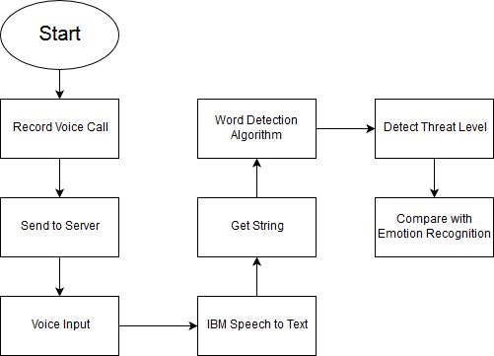
System Design
Audio Files works parallel for speech and emotion recognition as shown:
Figure 1: Speech Recognition

Slide 6
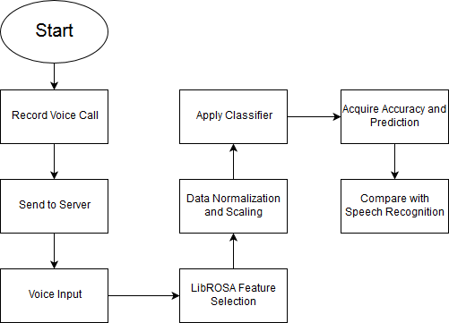
System Design
Figure 2: Emotion Recognition

Slide 7
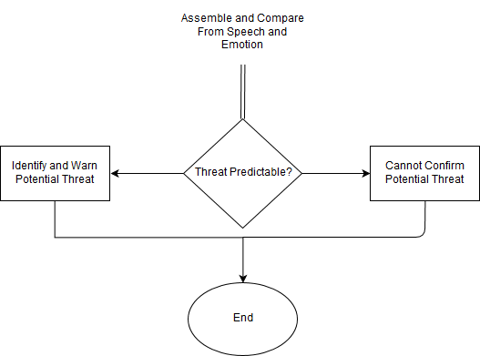
System Design
Figure 3: Gathered Results

Slide 8
User Interface
Start
Run In Background
Record Call
Save and Send to Server
End
Figure 4: End User Workflow

Slide 9
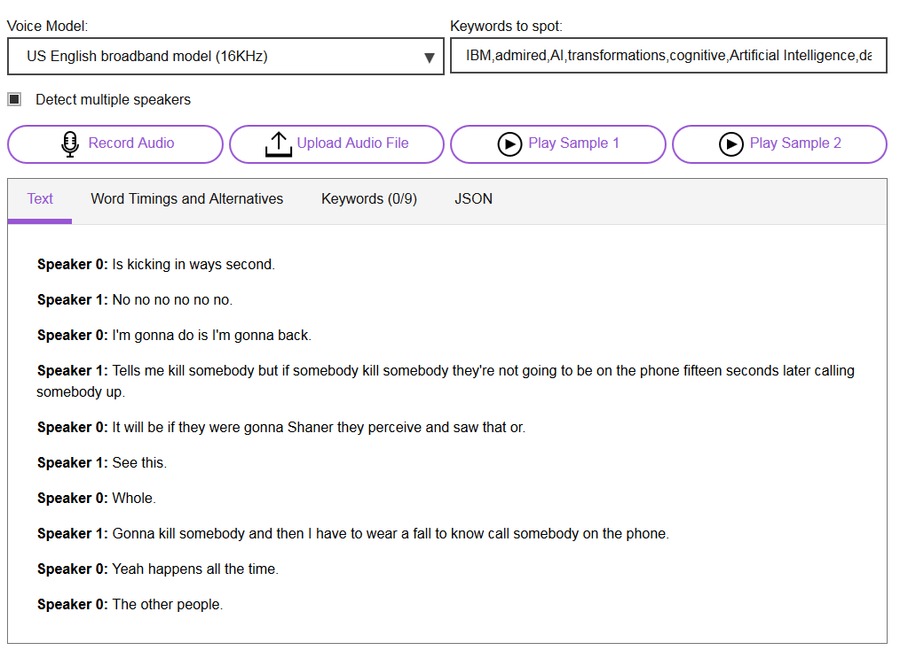
Implementation – Speech to Text
Using IBM Watson Speech to Text Service (DEMO)
Figure 5: IBM Watson Speech to Text Interface

Slide 10
Implementation – Word Detection
Data Collection
~5400 Words, 3 Classifications
~3900 Negative Words
~1100 Profane Words
~360 Threat Related Words
Examples: Shoot, Terrorize, Hijack, Abuse, etc.

Slide 11
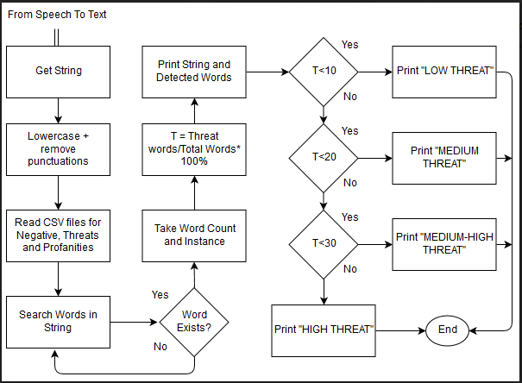
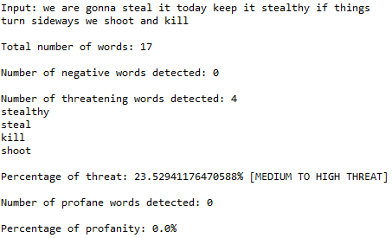
Implementation – Word Detection
Figure 7: Word Detection Results
Figure 6: Word Detection Algorithm Workflow

Slide 12
Implementation – Emotion Recognition
DATABASES
Speech Accent Archive
TESS
RAVDESS
LIBRARIES
PyAudioAnalysis
LibROSA
ALGORITHMS
Support Vector Machine
Random Forest
Naïve Bayes

Slide 13
Implementation – Emotion Recognition
DATABASES
RAVDESS
8 Emotions – 1440 recordings
5 emotions – 960 recordings
Calm, Happy, Sad, Angry and Fearful
LIBRARY
PyAudioAnalysis
21 of 34 Features – MFCC, Energy, Spectrum, etc.
Generates Frequency Charts and Spectrograms
LIBRARY
LibROSA
First 20 MFCC Features Selected

Slide 14
Implementation – Emotion Recognition Parameters
General Parameter: Random_State
Random Forest
N Estimators
Criterion
SVM
C Parameter
Gamma
Degree

Slide 15
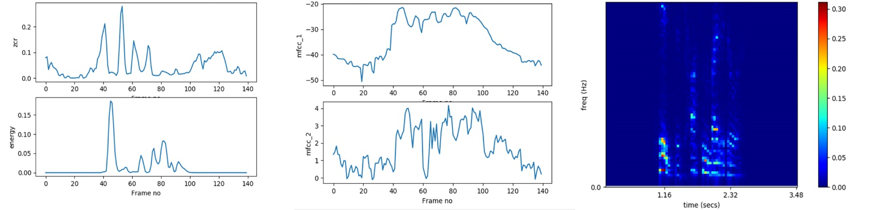
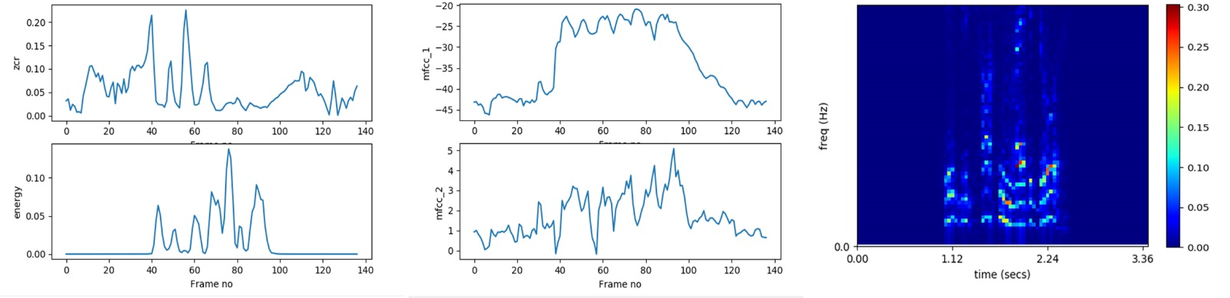
Implementation – Emotion Recognition
Feature Frequency Chart and Spectrograms for 5 Emotions
Figure 7: ZCR, Energy and MFCC and Spectrogram for CALM Emotion
Figure 8: ZCR, Energy and MFCC and Spectrogram for HAPPY Emotion

Slide 16
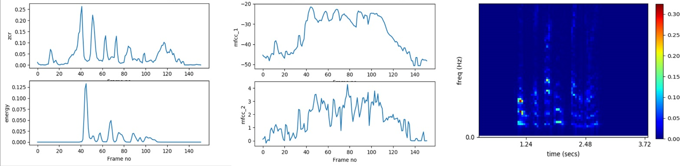
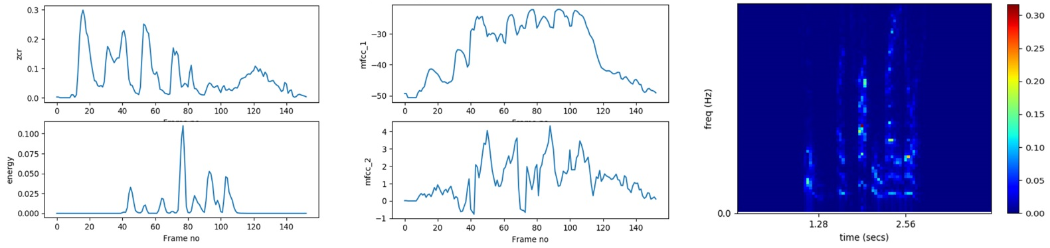
Implementation – Emotion Recognition
Feature Frequency Chart and Spectrograms for 5 Emotions
Figure 9: ZCR, Energy and MFCC and Spectrogram for SAD Emotion
Figure 10: ZCR, Energy and MFCC and Spectrogram for ANGRY Emotion

Slide 17
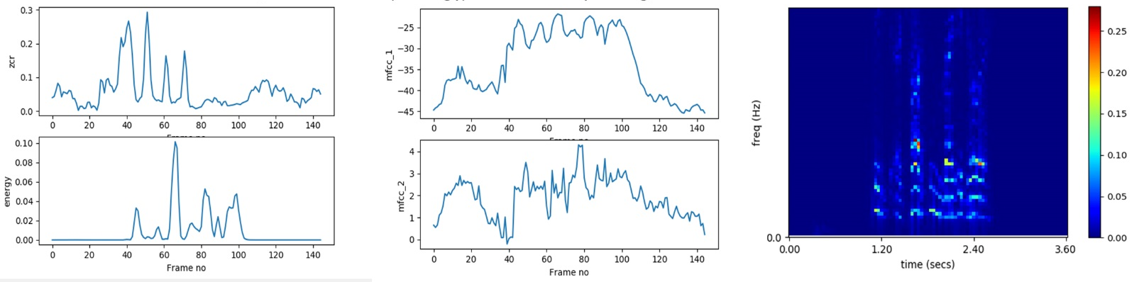
Implementation – Emotion Recognition
Feature Frequency Chart and Spectrograms for 5 Emotions
Figure 11: ZCR, Energy and MFCC and Spectrogram for FEARFUL Emotion

Slide 18
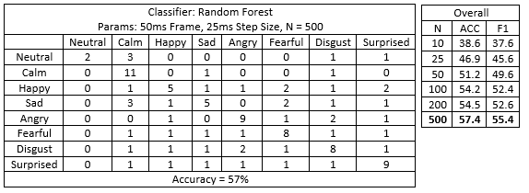
A Comparative Study
Comparison with 8 Emotions
[PyAudioAnalysis]
Figure 12: Confusion Matrix and Overall Accuracy Chart of 57% Accuracy from Random Forest
Parameters Used: Frame Size 50ms, Step Size 25ms, N = 500

Slide 19
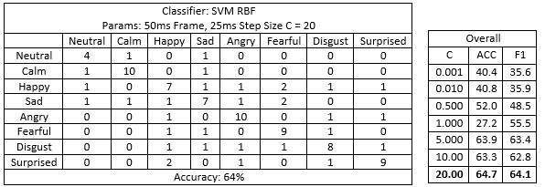
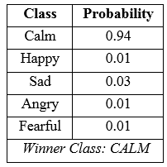
A Comparative Study
Comparison with 8 Emotions
[PyAudioAnalysis]
Figure 13: Confusion Matrix, Overall Accuracy With Estimation Chart of 64 % Accuracy from SVM RBF
Parameters Used: Frame Size 50ms, Step Size 25ms, C = 20

Slide 20
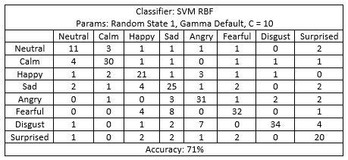
A Comparative Study
Comparison with 8 Emotions
[LibROSA]
Figure 14: Confusion Matrix of 71 % Accuracy from SVM RBF
Parameters Used: Random_State = 1, C = 10, Gamma = Default = 1/20 = 0.05

Slide 21
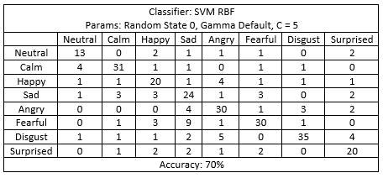
A Comparative Study
Comparison with 8 Emotions
[LibROSA]
Figure 15: Confusion Matrix of 70 % Accuracy from SVM RBF
Parameters Used: Random_State = 0, C = 5, Gamma = Default = 1/20 = 0.05

Slide 22
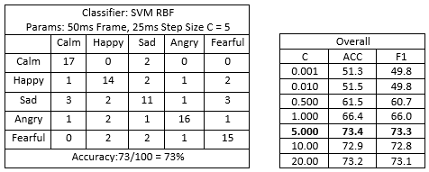
A Comparative Study
Comparison with 5 Emotions
[PyAudioAnalysis]
Figure 16: Confusion Matrix and Overall Accuracy of 73% from SVM RBF
Parameters Used: Frame Size 50ms, Step Size 25ms, C = 5

Slide 23
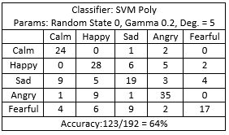
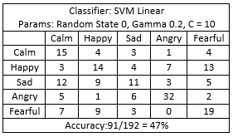
A Comparative Study
Comparison with 5 Emotions
[LibROSA]
Figure 17: 64% Accuracy from Polynomial SVM
Parameters Used: Random_State = 0
C = 10
Gamma = 1/5 = 0.2
Degree/Dimensions = 5
Figure 18: 47% Accuracy from Linear SVM
Parameters Used: Random_State = 0
C = 10
Gamma = 1/5 = 0.2

Slide 24
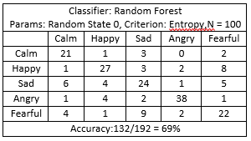
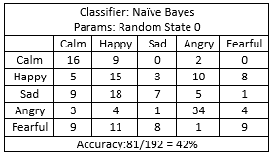
A Comparative Study
Comparison with 5 Emotions
[LibROSA]
Figure 19: 69% Accuracy from Random Forest
Parameters Used: Random_State = 0
Criterion = Entropy
N = 100
Figure 20: 42% Accuracy from Naïve Bayes
Parameters Used: Random_State = 0

Slide 25
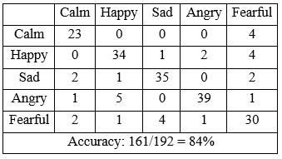
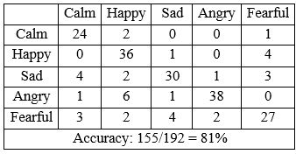
A Comparative Study
Highest Accuracies Using SVM RBF with 5 Emotions
[LibROSA]
Figure 21: 81% Accuracy
Parameters Used: Random_State = 0
Gamma = 1/10 = 0.1
C = 10
Figure 22: 84% Accuracy
Parameters Used: Random_State = 0
Gamma = 1/5 = 0.2
C = 10

Slide 26
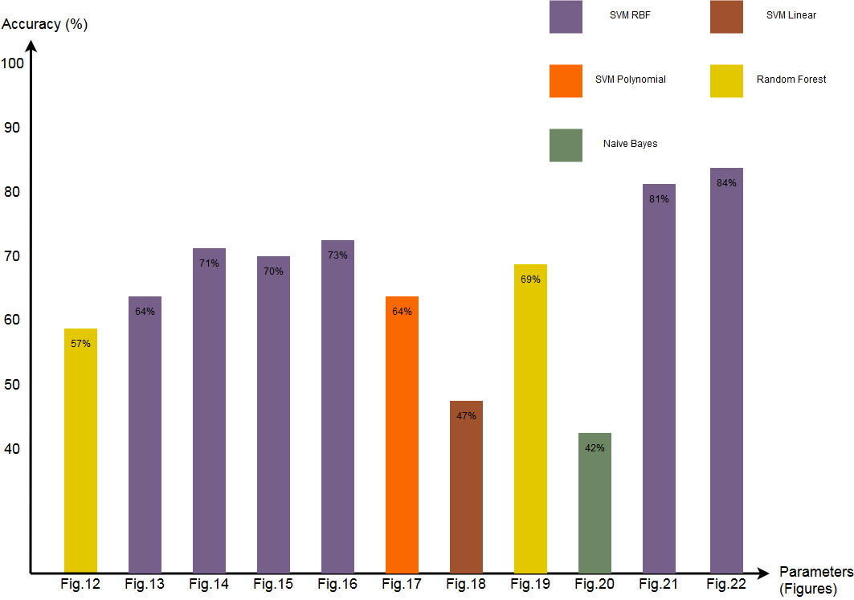
Results
Figure 23: Overall Results Comparison With Algorithms

Slide 27
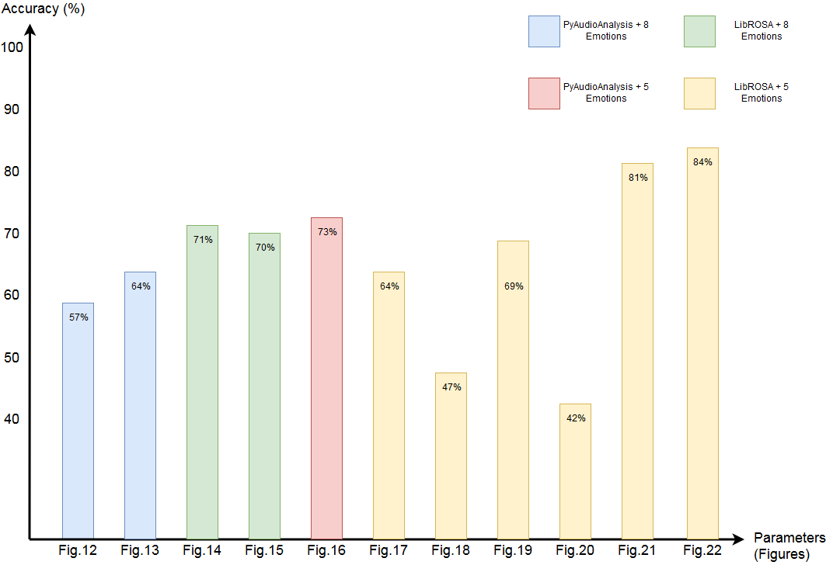
Results
Figure 24: Overall Results Comparison With Libraries and Emotions

Slide 28
Limitations
SPEECH TO TEXT
Simultaneous Speakers
Change in Pace and Tone
Inaccurate Words may Change Context
WORD DETECTION
Evolving Language
Dictionary Maintenance
EMOTION RECOGNITION
Complication in Data Preprocessing
Hence, A Comparative Study

Slide 29
Future Work
Work with large Threat related Data to determine ‘True Threat’
Find Solutions for sarcasm and code words
Compact System
Increased Performance
Additional Features – Larger Dictionary, Language Support, etc.

Slide 30
References
https://definitions.uslegal.com/t/threat-of-harm/
H.Hollien, Forensic Voice Identificaiton. London: Academic Press, 2002, pp.51-57.
J.H.L.Hansen and S.Patil, Speech Under Stress: Analysis, Modeling and Recognition, Chapter Speaker Classification I of the series Lecture Notes in Computer Science, vol. 4343, pp. 108-137, Jan. 2007.

