Slide 1
DIGITAL MARKETING
Astha Patel – 15012121012
Riya Jain - 15012121006

Slide 2
Objective of This Project
To manage and integrate various categories of shop sections, and to eliminate the concept of data redundancy each category will have data sharing property with other category as and when required.
To Provide the basic Facility’s like Create Account, Login, Purchase Product, View the Product Database.
In this Project we have to Section one for Administration and another for User admin can access the Product Section and Account Menegment.
Users can Access Some part of the Product like Purchase Product , View Products login and create Account.
Also user can Get the Bills of the Product that he was Purchase.

Slide 3
The Following Concepts We are used in
Our Project
Objects and Classes
File Management
Data Redundancy
Conditional Statements

Slide 4
Classes
Customer
Product
CreateAccount
Login
SetProduct
View Products
Purchase Products

Slide 5
Customer
Getdata
Display
CretateAccount
Login
PurchaseProducts
Product
Getdata
ShowData
SetProduct
ViewProduct

Slide 6
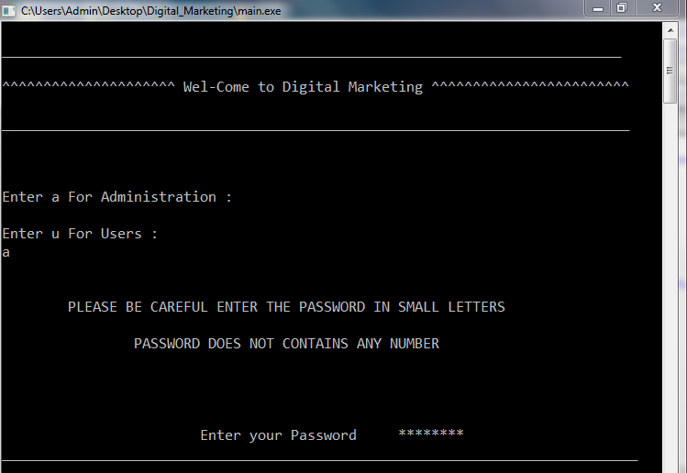

Slide 7
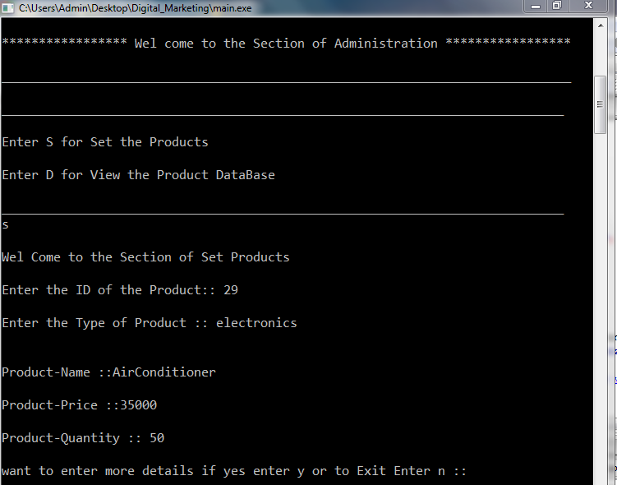

Slide 8
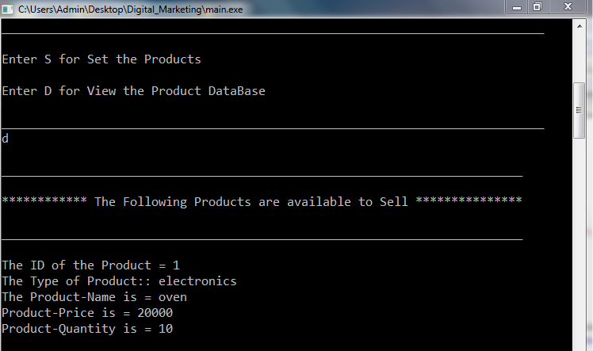

Slide 9
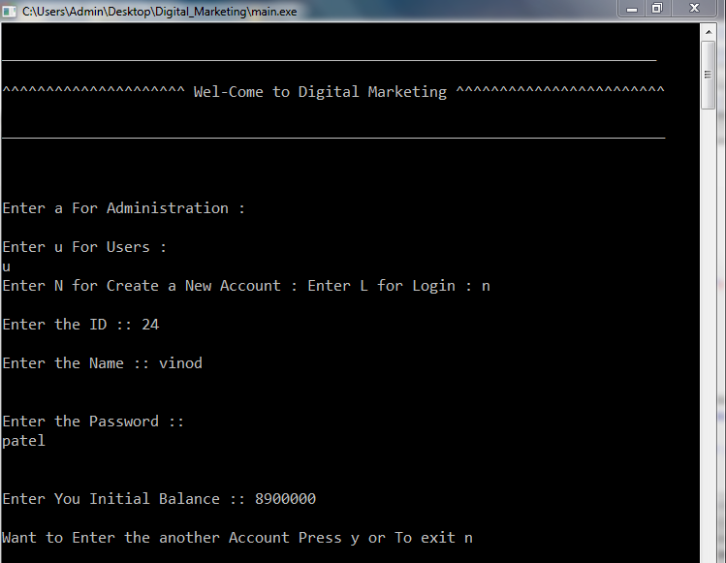

Slide 10
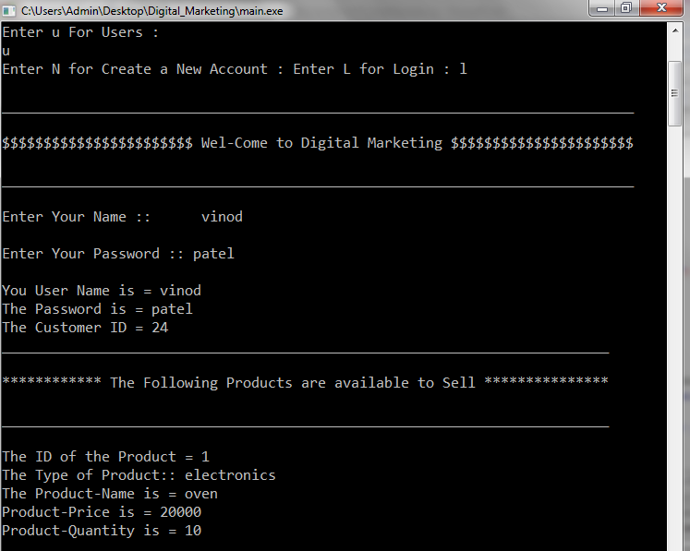

Slide 11
