Slide 1
Simulate, optimise, classify: the algorithmic organisations of pluri-dimensional space from 1953 onwards
Adrian Mackenzie
Sociology,
Lancaster

Slide 2
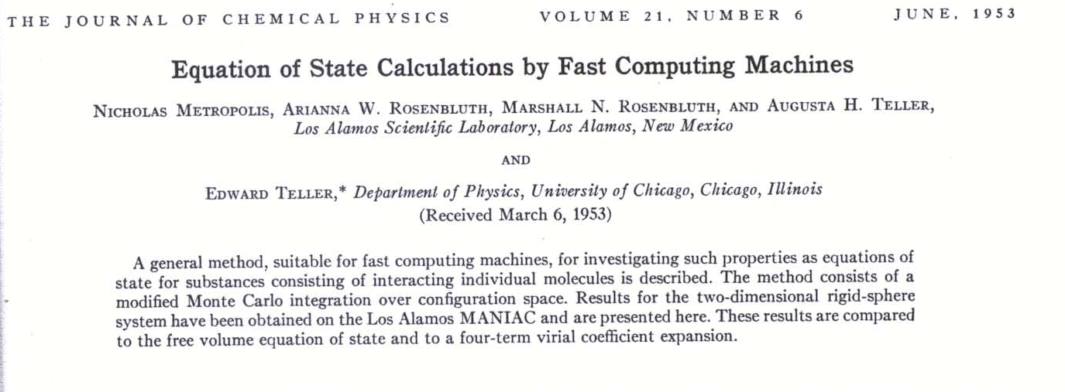
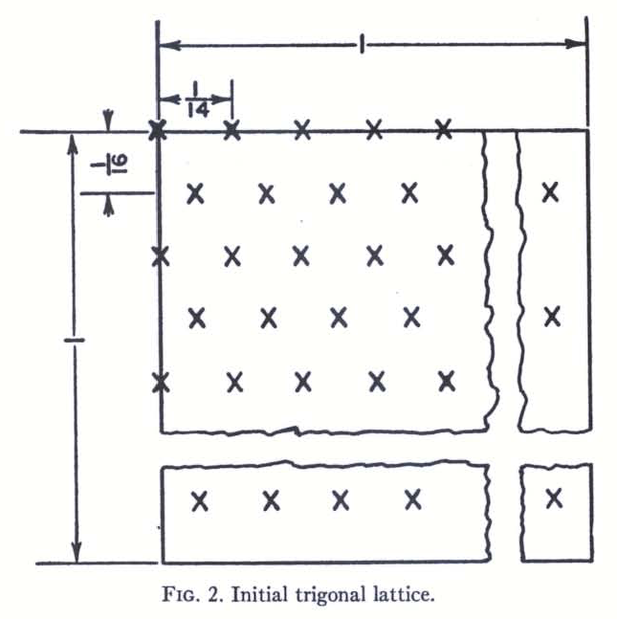
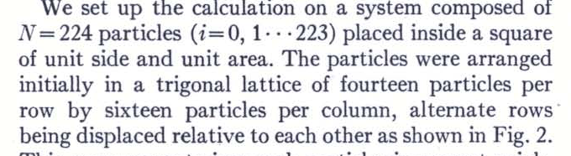
Prediction: exact means simulated:
Monte Carlo

Slide 3
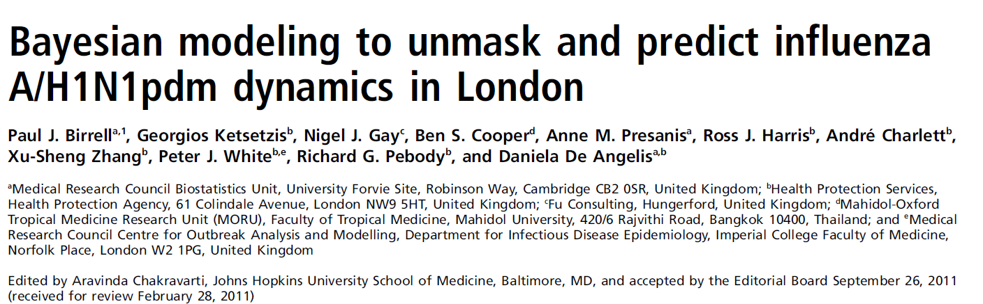
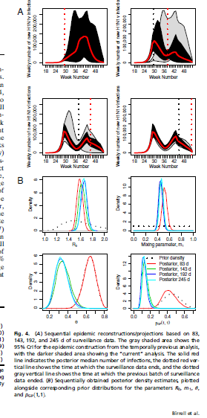
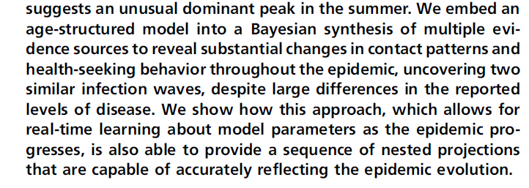
Simulated means open

Slide 4
Markov chain Monte Carlo changed our emphasis from “closed form” solutions to algorithms, expanded our impact to solving “real” applied problems and to improving numerical algorithms using statistical ideas, and led us into a world where “exact” now means “simulated”
Christian Robert and George Casella, 2008,18.

Slide 5
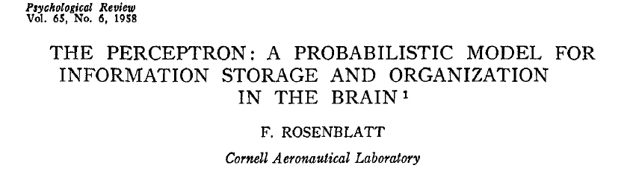
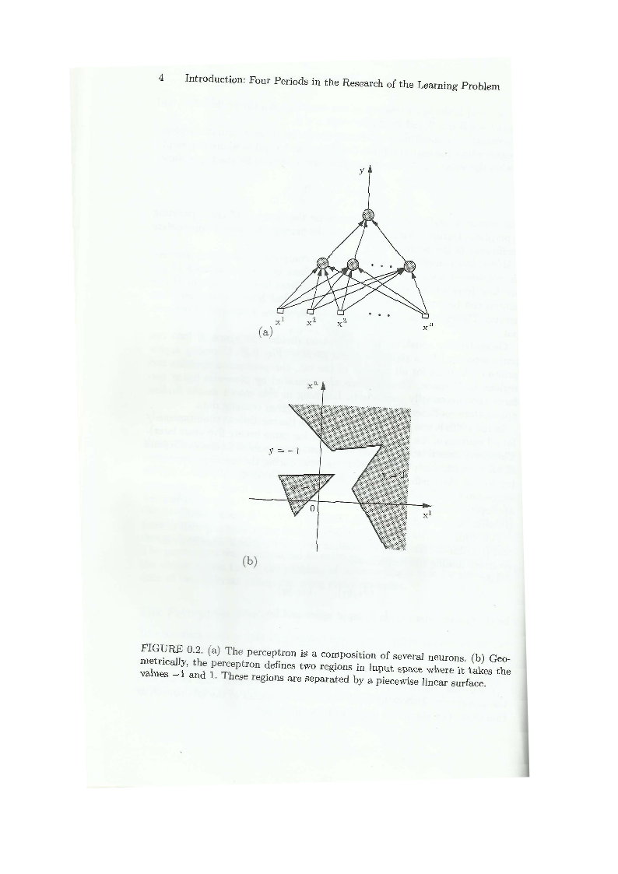
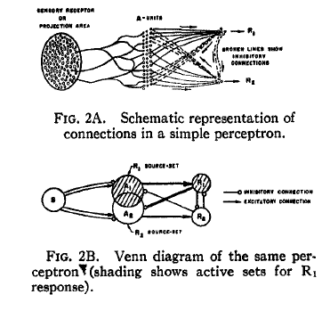
Optimise in order to classify: 1957
From the Perceptron to kittydar

Slide 6
Perceptron algorithm and the separating hyperplane

Slide 7
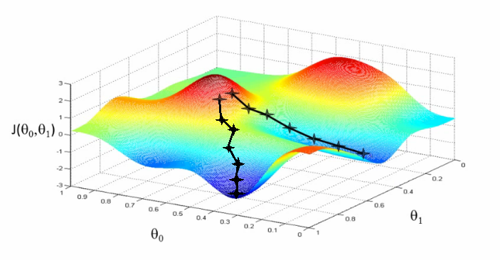
Optimisation – gradient descent

Slide 8
Kittydar and neural networks
http://harthur.github.io/kittydar/

Slide 9
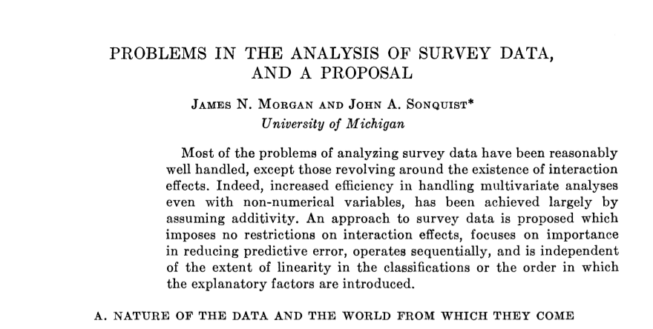
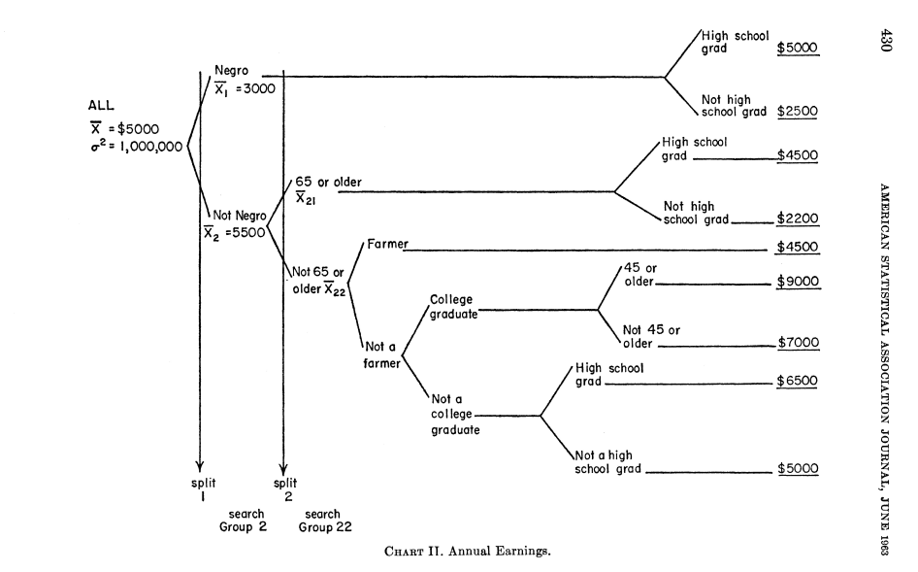
Classify: information and decision trees

Slide 10
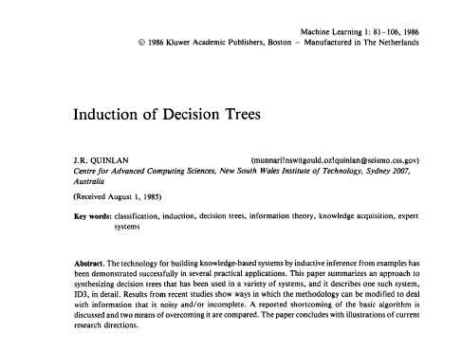
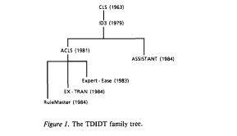
Classify: decision
The members of this family are sharply characterized by their representation of acquired
knowledge as decision trees.

Slide 11
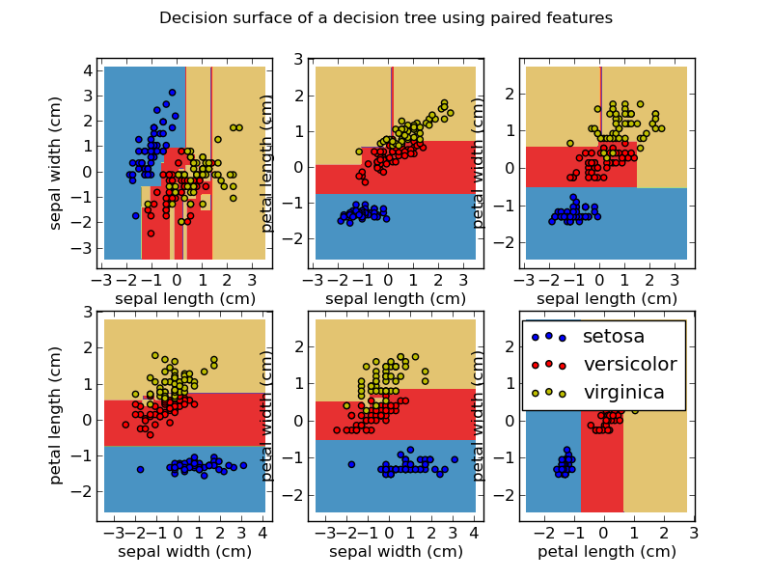
Decision tree

Slide 12
Random forests and Google Compute Engine
Google I/O Conference 2012

