Slide 1
Diagrammatic intensities: modelling methods from social physics to digital humanities
Adrian Mackenzie
Sociology, Lancaster University
a.mackenzie@lancaster.ac.uk

Slide 2
Machine learning knowledge today
Machine learning is not magic; it cannot get something from nothing. What it does is get more from less. Programming, like all engineering, is a lot of work: we have to build everything from scratch. Learning is more like farming, which lets nature do most of the work. Farmers combine seeds with nutrients to grow crops. Learners combine knowledge with data to grow programs.
Pedro Domingos, 2012, 81

Slide 3
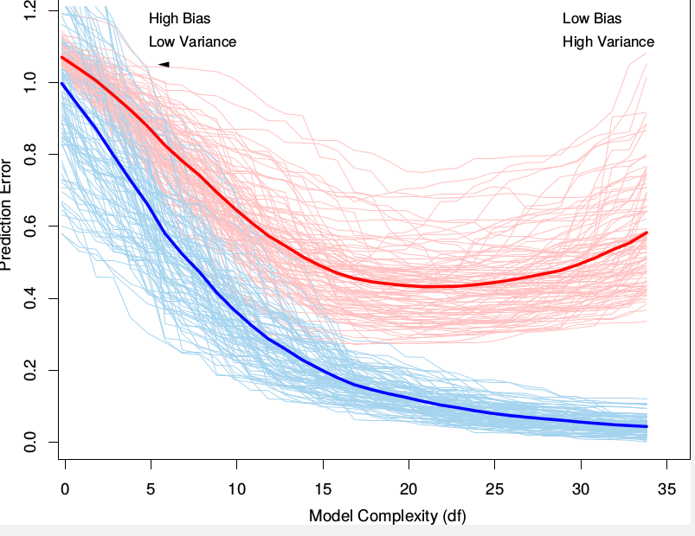

Slide 4
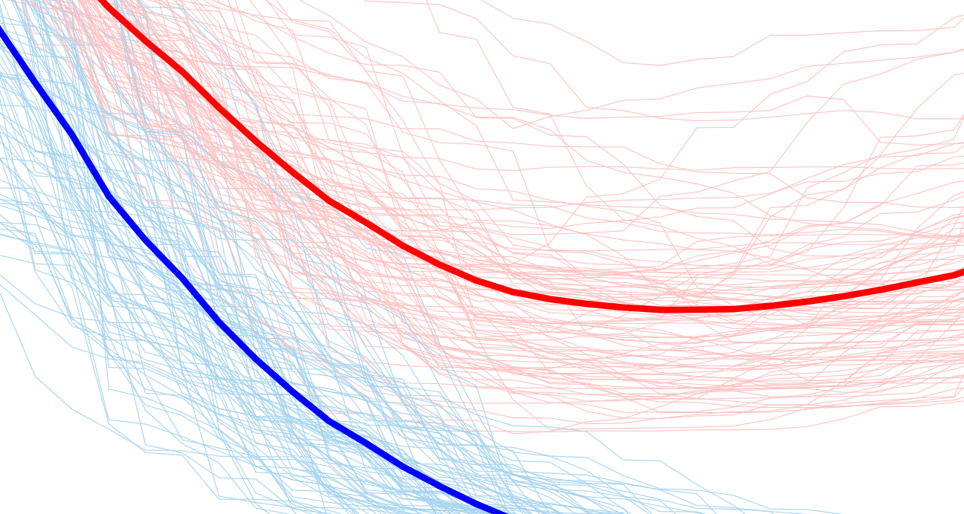

Slide 5
Relations to machine learning: social science
Just as the Internet radically changed the world by adding communications to computers, so too will big data change fundamental aspects of life by giving it a quantitative dimension it never had before 12
One of the areas that being most dramatically shaken up by N = all is the social sciences. They have lost their monopoly on making sense of empirical social data, as big-data analysis replace s the highly skilled survey specialists of the past. … More important, the need to sample disappears 30.
Big data is not about trying to “teach” a computer to “think” like humans. Instead, it's about applying math to huge quantities of data in order to infer probabilities. 12
(Mayer-Schonberger, Big Data, 2013)

Slide 6
Relations to machine learning: social physics
With the arrival of dense, continuous data and modern computation, we can now map out the details of society and build mathematical models of them. But these raw mathematical models are very far beyond most humans' understandings. They have too many variables and the relationships are too complex for the poor human mind. While these highly detailed and very mathematical models ar e good for building automatic systems for traffic, electric power,and the like, they are almost useless for guiding individual human decision making. 188-9
I believe there needs to be a dialogue between our human intuition and the big data statistics, something that is not built into most of our management systems today. Today most people have l ittle concept of how to use big data analytics, what they mean, and what to believe. A new language, one that goes beyond markets and classes and captures how detailed connections between peo ple determine change will help us develop this understanding. 189
Alex Pentland, Social Physics, 2014

Slide 7
Relations to machine learning: digital humanities
If the statistics are rather too complex to summarize here, I think it is fair to skip the mathematics and focus on the end results. We needn't know how long and hard Joyce sweated over Ulysses to appreciate his genius, and a clear understanding of the LDA machine is not required in order to see the beauty of the result. 124
Matthew Jockers, Macroanalysis, 2013

Slide 8
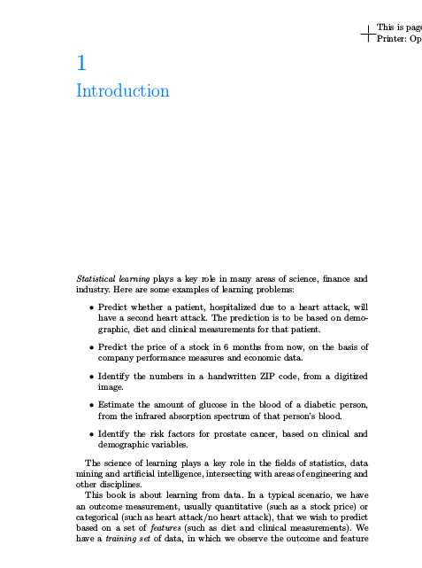
Hastie, T. et al. (2009) The Elements of Statistical Learning: Data Mining, Inference, and Prediction (2nd edition.). New York: Springer.

Slide 9
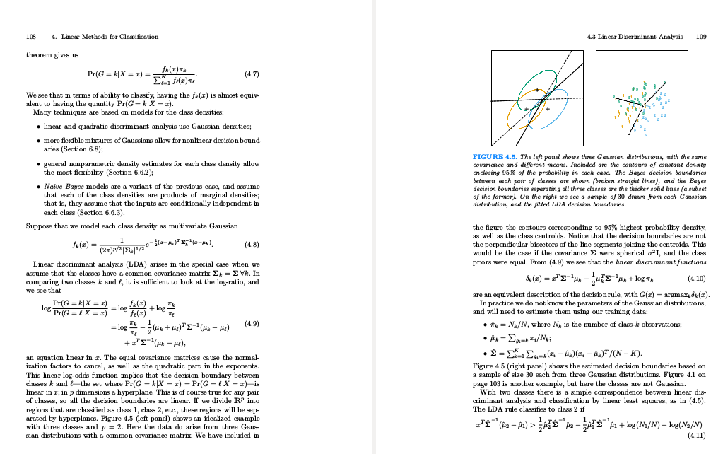

Slide 10
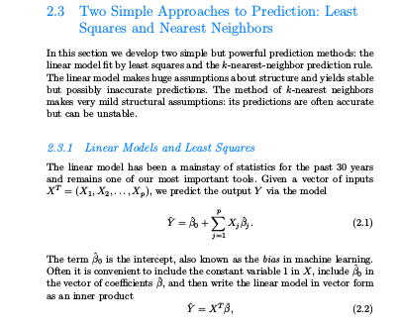

Slide 11
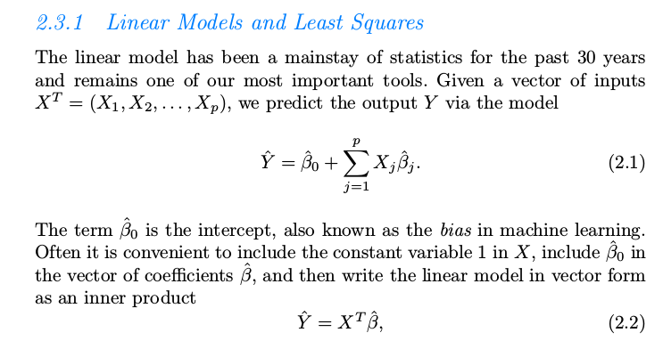

Slide 12
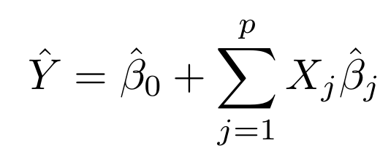
Equations – diagrams - icons
'Mathematical reasoning is diagrammatic' (Peirce)
Many diagrams resemble their objects not all in their looks; it is only in respect to the relations of their parts that their likeness consists.
C.S. Peirce, 'Of Reasoning in General', Essential Writings, volume 2, 13.

Slide 13
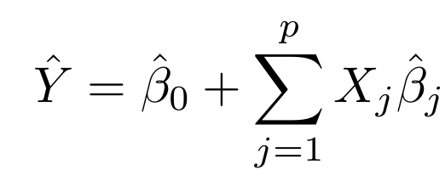
'Mathematical reasoning is diagrammatic' (Peirce)
As for algebra, the very idea of the art is that it presents formulae which can be manipulated, and that by observing the effects of such manipulation we find properties not to be otherwise discerned.
Peirce, Essential Writings, Volume 1, 228

Slide 14
Equations as diagrams
In such manipulations, we are guided by previous discoveries which are embodied in general formulae. These are patterns which we have the right to imitate in our procedure, and are the icons par excellence of algebra.
Peirce, Essential Writings, Volume 1, 228

Slide 15
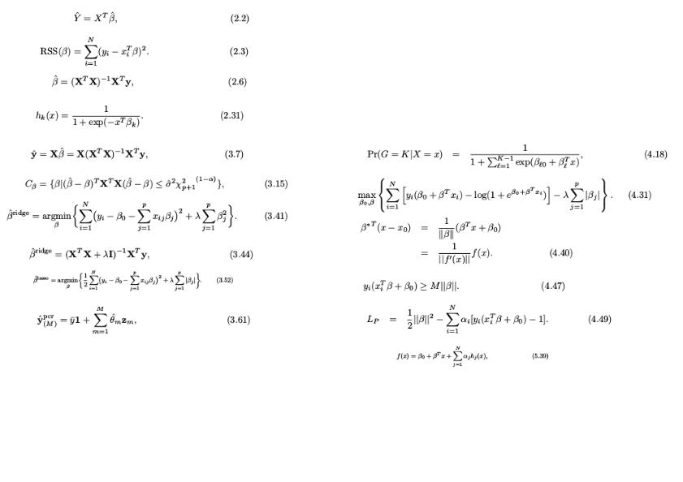

Slide 16
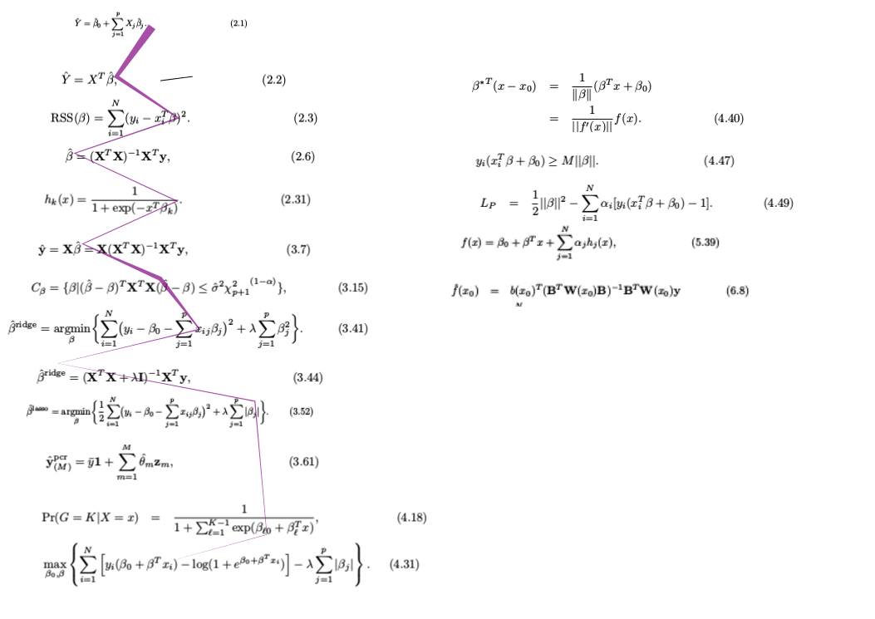
Transformations that diagonalize
We not only have to select the features of the diagram which it will be pertinent to pay attention to, but it is also of great importance to return again and again to certain features. ...
But the greatest point of art consists in the introduction of suitable abstractions. By this I mean such a transformation of our diagrams that characters of one diagram may appear in another as things.
Peirce, 'The Nature of Meaning', 212-213

Slide 17
Now mathematical reasoning is diagrammatic. But in order to discern the features of diagrammatic reasoning, it is requisite to begin with examples that are not too simple. In simple cases, the essential features are often so nearly obliterated that they can only be discerned when one knows what to look for.
Peirce, Nature of Meaning, 206

Slide 18
How to return to feature of diagrams?
“This course provides a broad introduction to machine learning and statistical pattern recognition. Topics include supervised learning, unsupervised learning, learning theory, reinforcement learning and adaptive control. Recent applications of machine learning, such as to robotic control, data mining, autonomous navigation, bioinformatics, speech recognition, and text and web data processing are also discussed.”
Course description, CS229, Stanford University, 2007, Andrew Ng

Slide 19
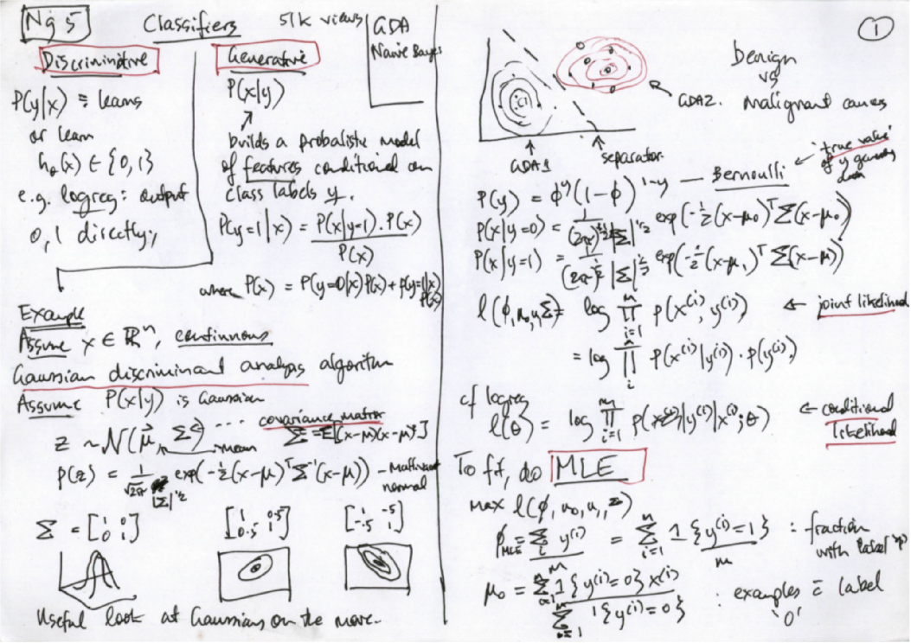
CS229, Stanford, 2007, Andrew Ng

Slide 20
Multiple returns to diagrams
If it is not removed from the practices that sustain it, reality is multiple. This may be read as a description that beautifully fits the facts. But attending to the multiplicity of reality is also an act. It is something that may be done – or left undone
A-M Mol, Body Multiple, 2003, 6

Slide 21
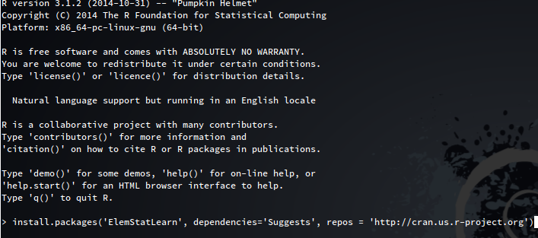
From Elements of Statistical Learning to ElemStatLearn

Slide 22
Machinic diagonalization in R
> The goal of the S [R] language ... is "to turn ideas into software, quickly and faithfully" ... it is the duty of the responsible data analysts to engage in this process ... the exercise of drafting an algorithm to the level of precision that programming requires can in itself clarify ideas and promote rigorous intellectual scrutiny. ... Turning ideas into software in this way need not be an unpleasant duty.
Venables and Ripley, Modern Applied Statistics with S, 2000, 2

Slide 23
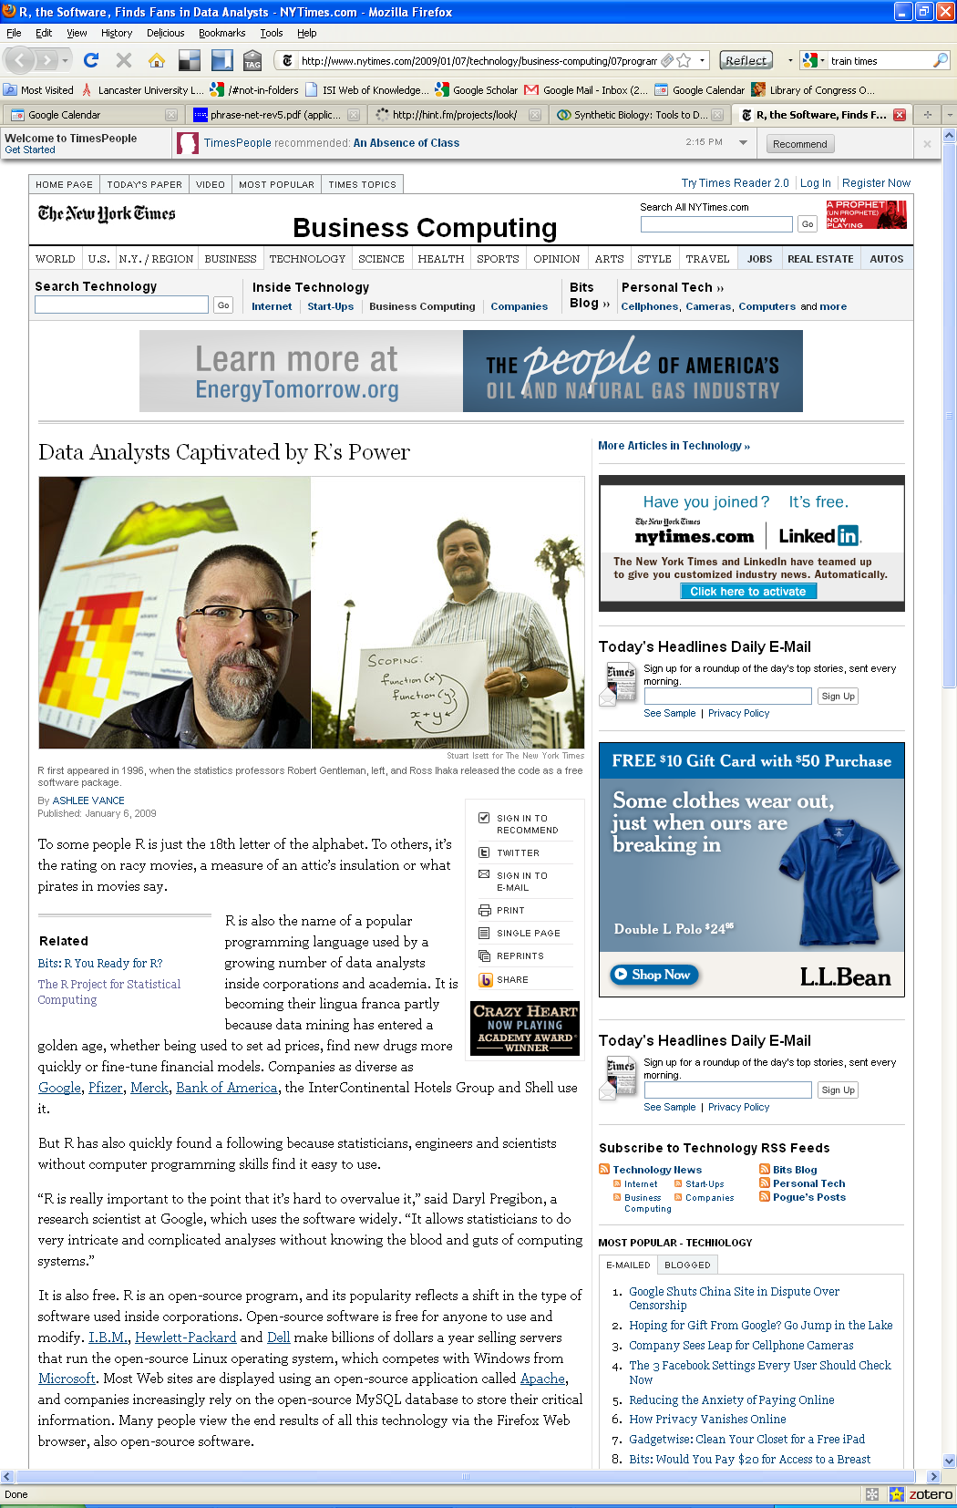
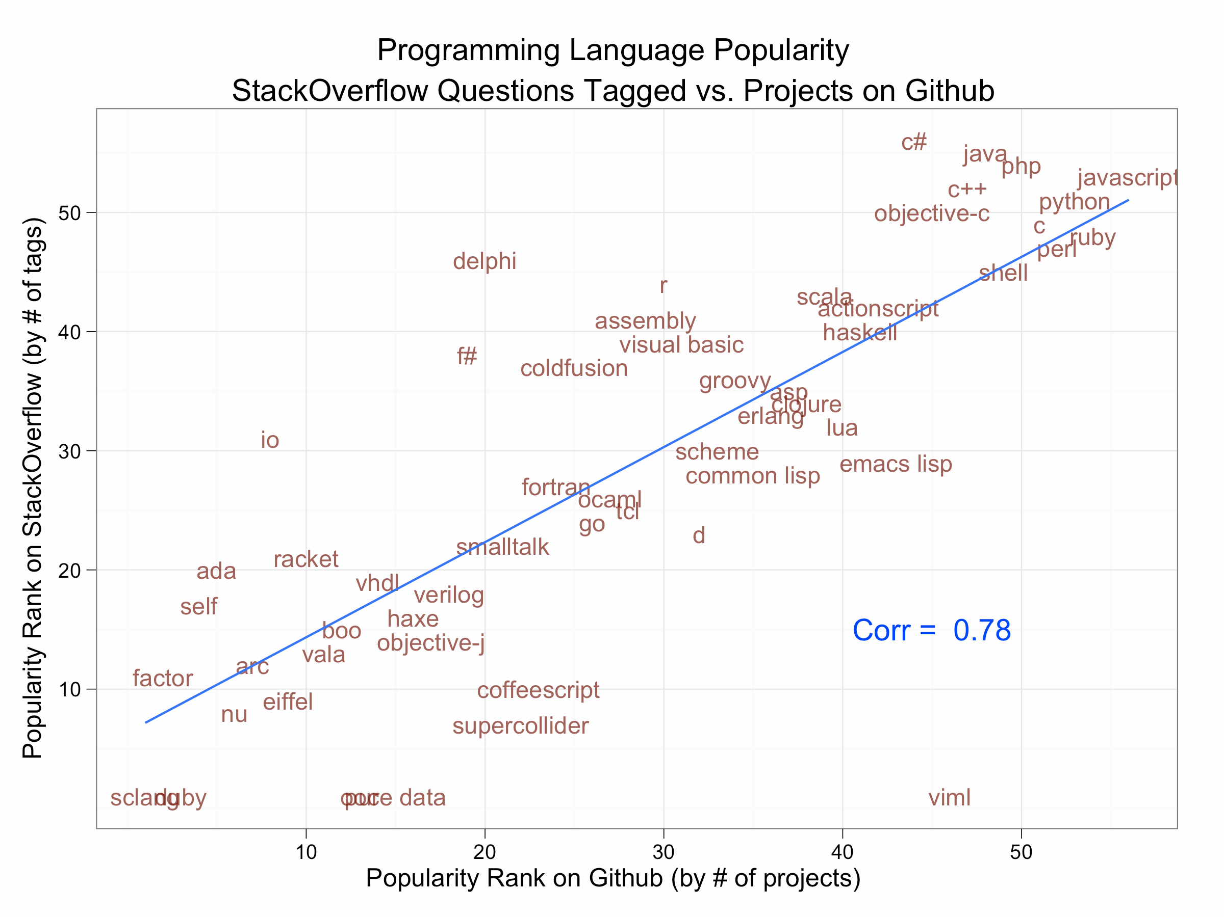
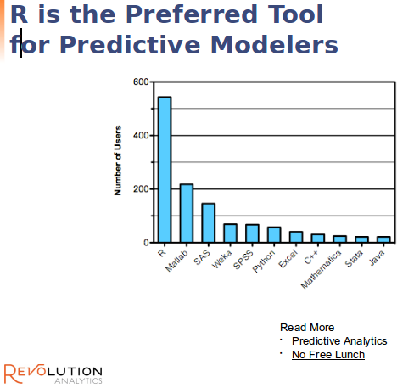

Slide 24
Conclusions
Relations to machine learning:
infer probabilities?
New language of human intuition?
Appreciate beauty of the results?

Slide 25
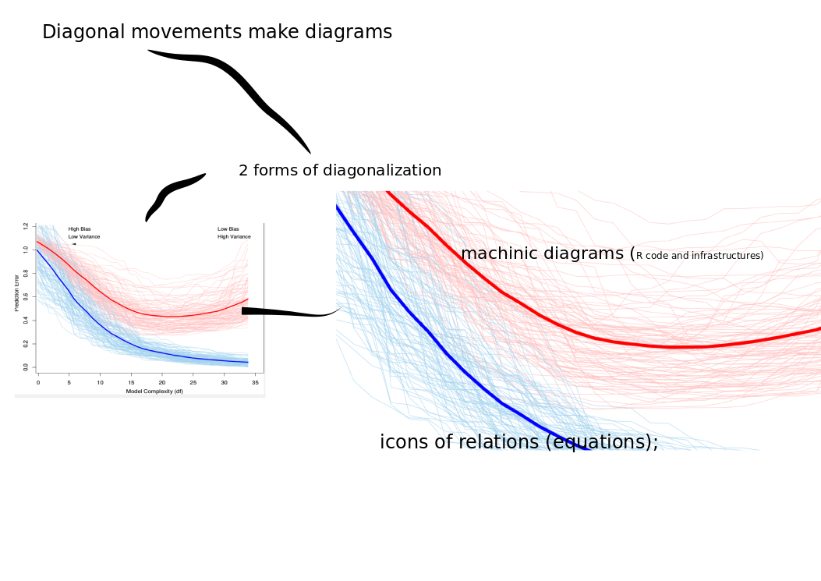
forms of diagonalization –
through icons of relations (equations);
through machinic diagrams (R code and infrastructures)

