Slide 1
Lesser Amazons: machine learning and difference
Adrian Mackenzie
Sociology, Lancaster

Slide 2
Part I: Machine learning as engine of difference?

Slide 3
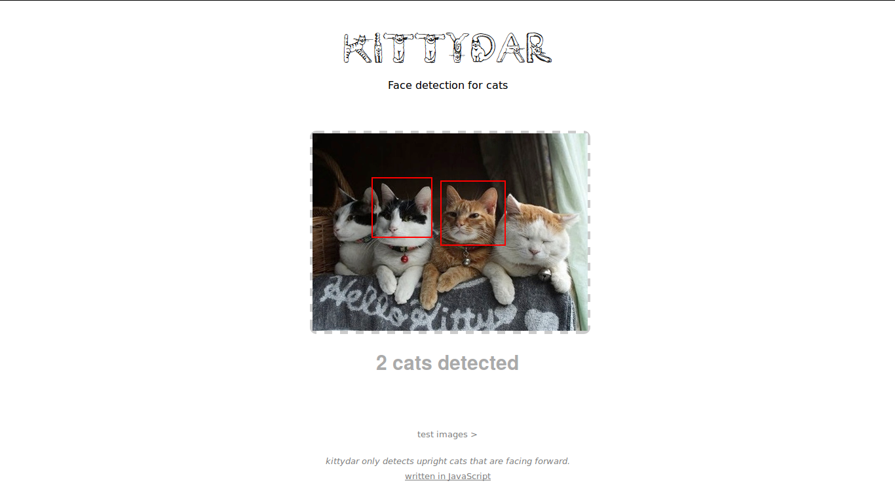

Slide 4
>In the past fifteen years, the growth in algorithmic modeling applications and methodology has been rapid. It has occurred largely outside statistics in a new community—often called machine learning—that is mostly young computer scientists . The advances, particularly over the last five years, have been startling Leo Breiman, 'Two cultures of statistics', 2001,200
>Definition: A computer program is said to learn from experience E with respect to some class of tasks T and performance measure P, if its performance at tasks in T, improves with experience E.
Tom Mitchell, Machine Learning 1997, 2
>The key question isn't 'How much will be automated?' It's how we'll conceive of whatever _can't_ be automated at a given time. Jaron Lanier, 2013, Who Owns the Future, 2013, 77

Slide 5
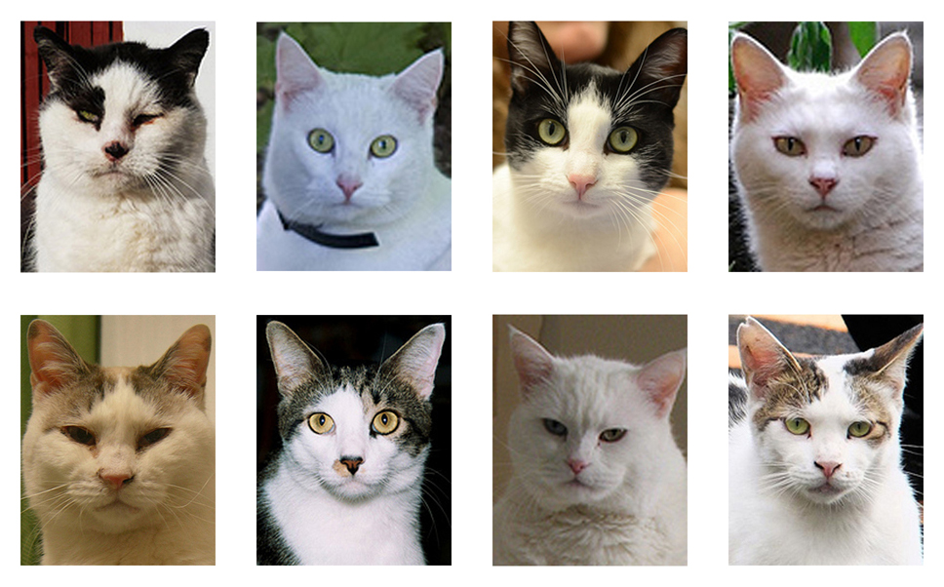

Slide 6
>Kittydar first chops the image up into many “windows” to test for the presence of a cat head. For each window, kittydar first extracts more tractable data from the image's data. Namely, it computes the Histogram of Orient Gradients descriptor of the image, using the hog-descriptor(http://github.com/harthur/hog-descriptor) library. This data describes the directions of the edges in the image (where the image changes from light to dark and vice versa) and what strength they are. This data is a vector of numbers that is then fed into a neural network (https://github.com/harthur/brain) which gives a number from 0 to 1 on how likely the histogram data represents a cat. The neural network has been pre-trained with thousands of photos of cat heads and their histograms, as well as thousands of non-cats. See the repo for the node training scripts
Heather Arthur

Slide 7
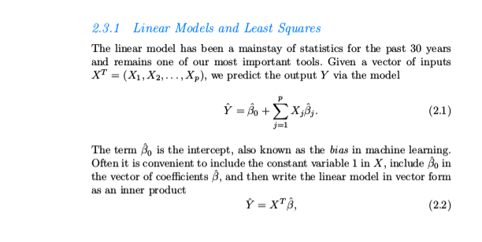
>neural network models consist of sums of non-linearly transformed linear models
Hastie, et. Al Elements of Statistical Machine Learning, 2009

Slide 8
Part II: Abstractions or?

Slide 9
> The experience of the transcendence of scientific objects, especially mathematical ones, … is the particular form of illusio which arises in the relationship between agents possessing the habitus socially required by the field and symbolic systems capable of imposing their demands on those who perceive them and operate them, and endowed with an autonomy closely linked to that of the field (which explains why the sense of transcendent necessity rises with the capital of accumulated resources and the qualifications demanded for entry)
Bourdieu, Pascalian Meditations, 2000, 113-114

Slide 10
> What is decisive is the entirely un-Platonic subjection of geometry to algebraic treatment, which discloses the modern idea of reducing terrestrial sense data and movements to mathematical symbols. Without this non-spatial symbolic language Newton would not have been able to unite astronomy and physics into a single science, or to put it another way, to formulate a law of gravitation where the same equation will cover the movements of heavenly bodies in the sky and motion of terrestrial bodies on earth. Even then it was clear that modern mathematics, in an already breathtaking development, had discovered the amazing human faculty to grasp in symbols those dimensions and concepts which at most had been thought of as negations and limitations of the mind, because their immensity seemed transcend the minds of mere mortals
Yet even more significant than this possibility – to reckon with entities which could not be "seen" by the eye of mind – was the fact that the new mental instrument, in this respect even newer and more significant than all the scientific tools it helped to devise, opened the way for altogether novel mode of meeting and approaching nature in experiment
Hannah Arendt, The Human Condition, 1998, 265

Slide 11
With the rise of modernity, mathematics does not simply enlarge its content or reach out into the infinite to become applicable to the immensity of an infinite and infinitely growing, expanding universe, but ceases to be concerned with appearances at all. ... it becomes instead the science of the structure of the human mind
Arendt, 266

Slide 12
>Under this condition of remoteness, every assemblage of things is transformed into a mere multitude, and every multitude, no matter how disorder, incoherent, and confused, will fall into certain patterns and configurations possessing the same validity and no more significance than the mathematical curve, which as Leibniz once remarked, can always be found between points thrown at random on a piece of paper.
Arendt, 267.

Slide 13
>Contemporary labor has introjected into itself many characteristics which originally marked the experience of politics. Poiesis has taken on numerous aspects of praxis
Paolo Virno, The Grammar of the Multitude, 2004, 50

Slide 14
Part III: Potential for Prediction

Slide 15
'prediction takes down potential'
Anna Munster, An Aesthesia of Networks 2013

Slide 16
> Surely this must be a primary task for critical enquiry – to uncover and probe the moments that come together in the making of a calculation that will automate all future decisions. To be clear, I am not proposing some form of humanist project of proper ethical judgement, but rather calling for attention to be paid to the specific temporalities and norms of algorithmic techniques that rule out, render invisible, other potential futures.
Louise Amoore, 'Data Derivatives On the Emergence of a Security Risk Calculus for Our Times', 2011

Slide 17
>When using quantitative methodologies in the academy (spidering, sampling, surveying, parsing, and processing), one must compete broadly with the sorts of media enterprises at work in the contemporary technology sector. A cultural worker who deploys such methods is little more than a lesser Amazon or a lesser Equifax.
Alex Galloway, 'The Cybernetic Hypothesis', 2014, 110

Slide 18
>But beyond the challenge of unequal talent and resources is the question of critical efficacy. Is it appropriate to deploy positivistic techniques against those self-same positivistic techniques? In a former time, such criticism would not have been valid or even necessary. Marx was writing against a system that laid no specific claims to the apparatus of knowledge production itself—even if it was fueled by a persistent and pernicious form of ideological misrecognition. Yet, today the state of affairs is entirely reversed. The new spirit of capitalism is found in brainwork, self-measurement and self-fashioning, perpetual critique and innovation, data creation and extraction. In short, doing capitalist work and doing intellectual work—of any variety, bourgeois or progressive—are more aligned today than they have ever been.
Galloway, 2014

Slide 19
Algorithms are actual entities imbued with discrete infinities that can also be defined as incomputab le probabilities. … In other words, infinite objects are not outside computation: they are the indeterminate condition through which algorithms become actual modes of thought. Speculative computation, therefore, does not mean that algorithms project the present (or past) into the future, but rather that algorithms introduce discrete infinities into actualities.
Luciana Parisi, Contagious Architecture: Computation, Aesthetics and Space 2013, 175-176
This peculiar mode of thought is not equivalent to a predictive model of probability (which would predict the future through the probabilities of the past), but instead needs to be understood in terms of speculative computation, which entails the probabilities of infinities. Parisi, 2013, 194

Slide 20
'a machine to put into equivalence endowed with the power to confer a unique form on the diversity of empirical situations.'
a history that as it unfolds invents new meanings for what we refer to as "abstract" and "concrete" 131
Stengers, Cosmopolitics I, 2010

Slide 21
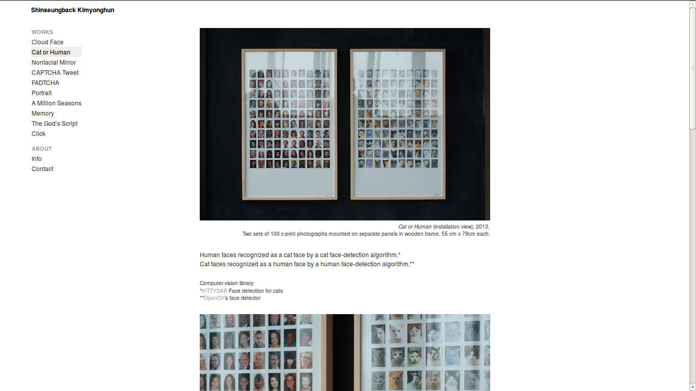

Slide 22
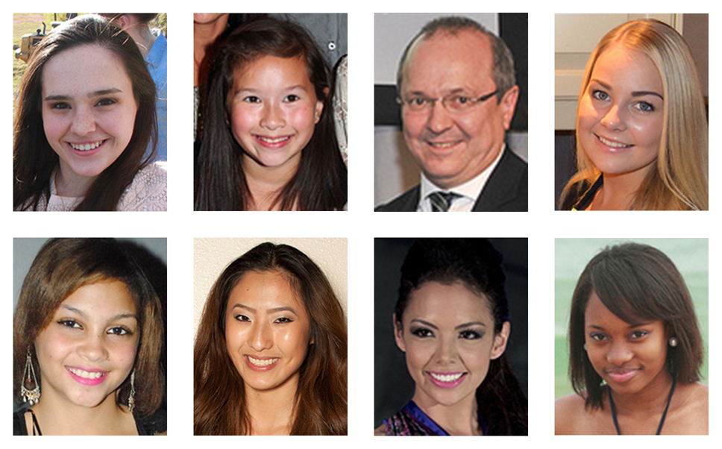

Slide 23
Conclusions
Felt (of) abstractions
The tensions between prediction and potential
The event of prediction

