Slide 1
Interdisciplinary space/ethos and publication
Adrian Mackenzie
Sociology, Lancaster
a.mackenzie@lancaster.ac.uk

Slide 2
Accountability & innovation vs ontological change
>the forms of interdisciplinary research addressed by our project have been explicitly or implicitly driven not only by the rationales of fostering accountability or innovation, but by an orientation towards effecting ontological change. This may be manifest, as we will show, in intentions to re-conceive both the object(s) of research and the relations between research subjects and objects.
Andrew Barry & Georgina Born, 2008, 25

Slide 3
Interdisciplinary vignettes
Vignette = 'small vine'
Vignette = graphic embellishment

Slide 4
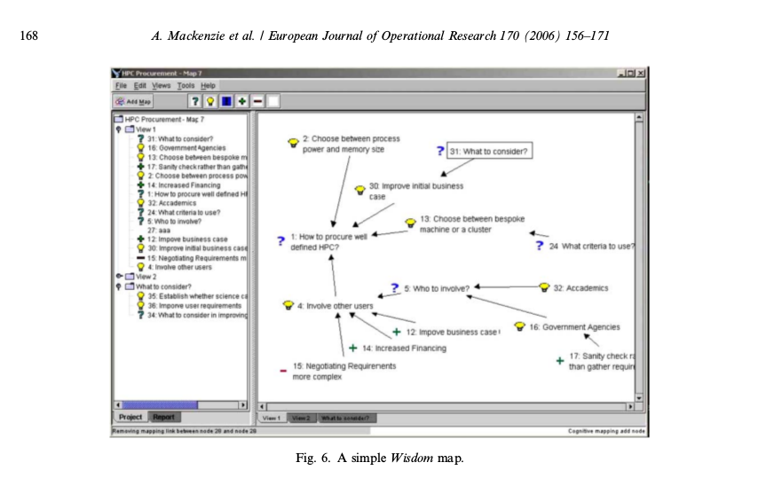

Slide 5
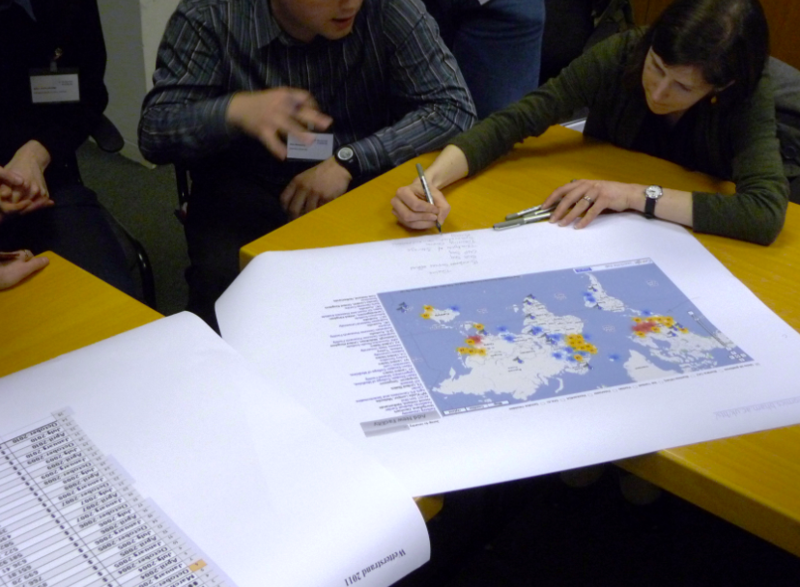
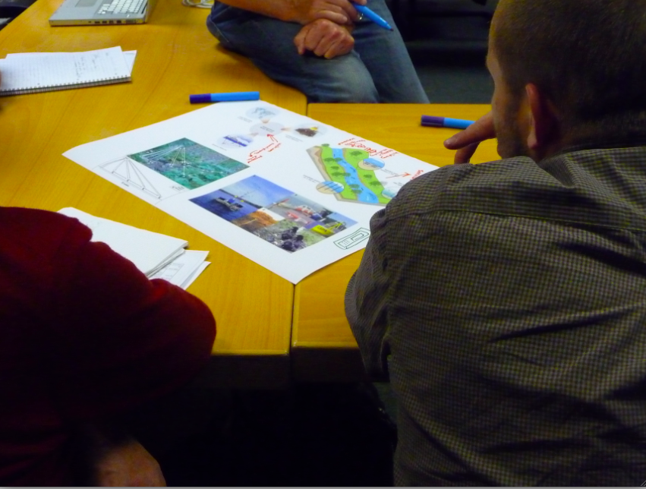
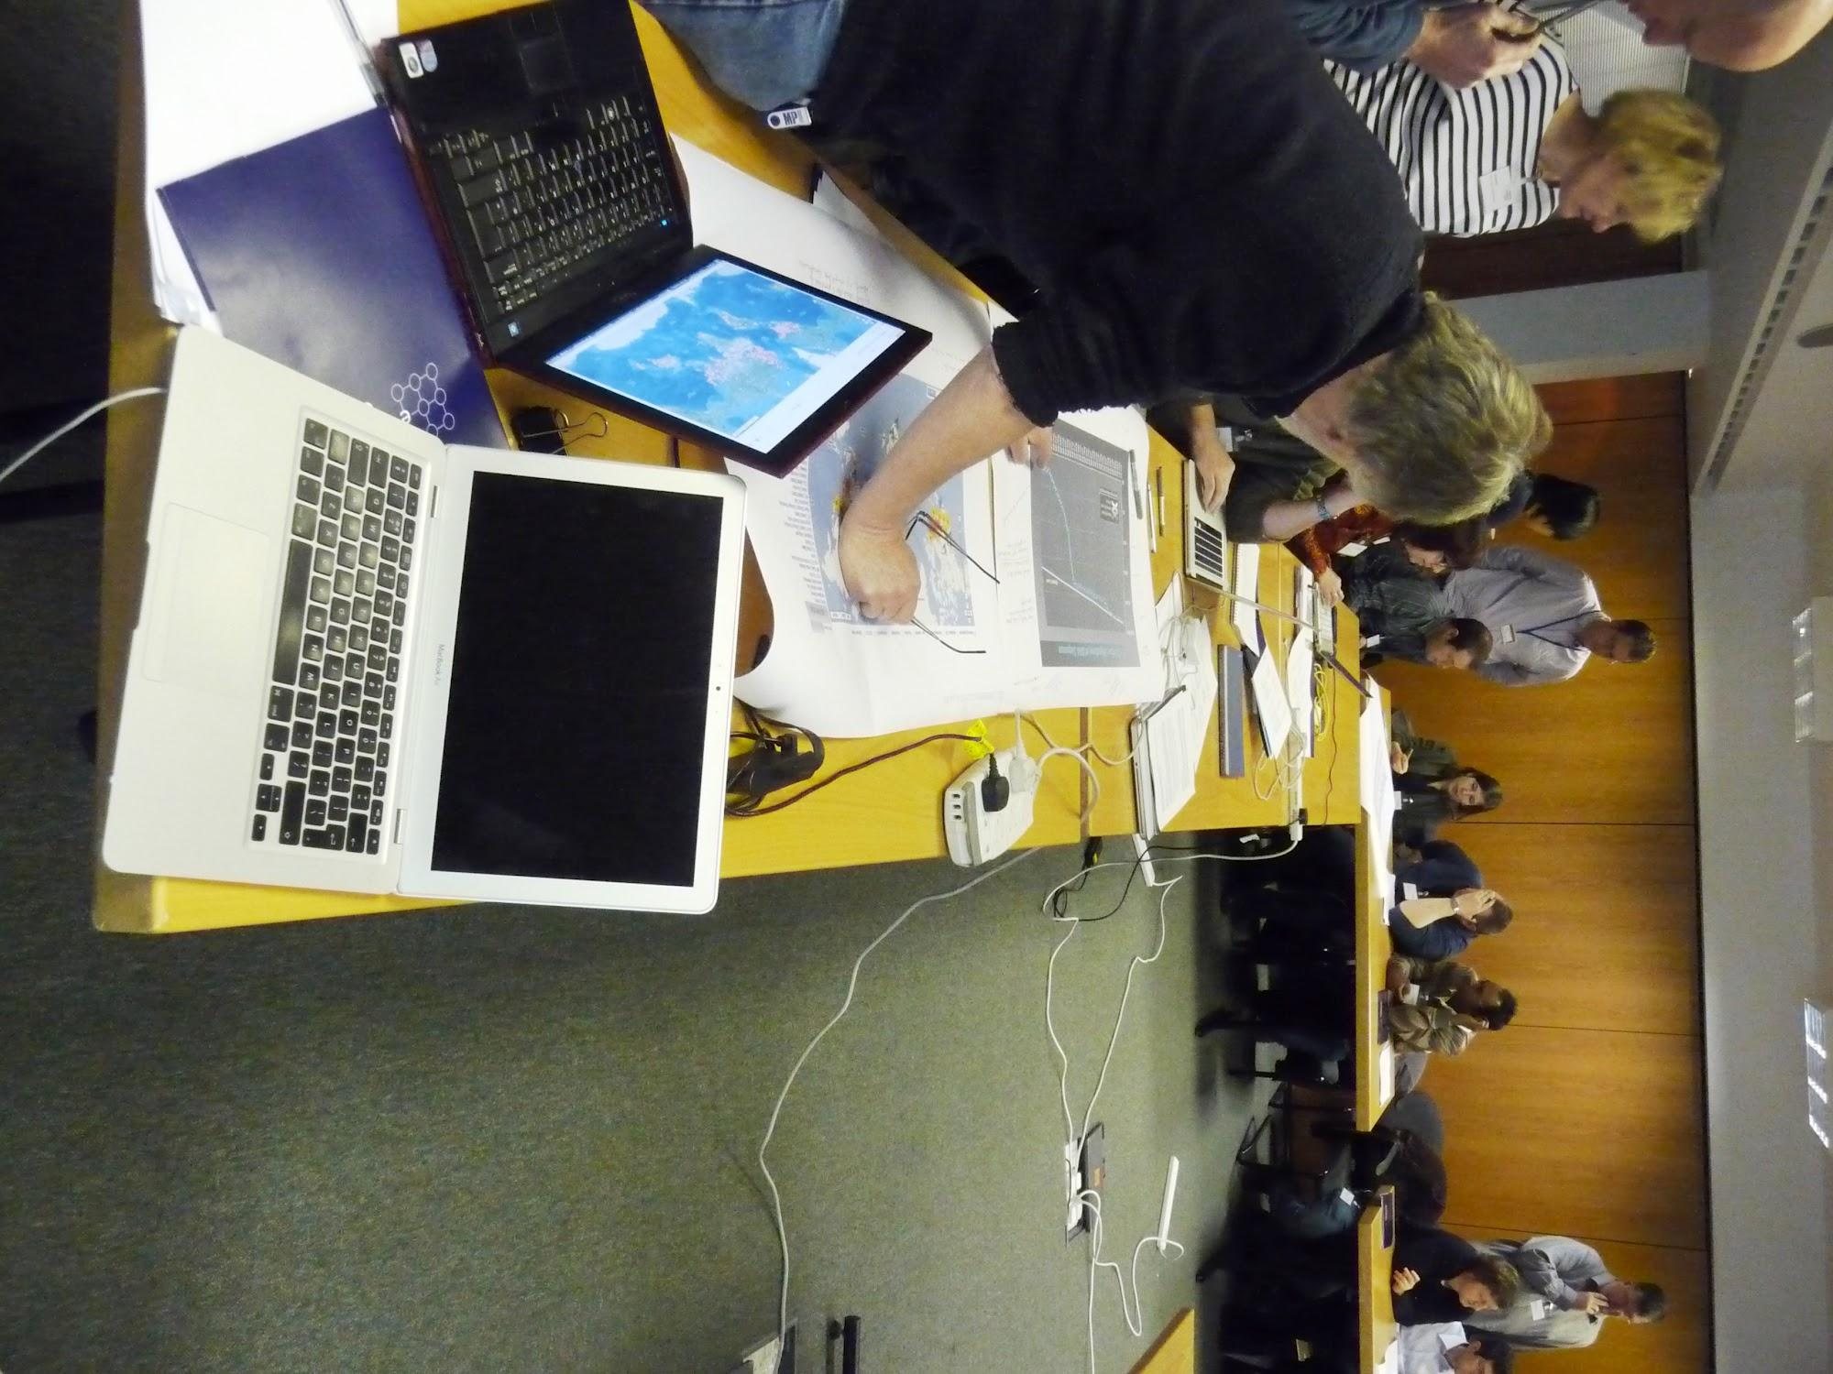
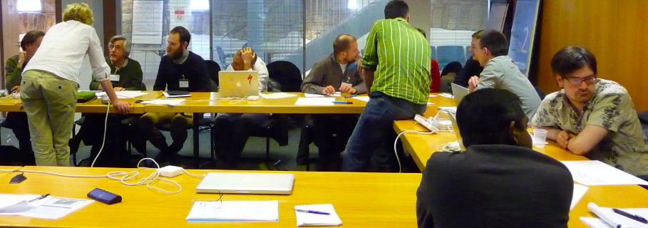

Slide 6
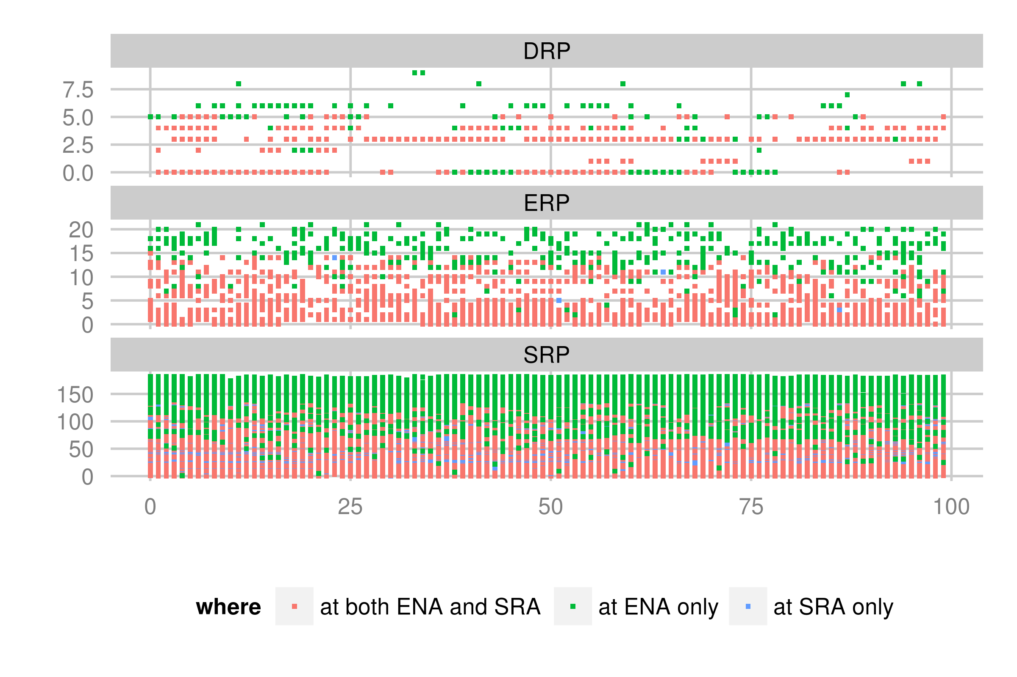
Sameness of data?

Slide 7
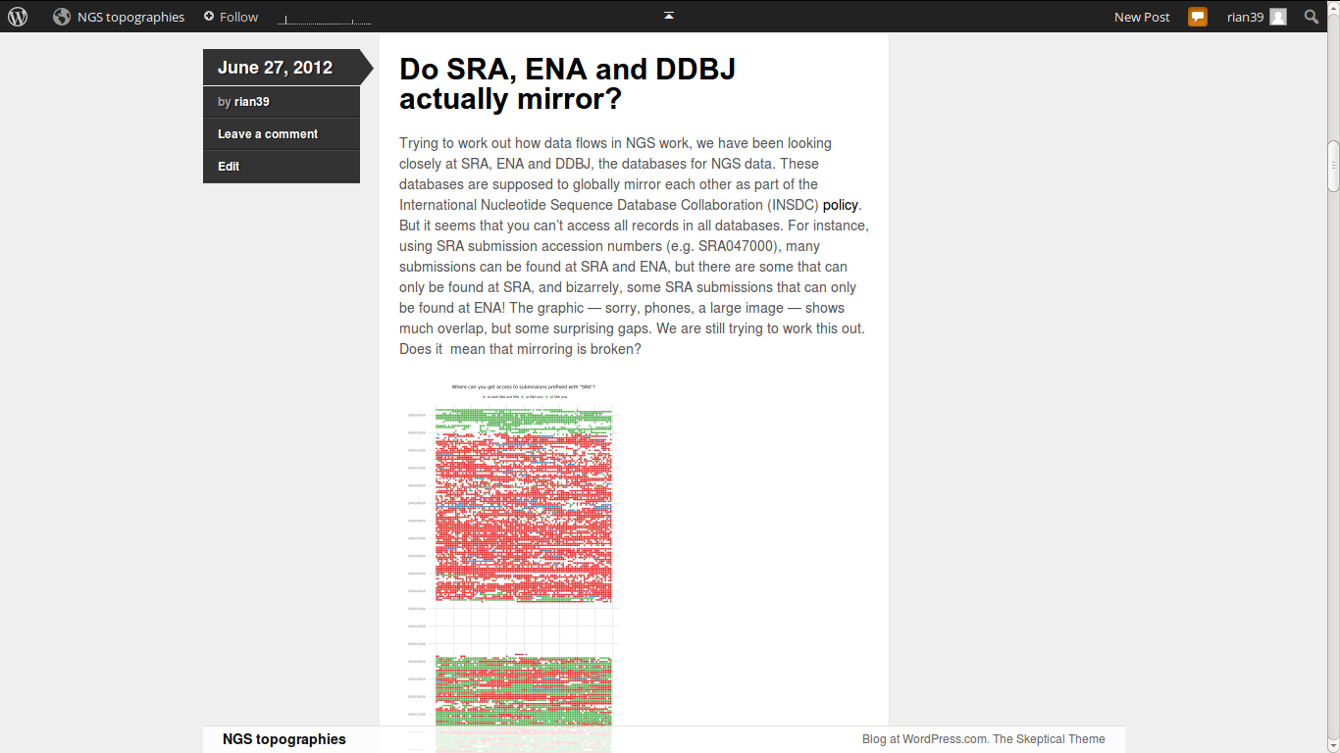

Slide 8
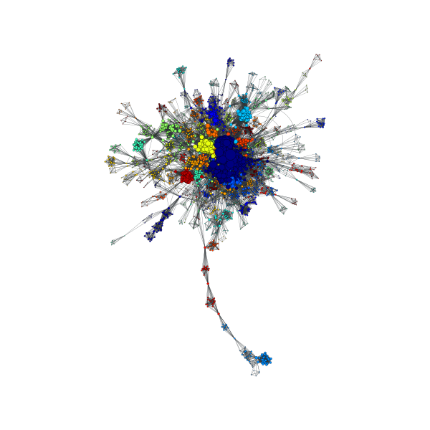
Authorship network for research articles linked to sequence data in Short Read Archive
Notes:
AM: co-author networks for sequence data in Short Read Archives
The co-author network shows that the machines are not working in a void, but within scientific communities where people are quite connected with each other. Hence, the network of co-authors. This socialises the flow of data in important ways, but we don’t know yet exactly how?
Impossibility of capturing the social, although it is possible to assemble the social from the data.

