Slide 1
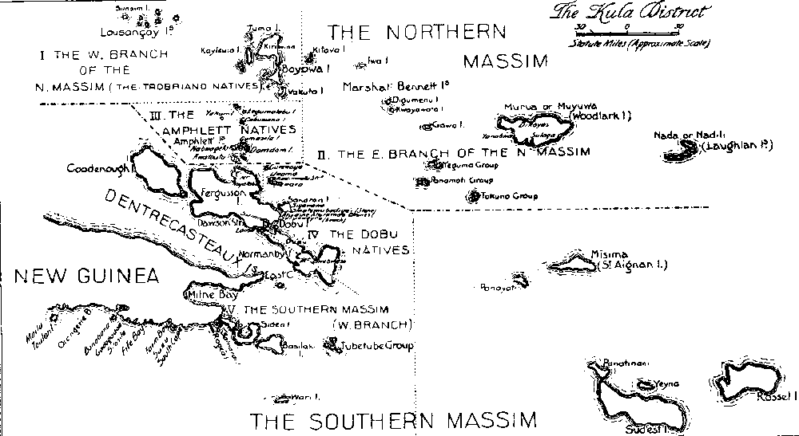
Week 6: Ethnography – studying what people do with things

Slide 2
Overview
Ethnography: history and development
Ethnographies of media and audiences
Ethnographies of people and things
Group research work
Preparation for interview with an ethnographer
Interview with Adam Fish

Slide 3
Review
Semiotics and textual methods
Discourse analysis – saying and seeing; statements and practices;
Little direct emphasis here on audiencing, spectating, using, etc.

Slide 4
Ethnography – general
ethno: nation, people, culture (things, network)
graph: draw, write, (narrate, record, chronicle)
ethnography: writing, drawing, (telling) about the people, phenomenon, network
Ethnography: the scientific description of races and peoples, with their customs, habits and mutual differences
(Shorter OED 5th ed, 2002)

Slide 5
Ethnography uses a range of tools and techniques to write, record, draw the ‘people, culture, network’….
Why?
Because what people/networks say/project, and what they do are different
Because a sensitive, reflexive account can only be made by ‘being there’
Give voice to the other?
How?
By becoming part of the everyday life of the people, group, network

Slide 6
But scrupulous, methodological reflexivity is essential………the careful, detailed account of the researcher’s positioning allows the ethnography to claim a (modest) objectivity, rather than the presumed subjectivism of qualitative work
Haraway (1988) Situated Knowledges: the science question in feminism and the privilege of the partial perspective

Slide 7
Ethnography as writing practice
The making of ethnography is artisanal, tied to the worldy work of writing (Clifford 1986: 6).
Cultures are not scientific 'objects' (assuming such things exist, even in the natural sciences). Culture, and our views of 'it,' are produced historically, and are actively contested (Clifford 1986: 18).

Slide 8
Ethnography – general
Main method in cultural/social anthropology; very important in urban sociology, media sociology and cultural studies
Focuses on one case or place – the 'field site' where an ethnographer does 'fieldwork'
Sustained personal contact between researcher and people they research
Looks at the whole situation over time

Slide 9
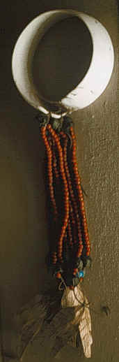
The 'field'
Notion of 'field site' develops in late 19 century, based on 'field sciences' (like geology)
'the field' in 20th century anthropology usually meant somewhere remote (New Guinea, Uganda, etc.)
'the field' in late 20th century ethnography included places close to home
Choice of field often affected by problems of access (who, where, when)

Slide 10
When/where is ethnography?
‘Single’ site studies (e.g. one hospital)
Multi-sited ethnography (life world, system) - following things, metaphors, conflicts between placed
Digital/virtual ethnography - online worlds: “a-sited”, uncertain of time, location, presence
  But are online/offline worlds not coexistent?

Slide 11
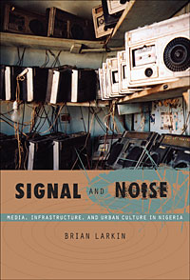
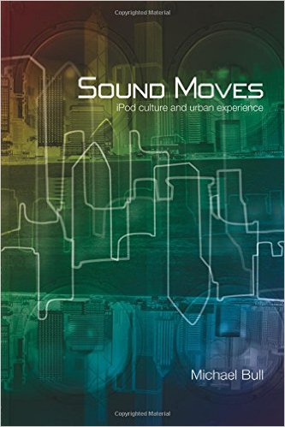
Ethnography as method for studying media in the social world
2 approaches
  Study how audiences make sense of media
  Study how media circulate and act in the world as things

Slide 12
How people make sense of media
Ethnographic studies of audiences, fans, and users
Observe how audiences make sense ('decoding' – Hall) of particular media, and how their sense-making relates to social and cultural identity
Explore how fans closely observe, interpret and transform across media (tv, music, blogs, etc)
Examine how users move across media in 'convergence cultures' as does content (see Fish, reading for today!)

Slide 13
How to study audiences
Earlier studies (1980s on) tend to use interviews that explore how people make sense of media
One-on-one; family; group;
Selection of people to interview will be shaped by what you think is important (class, gender, etc.)
Analysis of interviews – reading and reading; identify different clusters of meaning; link clusters to social or discursive positions

Slide 14
How to study audiences ethnographically
Observe, listen and talk to people as they go about everyday lives
Involves extended periods of time spent in 'the field'
'data' is gathered primarily by taking notes (sometimes photos and audio recording), and then writing notes up

Slide 15
Ethnography and media objects
Much ethnography focuses on what people do and make (images, objects, etc)
Study what people do with things (devices, technologies, products) in order to understand social relations and identities.
More focused on people as 'users' than as 'audience'

Slide 16
How to ethnographically study things like media?
Pay attention to where and how media objects engage people: visual form, material form, presentational form
Examine how things and people are co-constituted: look at what is actually done where, and by whom
Track mobility of things and how they are re-contextualised: look at the same thing in different places (public, private)

Slide 17
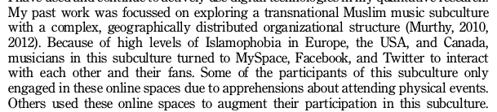
Digital ethnography: access new places
Murthy, 2013, 26
different platforms with different sub-cultures, etc

Slide 18
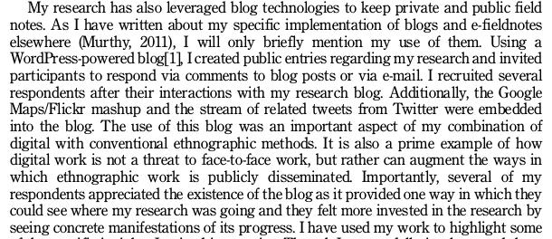
Digital ethnography as engagement
Ethnographers use digital platforms to relate to their field sites
  Widen the range of participants
  Deal with sensitive issues around identity
Murthy, 2013, 27

Slide 19
Digital ethnography as new mode of writing
Digital media as both object of research and research tool
Smartphones permit use of video and audio as documentation
Digital devices offer new ways of being present in the field
New ethical challenges -- how to anonymize?

Slide 20
Exercise: 'the field' in your group research project
List three specific places that you could study (given a few weeks!) as ethnographic field sites for your group research project
List some of the people you would want to meet, talk to and spend time with in these places.
List some of the things, artefacts, practices or events you would want to observe or participate in as an ethnographer.
How would you address the problems of access to sub-cultures, elites, niche social movements or marginal/vulnerable groups?
Write 300-500 words documenting the above.

Slide 21
Interview preparation
In your groups, construct 3 questions about doing ethnography, with a particular focus on
  How to participate in field sites ethnographically
  How to study people's relation to each other and to things (platforms, devices, etc.)

Slide 22
Next week
'Live methods'
Recent work on digital ethnography and digital methods

