Slide 1
Week 7: Ethnography and live methods

Slide 2
Overview
Media/cultural studies, commercial ethnography and 'live methods'
Introduction to live digital methods
Group research projects
Preparation for interview on ethnographic and live methods with Joe Deville
Interview

Slide 3
Review of ethnography in media and cultural studies
Ethnography as practice of writing about experience of particular place/time ('field site') as lived by people:
  Ethnographer's own experience and participation in the field site provides the 'data'
  Writing transforms 'data' into the ethnography
2 main approaches
  Ethnography as way of observing how media is used – by audiences, by fans, by social groups
    e.g. go into food outlets on campus, and observe how people mix media with everyday social life.
  Ethnography as study of how media objects circulate and are transformed
    How to do this? (Today: digital live methods?!)

Slide 4
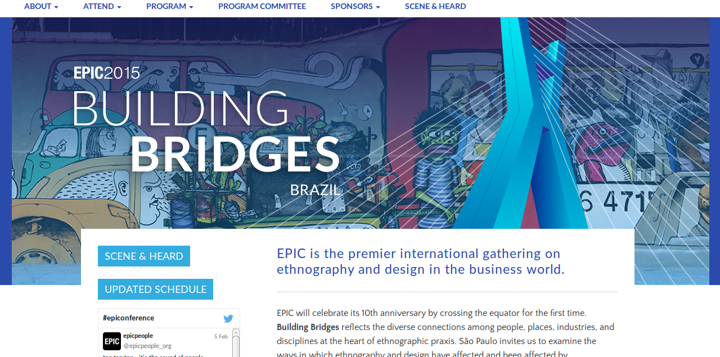
Ethnography as commercial method

Slide 5
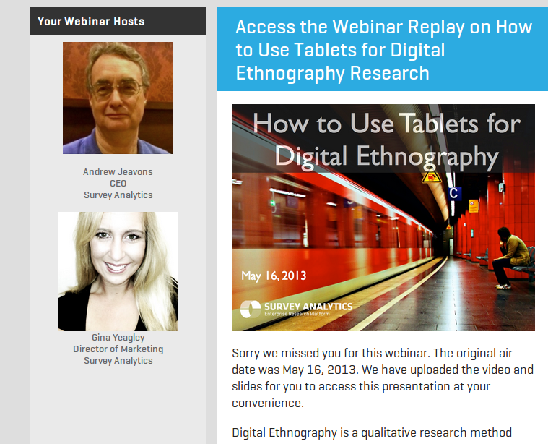
Ethnography as commercial method

Slide 6
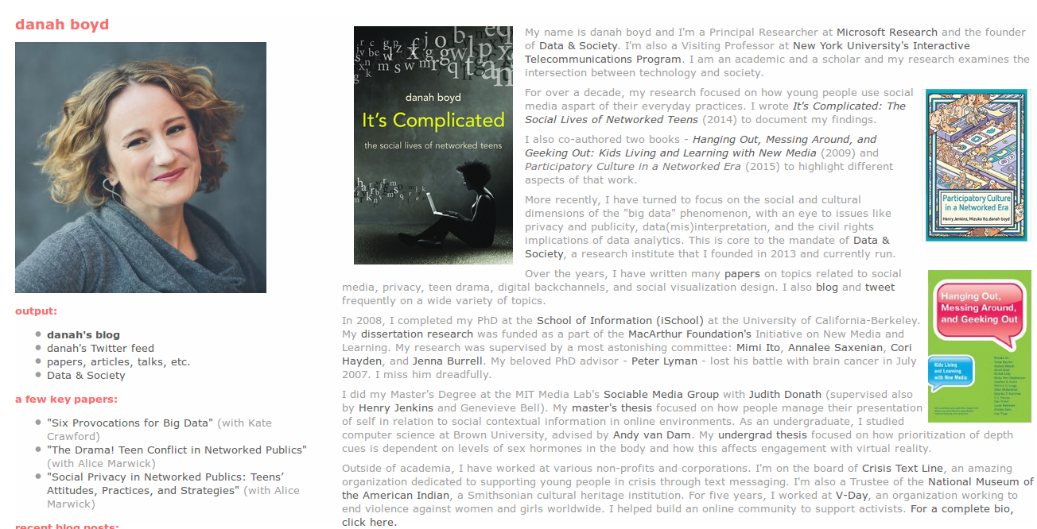
Ethnography as high-profile method

Slide 7
Exercise: why does media industry like ethnography?
Briefly explore danah boyd's home page http://www.danah.org/
Why would Microsoft employ her as 'Principal Researcher'?
How do you think ethnography is used by media companies today?

Slide 8
“Live methods” in media and cultural studies
Manifesto – a document that sets out a programme of change in response to standardisation and commercial uptake of methods such as ethnography
“Manifesto for Live Methods” (Back & Puwar, 2012)
  Written by media and cultural studies scholars for a broad audience of sociologists and media/cultural studies
  Seeks to discuss contemporary challenges in doing research
  Elements of the manifesto:
    New tools for live/realtime
    Avoid the trap of the now – expand the duration of the study
    See the whole without totalizing
    Make methods more artful and crafty
    Develop empirical devices that reinvent relations to social
    Curate knowledge on public platforms
    Utilize senses equally
    Lively words
    Recover history of inventive craft
    Take time
    Engage political and ethical issues without arrogance

Slide 9
Live methods as response
Reponse to:
market/industry research and its resources for survey, interview and ethnographic research
'new coordinated forms of social reality' (Back & Puwar, 2012, 7)
How to do this:
  Participation:
    'Thus, by participation I refer to amateurs acting together individually, collectively, or with organizations in fields otherwise dominated by gatekeepers or professionals' (Fish, 2013)
  Re-invention of methods

Slide 10
'Live methods' emphasise:
Looking outside 'academic methods'
Re-purposing art/activist approaches
Re-assessing how digital tools shape our understanding of social life
Re-ordering the relations between data-gathering, analysis and circulation

Slide 11
Ethnography includes possibility of participation
by making audiovisual media :
Use of writing, including blogs and other social media
Use of photography and film:
  e.g Adam Fish's videosAnthropological film-makers

Slide 12
Digital methods as expanded mode of ethnography
Digital media as both object of research and research tool
Smartphones permit use of video and audio as documentation
Digital devices offer new ways of being present in the field
New ethical challenges -- how to anonymize?

Slide 13
Further ways to make media as part of research:
Make images or recordings as empirical data to be analysed
  e.g. photos/videos of city streets
Make images/videos/recordings as part of an visual essay
Ask participants to take photos or make videos, and then look at them together
  Interview participants about what they made and what it means to them

Slide 14
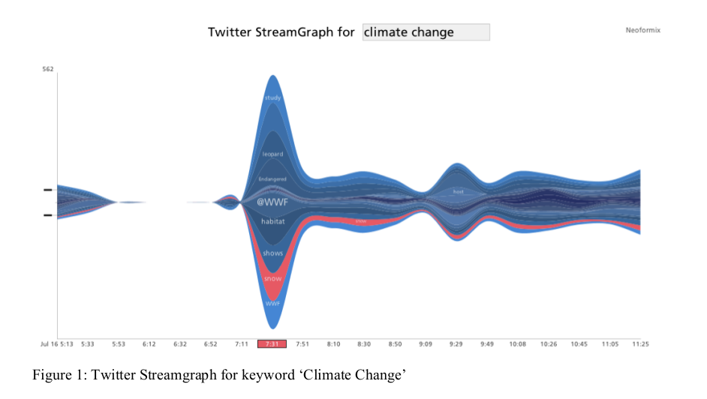
'Develop new tools for “real-time” and “live” investigation'
'The tools and devices for research craft are being extended by digital culture in a hyper-connected world, affording new possibilities to re-imagine observation and the generation of alternative forms of research data' (Back & Puwar, 7)

Slide 15
'Develop new tools for “real-time” and “live” investigation'
'The tools and devices for research craft are being extended by digital culture in a hyper-connected world, affording new possibilities to re-imagine observation and the generation of alternative forms of research data' (Back & Puwar, 7)
Marres & Gerlitz (2015) re-purpose data analytics tools for media and cultural studies
        Marres, Noortje, Carolin Gerlitz, and others. 2015. “Interface Methods: Renegotiating Relations between Digital Social Research, STS and Sociology.” Sociological Review. http://research.gold.ac.uk/11343/.
See Digital Methods Initiative (Amsterdam) for range of work on
- web, hyperlinks, etc. at https://wiki.digitalmethods.net/

Slide 16
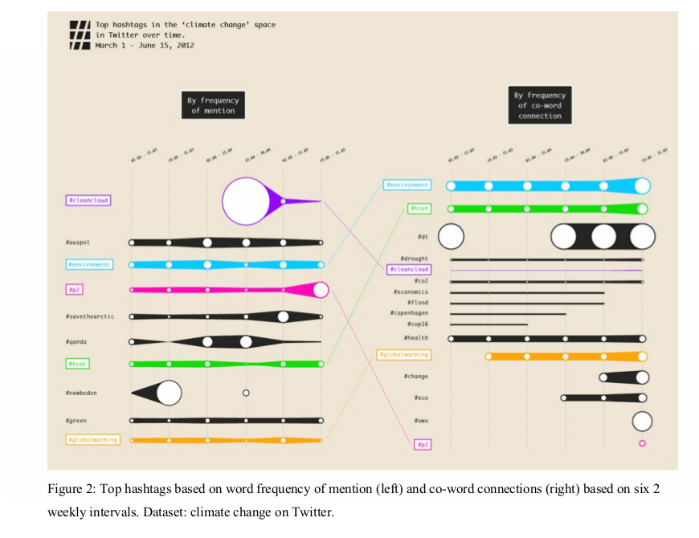
'Make sociological craft more artful and arty'

Slide 17
'Avoid the trap of the now'
Understanding media and cultural dynamics involves seeing a larger picture.
Methods can do this
Theory also useful for this!
'this requires that one is not lost in the short time frame of the now, captured in real time digital methods, for instance' (Back & Puwar, 2012, 8)

Slide 18
Group research project: live methods for longer durations
Run an Internet Archive Wayback Machine search on an important website for your project
  Not a news site – these change too often; best choose a website run by a particular company, fan group, etc.
  e.g. https://web.archive.org/web/*/http://www.starbucks.co.uk/
  Go through the webpages over time (hopefully 5-10 years) looking for significant changes.
Or experiment with the Digital Methods Initiative 'Website' analysis tool on a website important for your project:
  https://wiki.digitalmethods.net/Digitalmethods/TheWebsite
  This tool uses the Wayback Machine, but allows you to convert all the webpages into images that can be viewed more quickly.
  Go through the webpages over time (hopefully 5-10 years) looking for significant changes.
Write a brief outline (300-450 words) describing some initial observations and findings from this work.

Slide 19
Interview preparation
Following normal practice, construct 3 questions in your research groups that explore:
  The challenges of researching digital culture and 'the way digital tools themselves shape our understanding of contemporary social life' (Back & Puwar, 2012, 9)
  Ways of being attentive to larger scale or longer time frame

Slide 20
Next week
Putting methods together in a research design
Essay question

Slide 21
Exercise: live methods
Take one point from the 'live methods' (by Back and Puwar) that relates to your group research project, and discuss it with your neighbour to ensure you grasp it.
Discuss how you might practically actualise that point using equipment, devices, objects or infrastructures you have access to right here in the classroom.
Write a list of the practical steps you would need to do to perform to do it.

