Slide 1
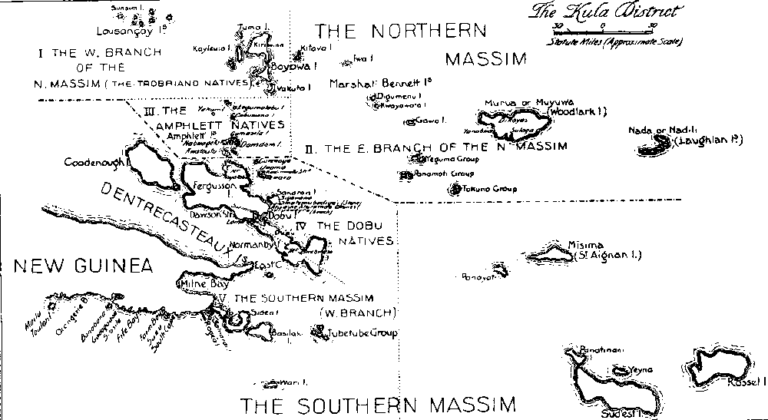
Week 6-7: Ethnography – studying what people do with media

Slide 2
Overview
Ethnography: history and development
Ethnographies of media and audiences
Ethnographies of people and things
Preparation for interview with an ethnographer
Interview with Adam Fish
Group research work
Digital ethnography – week 7 class

Slide 3
Review of methods
Semiotics and textual method
  Focus on individual texts/images
Discourse analysis – saying and seeing; statements and practices;
  Explore groups – ‘discursive formations’ – of texts/documents/media/images
But how to study ways of life, places, individual or group experiences and interactions with and in media?

Slide 4
Ethnography uses a range of tools and techniques to write, record, draw the ‘people, culture, network’….
Why?
Because what people say/project, and what they do are different
Because a sensitive, reflexive account can only be made by ‘being there’
Give voice to the other?
How?
By becoming part of the everyday life of the people, group, network

Slide 5
Ethnography – general
ethno: nation, people, culture (things, network)
graph: draw, write, (narrate, record, chronicle)
ethnography: writing, drawing, (telling) about the people, phenomenon, network
Ethnography: the scientific description of races and peoples, with their customs, habits and mutual differences
(Shorter OED 5th ed, 2002)

Slide 6
Ethnography – general
Main method in cultural/social anthropology; very important in urban sociology, media sociology and cultural studies
Focuses on one case or place – the 'field site' where an ethnographer does 'fieldwork'
Sustained personal contact between researcher and people they research
Looks at the whole situation over time

Slide 7
Ethnography is practice of writing
“The making of ethnography is artisanal, tied to the worldy work of writing” (James Clifford, Writing Culture, 1986: 6).
Cultures are not scientific 'objects' (assuming such things exist, even in the natural sciences). Culture, and our views of 'it,' are produced historically, and are actively contested (James Clifford, Writing Culture, 1986: 18).

Slide 8
“But scrupulous, methodological reflexivity is essential………the careful, detailed account of the researcher’s positioning allows the ethnography to claim a (modest) objectivity, rather than the presumed subjectivism of qualitative work”
Haraway (1988) Situated Knowledges: the science question in feminism and the privilege of the partial perspective

Slide 9
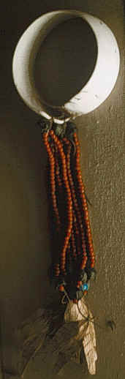
The 'field' site
Notion of 'field site' develops in late 19 century, based on 'field sciences' (like geology)
'the field' in 20th century anthropology usually meant somewhere remote (New Guinea, Uganda, etc.)
'the field' in late 20th century ethnography included places close to home
Actual choice of field site often affected by problems of access (who, where, when)

Slide 10
When/where is the ethnographic field site?
‘Single’ site studies (e.g. a hospital operating theatre, a newsroom, a living room, a street, a shop)
Multi-sited ethnography (life world, system)
  following things, metaphors, conflicts between places
Digital/virtual ethnography
  online worlds: “a-sited”, uncertain of time, location, presence
  But are online/offline worlds not coexistent?

Slide 11
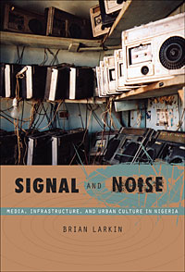
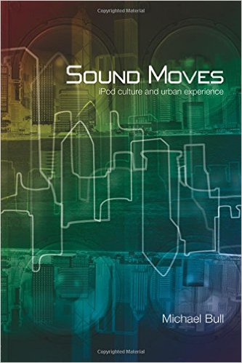
Ethnography as method for studying media in the social world
2 approaches
  Study how audiences make sense of media
  Study how media circulate and act in the world as things

Slide 12
How people make sense of media
Ethnographic studies of audiences, fans, and users
Observe how audiences make sense ('decoding' – Hall) of particular media, and how their sense-making relates to social and cultural identity
Explore how fans closely observe, interpret and transform across media (tv, music, blogs, etc)
Examine how users move across media in 'convergence cultures' as does content (see Fish, reading for today!)

Slide 13
How to study audiences
Earlier studies (1980s on) tend to use interviews that explore how people make sense of media
One-on-one; family; group;
Selection of people to interview will be shaped by what you think is important (class, gender, etc.)
Analysis of interviews – reading and reading; identify different clusters of meaning; link clusters to social or discursive positions

Slide 14
How to study audiences ethnographically
Observe, listen and talk to people as they go about everyday lives
Involves extended periods of time spent in 'the field'
'data' is gathered primarily by taking notes (sometimes photos and audio recording), and then writing notes up
e.g. Daniel Miller & Don Slater, The Internet: An Ethnographic Approach, 2001

Slide 15
Ethnography and media objects
Much ethnography focuses on what people do and make (images, objects, etc)
Study what people do with things (devices, technologies, products) in order to understand social relations and identities.
More focused on people as 'actors' than as 'audience'
e.g Eric Michaels, Bad Aboriginal Art: Tradition, Media and Technological Horizons, 1994

Slide 16
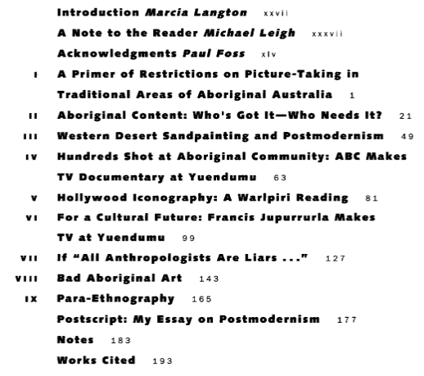
Eric Michaels, Bad Aboriginal Art: Tradition, Media and Technological Horizons, 1994

Slide 17
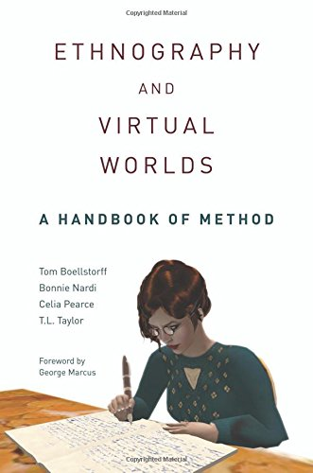
How to ethnographically study things like media?
Pay attention to where and how media objects engage people: visual form, material form, presentational form
Examine how things and people are co-constituted: look at what is actually done where, and by whom
Track mobility of things and how they are re-contextualised: look at the same thing in different places (public, private)

Slide 18
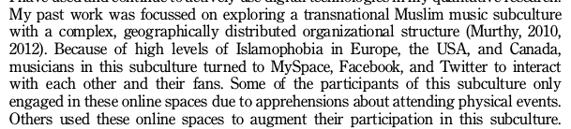
Digital ethnography: access new places
Murthy, 2013, 26
different platforms with different sub-cultures, etc

Slide 19
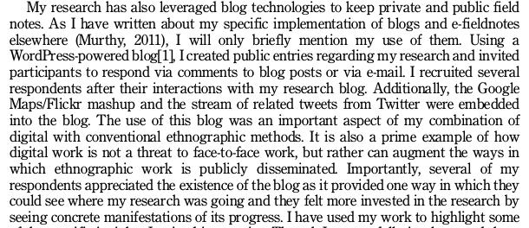
Digital ethnography as engagement
Ethnographers use digital platforms to relate to their field sites
  Widen the range of participants
  Deal with sensitive issues around identity
Murthy, 2013, 27

Slide 20
Digital ethnography as new mode of writing
Digital media as both object of research and research tool
Smartphones permit use of video and audio as documentation
Digital devices offer new ways of being present in the field
New ethical challenges -- how to anonymize?

Slide 21
Exercise: imagining field sites the group research project
List three specific places that you could study (given a few weeks!) as ethnographic field sites for your group research project
List some of the people you would want to meet, talk to and spend time with in these places.
List some of the things, artefacts, practices or events you would want to observe or participate in as an ethnographer.
How would you address the problems of access to sub-cultures, elites, niche social movements or marginal/vulnerable groups?
Write 300-500 words documenting the above.

Slide 22
Interview preparation
In your groups, construct 3 questions about doing ethnography, with a particular focus on
  How to participate in field sites ethnographically
  How to study people's relation to each other and to things (platforms, devices, etc.)

Slide 23
Next week (week 7)
Adrian is away (Berlin, ‘Operative images’ conference)
Chance to catch up on Group Work research portfolio for Weeks 1-6;
Week 7 group work exercise on digital ethnography – see Week 7 slides

