Slide 1
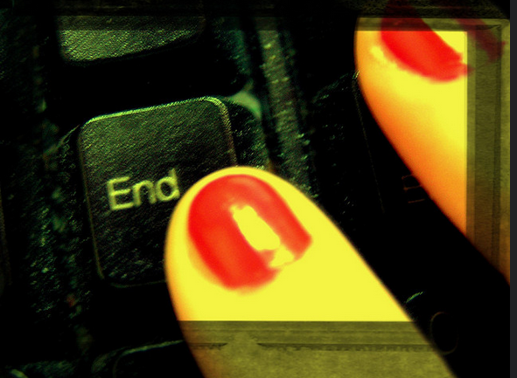
Week 10 Presentations and review

Slide 2
Today – overview
Presentations
Review of the term (and essay question)
Module feedback

Slide 3
Review

Slide 4
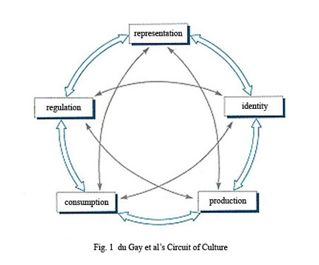
How to study media cultures today?
Media:
... a form of unevenly shared consciousness of persistently external events. [Media] is what appears to happen, in these powerfully transmitted and mediated ways, in a world within which we have no other perceptible connections but we feel is at once central and marginal to our lives. (Raymond Williams, 1973: 295–6)
Culture

Slide 5
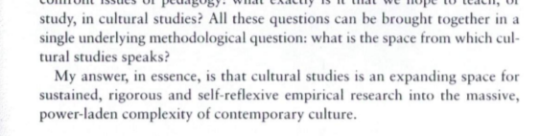
Week 2
p. 1

Slide 6
Methods for cultural studies according to Couldry, 2001
The single methodological question: 'what is the space from which cultural (and media) studies speaks?'
The answer: 'an expanding space for sustained, rigorous and self-reflexive empirical research into the massive, power-laden complexity of contemporary culture' (Couldry, 2001, 1)

Slide 7
Couldry: what is the space from which cultural/media studies speaks?
His answer is 'inside culture'
  High vs popular culture?
    Culture as process in which each person participates
    Culture does not necessarily equate to popular culture
    The problem with popular culture
      Culture + power: who does what when?
  What else should cultural and media studies be studying if not popular culture?
    e.g. middlebrow culture, elite experience, work, business, science, etc.

Slide 8
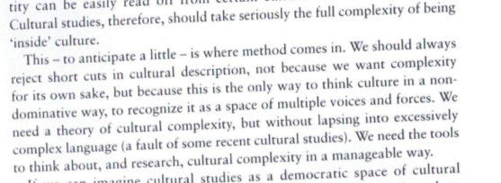
What tools/methods do we need to get inside culture?
Page 4
Being 'inside culture' is complex -
  Find ways of questioning 'forms of address' directed at us
  Couldry's 3 principles: openness, complexity and reflexivity (p.4).

Slide 9
Couldry: how can cultural/media studies be 'inside culture'?
Sociologically influenced and fully materialist methods:
  Look at media and cultural production (song, text, film, website, etc.) done by specific people in particular times and places
  Reflect on the conditions under which you produce knowledge of media and culture (p.12)
Distinctive concern with connections between power and culture (cf. Cultural sociology)

Slide 10
Couldry: media-cultural studies methods and their relation to theory
  Many different theoretical perspectives in MCS (structuralist, post-structuralist, philosophical, psychoanalysis, Marxism, etc.)
  Couldry suggests that MCS does not need to address fundamental philosophical debates
  Use theory from sociology, anthropology, psychoanalysis, philosophy if 'it can open perspectives for possible empirical work into culture' (14)

Slide 11
Couldry: experience and studying culture
Thinking about your own situation as key starting point to understanding complexity of contemporary media and cultures
Individual experience connects to web of relationships
Examples of 'forms of address'?
  Exercise: list some of the things you find yourself wanting to do when you feel distracted while writing an essay

Slide 12
Couldry: method and the complexity of contemporary culture
Materialist: culture is the result of what particular people have done at a particular time and place, under certain constraints
Reflexivity about method: think about how particular methods produce particular results or ways of seeing culture
Relations to theory: pragmatic – how does it open up different empirical questions

Slide 13
Week 3

Slide 14
What is a text?
Text = 'complex of interrelated meanings which its readers tend to interpret as a discrete, unified whole' (Couldry, 70-71)
Most famous comment in recent text theory?
  il n'y a pas de hors-texte (Derrida)
Are these slides a text?

Slide 15
Semiotic analysis and the production of meaning
Often used to analyse ideology and how structures unequal power relations
Approach text as systems of signs that produce meanings
Meanings arise from relations between signs in the text
Analyse text by mapping those relations

Slide 16
Signs and meaning-making
Sign – key concept of basic unit of all texts
Sign composed of signifier and signified, but can be attached to each other in different ways
Semiotics identifies key signs in a text and analyses their relations

Slide 17
Expanded definitions of 'the text'?
Text = 'complex of interrelated meanings which its readers tend to interpret as a discrete, unified whole' (Couldry, 70-71)
Textuality – 'the different ways in which something can function as a text for its readers' (Couldry, 71)
  Investigate specific forms of textuality;
    e.g. to compare the textuality of a magazine with a museum exhibition, you would need to compare the physicality, visual forms, arrangement of forms and materials
Intertextuality = relation between texts (e.g. film + merchandise)

Slide 18
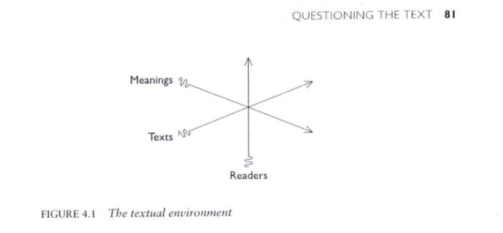
Textual environment: text and reader are co-produced
Examine not just meanings, but flows of texts and readers
Look at material structures of textual production and distribution
Processes that order how we read, connect or screen out texts
Helps us map what it means to be 'inside culture'
Suggests need to 'read' texts in multiple ways
Couldry, 81

Slide 19
Week 4

Slide 20
What visual methods are there, and who uses them?
Semiotics (see last week) – cultural studies
Compositional analysis (today) – art history
Content analysis – sociology and communication
Psychoanalytic and other theoretical readings – film studies
Discourse analysis – cultural studies, sociology and communication (next week)
Ethnography of social viewing practices – sociology and communication (2 weeks time)
Making images – photos, videos, etc: – sociology and communication, art and design
Visuality – visual media and cultural studies (today)

Slide 21
Basic method: compositional analysis
Form of close viewing (developed by art historians) that describes:
  Content – what is actually shown
  Colour and light – effect on realism, on atmosphere, etc.
  Space: scale, complexity, geometry, perspective
  Viewer's position – perspective, standpoint
Does not say much about meaning, or connotation or context
Focuses on rich description of the visual entity (painting, photograph, filmic scene, billboard, et.c)

Slide 22
Ways of approaching images
Mcs approaches image using methods of textual analysis, visuality and discourse analysis (next week)
the images themselves, sites of production, sites of audiencing/viewing
Remember: text, textuality, the textual environment
  Couldry: 'the textual environment' – flow of meanings, flow of readers, flow of texts
New term – visuality

Slide 23
Rose on 'the question of method in … visual culture studies'
What is 'visual culture studies'?
Not much discussion of methods in visual culture studies because:
'implicit methodology' of critical connoisseurship is used
Focuses on meaning, tends to ignore audiencing or the place of the researcher/critic

Slide 24
Gillian Rose's advice for doing visual cultural studies:
Ok to focus on meaning, and contested meanings, with the critic 'finding' the meanings and doing the critique
But also need to take into account
  Visuality = 'what happens when people look and what emerges from that act'
  Practices: 'fairly consistent ways of doing something, deploying certain objects, knowledges, bodily gestures and emotions' (Rose, 549)
  Visuality as practice: 'routinization and place-specificity [that makes] certain sorts of things visible in particular ways' 549

Slide 25
Week 5

Slide 26
Mitchell's idea of 'visual culture'
“I propose what I hope is a more nuanced and balanced approach located in the equivocation between the visual images as instrument and agency, the image as a tool for manipulation, on the one hand, and as an apparently autonomous source of its own purposes and meanings on the other. This approach would treat visual culture and visual images as go-betweens in social transactions, as a repertoire of screen images or templates that structure our encounters with other human beings” p. 176.

Slide 27
Part II: Discourse analysis
Discourse analysis as a key method for textual/media environments (texts, meanings and readers)
Discourse analysis: map groups of statements that structure of how things are thought and actions based on that thinking
Discourse analysis involves reading/looking at things and at actions
'Visualities themselves are practices' (Rose, 550)

Slide 28
Discourse analysis as a method
Centred on Foucault's notion of a discourse: groups of statements that structure the way a thing is thought, and the way we act on the basis of that thinking
Discourse includes both language and things, what is said and what is seen, what is written and what is done
Discourse analysis less concerned with meaning and more with how power actually works in practice
As always with Foucault: power is productive (not just repressive!)
Different emphases in discourse analysis – some on language ('critical discourse analysis' (Fairclough)) or images, and some on practice/institutions

Slide 29
Doing discourse analysis
Usually starts from authoritative account + lots of other sources that relate to it
No set number of sources, but sufficient quantity to generate complexity or tensions
Try to forget preconceptions in reading/viewing the sources
Look for common features across sources – similar conventions, styles, features – and perhaps code/tag images/texts
Look for different relations or reactions to the same thing: complexities, tensions, contradictions
Read with an eye for details that may indicate something taken-for-granted but neverthelss important

Slide 30
Observing 'what happens when people look'
Practice: what is routinely done, and involves body, things, thinking, place and knowledge
Practices are fundamental to performativity (and hence experience and identity)
Exercise: list examples of practice and say why they are practices

Slide 31
Discourse analysis of actions: visual practices and their importance
Focused on how institutions and subject-positions are made visible together:
  School:students/teacher;
  Factory:worker;
  Hospital/clinic: doctor/patient, etc
  Media: spectator?
Each is a regime of visibility
  Each may use images but in different ways

Slide 32
Methodology for studying regimes of visibility
Look at instititutional apparatuses (architecture, laws, regulations, policies, theories, rules)
Look at technologies – disparate sets of tools and methods assembled
  Compare photography as used in fashion magazine and photography as used in passports or forms of ID
Look at production, circulation and audiencing of images
  e.g. how are photographs used, stored, classified, valued, etc differently in different institutions

Slide 33
Rose's advice for doing visual cultural studies 3: critique
Researching visuality still focuses on critique (pointing to problems).
But critique is entangled with practices and performances of looking
  Not just finding the real meaning but intervening by
    Highlighting the unnoticed or invisible by attention to details
    'witness the world into being' differently 553

Slide 34
Week 6

Slide 35
Ethnography – general
ethno: nation, people, culture (things, network)
graph: draw, write, (narrate, record, chronicle)
ethnography: writing, drawing, (telling) about the people, phenomenon, network
Ethnography: the scientific description of races and peoples, with their customs, habits and mutual differences
(Shorter OED 5th ed, 2002)

Slide 36
Ethnography uses a range of tools and techniques to write, record, draw the ‘people, culture, network’….
Why?
Because what people/networks say/project, and what they do are different
Because a sensitive, reflexive account can only be made by ‘being there’
Give voice to the other?
How?
By becoming part of the everyday life of the people, group, network

Slide 37
But scrupulous, methodological reflexivity is essential………the careful, detailed account of the researcher’s positioning allows the ethnography to claim a (modest) objectivity, rather than the presumed subjectivism of qualitative work
Haraway (1988) Situated Knowledges: the science question in feminism and the privilege of the partial perspective

Slide 38
Ethnography as writing practice
The making of ethnography is artisanal, tied to the worldy work of writing (Clifford 1986: 6).
Cultures are not scientific 'objects' (assuming such things exist, even in the natural sciences). Culture, and our views of 'it,' are produced historically, and are actively contested (Clifford 1986: 18).

Slide 39
Ethnography – general
Main method in cultural/social anthropology; very important in urban sociology, media sociology and cultural studies
Focuses on one case or place – the 'field site' where an ethnographer does 'fieldwork'
Sustained personal contact between researcher and people they research
Looks at the whole situation over time

Slide 40
How people make sense of media
Ethnographic studies of audiences, fans, and users
Observe how audiences make sense ('decoding' – Hall) of particular media, and how their sense-making relates to social and cultural identity
Explore how fans closely observe, interpret and transform across media (tv, music, blogs, etc)
Examine how users move across media in 'convergence cultures' as does content (see Fish, reading for today!)

Slide 41
How to study audiences
Earlier studies (1980s on) tend to use interviews that explore how people make sense of media
One-on-one; family; group;
Selection of people to interview will be shaped by what you think is important (class, gender, etc.)
Analysis of interviews – reading and reading; identify different clusters of meaning; link clusters to social or discursive positions

Slide 42
How to study audiences ethnographically
Observe, listen and talk to people as they go about everyday lives
Involves extended periods of time spent in 'the field'
'data' is gathered primarily by taking notes (sometimes photos and audio recording), and then writing notes up

Slide 43
Ethnography and media objects
Much ethnography focuses on what people do and make (images, objects, etc)
Study what people do with things (devices, technologies, products) in order to understand social relations and identities.
More focused on people as 'users' than as 'audience'

Slide 44
How to ethnographically study things like media?
Pay attention to where and how media objects engage people: visual form, material form, presentational form
Examine how things and people are co-constituted: look at what is actually done where, and by whom
Track mobility of things and how they are re-contextualised: look at the same thing in different places (public, private)

Slide 45
Week 7

Slide 46
“Live methods” in media and cultural studies
Manifesto – a document that sets out a programme of change in response to standardisation and commercial uptake of methods such as ethnography
“Manifesto for Live Methods” (Back & Puwar, 2012)
  Written by media and cultural studies scholars for a broad audience of sociologists and media/cultural studies
  Seeks to discuss contemporary challenges in doing research
  Elements of the manifesto:
    New tools for live/realtime
    Avoid the trap of the now – expand the duration of the study
    See the whole without totalizing
    Make methods more artful and crafty
    Develop empirical devices that reinvent relations to social
    Curate knowledge on public platforms
    Utilize senses equally
    Lively words
    Recover history of inventive craft
    Take time
    Engage political and ethical issues without arrogance

Slide 47
Live methods as response
Reponse to:
market/industry research and its resources for survey, interview and ethnographic research
'new coordinated forms of social reality' (Back & Puwar, 2012, 7)
How to do this:
  Participation:
    'Thus, by participation I refer to amateurs acting together individually, collectively, or with organizations in fields otherwise dominated by gatekeepers or professionals' (Fish, 2013)
  Re-invention of methods

Slide 48
'Live methods' emphasise:
Looking outside 'academic methods'
Re-purposing art/activist approaches
Re-assessing how digital tools shape our understanding of social life
Re-ordering the relations between data-gathering, analysis and circulation

Slide 49
Ethnography includes possibility of participation
by making audiovisual media :
Use of writing, including blogs and other social media
Use of photography and film:
  e.g Adam Fish's videosAnthropological film-makers

Slide 50
Digital methods as expanded mode of ethnography
Digital media as both object of research and research tool
Smartphones permit use of video and audio as documentation
Digital devices offer new ways of being present in the field
New ethical challenges -- how to anonymize?

Slide 51
Further ways to make media as part of research:
Make images or recordings as empirical data to be analysed
  e.g. photos/videos of city streets
Make images/videos/recordings as part of an visual essay
Ask participants to take photos or make videos, and then look at them together
  Interview participants about what they made and what it means to them

Slide 52
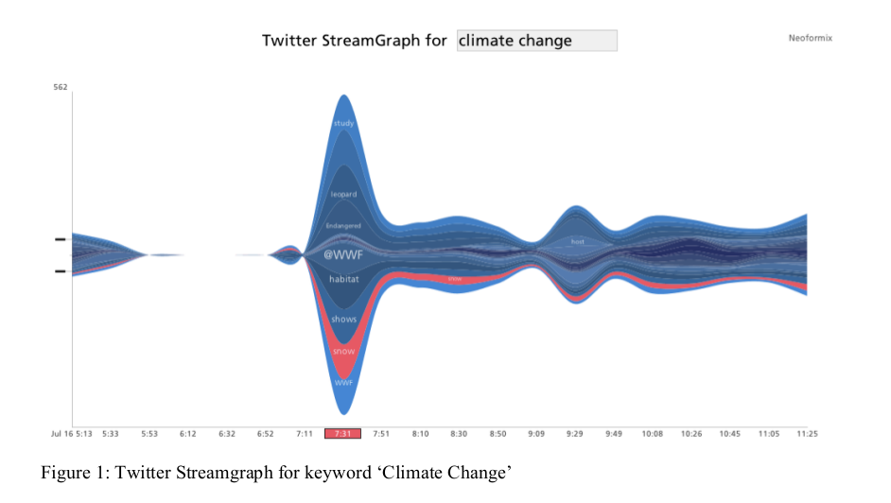
'Develop new tools for “real-time” and “live” investigation'
'The tools and devices for research craft are being extended by digital culture in a hyper-connected world, affording new possibilities to re-imagine observation and the generation of alternative forms of research data' (Back & Puwar, 7)

Slide 53
'Develop new tools for “real-time” and “live” investigation'
'The tools and devices for research craft are being extended by digital culture in a hyper-connected world, affording new possibilities to re-imagine observation and the generation of alternative forms of research data' (Back & Puwar, 7)
Marres & Gerlitz (2015) re-purpose data analytics tools for media and cultural studies
        Marres, Noortje, Carolin Gerlitz, and others. 2015. “Interface Methods: Renegotiating Relations between Digital Social Research, STS and Sociology.” Sociological Review. http://research.gold.ac.uk/11343/.
See Digital Methods Initiative (Amsterdam) for range of work on
- web, hyperlinks, etc. at https://wiki.digitalmethods.net/

Slide 54
Week 8

Slide 55
Methods overview
 | images | texts | places/things | people | organisations
semiotics | x | x | x
compositional analysis | x |  | ?
discourse analysis of documents | x | x |  |  | x
discourse analysis of institutions/practices |  |  | x |  | x
ethnography of audiences |  |  | x | x | x
ethnography of media objects | x | x | x
Live methods | x |  | x | x | x

Slide 56
Methods we did not cover much in the course
Psychoanalytic-influenced reading of texts (e.g. Lauren Berlant)
  Very important in film studies and some cultural studies
  Key notion: texts are structured by unconscious processes of desire and reveal symptoms of desiring processes
Media archaeology (e.g. Friedrich Kittler, Wolfgang Ernst)
  Development of Foucault's archaeological approach to discourse, expanded to include media infrastructures

Slide 57
Things we haven't covered but still need to cover
How to 'get into' your research
  Remember the cultural studies approach to research includes the position of the researcher as key element
'Research design' - how do you bring different methods around a key question or questions?
  The other vital components of research – theoretical framings, and existing research

Slide 58
How to 'get into' your research project: The method of 'writing the implosion':
A series of exercises to help explore the fabric of an object, and thereby ourselves!
  See Dumit, J., 2014. Writing the Implosion: Teaching the World One Thing at a Time. Cultural Anthropology 29, 344–362. doi:10.14506/ca29.2.09 (on the moodle)
'pick an artifact or a thing' – as a specific as possible
  Step 1: Brainstorm: write notes about the thing in response to the questions on pages 351-354
    Labour, epistemology, materials, technologies, contexts, politics, economics, texts, bodies, histories, parts, education, myth, symbolism
  Step 2: From knowledge-map to ignorance-map
    Look for patterns of ignorance in what you know about the object: why do you know some things and not others
    Where/how could you get answers to what you don't know ?
  Step 3: Try to find answers
    Who controls the answers (experts, institutions, platforms, etc.)?
    This is the work of discourse analysis: 'practices that systematically form the objects of which they speak' (Foucault)

Slide 59

Research design: how to bring things together?

Slide 60
Week 9

Slide 61
Revisiting the research questions
Exercise: research questions checklist
Does the question address current problems or approaches in media and cultural studies?
Does the question have any built-in assumptions about culture, media, power, experience, values, etc.?
Are the terms used in the question reasonably well-defined?
Is the question empirically researchable given your time and resources?
Does the question have the potential to contribute something new?
If there any problems with your research questions, discuss in the group how to fix them.

Slide 62
Re-visiting discourse analysis
Read short extract from Kendall & Wickham, Using Foucault's Methods, pages 139-141.
What is the contrast between two different ways of analysing 'discourse' (in Foucault's sense of that term)?
What would this contrast mean practically?
Did any of the guest researchers this term do discourse analysis?

Slide 63
Revisiting discourse analysis for group research projects
Identify some of the materials, documents, things or places in your group project that you might address using discourse analysis?
How does this approach shift emphasis away from meaning? What does it emphasise instead of meaning?

Slide 64
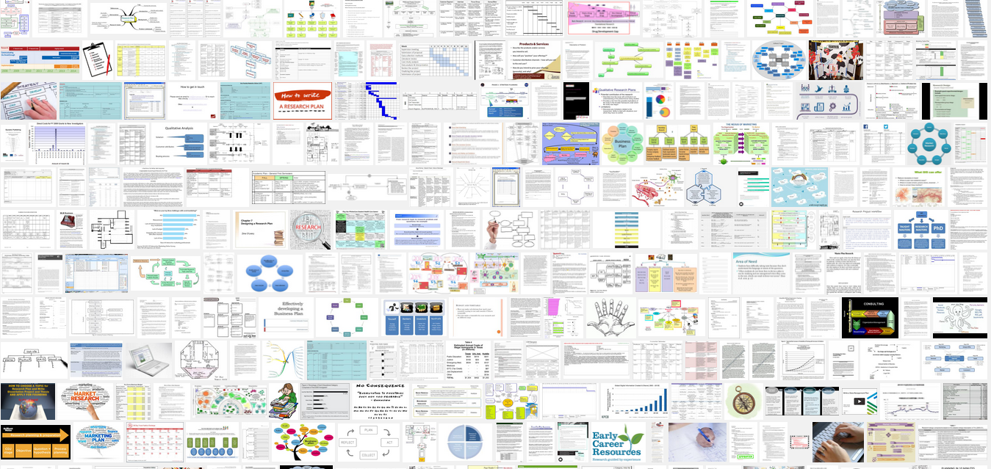
Making a research timetable?
Why do you need a plan or timetable at all? Why not just do the research?
Timetable as one place where research questions are translated into actually do-able research activities
Plans and timetables will always change and be revised as you do the research

Slide 65
Essay questions

Slide 66
Essay question
Nick Couldry defines media cultures in this way:
I use the term “media culture” .. to refer to collections of sense-making practices whose main resources of meaning are media. The only criterion for identifying a media culture is that its members are likely to recognize its distinctiveness, its way of “hanging together”. When I say “sense-making”, I do not mean that media cultures are exclusively or primarily ways of making sense of media. I mean instead that they are ways of making sense of the world that work primarily through, or in reliance on, media' (Couldry Media, Society, World: Social Theory and Digital Media Practice. 2012, 159–160).
Critically analyse what this claim means for the practice of media and cultural studies research today. Describe how your group research project addressed the methodological challenges of empirically researching contemporary media culture. You will need to spend some time in your essay describing what your research was about, but this description should mainly support your reflections on the challenges of researching media cultures.

Slide 67
Essay question discussion
Nick Couldry defines media cultures in this way:
I use the term “media culture” .. to refer to collections of sense-making practices whose main resources of meaning are media. The only criterion for identifying a media culture is that its members are likely to recognize its distinctiveness, its way of “hanging together”. When I say “sense-making”, I do not mean that media cultures are exclusively or primarily ways of making sense of media. I mean instead that they are ways of making sense of the world that work primarily through, or in reliance on, media' (Couldry Media, Society, World: Social Theory and Digital Media Practice. 2012, 159–160).
Critically analyse what this claim means for the practice of media and cultural studies research today. Describe how your group research project addressed the methodological challenges of empirically researching contemporary media culture. You will need to spend some time in your essay describing what your research was about, but this description should mainly support your reflections on the challenges of researching media cultures.
Why did Adrian choose this quote from Couldry? Is he crazy?
What has it got to do with methods in media and cultural studies? It talks about media and sense-making.
What are the hard parts of this question?
How does the group research project help me discuss this topic?

