Slide 1
Socl923: Critical methods in media and cultural studies
Week 1, 2016

Slide 2
Overview of today's session
Course outline
Course assessment
Methods in media and cultural studies
Research project

Slide 3
Course outline
Weeks 1-7: methods, guest interviews
  Each week: 1-2 methods; 1 guest whose work we read and discuss in terms of methods
Weeks 8-10: group projects;

Slide 4
Course assessment
Group research projects developed each week
Group work documented in online research portfolio
Group work summarised in presentations Week 19
Individual essay reflecting on methods in media and cultural studies
  Question is already in the course outline
Assessment for this course is:
Group work: research methods portfolio 25%; due week 19, 14 March
Group work: presentation of research project 15%; due Week 19, 15 March
Individual essay on research (3000 words) 60%; due Monday Week 21, Summer term, 15 April 2015, 5pm.

Slide 5
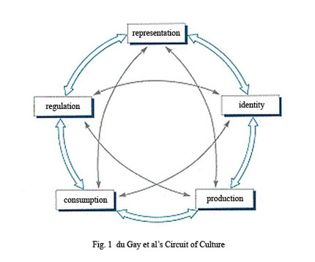
How to study media cultures today?
Media:
... a form of unevenly shared consciousness of persistently external events. [Media] is what appears to happen, in these powerfully transmitted and mediated ways, in a world within which we have no other perceptible connections but we feel is at once central and marginal to our lives. (Raymond Williams, 1973: 295–6)
Culture

Slide 6


Slide 7
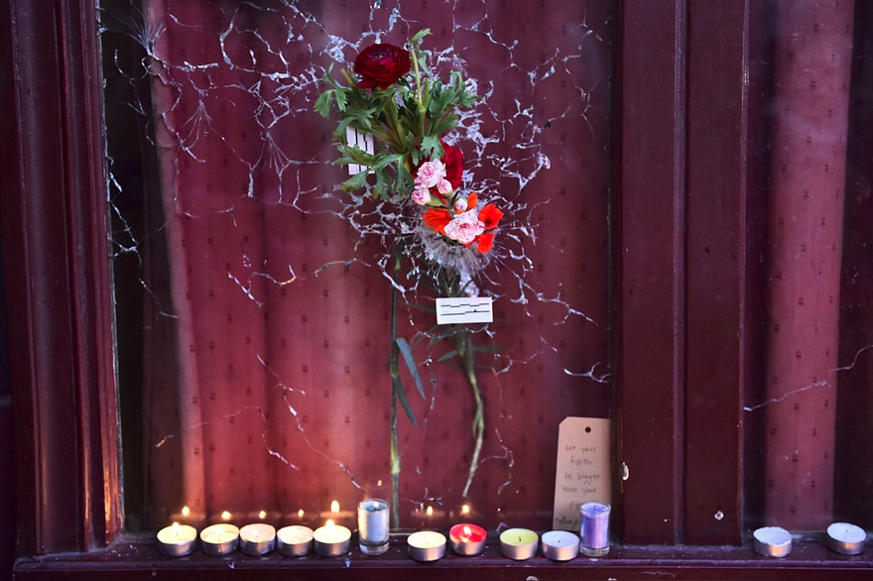

Slide 8
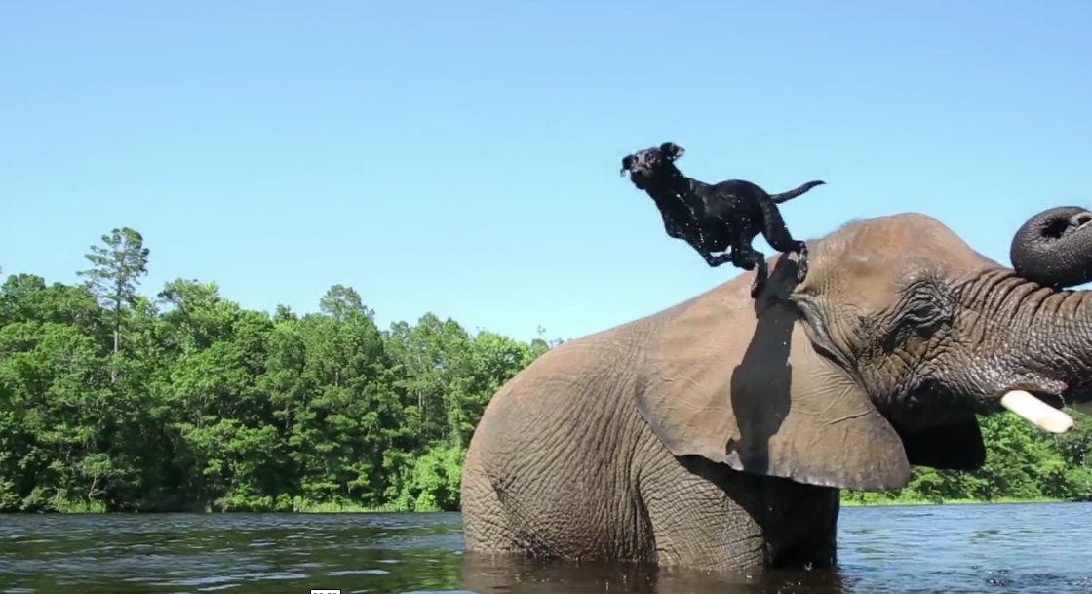

Slide 9
How to study media cultures today?
Media
... a form of unevenly shared consciousness of persistently external events. [Media] is what appears to happen, in these powerfully transmitted and mediated ways, in a world within which we have no other perceptible connections but we feel is at once central and marginal to our lives. (Raymond Williams, 1973: 295–6)

Slide 10
Textual methods
From 'classic' cultural studies methods (semiotics) to contemporary 'textual environments.'

Slide 11
Visual methods
From formal composition analysis to 'expert readings.'
From 'expert readings' to 'discourse analysis'

Slide 12
Discourse analysis
Analysis of how statements structure what we think
Moving from elite or authorative examples to a more diverse archive

Slide 13
Ethnography
Observing what people do with and in media as participants (not just as audience or spectator)
Researcher becomes a participant
Challenges of digital ethnography

Slide 14
Choosing the group project topic
Topic does not have to be something that everyone in the group is interested in
Requirements:
  international in scope
  Involves recent event (2015 onwards)
    e.g. a news event, a media event (e.g. film launch), an online event ('blue' dress), something in popular culture, etc.
  Can be researched using multiple methods – textual, visual, discourse analysis, ethnography
In your groups, brainstorm a list of five possible topics, and then rank them in order of group interest.

Slide 15
Setting up the group research portfolio
Sign up a for a blog account (wordpress, blogger, blog.com) and make sure everyone has access to it
Send me the address or URL so I can see it.
Post a brief description of the research topic and why it is interesting (300-400 words)
Post the description to the blog

Slide 16
Next week
Textual analysis
Read article by Anne Cronin on advertising & cities

