Slide 1
Week 5
Visual analysis II: 'the visual construction of the social'

Slide 2
Overview
“Showing seeing” (Mitchell) – studying the visual – the basic problem
Discourse analysis and practices of visibility
Group research project exercise
Interview with Graeme Gilloch

Slide 3
'Showing seeing'
Reading for this week: W.J.T. Mitchell on the idea of 'visual culture'
Key ideas:
Myths of a 'visual culture' or the 'pictorial turn'
All media are mixed (no 'visual media')
Not so much social construction of vision as visual construction of the social
Page 176

Slide 4
Mitchell's idea of 'visual culture'
“I propose what I hope is a more nuanced and balanced approach located in the equivocation between the visual images as instrument and agency, the image as a tool for manipulation, on the one hand, and as an apparently autonomous source of its own purposes and meanings on the other. This approach would treat visual culture and visual images as go-betweens in social transactions, as a repertoire of screen images or templates that structure our encounters with other human beings” p. 176.

Slide 5
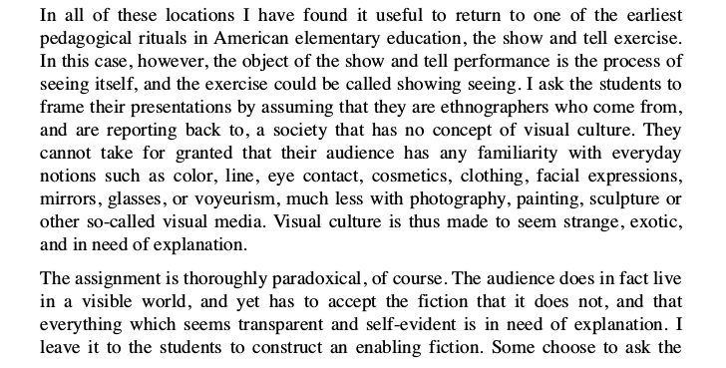
Mitchell, 'Showing seeing'
“Show and tell exercise”
  Seeks to challenge our assumptions or taken for granted approaches to living in a 'visible world.'
  Paradoxical exercise!
  Requires an 'enabling fiction.'
Page 176

Slide 6
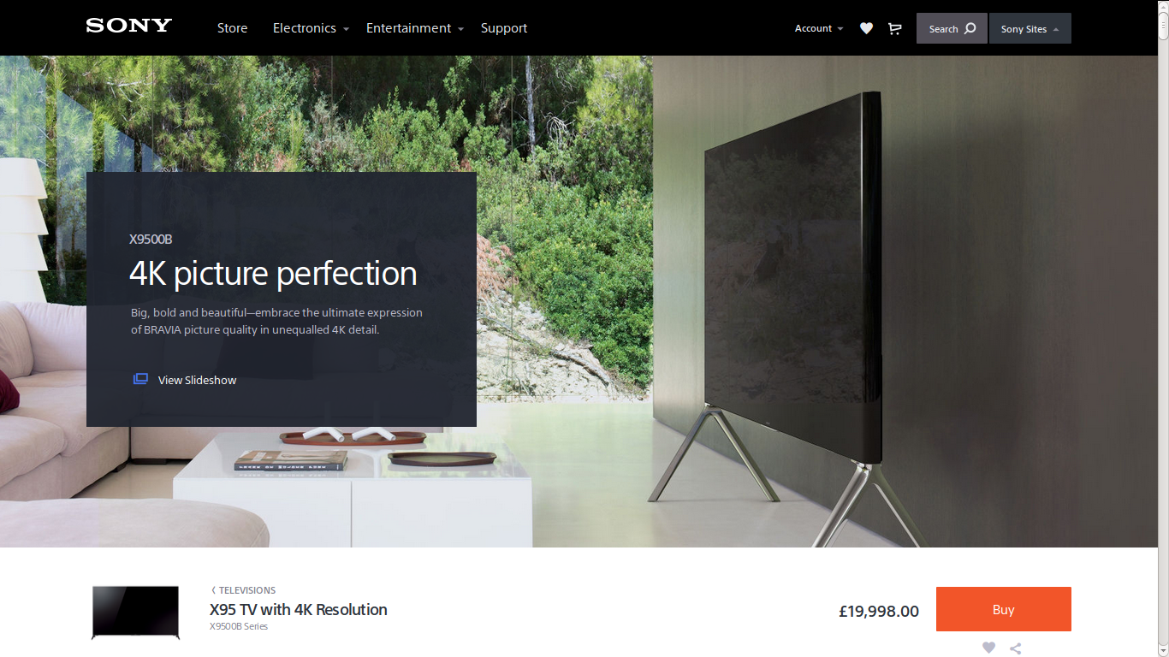

Slide 7
Exercise: 'showing seeing'
Re-read Mitchell on 'showing seeing' (page 176)
Look at this screen – the one you are reading now
Describe seeing it for people who have no visual culture
  You cannot assume that they know anything about eyes, images, light, colour, pictures, technologies, etc. and need all of that explained to them

Slide 8
Part II: Discourse analysis
Discourse analysis as a key method for textual/media environments (texts, meanings and readers)
Discourse analysis: map groups of statements that structure of how things are thought and actions based on that thinking
Discourse analysis involves reading/looking at things and at actions
'Visualities themselves are practices' (Rose, 550)

Slide 9
Discourse analysis as a method
Centred on Foucault's notion of a discourse: groups of statements that structure the way a thing is thought, and the way we act on the basis of that thinking
Discourse includes both language and things, what is said and what is seen, what is written and what is done
Discourse analysis less concerned with meaning and more with how power actually works in practice
As always with Foucault: power is productive (not just repressive!)
Different emphases in discourse analysis – some on language ('critical discourse analysis' (Fairclough)) or images, and some on practice/institutions

Slide 10
Doing discourse analysis
Usually starts from authoritative account + lots of other sources that relate to it
No set number of sources, but sufficient quantity to generate complexity or tensions
Try to forget preconceptions in reading/viewing the sources
Look for common features across sources – similar conventions, styles, features – and perhaps code/tag images/texts
Look for different relations or reactions to the same thing: complexities, tensions, contradictions
Read with an eye for details that may indicate something taken-for-granted but neverthelss important

Slide 11
Observing 'what happens when people look'
Practice: what is routinely done, and involves body, things, thinking, place and knowledge
Practices are fundamental to performativity (and hence experience and identity)
Exercise: list examples of practice and say why they are practices

Slide 12
Discourse analysis of actions: visual practices and their importance
Focused on how institutions and subject-positions are made visible together:
  School:students/teacher;
  Factory:worker;
  Hospital/clinic: doctor/patient, etc
  Media: spectator?
Each is a regime of visibility
  Each may use images but in different ways

Slide 13
Methodology for studying regimes of visibility
Look at instititutional apparatuses (architecture, laws, regulations, policies, theories, rules)
Look at technologies – disparate sets of tools and methods assembled
  Compare photography as used in fashion magazine and photography as used in passports or forms of ID
Look at production, circulation and audiencing of images
  e.g. how are photographs used, stored, classified, valued, etc differently in different institutions

Slide 14
Sources for analysis of institutional apparatuses
Images and documents
Architectures of specific places
Websites and apps
What experts, practitioners, professionals and participants say or do
Wider discourses and institutions (governments, organisations)

Slide 15
Sources for discourse analysis of technologies
Technologies of display, seeing, looking, searching,
Textual technologies – labels, captions, indexes, print formats (booklet, pamphlet, article, etc.)
Architectural technologies: entry points, facades, designated paths, thresholds, accessible vs inaccessible spaces
Specialized spaces: studios, laboratories, control rooms, archives, etc.

Slide 16
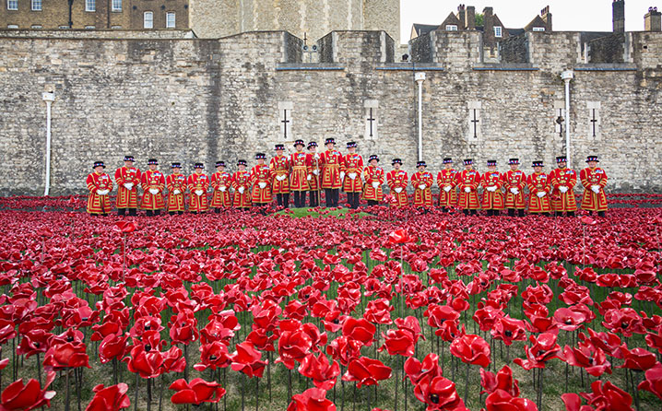
Example: 'Blood Swept Lands, Seas of Red', 2014

Slide 17
Group research project exercise
Write a description of the visual construction of your research topic following the 'showing seeing' guidelines and rules described by W.J.T. Mitchell in this week's reading.
Document this description using text and images on your group project online site.

Slide 18
Group research project exercise B
Write a preliminary description of the institutional apparatuses, technologies and practices of audiencing that visually construct your topic of analysis.
Document this description using text and images on your group project online site.

Slide 19
Exercise for the group research blog
Discourse analysis
Write a preliminary description (400-500 words) of the institutional apparatuses, technologies and practices of audiencing that visually construct your topic of analysis.
Document this description using text and images on your group project blog site.
OR
Showing seeing
Write a description (400-500 words) of the visual construction of your research topic following the 'showing seeing' guidelines and rules described by W.J.T. Mitchell in this week's reading.
Document this description using text and images on your group project blog site.

Slide 20
Preparation for the interview with Graeme Gilloch
Follow usual practice and prepare 3 three questions in your groups for the visitor.
The questions must relate to methods for studying:
  Visual/media construction of the social
  Power relations and visibility

Slide 21
Next week: ethnography and observing people in practice
Adam Fish reading

