Slide 1
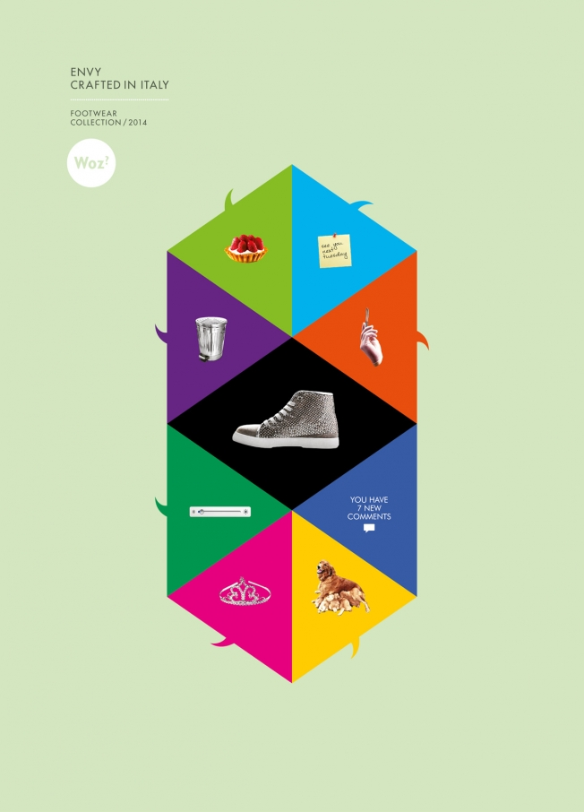
Week 3 2017
Textual analysis: from semiotics to textual environments

Slide 2
Week 3 overview
This week: working with texts using semiotics, textuality and textual environments
  Starting point: MCS analyses texts, we can better understand how meanings, representations and values are shaped in particular ways (hegemonic, dominant, etc).
    Semiotics as a method of exploring structure of a text and its meanings
    Textuality as a method of exploring what a text does
  End point: textual environments: MCS research also need to look beyond 'the text' itself (reading from Couldry)
Exploring implications of the textual environment for your research project
Prepare interview questions
Interview with guest

Slide 3
Key points from Couldry last week
Need for method in media and cultural studies (Couldry's view)
  to resist dominant or accepted view of culture;
  to find voices that are not visible; to connect our own experience with others;
  to address concerns with culture and power;
  to get inside culture
Materialist, empirical, & reflexive methods

Slide 4
What is a text?

Slide 5
What is a text?
Text = 'complex of interrelated meanings which its readers tend to interpret as a discrete, unified whole' (Couldry, 70-71)
Most famous comment in recent text theory?
  il n'y a pas de hors-texte (Derrida)
Are these slides a text?

Slide 6
Methods for researching texts: Semiotics and discourse analysis as methods
Semiotics – study of signs – how texts make meanings (Barthes); possibly most popular method in media and cultural studies
Discourse analysis – analysis of a particular form of language and the practices/institutions linked to and shaped by that form of language (Foucault – more on this next week)

Slide 7
Semiotic analysis and the production of meaning
Often used to analyse ideology and how structures unequal power relations
Approach text as systems of signs that produce meanings
Meanings arise from relations between signs in the text
Analyse text by mapping those relations

Slide 8
Signs and meaning-making
Sign – key concept of basic unit of all texts
Sign composed of signifier and signified, but can be attached to each other in different ways
Semiotics identifies key signs in a text and analyses their relations

Slide 9
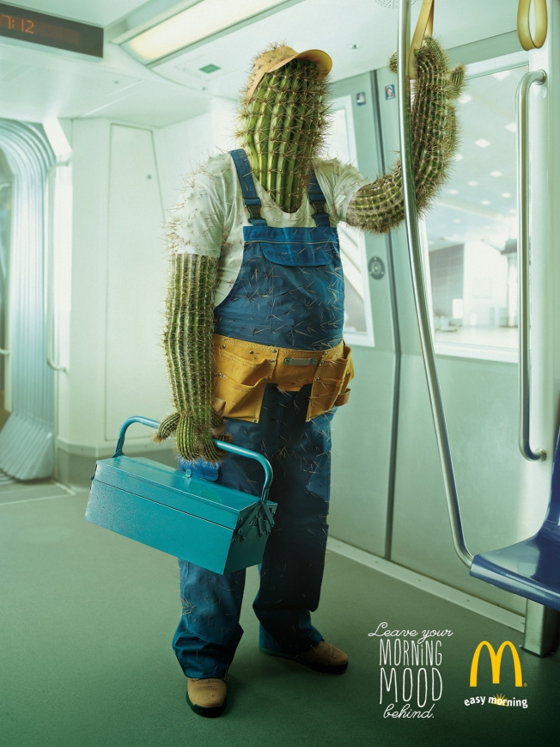

Slide 10
List of signs
1. commuter train
2. absence of other people
3. workman clothes & toolbox
4. cactus boyd
5. McDonalds logo
6. Advertising copy
Relations between signs:
1. Logo + writing
2. Work clothes + cactus
3. Workman + train
4. Train + city

Slide 11
Semiotics offers concepts to help think about relations between signs
Various analytical concepts:
  Denotive vs connotative
  Iconic, indexical and symbolic signs (Peirce)
  Syntagmatic vs paradigmatic (Jakobsen)
  Synecdochal – part stands in for whole
What signs do:
  Signs may attach, produce or transfer meaning in a text
  Signs may 'naturalise' a particular meaning (make it seem obvious and uncontestable) in a text
  Signs may link to wider systems of meaning (codes – Hall; mythology - Barthes)

Slide 12
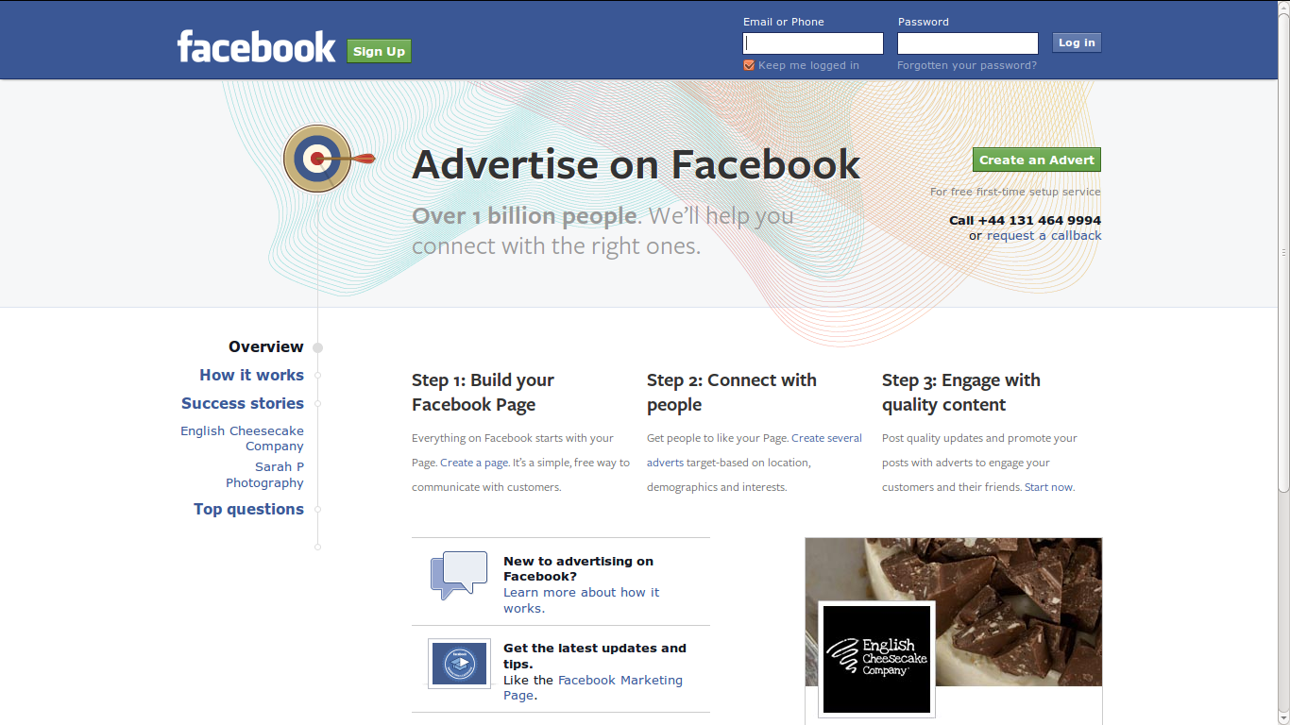
https://www.facebook.com/advertising?campaign_id=214294157440&placement=broad&creative=50677677152&keyword=+online++ads&extra_1=52fa307e-7315-4929-4a70-000014e7bdbf

Slide 13
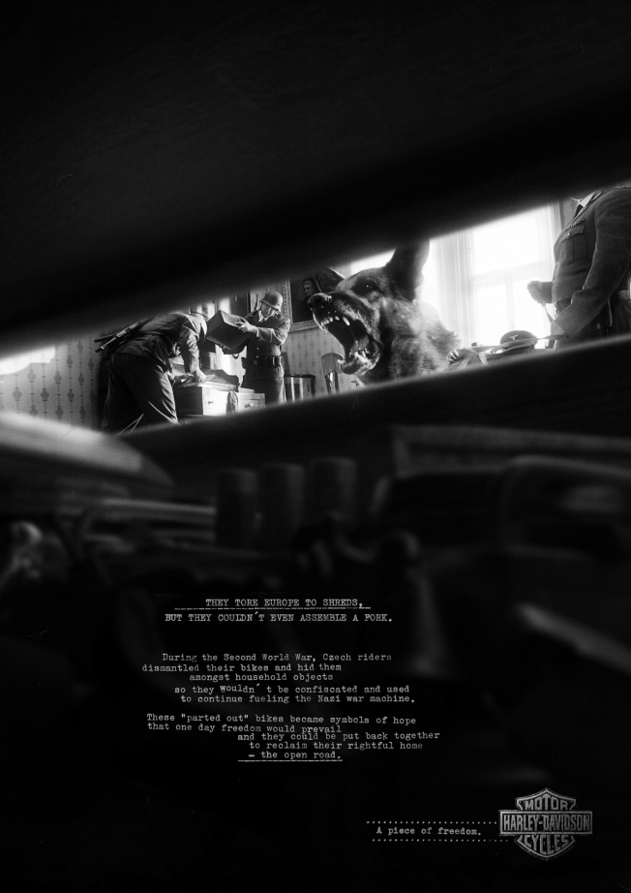

Slide 14
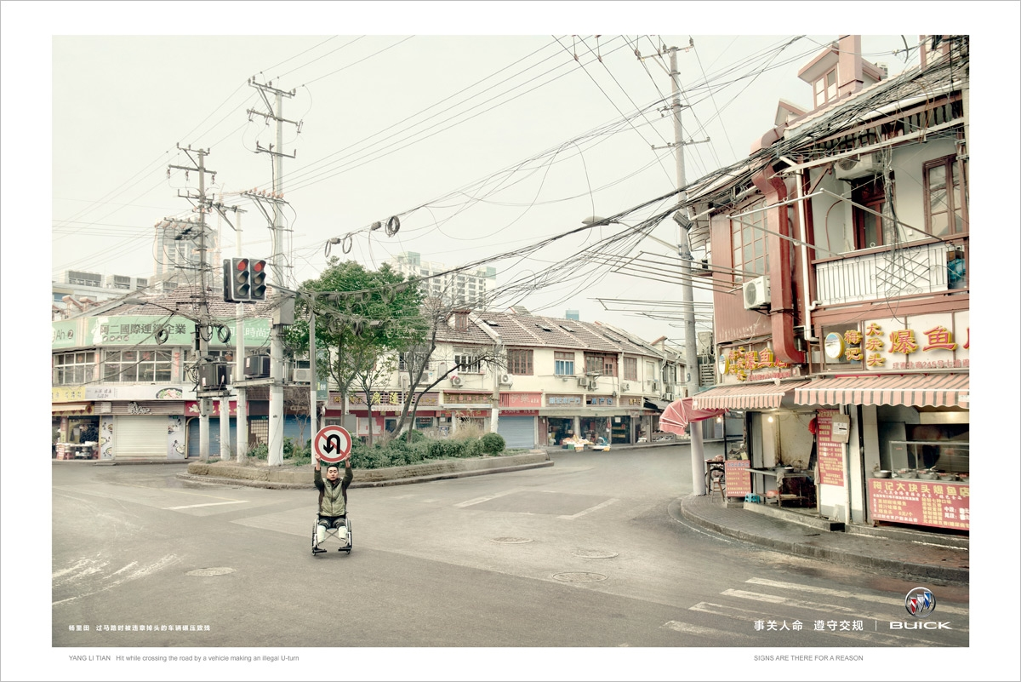

Slide 15
Exercise: semiotics and sign
Identify linguistic and visual signs here, and describe their signifieds and signifiers
Describe some of the relations between signs and how they attach, make or transfer meaning in the text
Identify some wider systems of meaning (codes, etc.)

Slide 16
The limitations of semiotics
Tends to treat texts in isolation and assume an 'expert reader' who analyses them
  Technical vocabulary can be confusing
  Expert reader is not necessarily ‘inside culture’
How to select the texts (Couldry, 68) and explain why they matter?
Doesn't explore how a text is taken up in particular social, cultural or media settings.

Slide 17
Using semiotics today
Most effective where production of meanings is standardised or controlled:
  Fashion
  Advertising
  News
  Certain well-defined genres of books, television and films (e.g. romances, westerns, soap operas)

Slide 18
Expanded definitions of 'the text'?
Text = 'complex of interrelated meanings which its readers tend to interpret as a discrete, unified whole' (Couldry, 70-71)
Textuality – 'the different ways in which something can function as a text for its readers' (Couldry, 71)
  Investigate specific forms of textuality;
    e.g. to compare the textuality of a magazine with a museum exhibition, you would need to compare the physicality, visual forms, arrangement of forms and materials
Intertextuality = relation between texts (e.g. film + merchandise)

Slide 19
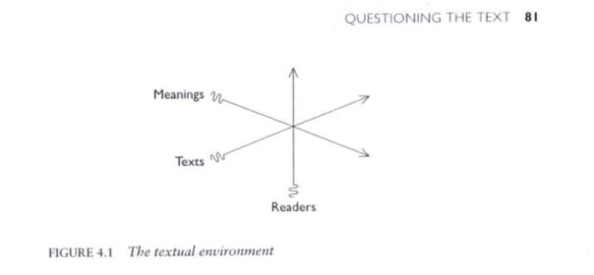
Textual environment: text and reader are co-produced
Examine not just meanings, but flows of texts and readers
Look at material structures of textual production and distribution
Processes that order how we read, connect or screen out texts
Helps us map what it means to be 'inside culture'
Suggests need to 'read' texts in multiple ways
Couldry, 81

Slide 20
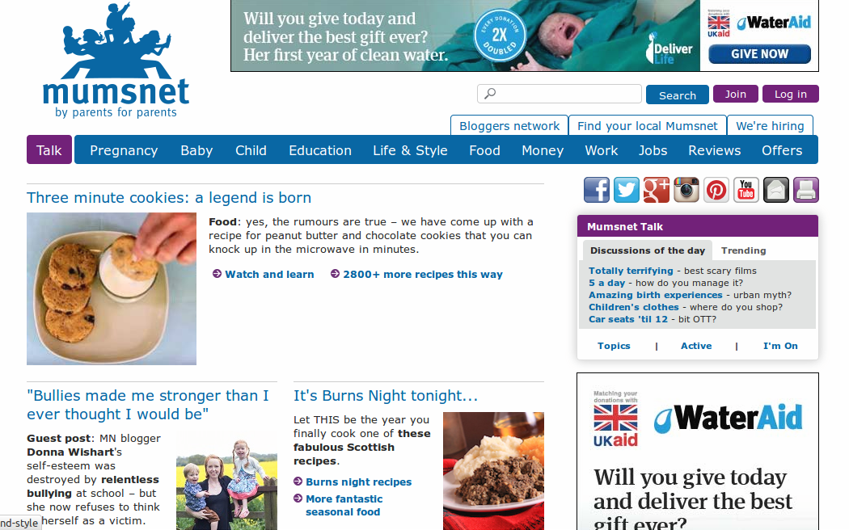
Textual environment: texts and readers are co-produced
Examine not just meanings, but flows of texts and readers
Look at material structures of textual production and distribution
Processes that order how we read, connect or screen out texts
Helps us map what it means to be 'inside culture'
Suggests need to 'read' texts in multiple ways

Slide 21
Group Research Project: fake news: from semiotics to the textual environment
Choose one or two contrasting texts relating to your project and do a brief semiotic analysis of how they make meanings
Using the same texts, describe the textuality of the texts
Using the same texts, describe some aspects of the textual production and distribution in the textual environment
How does an analysis of the textual environment differ from the semiotic analysis of the text in your examples?
Document the examples and your analysis of them on your group research site (400-500 words)

Slide 22
Part II: The interview
Tracy Jensen and her research on online discussion forums

Slide 23
Exercise: prepare interview questions
In your research project groups, frame 3 questions about how to study a website like Mumsnet in terms of
  Production of meanings
  Broader approaches to textuality, textual environments, etc.
Remember:
  You are not asking about what happens on Mumsnet
  You are asking questions that help you understand how Tracey worked with the 'texts' on Mumsnet

Slide 24
Overview
Basic techniques for analysing production of meaning in texts:
  semiotics
Expanding the notion of the text.
  Key concepts: textuality and textual environments
Next week: discourse analysis and visual materials

