Slide 1
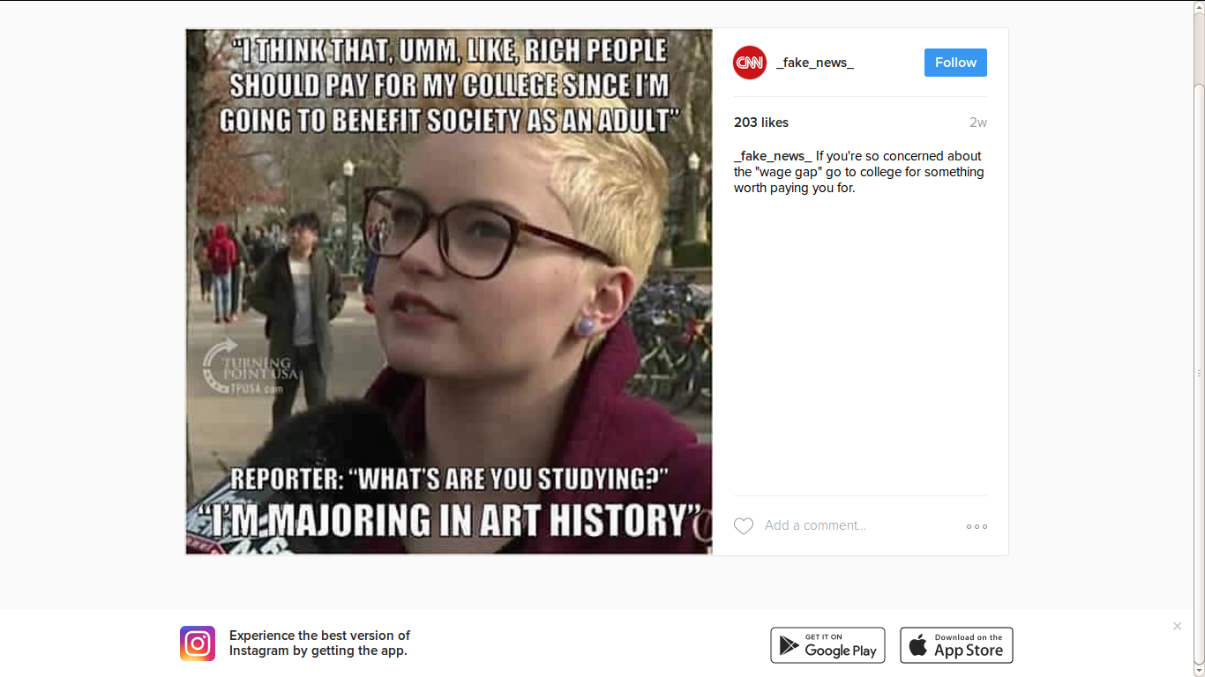
Week 4: Visual culture and its visualities

Slide 2
Overview
A: Visual methods in general
  Basic method: compositional analysis treats images as a text
B: Visuality, practice and performativity (based on reading from Gillian Rose)
  How to study acts of seeing
  Group research exercise
C: Interview preparation
  Interview itself

Slide 3
What visual methods are there, and who uses them?
Semiotics (see last week) – cultural studies
Compositional analysis (today) – art history
Content analysis – sociology and communication
Psychoanalytic and other theoretical readings – film studies
Discourse analysis – cultural studies, sociology and communication (next week)
Ethnography of social viewing practices – sociology and communication (2 weeks time)
Making images – photos, videos, etc: – sociology and communication, art and design
Visuality – visual media and cultural studies (today)

Slide 4
Basic method: compositional analysis
Form of close viewing (developed by art historians) that describes:
  Content – what is actually shown
  Colour and light – effect on realism, on atmosphere, etc.
  Space: scale, complexity, geometry, perspective
  Viewer's position – perspective, standpoint
Does not say much about meaning, or connotation or context
Focuses on rich description of the visual entity (painting, photograph, filmic scene, billboard, et.c)

Slide 5
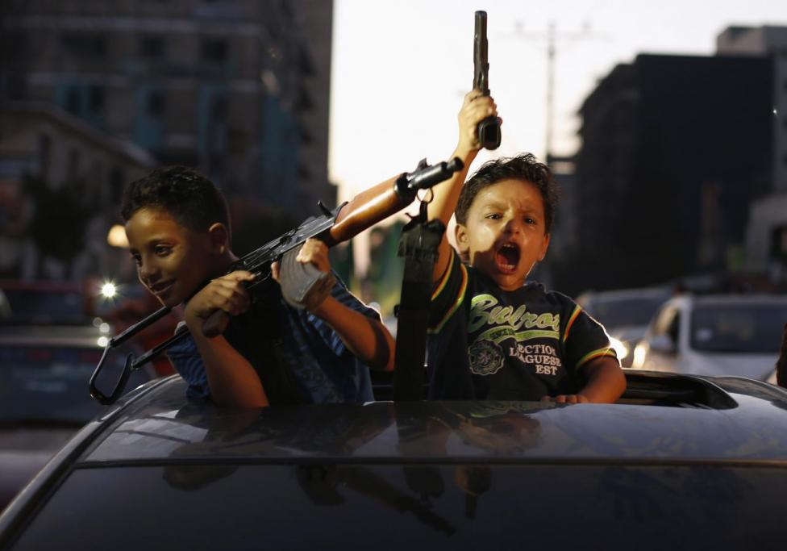
Compositional analysis

Slide 6
Exercise: compositional analysis
In pairs, list some key compositional aspects of the Reuters News photograph
Content
Colour
Light
Space
Scale
Viewer position

Slide 7
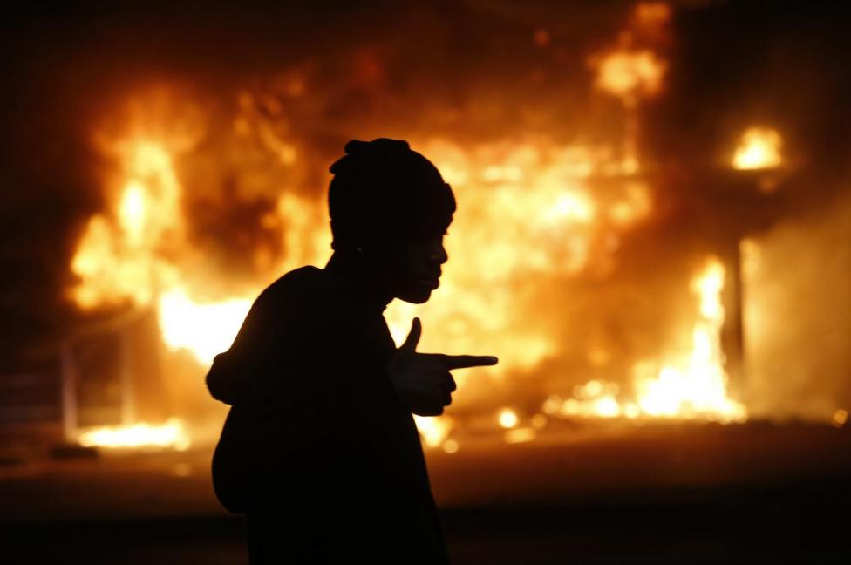
Part B: Visuality – practices, reflexivity, critique

Slide 8
Ways of approaching images
Mcs approaches image using methods of textual analysis, visuality and discourse analysis (next week)
the images themselves, sites of production, sites of audiencing/viewing
Remember: text, textuality, the textual environment
  Couldry: 'the textual environment' – flow of meanings, flow of readers, flow of texts
New term – visuality

Slide 9
Rose on 'the question of method in … visual culture studies'
What is 'visual culture studies'?
Not much discussion of methods in visual culture studies because:
  'implicit methodology' of critical connoisseurship is used
  Focuses on meaning, tends to ignore audiencing or the place of the researcher/critic

Slide 10
Gillian Rose's advice for doing visual cultural studies:
Ok to focus on meaning, and contested meanings, with the critic 'finding' the meanings and doing the critique
But also need to take into account:
  1. Visuality = 'what happens when people look and what emerges from that act'
  2. Practices: 'fairly consistent ways of doing something, deploying certain objects, knowledges, bodily gestures and emotions' (Rose, 549)
Visuality as a practice:
  'routinization and place-specificity [that makes] certain sorts of things visible in particular ways' (Rose, 549)

Slide 11
Rose's advice for doing visual cultural studies: place + practice
Researching visuality focuses on
  1. Specific places where people see or look (airport, loungeroom, street, media platform, etc.), including related geographies (global, local, digital, etc.)
  2. Performativity of practice:
    Do you understand the notion of performativity (Austin/Butler)?
      Discuss with your neighbour.
    Practices produce entities that are said to pre-exist the practice;
    Seeing/looking is a doing that makes something;
  In both respects (place + performativity), research is closer to everyday life

Slide 12
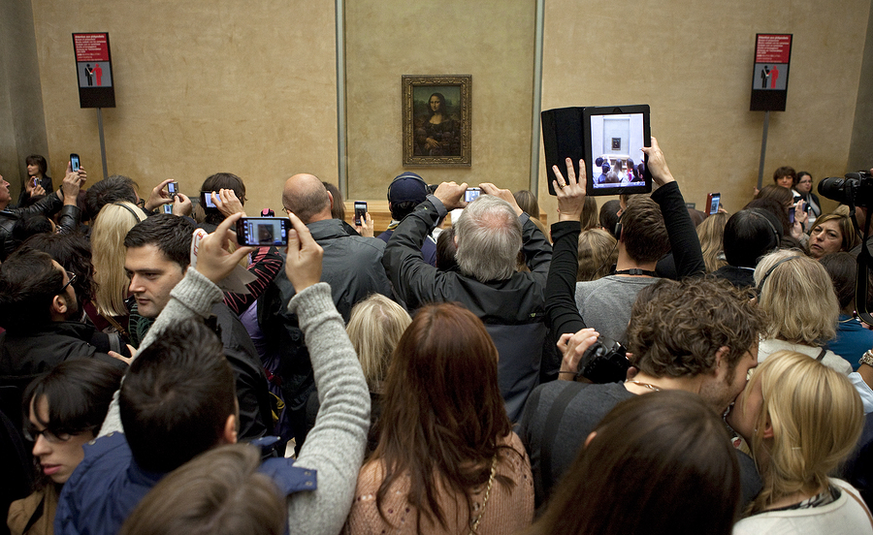
      e.g. Da Vinci's Mona Lisa and visitors who come to the Louvre to see it – what is the performativity of seeing the Mona Lisa?

Slide 13
Rose's advice for doing visual cultural studies 2: reflexivity
Researching visuality entails reflexivity:
  How the researcher is entangled with the object of research (551)
  Entangled with the object means:
    What questions you ask, and what you see depends on who you are and how you relate to what you are seeing
      e.g. a scientific visualization, a computer game, an instagram image
Reflexivity: 'the critic is required to work through the process of reaching that verdict, demonstrating that it was attained through a series of specific interactions rather than from a series of cumulative revelations' (551)

Slide 14
Rose's advice for doing visual cultural studies 3: critique
Researching visuality still focuses on critique (pointing to problems).
But critique is entangled with practices and performances of looking
  Not just finding the real meaning but intervening by
    Highlighting the unnoticed or invisible by attention to details
    'witness the world into being' differently 553

Slide 15
Thinking about visuality for the 'fake news' group research project
Choose two contrasting visual objects/images that relate to different places or practices associated with your project; e.g. a magazine article vs an image that appeared on Twitter, Facebook or Instagram;
Do a compositional analysis of the 2 images
Explore the visuality of these images
  Following Roses' advice about practices and places, list some of the different ways in which people in different places might look at these visual entities.
  You might examine different ways of talking about them, different ways of making or circulating them, different places in which they are seen, different affective/emotional relations, group or social activities associated with them
  You will need to describe where you found the object, look at surrounding text, comments, and audiences.
Write a post (400-500 words) for the online group portfolio that compares the results of the compositional analysis and the analysis of visuality
  make sure you include the images or hyperlinks to them

Slide 16
Interview: prepare questions on visual analysis and visuality
In your groups, prepare 2 questions that ask Miriam how she studies visuality
  The places where urban photographs appear
  The practices associated with them
Also ask her something about reflexivity and critique

Slide 17
Next week
Discourse analysis – combining textuality and visuality

Slide 18
Gillian Rose's critique of visual cultural studies
Exercise: what is Roses' critique of typical visual cultural studies?

Slide 19
Exercise: methods and textual environment
Take the list of visual methods and say what site/s of the image of the image they focus on (production, image itself, audiencing)

