Slide 1
Socl923: Critical methods in media and cultural studies
Week 1, 2017

Slide 2
Overview of today's session
Course outline
Course assessment
Methods talk in media and cultural studies
Research project planning

Slide 3
Course outline
Weeks 1-7: methods, guest interviews
  Each week: 1-2 methods; 1 guest whose work we read and discuss in terms of methods
Weeks 8-10: group projects;

Slide 4
Course assessment
Group research projects developed each week
Group work documented in online research portfolio
Group work summarised in presentations Week 20
Individual essay reflecting on methods in media and cultural studies
  Question is already in the course outline
Assessment for this course is:
Group work: research methods portfolio 25%; due week 19, 20 March
Group work: presentation of research project 15%; due Week 19, 24 March
Individual essay on research (3000 words) 60%; due Monday Week 21, Summer term, 20 April 2017, 5pm.

Slide 5
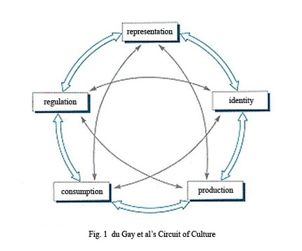
How to study media cultures today?
Media:
... a form of unevenly shared consciousness of persistently external events. [Media] is what appears to happen, in these powerfully transmitted and mediated ways, in a world within which we have no other perceptible connections but we feel is at once central and marginal to our lives. (Raymond Williams, 1973: 295–6)
Culture

Slide 6
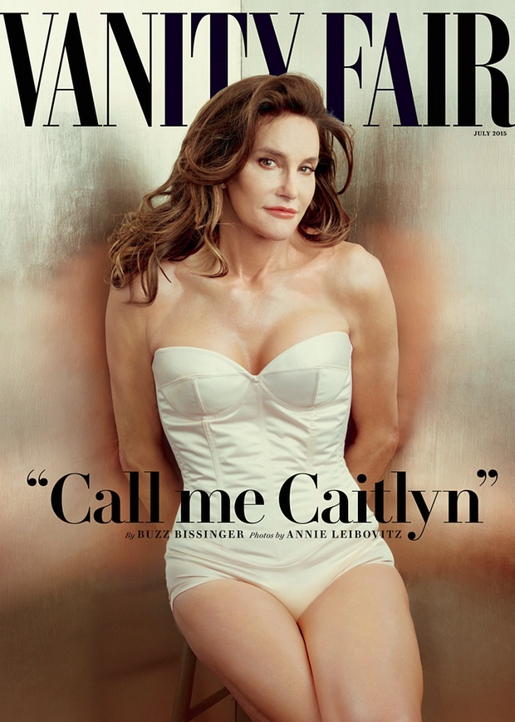

Slide 7
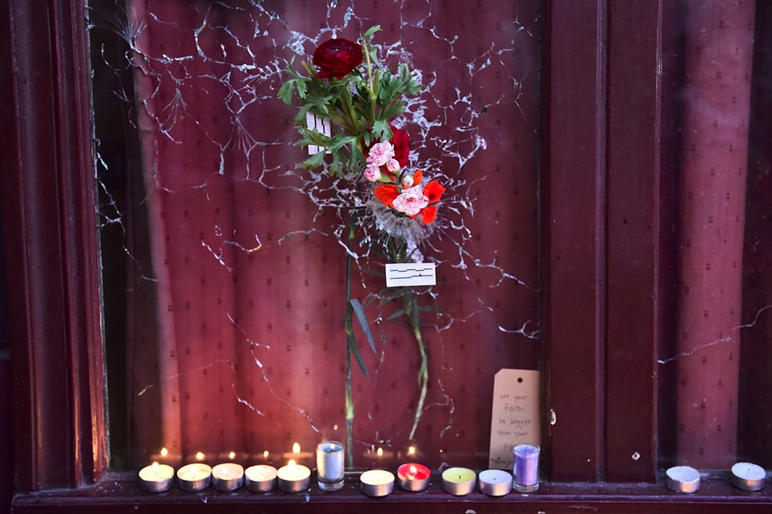

Slide 8
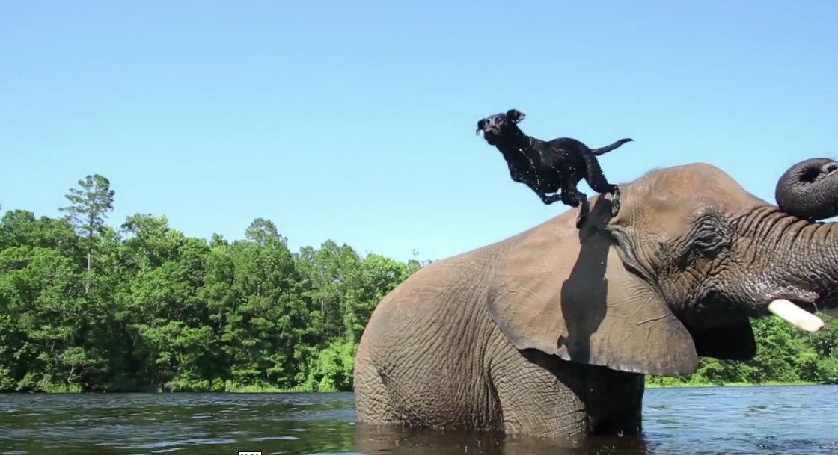

Slide 9
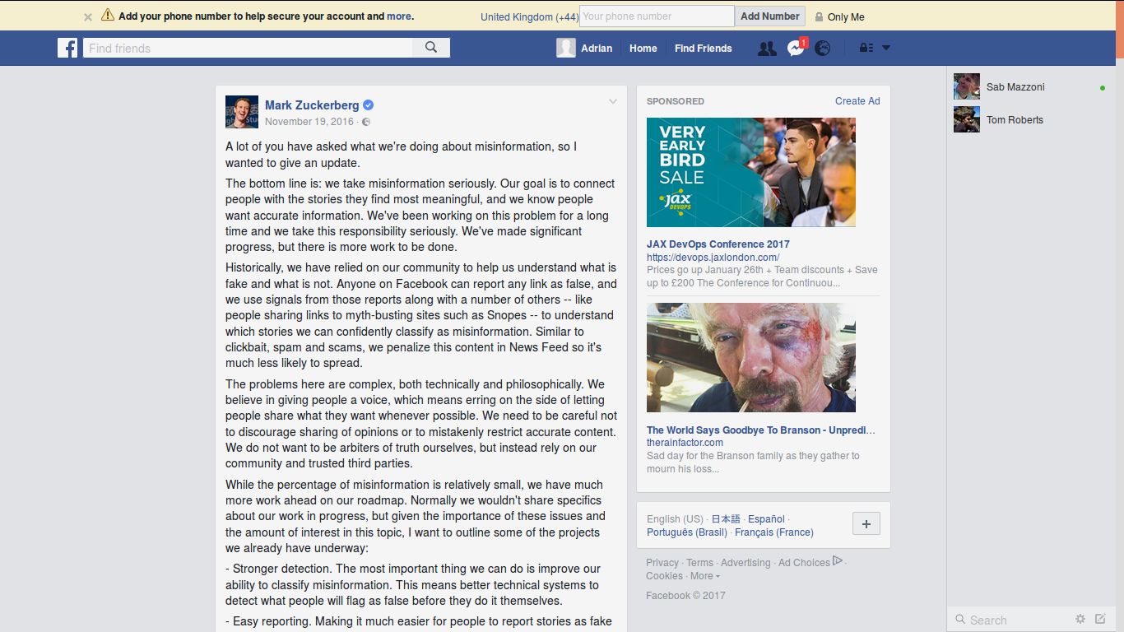

Slide 10
How to study media cultures today?
Media
... a form of unevenly shared consciousness of persistently external events. [Media] is what appears to happen, in these powerfully transmitted and mediated ways, in a world within which we have no other perceptible connections but we feel is at once central and marginal to our lives. (Raymond Williams, 1973: 295–6)

Slide 11
Textual methods
From 'classic' cultural studies methods (semiotics) to contemporary 'textual environments.'

Slide 12
Visual methods
From formal composition analysis to 'expert readings.'
From 'expert readings' to 'discourse analysis'

Slide 13
Discourse analysis
Analysis of how statements structure what we think
Moving from elite or authorative examples to a more diverse archive

Slide 14
Ethnography
Observing what people do with and in media as participants (not just as audience or spectator)
Researcher becomes a participant
Challenges of digital ethnography

Slide 15
Digital methods
Emerging in last 5-10 years
Seek to engage with the specificities of online, network or digital cultures
Aim to overcome some of difficulties of working with networked and algorithmic media

Slide 16
The group project topic: ‘fake news’
Topic does not have to be something that everyone in the group is interested in
Requirements:
  international in scope
  Involves recent event (2015 onwards)
    e.g. a news event, a media event (e.g. film launch), an online event ('blue' dress), something in popular culture, etc.
  Can be researched using multiple methods – textual, visual, discourse analysis, ethnography, digital methods

Slide 17
Getting into your research project: the method of 'writing the implosion':
How to 'get into' your research project: The method of 'writing the implosion':
A series of exercises to help explore the fabric of an object, and thereby ourselves!
  See Dumit, J., 2014. Writing the Implosion: Teaching the World One Thing at a Time. Cultural Anthropology 29, 344–362. doi:10.14506/ca29.2.09 (on the moodle)
'pick an artifact or a thing' – as a specific as possible: ‘fake news on Facebook’
  Step 1: Brainstorm: write notes about the thing in response to the questions on pages 351-354
    Labour, epistemology, materials, technologies, contexts, politics, economics, texts, bodies, histories, parts, education, myth, symbolism
  Step 2: From knowledge-map to ignorance-map
    Look for patterns of ignorance in what you know about the object: why do you know some things and not others
    Where/how could you get answers to what you don't know ?
  Step 3: Try to find answers
    Who controls the answers (experts, institutions, platforms, etc.)?
    This is the work of discourse analysis: 'practices that systematically form the objects of which they speak' (Foucault)

Slide 18
Setting up the group research digital portfolio
Your could set up a Facebook group or sign up a for a blog account (wordpress, blogger, blog.com, or somewhere else). Either way, make sure everyone has access to it
Send me the address or URL so I can see it.
Write a brief description of significance of ‘fake news’ as a topic for media and cultural studies research (300-400 words)
Post the description online (blog, Facebook, etc).

Slide 19
Next week
Textual analysis
Read article by Anne Cronin on advertising & cities

