Slide 1

SOCL923
Working with texts I: Textual Analysis

Slide 2
Week 2 overview
Work on Couldry intro
Explore implications of Couldry account of culture, power, and experience for methods
Morning tea
Prepare interview questions
Interview with guest

Slide 3
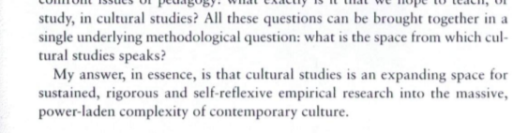
Methods for cultural studies
p. 1

Slide 4
Couldry: what is the space from which cultural/media studies speaks?
High vs popular culture?
Culture as process in which each person participates
The problem with popular culture
Culture + power: who does what when?
What else should cultural studies be studying?
How should it be studying it?

Slide 5
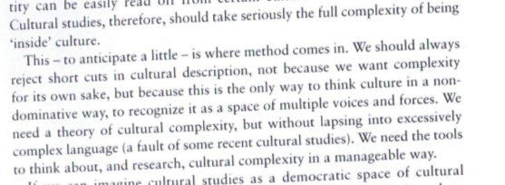
Why do we needs tools/methods to think about culture?
'Cultural studies … should take seriously the full complexity of being “inside culture.” This … is where method comes in.' Couldry, Inside Culture
Page 4

Slide 6
Couldry: what is cultural/media studies?
Sociologically influenced and fully materialist methods
Distinctive concern with connections between power and culture (cf. Cultural sociology)

Slide 7
Couldry: experience and studying culture
Individual experience connects to web of relationships
Thinking about your own situation as key starting point

Slide 8
Couldry: method and the complexity of contemporary culture
Materialist: culture is the result of what particular people have done at a particular time and place, under certain constraints
Reflexivity about method: think about how particular methods produce particular results or ways of seeing culture
Relations to theory: pragmatic – how does it open up different empirical questions

Slide 9
Exercise 1: culture and power in your research project
Make a small collection of different online materials relating to your topic
List some of the kinds of voices you can find associated with your chosen topic
Describe some of the ways in which your own situations might shape your experience of your research topic
List some ways in which your research might be materialist in its approach
List some theoretical approaches that might open empirical questions for research

Slide 10
Exercise 2: documenting the complexity of a cultural studies approach to your research topic
Collectively draft an blog entry or piece of writing that:
  provides some sample empirical materials (cut and pasted?), or via hyperlinks
  Lists some of the voices (individual, group, institutional, commercial, etc.) evidenced in this materials
  Describes how your own situations (as students, as a certain age, sex, class, nationality, etc.) affects your experience (or lack of experience!) in relation to the topic
  Discusses in a preliminary way 2-3 theoretical approaches you might make use of in empirically researching the topic

Slide 11
Part B Interview preparation
Each group will ask 3 questions
Nominate 3 people to ask the question
One person in each group will make notes on the discussion that follows the question

Slide 12
Exercise
Informed by the reading today (Couldry) and the work you have already done on research project, draft questions that address
1. Power and culture
2. Reflectivity, experience and participation
3. Materialist methods and theories
In relation to the recommended reading (Tyler)

Slide 13
Review of key points
Need for method in cultural studies – to resist dominant or accepted view of culture; to find voices that are not visible; to connect our own experience with others; to deal with problems of power
Next week: working with the complexity of texts using semiotics and discourse analysis

