Slide 1
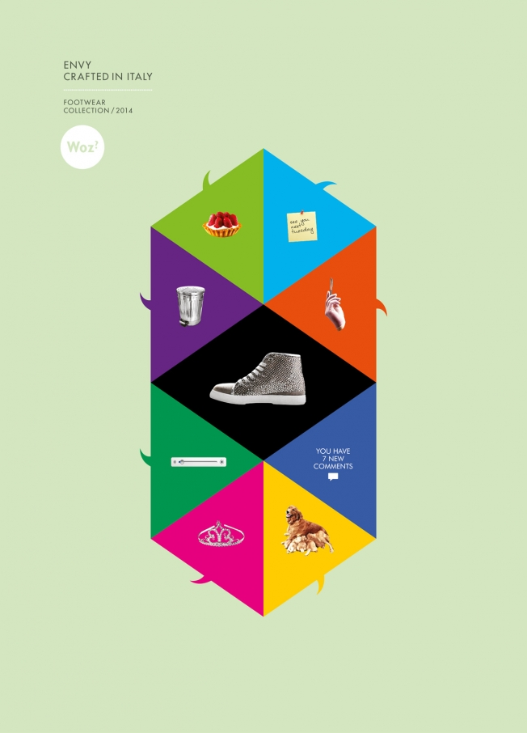
Week 3
Textual analysis

Slide 2
Key points from Couldry last week
Need for method in cultural studies – to resist dominant or accepted view of culture; to find voices that are not visible; to connect our own experience with others; to deal with connection of culture and power
This week: working with texts using semiotics in textual environments
Motivating intuition: by analysing texts, we can better understand how meanings, representations and values are shaped in particular ways (hegemonic, dominant, etc).
But also need to look beyond 'the text' itself to answer this

Slide 3
Semiotics and discourse analysis as methods
Semiotics – study of signs – how texts make meanings (Barthes); possibly most popular method in media and cultural studies
Compare discourse analysis – analysis of a particular form of language and the institutions linked and shaped by that form of language (Foucault – more on this next week)

Slide 4
Semiotic analysis
Often used to reveal ideology and how it is structured by unequal social power relations
e.g. how an advertisement represents social differences

Slide 5


Slide 6
Signs and meaning-making
Sign – key concept of basic unit of all texts
Sign composed of signifier and signified, but can be attached to each other in different ways
Semiotics identifies key signs in a text and analyses their relations

Slide 7
Relations between signifier and signified
Various analytical concepts:
  Pierce – iconic, indexical and symbolic signs
  Syntagmatic vs paradigmatic
  Denotive vs connotive
  Synecdochal – parts stands in for whole
  Signs may work in all or some of these ways to attach, produce or transfer meaning in a text
  Signs may 'naturalise' a particular meaning (make it seem obvious and uncontestable)
  Signs may link to wider systems of meaning (codes – Hall; mythology - Barthes)

Slide 8
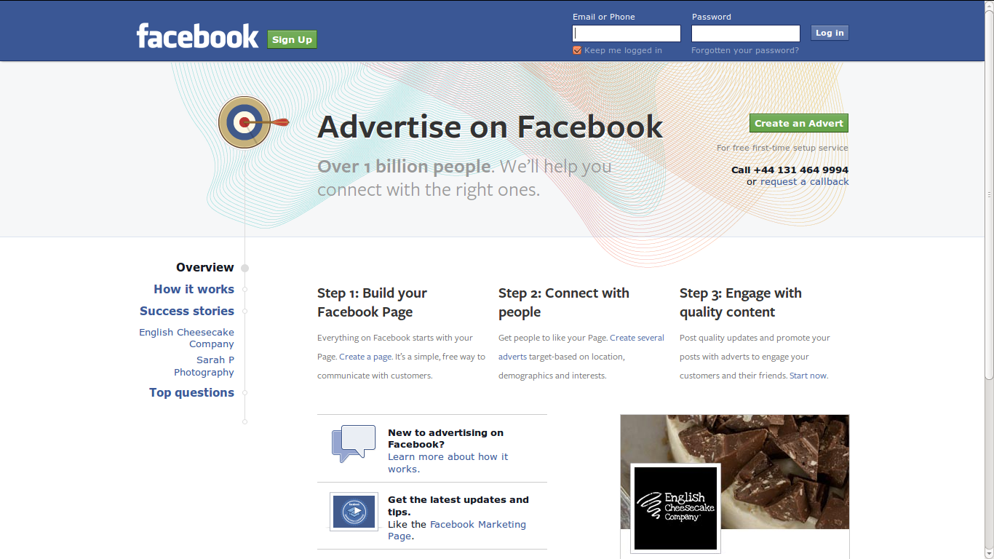
https://www.facebook.com/advertising?campaign_id=214294157440&placement=broad&creative=50677677152&keyword=+online++ads&extra_1=52fa307e-7315-4929-4a70-000014e7bdbf

Slide 9


Slide 10
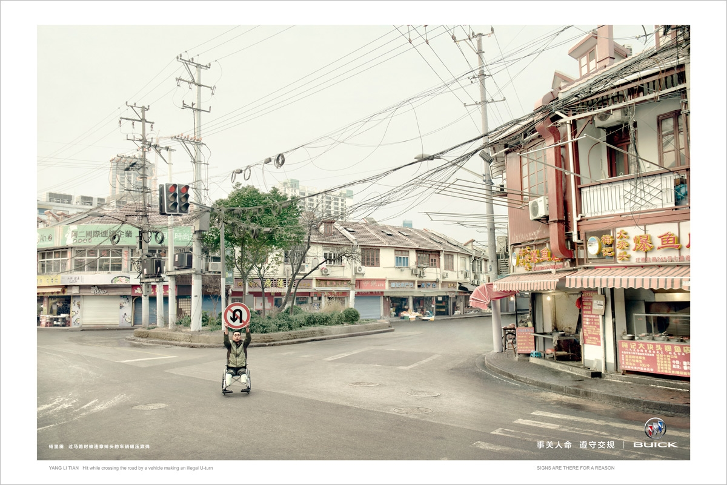

Slide 11
Exercise: semiotics and sign
Identify linguistic and visual signs here, and describe their signifieds and signifiers
Describe some of the relations between signs and how they attach, make or transfer meaning in the text
Identify some wider systems of meaning (codes, etc.)

Slide 12
Problems with semiotics
Tends to treat texts in isolation and assume an 'expert reader' who analyses them
How to select the texts (Couldry, 68) and explain why they matter?
Technical vocabulary can be confusing
Doesn't ask how a text is taken up in particular social, cultural or media settings.

Slide 13
Using semiotics today
More effective where meanings are standardised or controlled
  Fashion
  Advertising
  News
  Certain genres of books, television and films

Slide 14
Definition of 'the text'
Text = 'complex of interrelated meanings which its readers tend to interpret as a discrete, unified whole' (Couldry, 70-71)
Textuality – 'the different ways in which something can function as a text for its readers' (Couldry, 71)
Investigate specific forms of textuality; e.g. compare the textuality of an episode of a soap opera with a museum
Intertextuality = relation between texts (film + merchandise)
Notion of 'textual environment' incorporates forms and practices

Slide 15
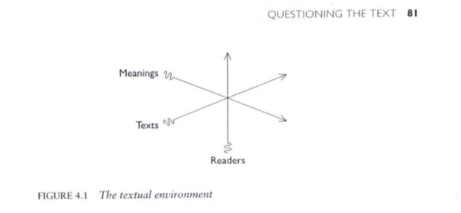
Textual environment: text and reader are co-produced
Examine not just meanings, but flows of texts and readers
Look at material structures of textual production and distribution
Processes that order how we read, connect or screen out texts
Couldry, 81

Slide 16
Exercise: the textual environment of your group research topic
Choose one or two contrasting texts relating to your project and do a semiotic analysis of how they make meanings
Using the same texts, describe the textuality of the texts
Using the same texts, describe some aspects of the textual production and distribution in the textual environment
How does an analysis of the textual environment differ from the semiotic analysis of the text in your examples?
Document the examples and yours analysis on your group research site

Slide 17
Part II: The interview
Anne Cronin and her work on advertising in the city
Advertisements – classic examples of 'texts' analysed semiotically (e.g. Barthes)

Slide 18
Exercise: prepare interview questions
In your research project groups, frame 3 questions about how to study advertisements as:
  Texts – using semiotics or other approaches
  Textual environments
Remember:
  You are not asking about how ads work
  You are asking questions that help you understand how Anne Cronin did her research on ads
  You cannot assume that Anne Cronin has read Nick Couldry's work on textual environments, so you might need to frame your questions

