Slide 1
Week 4
Visual Analysis

Slide 2
Overview
Visual methods in general (Rose)
Discourse analysis as a method
Applying discourse analysis to the group research projects
Interview preparation
Interview itself

Slide 3
Ways of approaching images
Site of production, the images themselves, sites of audiencing/viewing
Couldry: 'the textual environment' – flow of meanings, flow of readers,

Slide 4
What visual methods are there, and who uses them?
Semiotics (see last week) – cultural studies
Compositional analysis – art history
Content analysis – sociology and communication
Psychoanalytic and other theoretical readings: – cultural studies
Discourse analysis – cultural studies, sociology and communication
Ethnography of social viewing practices – sociology and communication
Making images – photos, videos, etc: – sociology and communication, art and design

Slide 5
Exercise: methods and textual environment
Take the list of visual methods and say what site/s of the image of the image they focus on (production, image itself, audiencing)

Slide 6
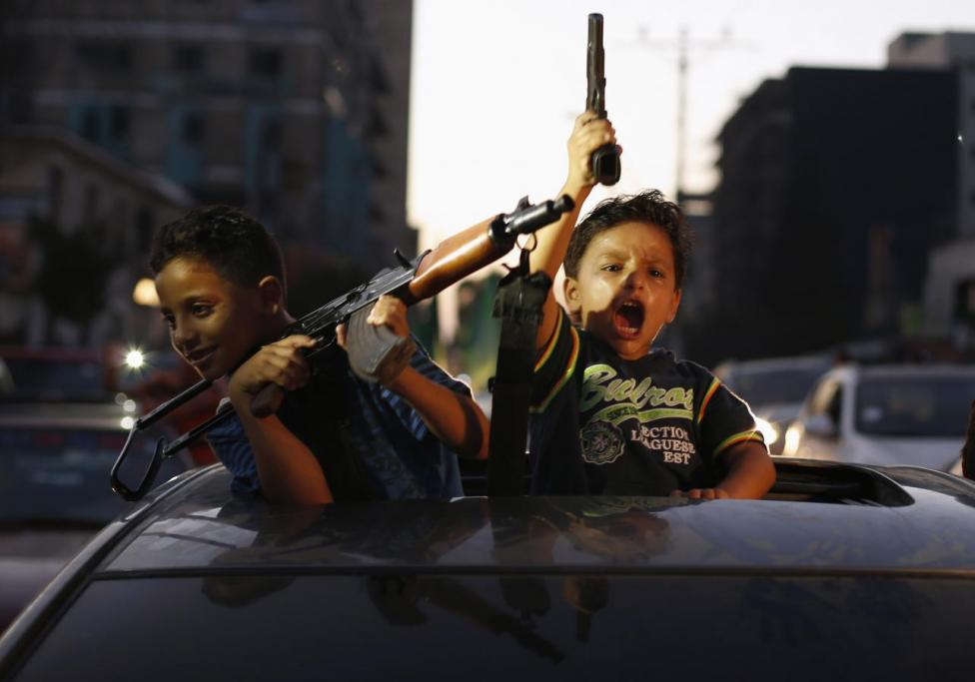
Compositional analysis

Slide 7
Compositional analysis
Content – what is actually shown
Colour – effect on realism, on atmosphere, etc.
Space: scale, complexity, geometry, perspective
Viewer's position

Slide 8
Exercise: compositional analysis
1. In pairs, list some key compositional aspects of the Reuters photograph

Slide 9
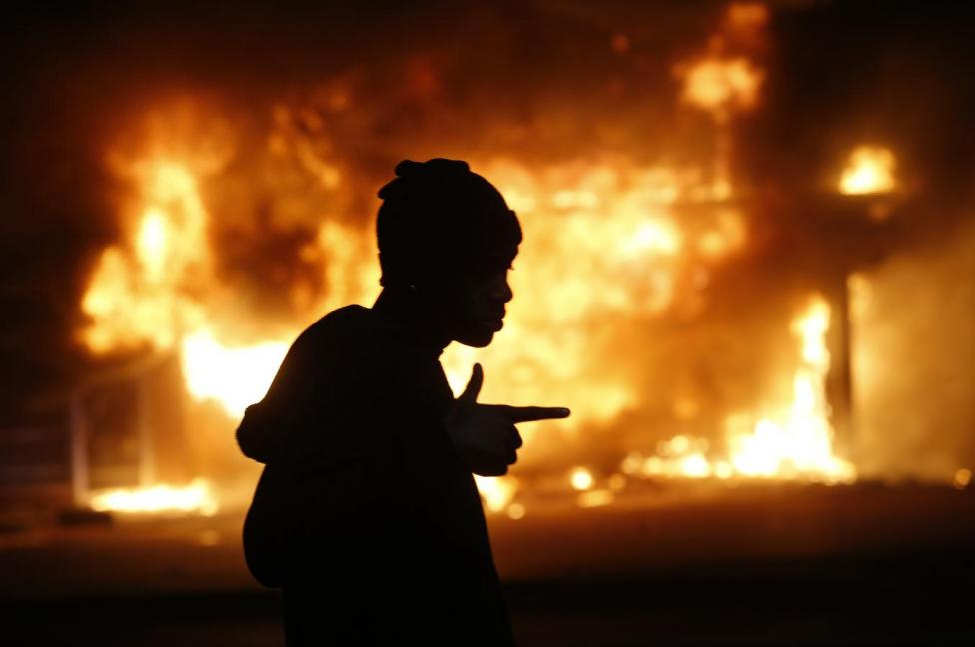

Slide 10
Gillian Rose's critique of visual cultural studies
Exercise: what is Roses' critique of typical visual cultural studies?

Slide 11
Gillian Rose's critique of visual cultural studies
Focus on meaning, and contested meanings, with the critic 'finding' the meanings and doing the critique
Reliance on connoisseurship to identify what matters

Slide 12
Discourse analysis as a method
Centred on Foucault's notion of a discourse: groups of statements that structure the way a thing is thought, and the way we act on the basis of that thinking
Discourse includes both language and things, what is read and what is see, what is written and what is done
Discourse analysis less concerned with meaning and more with how power actually works in practice
As always with Foucault: power is productive (not just repressive!)
Different emphases in discourse analysis – some on language ('critical discourse analysis' (Fairclough)) or images, and some on practice/institutions

Slide 13
Doing discourse analysis
Usually starts from authoritative account + lots of other sources that relate to it
No set number of sources, but sufficient quantity to generate complexity or tensions
Try to forget preconceptions in reading/viewing the sources
Look for common features across sources – similar conventions, styles, features – and perhaps code/tag images/texts
Look for different relations or reactions to the same thing: complexities, tensions, contradictions
Read with an eye for details that may indicate something taken-for-granted but neverthelss important

Slide 14
Exercise: finding an authoritative sourcefor your group research project
Spend some time identifying what might be an authoritative source for your topic
Now find some less authoritative sources
List some common features and some differences between the two types of sources
Can you identify any contradictions or tensions that need further analysis?
Write this analysis up as a post for the online group documentation – make sure you include snippets or examples from the different sources

Slide 15
Exercise: prepare questions on discourse analysis and visual culture for interview
In your groups, prepare 3 questions that ask the guest how he/she studies
  Visual forms
  Relations of power associated with visual things
  Practice

