Slide 1
Week 5
Visual analysis II: 'the visual construction of the social'

Slide 2
Overview
Review of discourse analysis
“Showing seeing” (Mitchell)
Discourse analysis and practices of visibility
Group research project exercise
Interview with Graeme Gilloch

Slide 3
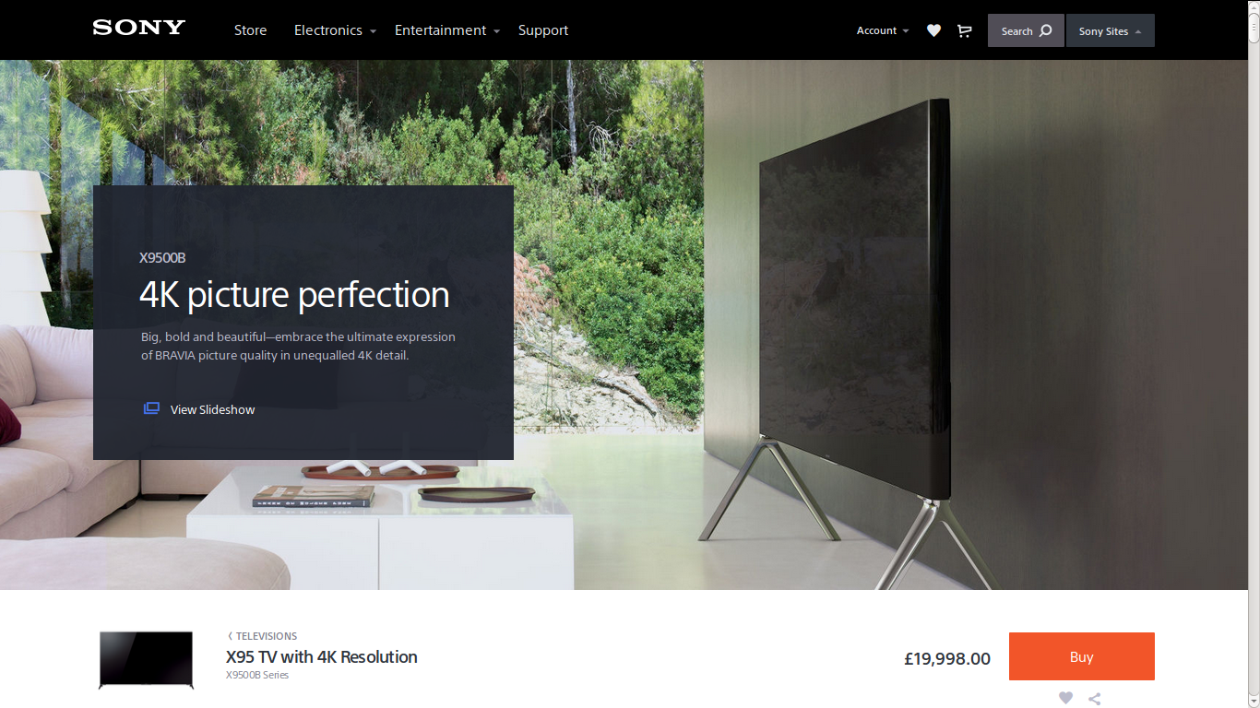

Slide 4
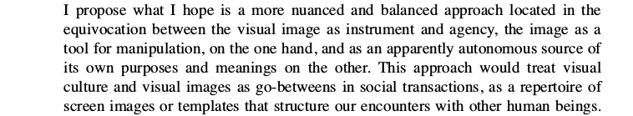
Reading for this week: W.J.T. Mitchell on the idea of 'visual culture'
Key ideas:
Myths of a 'visual culture' or the 'pictorial turn'
All media are mixed (no 'visual media')
Not so much social construction of vision as visual construction of the social
Page 176

Slide 5
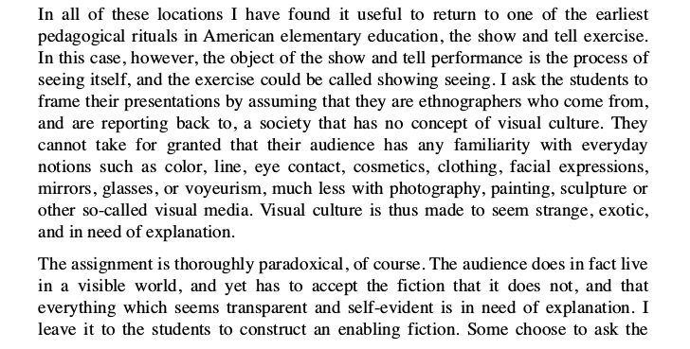
Mitchell, 'Showing seeing'
Page 176

Slide 6
Exercise: 'showing seeing'
Re-read Mitchell on 'showing seeing' (page 176)
Look at this screen
Describe seeing it for people who have no visual culture
  You cannot assume that they know anything about eyes, images, pictures, technologies, etc.
Report back to the group

Slide 7
Review
Discourse analysis as a key method for textual/media environments (texts, meanings and readers)
Discourse analysis: map groups of statements that structure of how things are thought and actions based on that thinking
Discourse analysis involves reading/looking at things and at actions
'Visualities themselves are practices' (Rose, 550)

Slide 8
Observing 'what happens when people look'
Practice: what is routinely done, and involves body, things, thinking, place and knowledge
Practices are fundamental to performativity (and hence experience and identity)
Exercise: list examples of practice and say why they are practices

Slide 9
Discourse analysis of actions: visual practices and their importance
Focused on how institutions and subject-positions are made visible together:
  School:students/teacher;
  Factory:worker;
  Hospital/clinic: doctor/patient, etc
  Media: spectator?
Each is a regime of visibility
  Each may use images but in different ways

Slide 10
Methodology for studying regimes of visibility
Look at instititutional apparatuses (architecture, laws, regulations, policies, theories, rules)
Look at technologies – disparate sets of tools and methods assembled
  Compare photography as used in fashion magazine and photography as used in passports or forms of ID
Look at production, circulation and audiencing of images
  e.g. how are photographs used, stored, classified, valued, etc differently in different institutions

Slide 11
Sources for analysis of institutional apparatuses
Images and documents
Architectures of specific places
Websites and apps
What experts, practitioners, professionals and participants say or do
Wider discourses and institutions (governments, organisations)

Slide 12
Sources for discourse analysis of technologies
Technologies of display, seeing, looking, searching,
Textual technologies – labels, captions, indexes, print formats (booklet, pamphlet, article, etc.)
Architectural technologies: entry points, facades, designated paths, thresholds, accessible vs inaccessible spaces
Specialized spaces: studios, laboratories, control rooms, archives, etc.

Slide 13
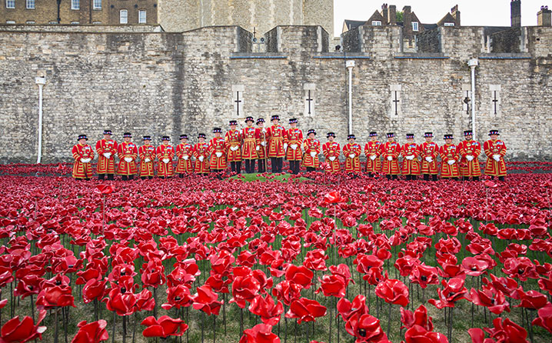
Example: 'Blood Swept Lands, Seas of Red', 2014

Slide 14
Group research project exercise
Write a description of the visual construction of your research topic following the 'showing seeing' guidelines and rules described by W.J.T. Mitchell in this week's reading.
Document this description using text and images on your group project online site.

Slide 15
Group research project exercise B
Write a preliminary description of the institutional apparatuses, technologies and practices of audiencing that visually construct your topic of analysis.
Document this description using text and images on your group project online site.

Slide 16
Preparation for the interview with Graeme Gilloch
Follow usual practice and prepare 3 three questions in your groups for the visitor.
The questions must relate to methods for studying:
  Visual/media construction of the social
  Power relations and visibility

Slide 17
Next week: ethnography and observing people in practice

Slide 18
For your group research blog, choose one image or object (different to last week), and write an analysis of it that uses:
1. the implicit methodology of visual culture studies as described by Gillian Rose;
2. the practice-based methodology to highlights objects, knowledges, bodily gestures, emotions and places.
In order to do 2. you might need to describe where you found the object, look at surrounding text, comments, and audiences.

