Slide 1
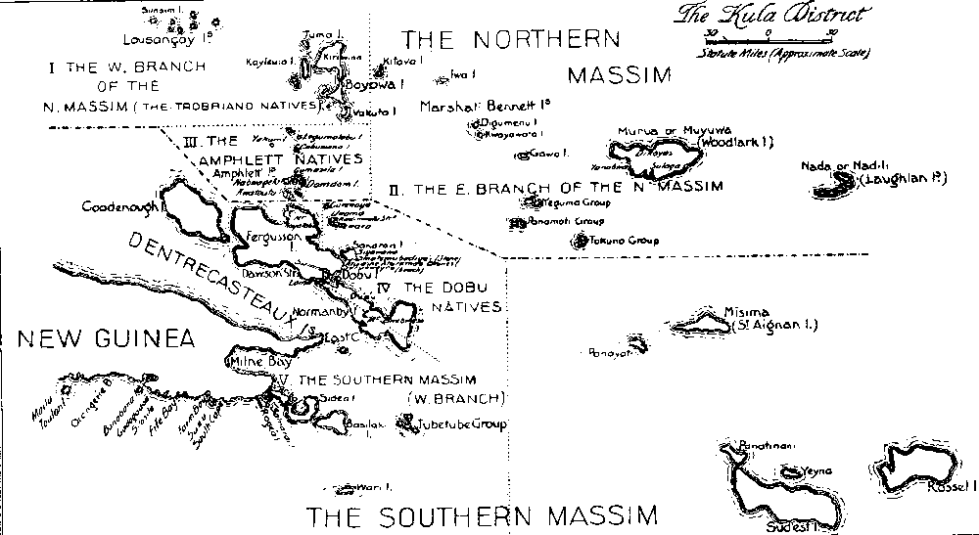
Week 6: Ethnography – studying what people do with things

Slide 2
Overview
Ethnography: history and development
Ethnographies of media and audiences
Ethnographies of users and things
Group research work
Preparation for interview with an ethnographer
Interview with Lucy Suchman

Slide 3
Review
Semiotics and textual methods
Discourse analysis – saying and seeing; statements and practices;
Little emphasis here on audiencing, spectating, using, etc.

Slide 4
Ethnography – general
Main method in cultural/social anthropology; very important in urban sociology, media sociology and cultural studies
Focuses on one case or place
Sustained personal contact between researcher and people they research
Looks at the whole situation
Notion of 'field site' develops in late 19 century, based on 'field sciences' (like geology)

Slide 5
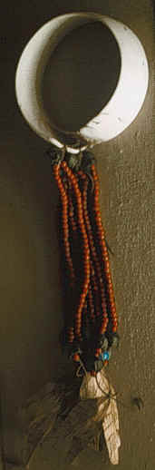
The 'field'
'the field' in 20th century anthropology usually meant somewhere remote (New Guinea, Uganda, etc.)
'the field' in late 20th century ethnography included places close to home
Choice of field often affected by problems of access (who, where, when)

Slide 6
Ethnography as method for studying media in the social world
2 approaches
  Study how audiences make sense of media
  Study how media circulate and act in the world as things

Slide 7
Ethnographic studies of audiences, fans, and users
Observe how audiences make sense ('decoding' – Hall) of particular media, and how their sense-making relates to social and cultural identity
Explore how fans closely observe, interpret and transform across media (tv, music, blogs, etc)
Examine how users move across media in 'convergence cultures' (Jenkins), as does content

Slide 8
How to study audiences
Earlier studies (1980s on) tend to use interviews that explore how people make sense of media
One-on-one; family; group;
Selection of people to interview will be shaped by what you think is important (class, gender, etc.)
Analysis of interviews – reading and reading; identify different clusters of meaning; link clusters to social or discursive positions

Slide 9
How to study audiences ethnographically
Observe, listen and talk to people as they go about everyday lives
Involves extended periods of time spent in 'the field'
'data' is gathered primarily by taking notes (sometimes photos and audio recording), and then writing notes up

Slide 10
Ethnography and media objects
Much ethnography focuses on what people do and make (images, objects, etc)
Study what people do with things (devices, technologies, products) in order to understand social relations and identities.
More focused on people as 'users' than as 'audience'

Slide 11
How to ethnographically study things like media?
Pay attention to where and how media objects engage people: visual form, material form, presentational form
Examine how things and people are co-constituted: look at what is actually done where, and by whom
Track mobility of things and how they are re-contextualised: look at the same thing in different places (public, private)

Slide 12
Exercise – ethnography of 'users'
Go to Learning Zone and observe how people are using images and text
Write notes on the place, the visual forms, the material forms, how people sit, talk, and whatever else they do.

Slide 13
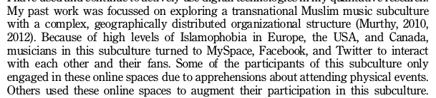
Digital ethnography: access new places
Murthy, 2013, 26
different platforms with different sub-cultures, etc

Slide 14
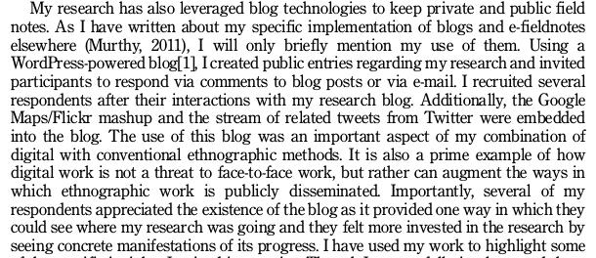
Digital ethnography as engagement
Murthy, 2013, 27

Slide 15
Digital ethnography as new mode of writing
Digital media as both object of research and research tool
Smartphones permit use of video and audio as documentation
Digital devices offer new ways of being present in the field
New ethical challenges -- how to anonymize?

Slide 16
Exercise: 'the field' in your group research project
Discuss actual places nearby that could be ethnographic field sites for your group research project
How could you explore 'decoding' processes there?
What kinds of mobility or circulation of media could you observe, and how would could document them?
Write up these notes for your group research project online

Slide 17
Interview preparation
In your groups, construct 3 questions about doing ethnography, with a particular focus on
  How to write ethnographically
  How study people's relation to things
  This quote: 'configuration orients us to the entanglement of imaginaries and artefacts that comprise technological projects (Suchman 2012: 57).'

Slide 18
  In relation to your research project, find 2 different entanglements of 'imaginaries' and 'artefacts.' Document these using screen shots, quotes or some other empirical material on your group research project blog. Describe how the examples can be understood in terms of configuration.

