Slide 1
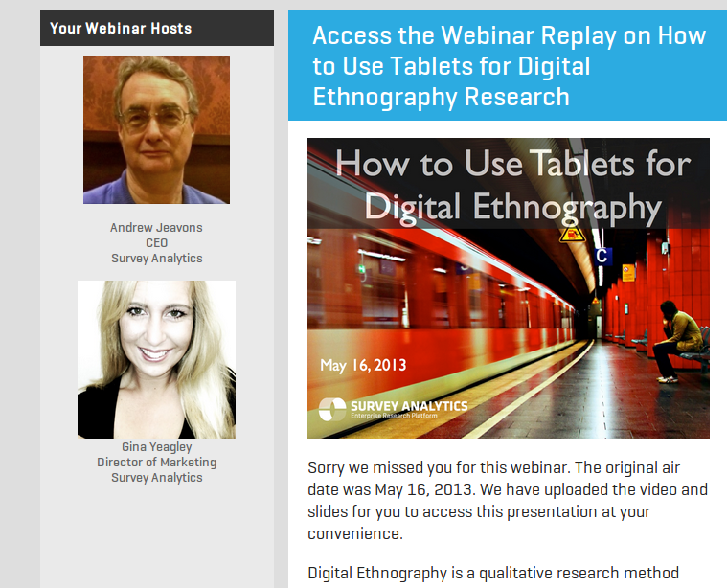
Week 7: Ethnography and participation

Slide 2
Overview
Ethnography and 'live methods'
Ethnography and digital ethnography
Group research projects and live methods
Preparation for interview on ethnography
Interview

Slide 3
Review
Ethnography as way of studying how media is 'consumed' – by audiences, by fans, by social groups
Ethnography as study of how media objects circulate and are transformed
different platforms with different sub-cultures, etc

Slide 4
Participation
'Thus, by participation I refer to amateurs acting together individually, collectively, or with organizations in fields otherwise dominated by gatekeepers or professionals' (Fish, 2013)

Slide 5
Ethnography as making media
Use of writing
Use of photography and film
  Anthropological film-makers
Use of digital platforms

Slide 6
How to make media as part of research?
Make images or recordings as empirical data to be analysed
  e.g. photos/videos of city streets
Make images/videos/recordings as part of an visual essay
Ask participants to take photos or make videos, and then look at them together
  Interview participants about what they made and what it means to them
Question: which one of these does ethnographic film-making focus on?

Slide 7
Live methods again
Manifesto
  New tools for live/realtime
  Avoid the trap of the now
  See the whole without totalizing
  Make methods more artful and crafty
  Develop empirical devices that reinvent relations to social
  Curate knowledge on public platforms
  Utilize senses equally
  Lively words
  Recover history of inventive craft
  Take time
  Engage political and ethical issues without arrogance

Slide 8
Exercise: live methods
Take one point from the 'live methods' (by Back and Puwar) that relates to your group research project, and discuss it with your neighbour to ensure you grasp it.
Discuss how you might practically actualise that point using equipment, devices, objects or infrastructures you have access to right here in the classroom.
Write a list of the practical steps you would need to do to perform to do it.

Slide 9
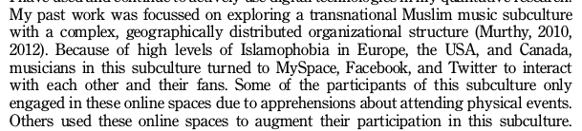
Digital ethnography: access new places
Places that would be difficult to access – geographically or socially
Murthy, 2013, 26

Slide 10
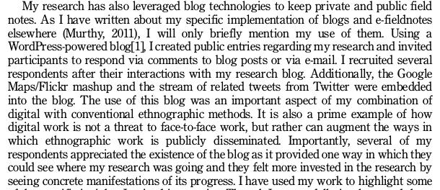
Digital ethnography as engagement or form of accountability
All ethnography 'engages' participants (a.k.a. 'informants')
Murthy, 2013, 27

Slide 11
Digital ethnography as new mode of writing
Digital media as both object of research and research tool
Smartphones permit use of video and audio as documentation
Digital devices offer new ways of being present in the field
New ethical challenges -- how to anonymize?

Slide 12
Digital ethnography as 'live method'
Re-ordering the relations between data-gathering, analysis and circulation
Looking outside 'academic methods' and repurposing art/activist approaches
Reassessing how digital tools shape our understanding of social life

Slide 13
Group research project: digital ethnography
Discuss a digital ethnographic study that would:
  Deal with problems of geography and social inclusion
  Provide some way for participants to engage in the research (see 'Live Methods' manifesto)
Write a brief outline (300-450 words) describing how you imagine this study would work in practice.

Slide 14
Interview preparation
Following normal practice, construct 3 questions in your research groups that address:
  Researchers as participants in media cultures
  The liveness of methods
  The challenges of digital ethnography in 'convergence cultures'.

