Slide 1
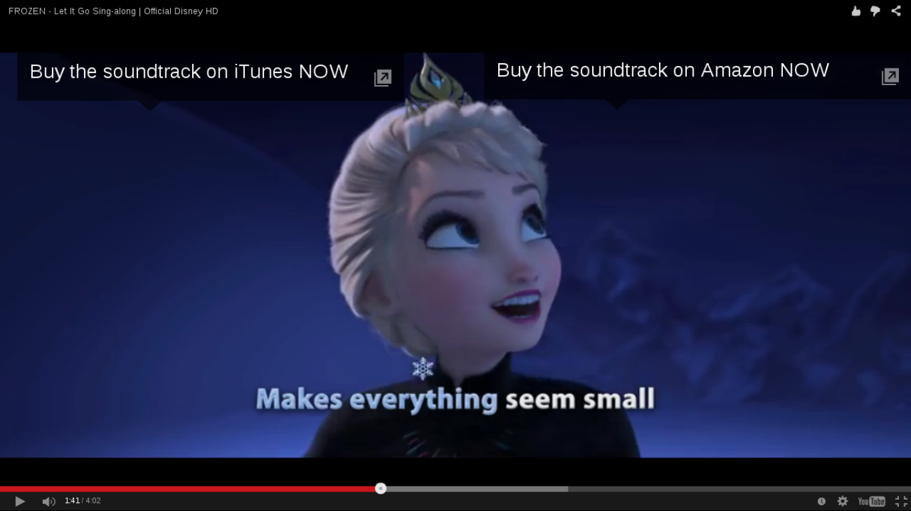
Week 8:
Research questions and design

Slide 2
Media and cultural studies
'We need the tools to think about, and research, cultural complexity in a manageable way' Couldry, Inside Culture, 2000, p.4
Why?
https://www.youtube.com/watch?v=3XviR7esUvo

Slide 3
Overview
Interview – catch up from last week
Review of methods
Report on the blogs
Research design exercises x 4

Slide 4


Slide 5
Methods overview
 | images | texts | places/things | people | organisations
semiotics | x | x | x
compositional analysis | x |  | ?
discourse analysis of documents | x | x |  |  | x
discourse analysis of institutions/practices |  |  | x |  | x
ethnography of audiences |  |  | x | x | x
ethnography of media objects | x | x | x
participatory methods | x |  | x | x | x

Slide 6
Methods we did not cover in the course
Psychoanalysis-influenced reading of text (e.g. Lauren Berlant)
Digital methods (e.g. Richard Rodgers)
Media archaeology (e.g. Friedrich Kittler)

Slide 7
Report on the online projects?
Discuss as a group where you are up to, and prepare brief report

Slide 8
Exercise: the research materials
List all the materials/places/people/things that could be relevant to your project
Make a table of these and suggest what methods would be appropriate to work with these materials

Slide 9
Exercise: the relevant theories and approaches
Choose 3 course outlines from courses you are doing this year (use moodle?); they can include sociology, gender and women studies, anthropology, science studies.
Choose 2 theories/key texts from each – these should be major theories or approaches
Discuss as a group the 2-3 most relevant theories/approaches for your project
Write a brief description of how the most relevant approaches relate to your project

Slide 10
Exercise: the research literature
Use Google Scholar or Web of Science to find some recent academic literature from cultural and media studies relating to your project topic.
Approaches:
  1. search by topic, concept or theory
  2. look at recent citations of earlier work you think is relevant
Use bibliographic software (zotero, mendeley, endnote)!

Slide 11
Exercise: the research question
Individually write two potential research questions.
Gather in a group to discuss and choose best two for the project
Groups present to each other and discuss
Rewrite best two for project

Slide 12
Activity for online project
Develop the table of empirical materials and methods you started in class, and then put it up on the blog. The table should show
  the empirical materials you will use, with numbers that quantify how many of each thing
  the methods you will use to gather and analyse the materials
  the order in which you will work on the materials
Annotate the list of academic references you found relating to your research topic.
  You should put a full bibliographic reference for each reference.
  Rank or order the list of references in terms of their relevance to your project, and briefly describe why they are relevant.
  Put the list of references on the group research blog.
Put the best two research questions on the blog, along with some discussion of how you arrived at them.

Slide 13
Essay question
Nick Couldry wrote in 2000: 'cultural studies is an expanding space for sustained, rigorous and self-reflexive empirical research into the massive, power-laden complexity of contemporary culture' (Couldry, 2000, 1).
Critically analysis what this claim means for media and cultural studies research in 2014/2015. Drawing on the various interpretative, textual, visual, observational and participatory methods discussed in the course, describe some of the ways your group research project could address the challenges of empirically researching contemporary culture today. You will need to spend some time in your essay describing what your research was about, but this description should mainly serve to highlight your analysis of the challenges of contemporary research.

