Slide 1
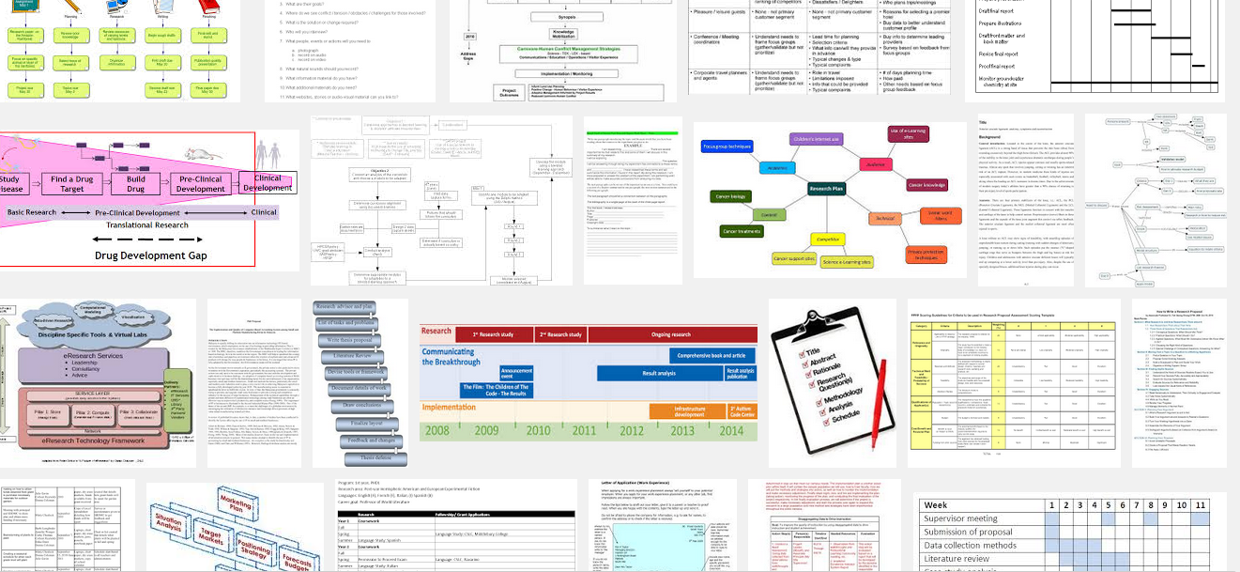
Week 9: Research design

Slide 2
Overview
Interview – Fish?
Revisiting research questions
Finishing the online project
Essay question (again)
Preparation for presentations

Slide 3
Exercise: research questions checklist
Does the question connect to current problems or approaches in media and cultural studies?
Does the question have any built-in assumptions about culture, media, power, experience, values, etc.?
Are the terms used in the question well-defined?
Is the question empirically researchable?
Does the question have the potential to contribute something new?

Slide 4


Slide 5
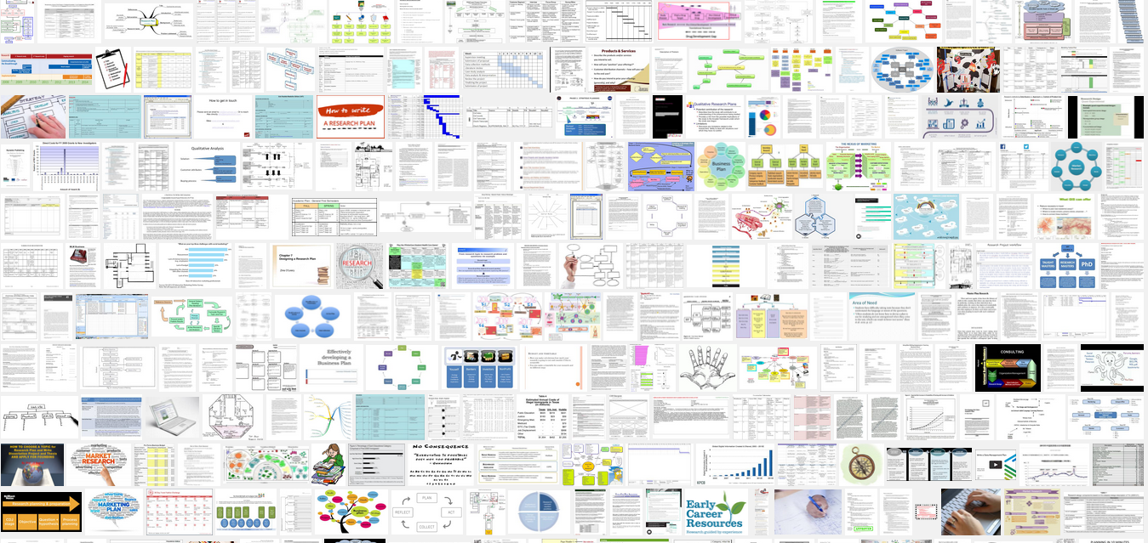
Making a research plan
Why do you need a plan at all? Why not just do the research? Regard plan as place to do thinking/design of a project

Slide 6
Exercise: the research plan
Look at the variety of visual forms and organisations of research (Google images?) and choose one to imitate for your project
Select key examples, approaches/methods and organise them in a research plan for a project that would last 3 months
Document the research plan online.

Slide 7
Methods overview
 | images | texts | places/things | people | organisations
semiotics | x | x | x
compositional analysis | x |  | ?
discourse analysis of documents | x | x |  |  | x
discourse analysis of institutions/practices |  |  | x |  | x
ethnography of audiences |  |  | x | x | x
ethnography of media objects | x | x | x
participatory methods | x |  | x | x | x

Slide 8
    Assessment criteria for the online group research project
1. The blog should show regular and frequent contributions from all members of a research throughout the course.
2. The contents of the blog should document the development of the research project beginning from choice of topic, through framing of questions, consideration of relevant academic work, design of research, examples of materials, objects, things, and events relating to the project, and critical, theoretically and methodologically informed writing about how the research group carried out the project.
3. The blog should demonstrate the research group has a considered and practiced with a range of different research methods and approaches, and this range of methods should include visual, textual, and audiovisual analysis, ethnographic and interview techniques, as well as consideration of medium specificity. It may also include activist, participant, and other kinds of critical practice such as photography, video-making, sound recordings, etc.
4. Effective research blogs will make use of the many different blogging possibilities of displaying images, writing entries, tagging entries to organise them, linking to other sources (including other blogs), and feedback through comments.

Slide 9
Presentations (week 10)
12-15 minutes;
8-10 slides
Everyone presents some part of the project

Slide 10
Typical presentation structure (12-15 minutes)
Title-introduction – framing remarks
Topic and research question
Related work – overview
Plan of research
Concrete examples
Conclusion
  Implications
  Remaining questions/problems

Slide 11
Essay question discussion
Nick Couldry wrote in 2000: 'cultural studies is an expanding space for sustained, rigorous and self-reflexive empirical research into the massive, power-laden complexity of contemporary culture' (Couldry, 2000, 1). Critically analysis what this claim means for media and cultural studies research in 2014/2015. Drawing on the various interpretative, textual, visual, observational and participatory methods discussed in the course, describe some of the ways your group research project could address the challenges of empirically researching contemporary culture today. You will need to spend some time in your essay describing what your research was about, but this description should mainly serve to highlight your analysis of the challenges of contemporary research.
Why this quote from Couldry?
What has it got to do with media? It talks about culture …
What are the hard parts of this question?

