Slide 1
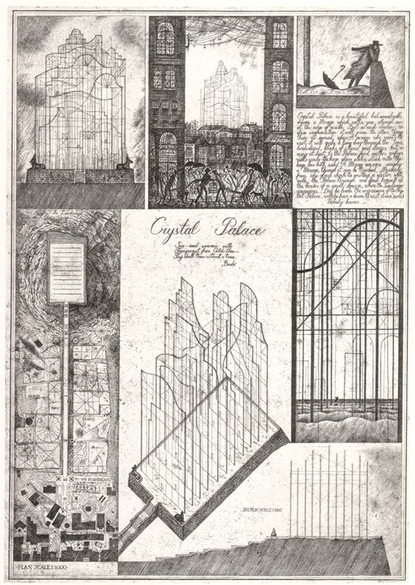
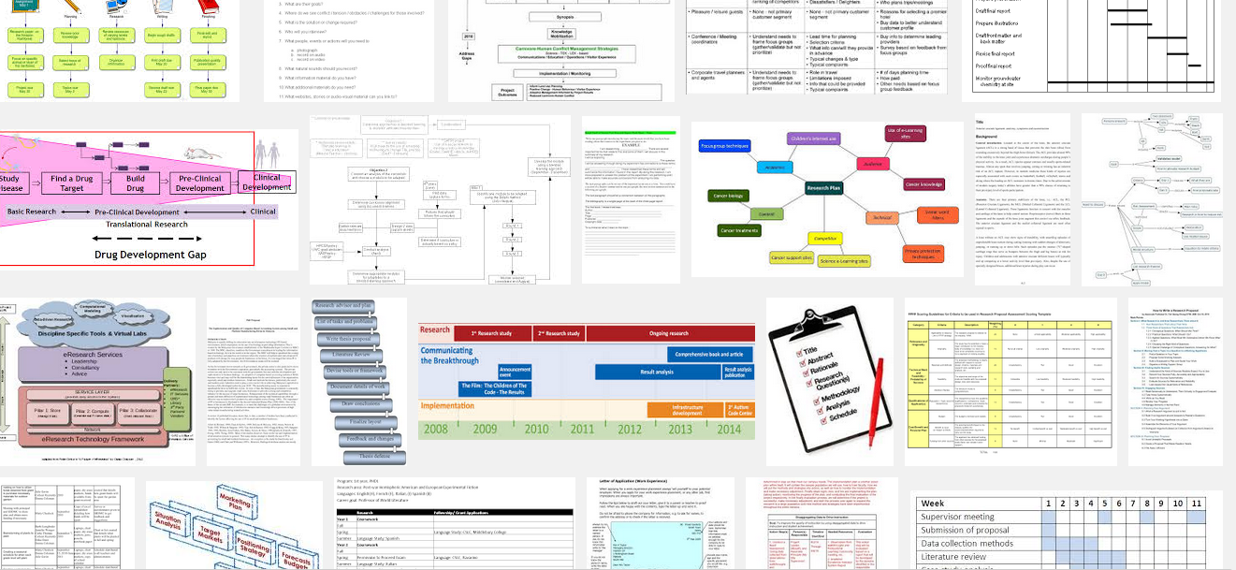
Week 9: Research design

Slide 2
Overview
Research questions?
Re-visiting discourse analysis and live methods (weeks 6 & 7)
Finishing the online project: the plan/timetable of a project
Preparation for presentations
Essay question

Slide 3

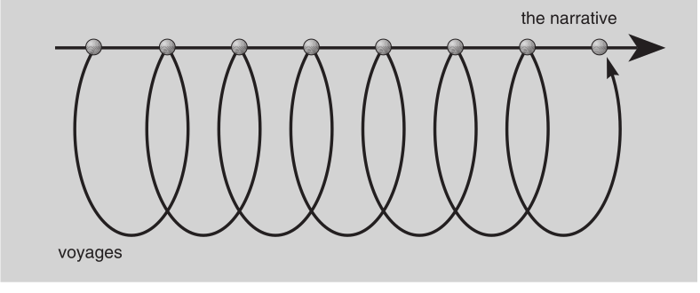
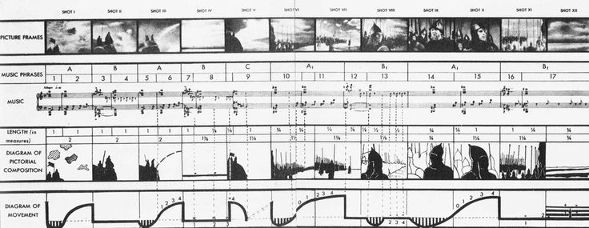

Slide 4
The research questions
Exercise: research questions checklist
Does the question narrow down the topic and focus on some specific aspect of it?
Does the question address current problems or approaches in media and cultural studies?
Does the question have any built-in assumptions about culture, media, power, experience, values, etc.?
Are the terms used in the question reasonably well-defined?
Is the question empirically researchable given your time and resources?
Does the question have the potential to contribute something new?
If there any problems with your research questions, discuss in the group how to fix them.

Slide 5
Re-visiting discourse analysis
Read short extract from Kendall & Wickham, Using Foucault's Methods, pages 139-141.
What is the contrast between two different ways of analysing 'discourse' (in Foucault's sense of that term)?
What would this contrast mean practically?
Do any of the guest researchers this term do a version of discourse analysis?

Slide 6
Revisiting discourse analysis for group research projects
Identify some of the materials, documents, things or places in your group project that you might address using discourse analysis?
How does this approach shift emphasis away from meaning? What does it emphasise instead of meaning?

Slide 7
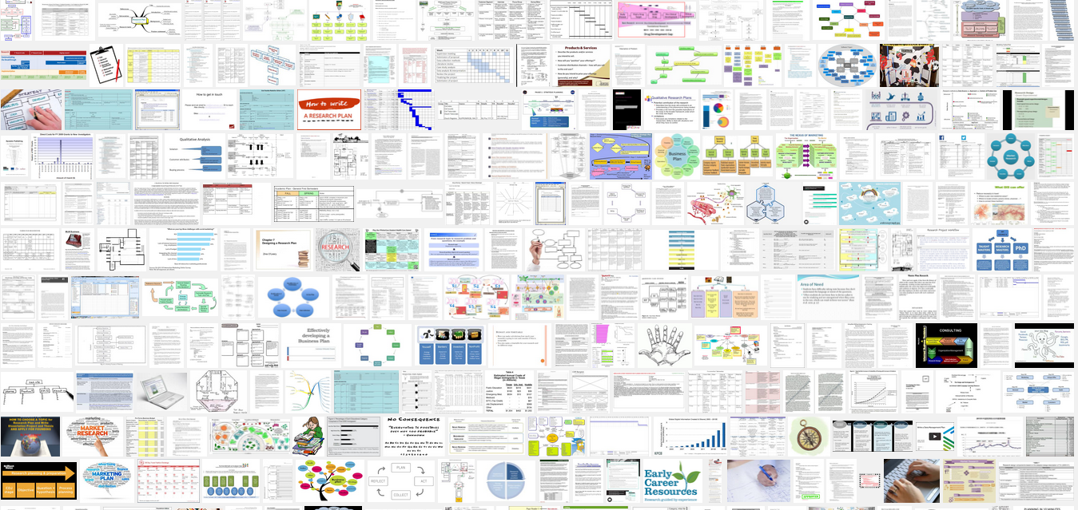
Making a research plan

Slide 8
Making a research timetable?
Why do you need a plan or timetable at all? Why not just do the research?
Timetable as one place where research questions are translated into actually do-able research activities
Plans and timetables will always change and be revised as you do the research

Slide 9
Exercise: the research timetable
Given your revised research questions (and the examples and approaches/methods you have on the blog), design a research plan for a project that would last 3 months
  See Google images for many examples of how this can be done
  Usually in the form of a timetable
Put the research plan online and write a rationale (300-400 words):
  e.g. the way different methods help you deal with a particular research question.
  e.g. any particularly unusual focus or novel approaches

Slide 10
Methods review
 | images | texts | places/things | people | organisations
semiotics | x | x | x
compositional analysis | x |  | ?
discourse analysis of documents | x | x |  |  | x
discourse analysis of institutions/practices |  |  | x |  | x
ethnography of audiences |  |  | x | x | x
ethnography of media objects | x | x | x
Participatory and live methods | x |  | x | x | x

Slide 11
    Assessment criteria for the online group research project
1. The blog should show regular contributions from all members of a research throughout the course.
2. The contents of the blog should document the development of the research project beginning from choice of topic, through framing of questions, consideration of relevant academic work, design of research, examples of materials, objects, things, and events relating to the project, and critical, theoretically and methodologically informed writing about how the research group carried out the project.
3. The blog should demonstrate the research group has a considered and practiced with a range of different research methods and approaches, and this range of methods should include visual, textual, and audiovisual analysis, ethnographic and interview techniques, as well as consideration of medium specificity. It may also include activist, participant, and other kinds of critical practice such as photography, video-making, sound recordings, etc.
4. Effective research blogs will make use of the many different blogging possibilities of displaying images, writing entries, tagging entries to organise them, linking to other sources (including other blogs), and feedback through comments.

Slide 12
Guidance on presentations (week 10)
10-12 minutes;
8 slides
Everyone in the group should speak

Slide 13
Normal presentation structure
Title-introduction – framing remarks
Topic and research question
Related work – overview
Plan of research
Concrete examples
Conclusion
  Implications
  Remaining questions/problems

Slide 14
Unusual presentation structures
Montage?
Voyages?
Other non-linear narratives?

Slide 15
Essay question (3000 words)
Our collective research topic this term has been 'fake news.' In your group projects you have investigated various ways of making sense of this recent controversy. Drawing on your experience of working on this topic, the various exploratory activities undertaken in your groups, and the in-class interviews with guest, as well as media and cultural studies readings, critically reflect on the following statement:
'In its research practice, media and cultural studies is a way of making sense of a world that works primarily through, or in reliance, on media.'
In writing your essay, you are not expected to carry out new research, but you should draw on readings, concepts and analytical approaches discussed during the course.

Slide 16
Essay question discussion
Our collective research topic this term has been 'fake news.' In your group projects you have investigated various ways of making sense of this recent controversy. Drawing on your experience of working on this topic, the various exploratory activities undertaken in your groups, and the in-class interviews with guest, as well as media and cultural studies readings, critically reflect on the following statement:
'In its research practice, media and cultural studies is a way of making sense of a world that works primarily through, or in reliance, on media.'
In writing your essay, you are not expected to carry out new research, but you should draw on readings, concepts and analytical approaches discussed during the course.
Why did Adrian choose this quote from Couldry?
What are the hard parts of this question?
How does the group research project help me discuss this topic?

