Slide 1
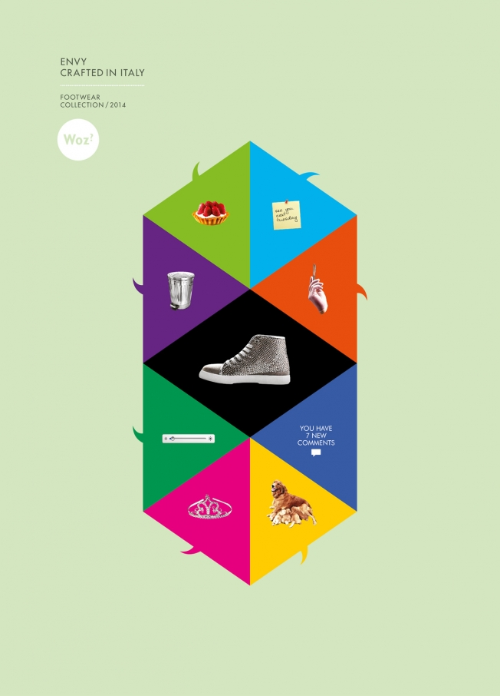
SOCL923
Working with texts I: Textual analysis and 'inside culture'

Slide 2
Week 2 overview
A. Techniques for working with texts & documents
  Zotero and managing references
  Reading academic articles – 5 steps to grasp argument
B. Work on Couldry's introduction from Inside Culture: Re-Imagining the Method of Cultural Studies
  Exploring implications of Couldry’s account of culture, power, and experience for the ‘fake news’ group research project
C. Prepare interview questions & interview with guest

Slide 3
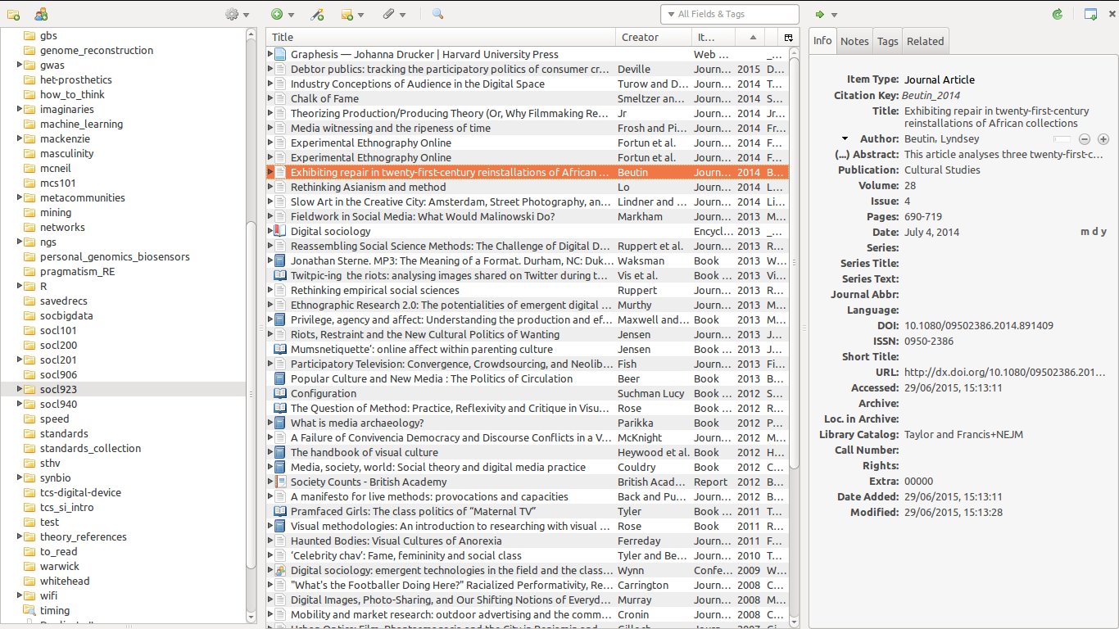
Techniques for working with texts: e.g in Zotero

Slide 4
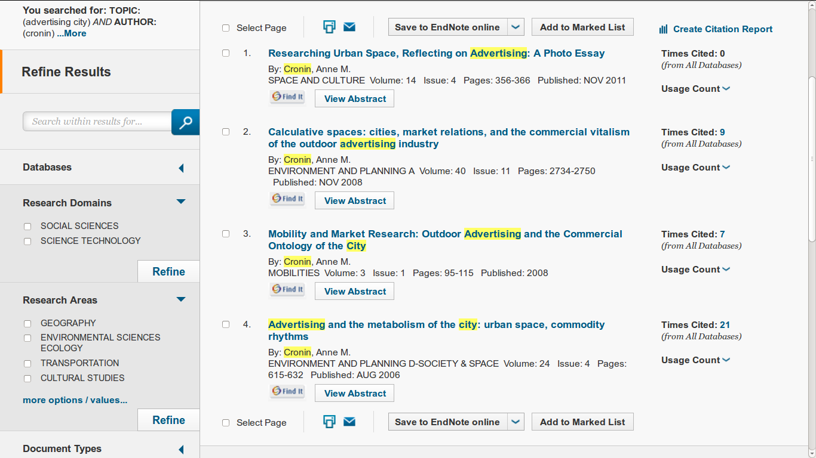
Getting references into Zotero

Slide 5
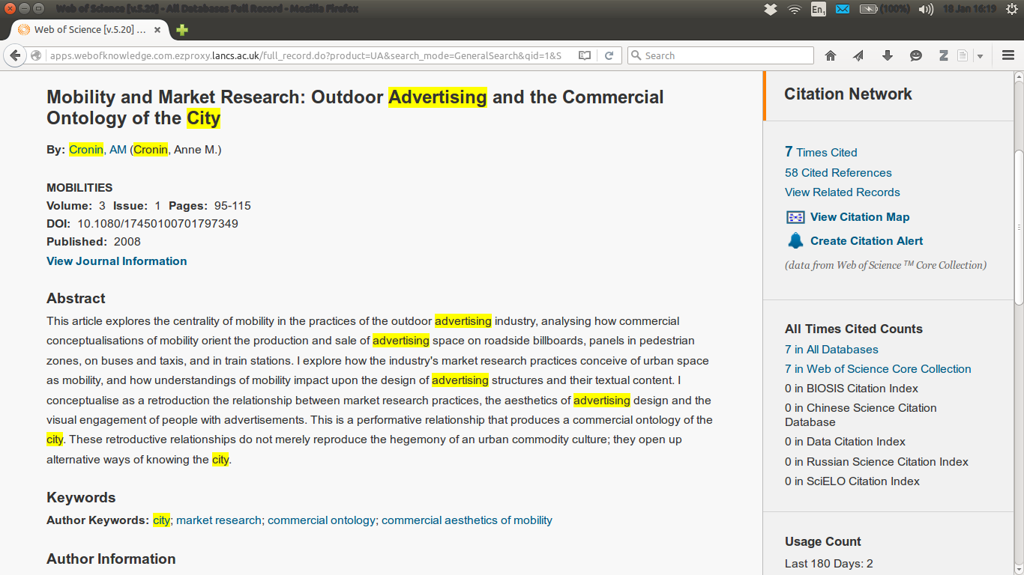
Getting references into Zotero

Slide 6
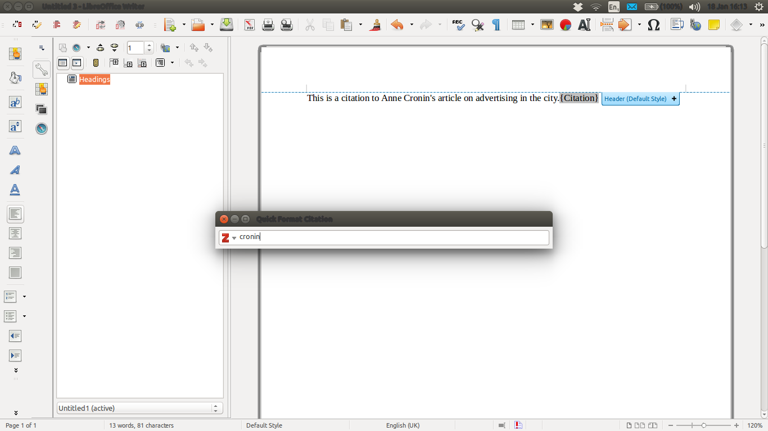
Adding references to essays

Slide 7
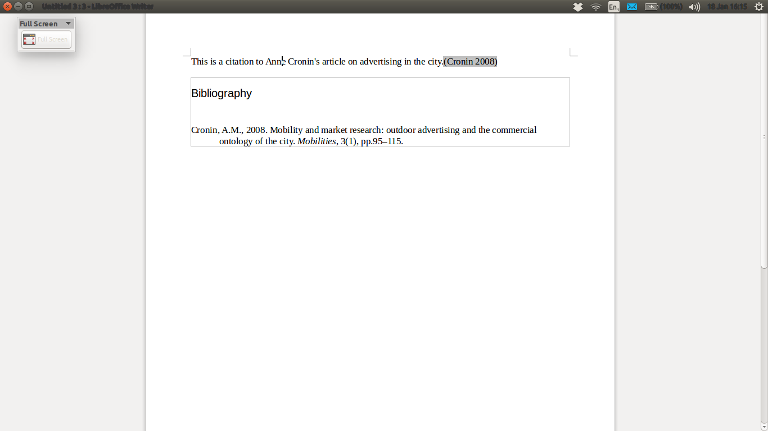
References formatted in bibliography

Slide 8
Reading academic articles
Usually best not to read articles from start to end
  Too slow
  Too much detail
Read for the argument in 25-30 minutes by:
  Reading abstract about 5 times, basically memorising it so that you can say what the article is about without looking at it (5 minutes)
  Write some notes saying what the necessary parts of the article will have to be (5 minutes)
  Look in introduction, conclusion and section starts/ends for summary of main points (5-8 minutes)
  Scan pages looking for things not mentioned in the abstract or summary so far (5 minutes)
  Write summary notes (5 minutes)

Slide 9
Exercise: reading the abstract for Cronin, 2008
Slowly read the title & abstract five times for Cronin and try to memorise it (4-5 minutes)
Mobility and Market Research: Outdoor Advertising and the Commercial Ontology of the City
By:Cronin, AM (Cronin, Anne M.)
MOBILITIES
View Journal Information
Abstract
This article explores the centrality of mobility in the practices of the outdoor advertising industry, analysing how commercial conceptualisations of mobility orient the production and sale of advertising space on roadside billboards, panels in pedestrian zones, on buses and taxis, and in train stations. I explore how the industry's market research practices conceive of urban space as mobility, and how understandings of mobility impact upon the design of advertising structures and their textual content. I conceptualise as a retroduction the relationship between market research practices, the aesthetics of advertising design and the visual engagement of people with advertisements. This is a performative relationship that produces a commercial ontology of the city. These retroductive relationships do not merely reproduce the hegemony of an urban commodity culture; they open up alternative ways of knowing the city.

Slide 10
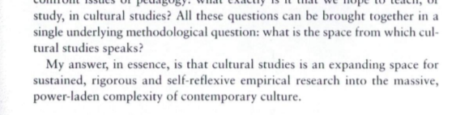
Methods for cultural studies according to Couldry, 2001
p. 1
The single methodological question: 'what is the space from which cultural (and media) studies speaks?'
The answer: 'an expanding space for sustained, rigorous and self-reflexive empirical research into the massive, power-laden complexity of contemporary culture' (Couldry, 2001, 1)

Slide 11
Couldry: what is the space from which cultural/media studies speaks?
His answer is 'inside culture'
  High vs popular culture?
    Culture as process in which each person participates
    Culture does not necessarily equate to popular culture
    The problem with popular culture
      Culture + power: who does what when?
  What else should cultural and media studies be studying if not popular culture?
    e.g. middlebrow culture, elite experience, work, business, science, etc.

Slide 12
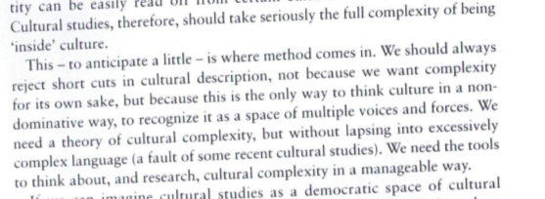
What tools/methods do we need to get inside culture?
Page 4
Being 'inside culture' is complex -
  Find ways of questioning 'forms of address' directed at us
  Couldry's 3 principles: openness, complexity and reflexivity (p.4).

Slide 13
Couldry: how can cultural/media studies be 'inside culture'?
Sociologically influenced and fully materialist methods:
  Look at media and cultural production (song, text, film, website, etc.) done by specific people in particular times and places
  Reflect on the conditions under which you produce knowledge of media and culture (p.12)
Distinctive concern with connections between power and culture (cf. Cultural sociology)

Slide 14
Couldry: media-cultural studies methods and their relation to theory
  Many different theoretical perspectives in MCS (structuralist, post-structuralist, philosophical, psychoanalysis, Marxism, etc.)
  Couldry suggests that MCS does not need to primarily address fundamental philosophical debates
  Use theory from sociology, anthropology, psychoanalysis, philosophy if 'it can open perspectives for possible empirical work into culture' (14)

Slide 15
Couldry: experience and studying culture
Thinking about your own situation as key starting point to understanding complexity of contemporary media and cultures
Individual experience connects to web of relationships
Examples of 'forms of address'?
  Exercise: list some of the things you find yourself wanting to do when you feel distracted while writing an essay

Slide 16
Couldry: method and the complexity of contemporary culture
Materialist: culture is the result of what particular people have done at a particular time and place, under certain constraints
Reflexivity about method: think about how particular methods produce particular results or ways of seeing culture
Relations to theory: pragmatic – how does it open up different empirical questions

Slide 17
Exercise 1: culture and power in ‘fake news’
Make a collection of three different online texts relating to the topic of ‘fake news’
Describe some of the ways in which your own situations might shape your experience of ‘fake news’
List some ways in which your research might be materialist in its approach
List two different theoretical approaches that might open empirical questions for research

Slide 18
Exercise 2: documenting the complexity of a cultural studies approach to your research topic
Collectively draft an blog entry or piece of writing that:
  provides some sample empirical materials (cut and pasted?), or via hyperlinks
  Lists some of the voices (individual, group, institutional, commercial, etc.) evidenced in this materials
  Describes how your own situations (as students, as a certain age, sex, class, nationality, etc.) affects your experience (or lack of experience!) in relation to the topics of ‘fake news’
  Discusses in a preliminary way 2-3 theoretical approaches you might make use of in empirically researching the topic

Slide 19
Part B Interview preparation
Each group will ask 3 questions
Nominate 3 people to ask the question
One person in each group will make notes on the discussion that follows the question

Slide 20
Exercise: interview questions
Informed by the reading today (Couldry) and the work you have already done on research project, draft questions that address:
1. Power and culture
2. Reflectivity, experience and participation
3. Materialist methods and theories
in relation to the recommended reading (Cronin)

Slide 21
Review of key points
Techniques and tools for working with texts (academic and non-academic)
Need for method in media and cultural studies – to get 'inside culture;
  to resist dominant or mass media view of culture; to find voices that are not visible; to connect our own experience with others; to deal with problems of power
Next week: working with the complexity of texts using semiotics and discourse analysis

