Slide 1


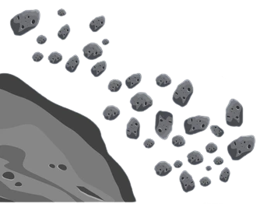
Better Regressive Estimation of Asteroid Diameter (B.R.E.A.D.)
Rylan Donohoe, Riana Dutta,
Gabrielle MacInnes, Kaitlyn Pereira

Slide 2
Background
Better Regressive Estimation of Asteroid Diameter (B.R.E.A.D.)
Rylan Donohoe, Riana Dutta,
Gabrielle MacInnes, Kaitlyn Pereira
Problem
Goal
Process
Results
Summary
Do you know what helps you make your point clear? Lists like this one:
They’re simple
You can organize your ideas clearly and in an easy way
You’ll never forget to buy milk!
And the most important thing: the audience won’t miss the point of your presentation

Slide 3

Problem
Better Regression Estimation of Asteroid Diameter (B.R.E.A.D.)
Rylan Donohoe, Riana Dutta,
Gabrielle MacInnes, Kaitlyn Pereira
Problem
Goal
Process
Results
Summary
NASA's current formula for asteroid diameter
Based only on measured albedo (a) and absolute magnitude (H)
Assumes spherical object with a uniform surface (no albedo variation)
Errors in a and H values can lead to significant inaccuracy in diameter (factor of 2+)

Slide 4
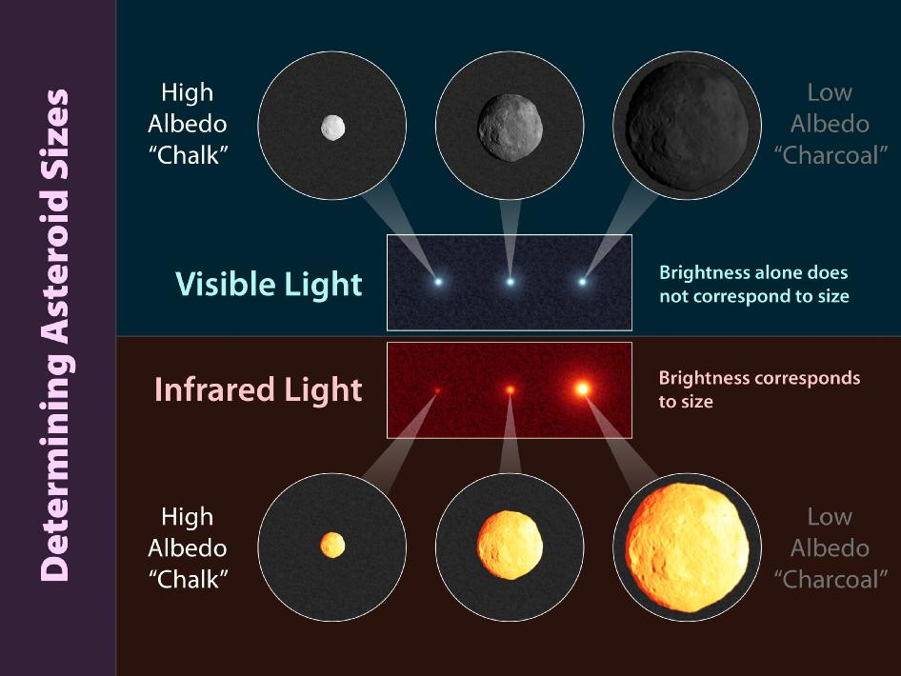
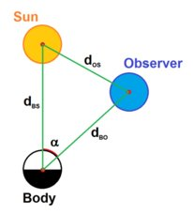
How the Features Correlate to Diameter
Problem
Goal
Process
Results
Summary
Albedo
Absolute Magnitude
The albedo is the proportion of light/radiation reflected
The intrinsic brightness of the asteroid
A measure of how bright an object appears viewed from a distance of 10 parsecs
High correlation to actual diameter

Slide 5
Goal
Problem
Goal
Process
Results
Summary
Implement machine learning algorithms to calculate the diameter of an asteroid using more parameters and compare results to NASA’s formula.

Slide 6
Process
Problem
Goal
Process
Results
Summary
Dataset
From NASA’s Jet Propulsion Laboratory, maintained by the California Institute of Technology.
Includes the name, diameter (if known) and 25 other parameters of almost 800,000 different asteroids
Modifications
Removed parameters missing majority of datapoints and asteroids with little data
Removed outliers
Final data: 11 features for 126713 asteroids

Slide 7
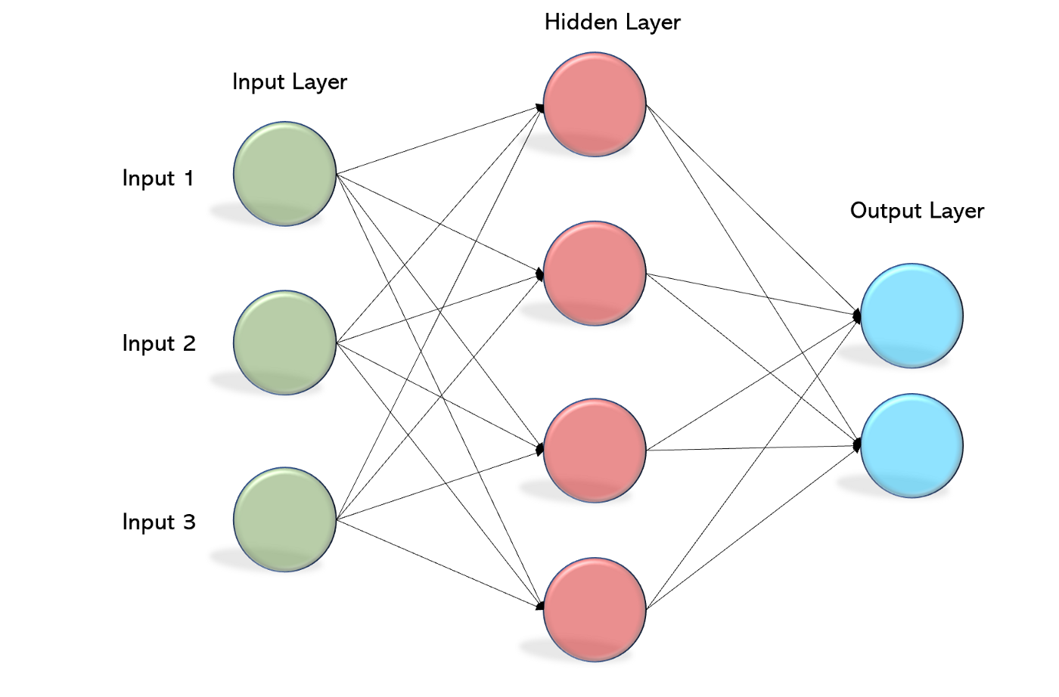
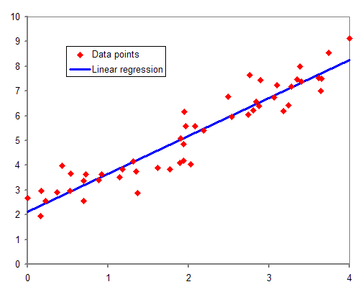
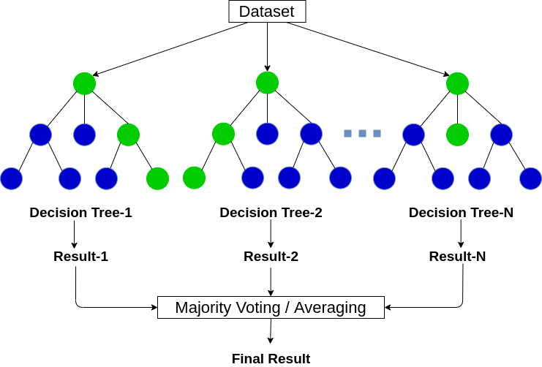
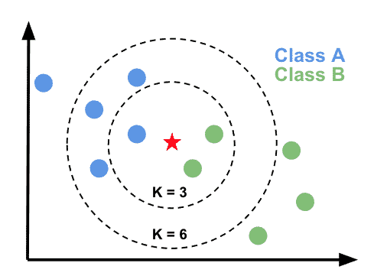
Algorithms Used
Problem
Goal
Process
Results
Summary
Multi-Layer
Perceptron
Linear
Regression
k-Nearest
Neighbor
Random
Forest

Slide 8
Features
Problem
Goal
Process
Results
Summary
Overview of features used in our models:
Semi-major Axis – longest radius of the ellipse of the asteroid's orbit
Perihelion Distance – distance to the sun at closest point in orbit
Aphelion Distance – distance to the sun at furthest point in orbit
Orbital Period – time for asteroid to make a full orbit
Data Arc-span – time period between earliest and latest observations
Orbit Condition Code – how well the asteroid's orbit is known from 0-9
Number Observations
Absolute Magnitude – apparent brightness from a distance of 10 parsecs
Albedo – percent of light reflected
Neo – binary indicating whether it is a near earth object
Moid – minimum orbit intersection distance

Slide 9
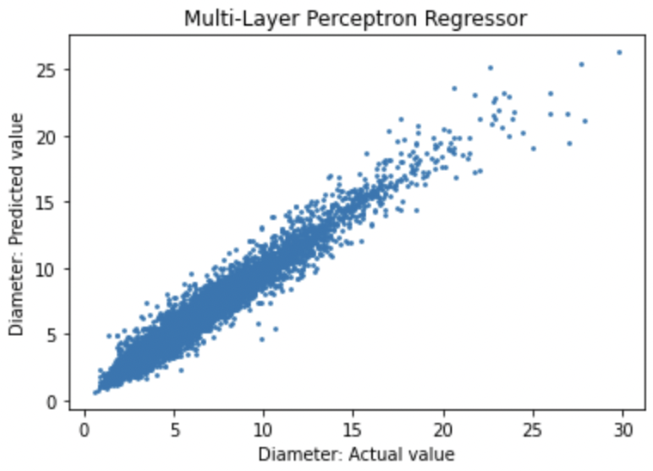
Multi-Layer Perceptron
Problem
Goal
Process
Results
Summary
Mean Absolute Error:
0.3193
Mean Squared Error:
0.2571
R² Score:
0.9612

Slide 10
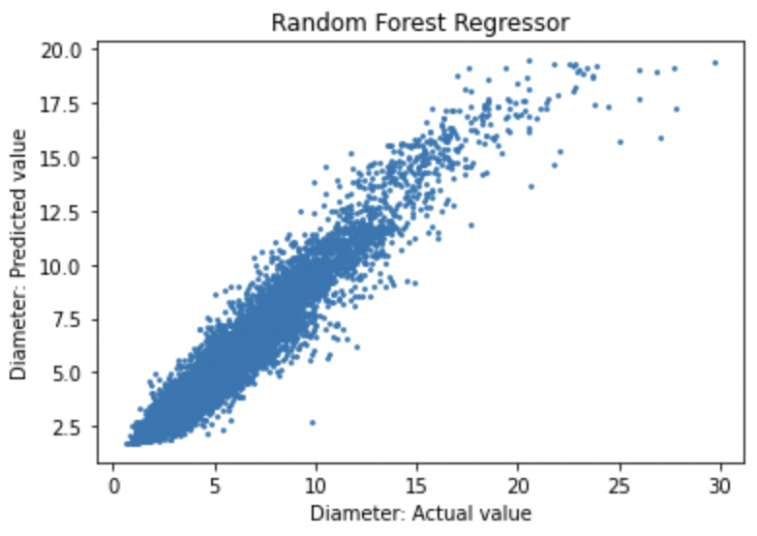
Random Forest
Problem
Goal
Process
Results
Summary
Mean Absolute Error:
0.4932
Mean Squared Error:
0.4944
R² Score:
0.9254

Slide 11
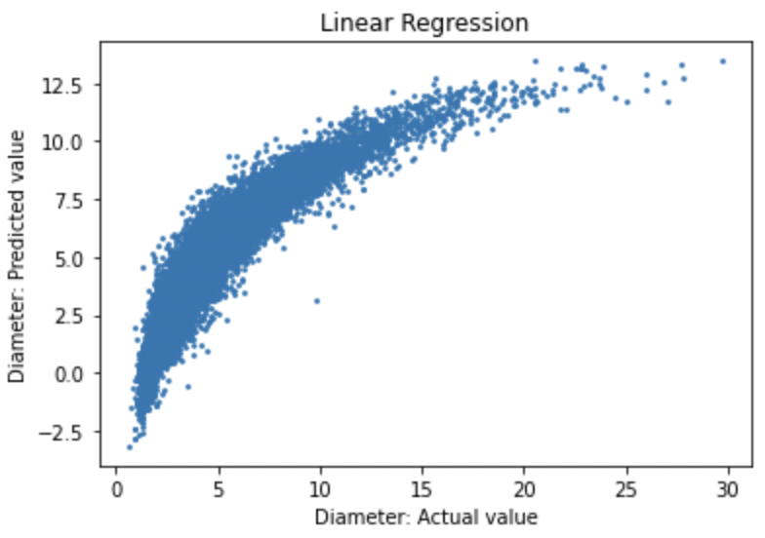
Linear Regression
Problem
Goal
Process
Results
Summary
Mean Absolute Error:
0.7321
Mean Squared Error:
1.192
R² Score:
0.8202

Slide 12
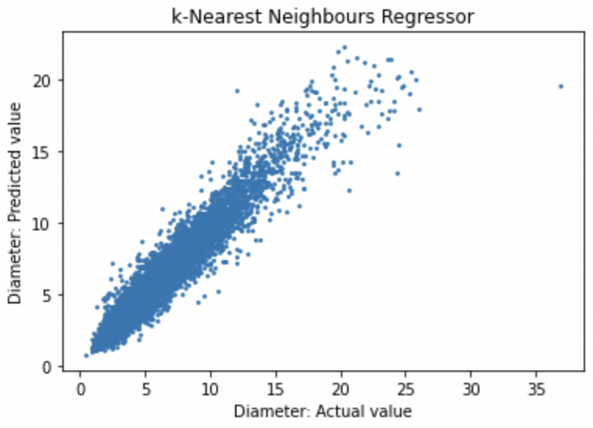
k-Nearest Neighbors
Problem
Goal
Process
Results
Summary
Mean Absolute Error:
0.4025
Mean Squared Error:
0.4077
R² Score:
0.9385

Slide 13
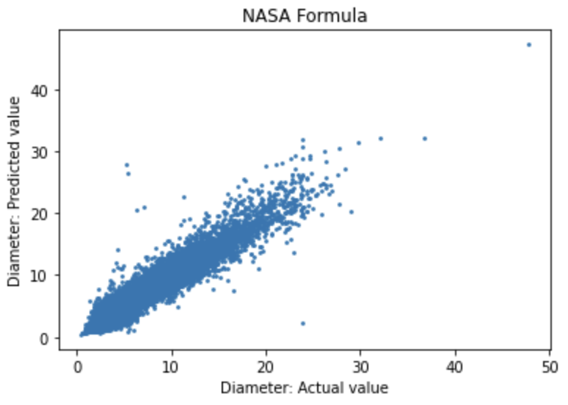
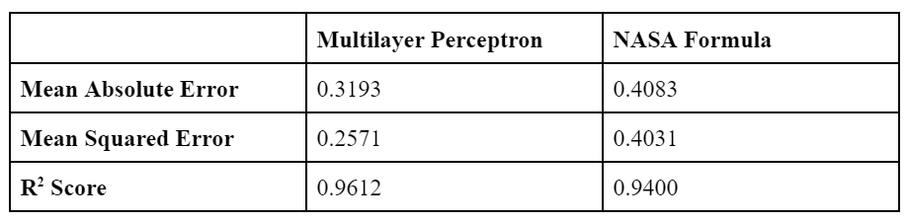
Comparison with NASA’s Algorithm
Problem
Goal
Process
Results
Summary

Slide 14
Summary
Problem
Goal
Process
Results
Summary
Our model’s performance and accuracy is on par with NASA’s formula for diameter (i.e., our coefficient of determination is slightly higher) and uses more features so is less prone to being skewed by unreliable measurements.

Slide 15
Thank You!
Any questions?
GitHub
DevPost

Slide 16
Thank You!
Any questions?
GitHub
DevPost

