Slide 1

A Multi-Component NLP System for Fake News and Misinformation Detection
6INTELSY — INTELLIGENT SYSTEMS | 6DANCS — DATA ANALYTICS FOR COMPUTER SCIENCE
2nd Semester AY 2025-2026
Presented by: Rian Cortez, Ryence Cortez, Ranz Cuarto, Mark Darius David
HOLY ANGEL UNIVERSITY — SCHOOL OF COMPUTING

Slide 2

Project Description
A MULTI-COMPONENT NLP SYSTEM THAT CLASSIFIES POLITICAL STATEMENTS BY VERACITY USING DISTILBERT, TEXT-CNN, SPACY NER, AND A CONTEXTUAL BANDIT RL AGENT — BUILT ON THE LIAR BENCHMARK.
Problem Statement
Objectives
Misinformation spreads faster than corrections
Goal:
1
Build a modular, transparent, and fair misinformation detection system
2
Manual fact-checking cannot scale to daily content volume
Scope:
English-language short-form US political statements (LIAR benchmark)
Existing classifiers suffer from poor calibration, viewpoint bias, and lack of transparency
3
Success metric:
Macro-F1 on held-out test partition

Slide 3
Dataset
LIAR Benchmark (Wang, 2017)
Pre-defined train/valid/test splits — no leakage
12,836 short political statements from PolitiFact.com
Rich metadata: speaker, party, job title, state, context
6 veracity classes: pants-fire, false, barely-true, half-true, mostly-true, true
Key finding: Republican (4,497) vs Democrat (3,336) speaker imbalance

Slide 4


Data Preparation
Raw data: TSV files with 14 columns per statement
Text cleaning: Unicode normalization, HTML artifact removal, whitespace stripping
Text-CNN branch: lowercased → word-level tokenization → GloVe 300d embedding initialization
DistilBERT branch: HuggingFace subword tokenizer → max 128 tokens → attention mask generation
Label mapping: pants-fire=0, false=1, barely-true=2, half-true=3, mostly-true=4, true=5
Pre-defined splits used as-is — no re-splitting to prevent leakage

Slide 5
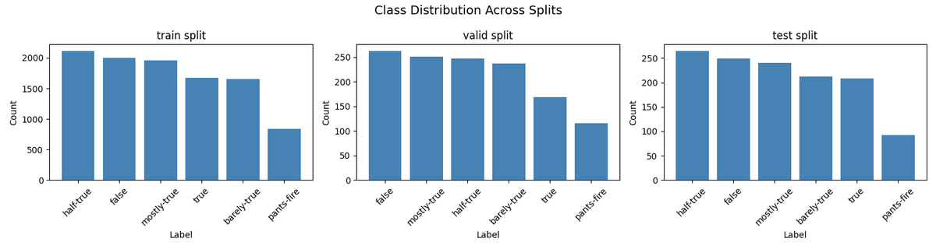
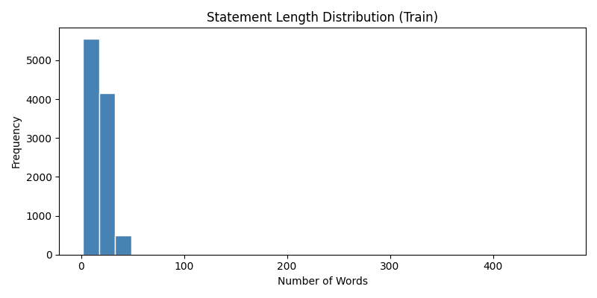
Descriptive Analysis
Average statement length: 18 words (max 467, min 2)
pants-fire: ~8% across all splits — rarest and hardest class
Most mentioned speaker: Barack Obama (488 appearances)
Most mentioned location: Texas (52 appearances)
Most mentioned organization: Medicare and Congress
Republican (4,497) vs Democrat (3,336) — speaker imbalance confirmed

Slide 6
System Architecture
4 integrated components:
Core Model: DistilBERT fine-tuned for 6-class veracity classification
CNN Component: Text-CNN (Kim, 2014) — implemented from scratch over GloVe 300d embeddings
NLP Component: spaCy NER — extracts PERSON, ORG, GPE entities for provenance analysis
RL Component: Contextual bandit with epsilon-greedy exploration — learns optimal confidence threshold

Slide 7
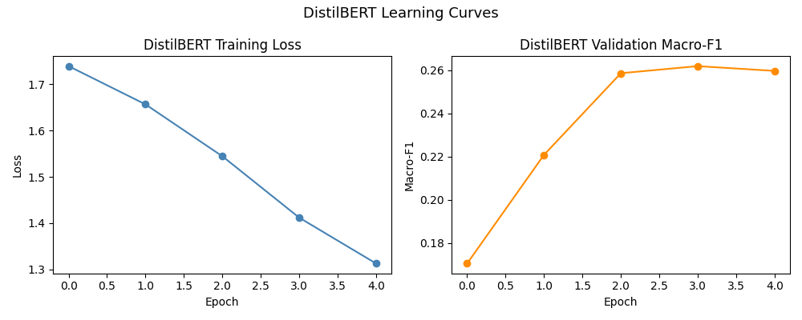
Results & Baselines
Model
Test Accuracy
Test Macro-F1
Logistic Regression
0.2478
0.2214
Text-CNN
0.2478
0.2384
DistilBERT
0.2762
0.2602
DistilBERT outperforms both baselines on all metrics
Low absolute scores expected for 6-class veracity classification on short text

Slide 8
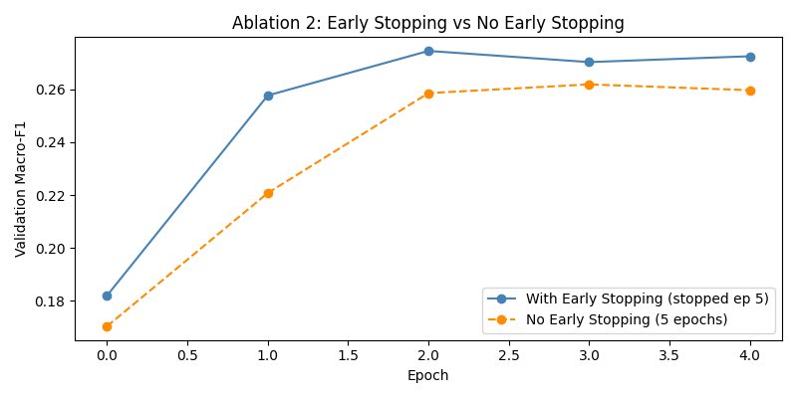
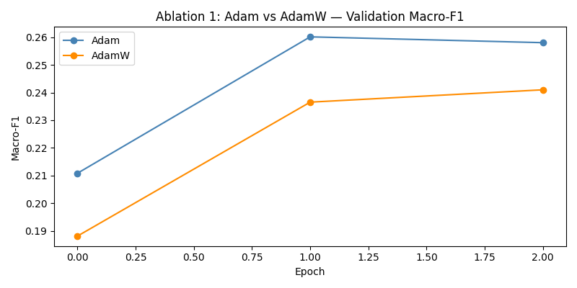
Ablations & Error Analysis
Ablation 2
Ablation 1
Early Stopping:
Adam vs AdamW:
With (0.2654) > Without (0.2602)
Adam (0.2743) > AdamW (0.2690)
on Macro-F1
on Macro-F1

Slide 9
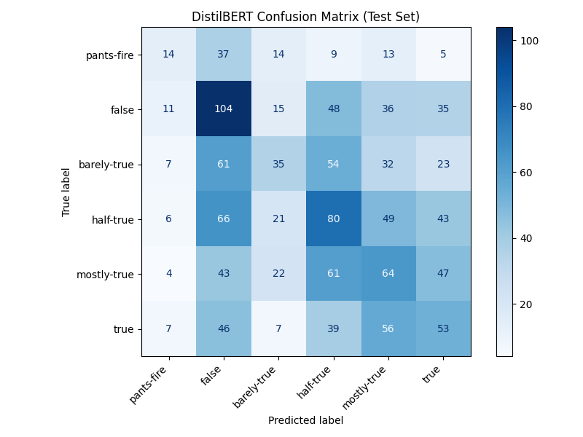
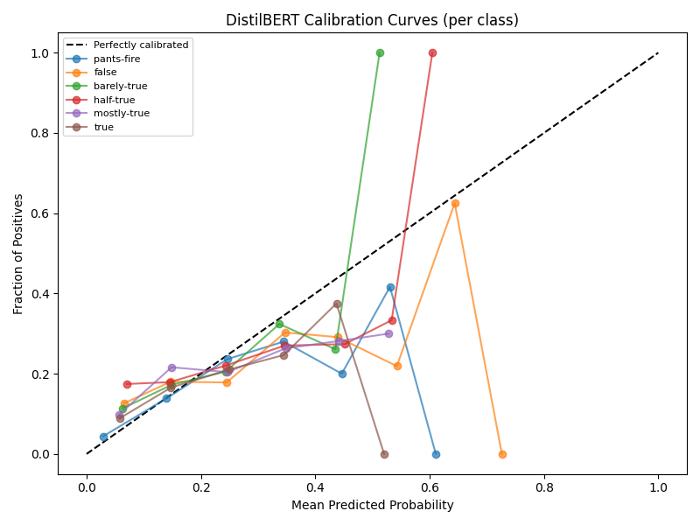
Ablations & Error Analysis
Confusion Matrix finding:
Calibration:
Model predicts toward middle classes — pants-fire most confused with false
Model overconfident above 0.5 probability — supports conservative threshold of 0.8

Slide 10
Bias & RL Analysis
Party | n | Macro-F1
Republican | 571 | 0.2231
Democrat | 406 | 0.2715
None | 214 | 0.2641

Slide 11
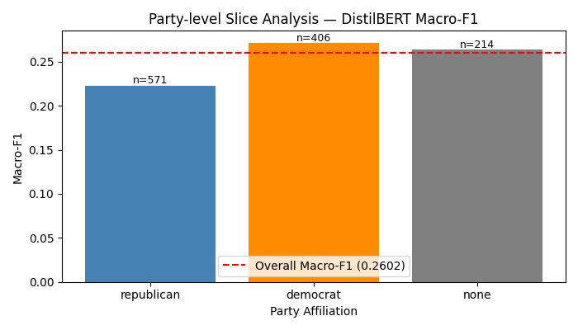
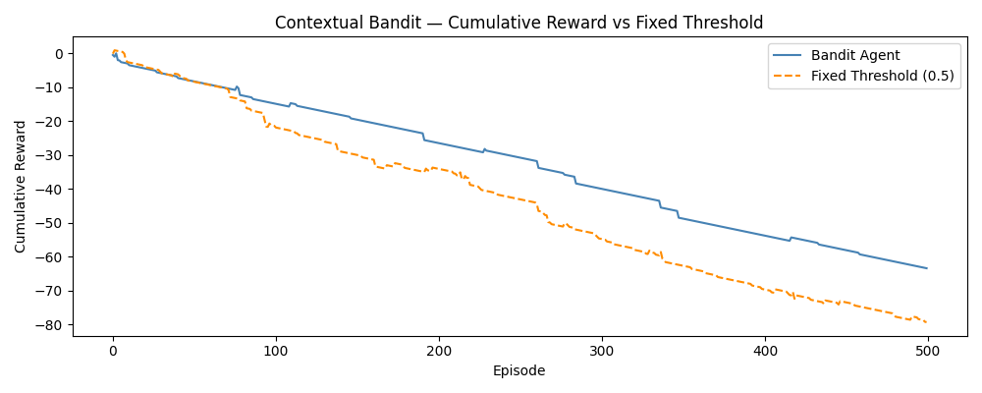
Bias & RL Analysis
NER Slice Analysis:
Bandit Agent:
GPE (0.2011) and ORG (0.2068) statements harder to classify
Converged on threshold 0.8 after 500 episodes, outperforms fixed threshold baseline

Slide 12
Ethics, Limitations & Conclusion
Risks
Limitations
Conclusion
Risk 1: False positives — mitigated by conservative threshold (0.8) and human-in-the-loop design
Risk 2: Political bias — confirmed and documented; Republican F1 gap of ~0.04
Risk 3: Censorship misuse — restricted to research use only via model license
US political domain only; low absolute F1; bandit uses simulated probs in Week 2
Data preparation pipeline successfully processed 12,836 statements across 3 splits
Descriptive analysis revealed class imbalance, speaker distribution bias, and entity-level disparities
DistilBERT improves over baselines (F1: 0.2602 vs 0.2384 CNN, 0.2214 LR)
Bias confirmed, documented, and transparent
System designed for human oversight — not autonomous deployment
github.com/riancrtz/fake-news-detection-nlp

Slide 13
The End
THANK YOU FOR LISTENING
Presented by: Rian Cortez, Ryence Cortez, Ranz Cuarto, Mark Darius David
HOLY ANGEL UNIVERSITY — SCHOOL OF COMPUTING

