Slide 1
A Brief Foray into Dynamic Programming
Rian J Stockbower

Slide 2
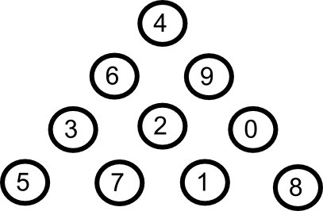
The Problem
Which path (from top to bottom) gives us the highest total value?
Notes:
TALK ABOUT THE WHAT THE SOLUTION IS

Slide 3
Brute force
Try 'em all!
Notes:
Brute force approach: try all paths from top to bottom, and see which one's the biggest
(Step over to the whiteboard, walk through the brute force approach)
[insert slide with brute force pseudocode?]

Slide 4
A Brute-force Solution
Try all the paths!
Start at the top node:
GetPathValues(Node n):
If this node has no children:
Return a singleton list with the node's value as the
element
Otherwise, for all child nodes:
Get path values for child node (recursively)
Add the node value to all elements in this list
Append this list to a cumulative list of path values
from the other children
Return this cumulative list
Compute the maximum value from the cumulative list returned
by the top node

Slide 5
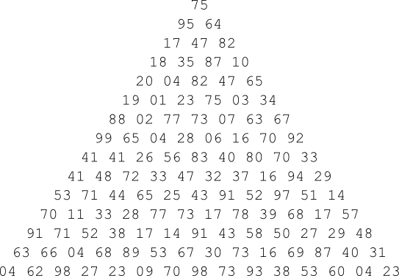
Brute force this...
There are 2^{n-1} paths where n is the triangle depth.
Now imagine n=100...
...that's 6.338e29 possibilities...
Do you have the lifetime of the universe to spare?
Notes:
Step over the whiteboard and briefly show why it's 2^(n-1):
2^(1-1) = 1 possibility
2^(2-1) = 2 possibilities
2^(3-1) = 4 possibilities
2^(4-1) = 8 possibilities, which is our small example triangle (refer back to whiteboard)
Checking 2^99 at 1 trillion per second = 20 billion years to completion.
A medium sized triangle

Slide 6
Dynamic approach
Cache stuff!
Notes:
Step over to the whiteboard, and walk through a bottom-up approach to caching values.
In the Project Euler problem sets, the idea of caching becomes important pretty early on, because you do a lot of factoring, and naive factoring does a lot of redundant work

Slide 7
Caching values
A Dynamic Programming Solution
For each Node at bottom:
GetMaxPath(Node n)
If we have cached a max
Return the cached max
Else
Get max path for each parent (recursively)
Compute the max of the parent max values
Add the value of this max to the node value
and cache it
Return the cached value
Compute the max value of the max paths for the nodes on the bottom

Slide 8
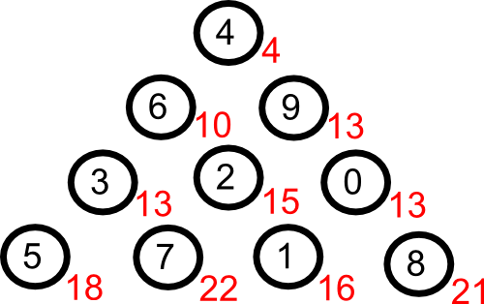
Dynamic approach: max(a,b) at each child node

Slide 9
Results
1,000 runs:
Brute force method on a triangle with 15 rows:
5,699ms total (~5ms per run)
Dynamic approach on a triangle with 15 rows:
3ms total (0.003ms per run)
Dynamic approach on all three triangles (4, 15, 100 rows):
145ms total (0.145ms per run)
That's a 1,600x improvement on the medium sized triangles, and a comparison between the 100 line triangles is impossible.

Slide 10
End

Slide 11
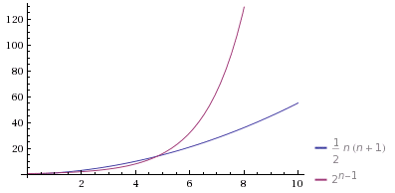
Complexity in terms of triangle height (n)
Dynamic: quadratic in terms of n
Brute force: exponential in terms of n

Slide 12
private static int ReturnGreatest(int[,]Triangle) { int lines = Triangle.GetLength(0); int[] LargestValues = new int[lines]; //Initialize bottom row for (int i = 0; i < lines; i++) { LargestValues[i] = Triangle[lines - 1, i]; } for (int i = lines - 2; i >= 0; i--) { //Not starting at the bottom row, since that's already initialized for (int j = 0; j <= i; j++) { LargestValues[j] = Triangle[i, j] + Math.Max(LargestValues[j], LargestValues[j + 1]); } } return LargestValues[0]; }

