Slide 1
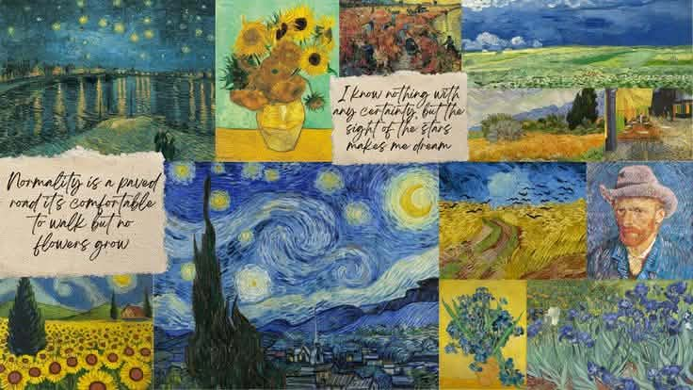
BEAUTY OF ART
A World of Creativity and Expression
By: Rianna Camille A. Mendoza

Slide 2
What is Art?
Art is a form of creative expression that allows people to communicate their thoughts, emotions, and imagination. It comes in many forms such as drawing, painting, sculpture, photography, and digital art. Through art, we can express ourselves, share stories, and appreciate the beauty of different perspectives.

Slide 3
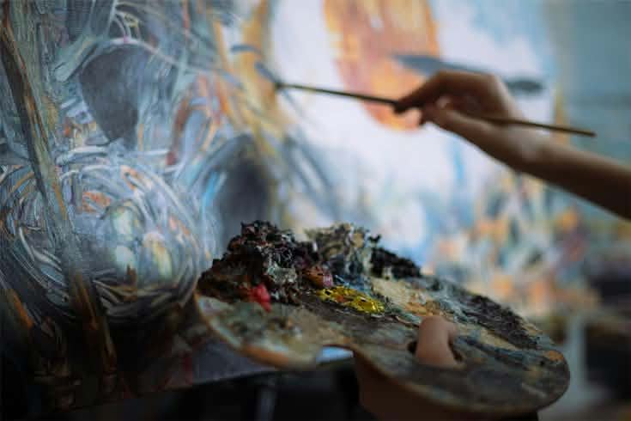
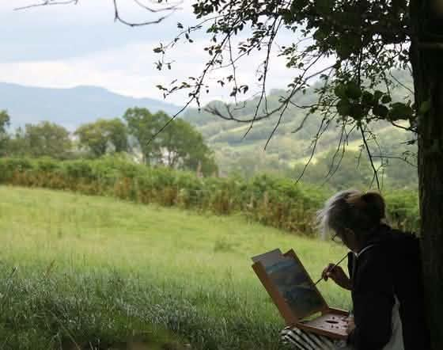
Importance of Art
Art helps us with:
Self-expression
Culture and History
Creativity
Connection

Slide 4
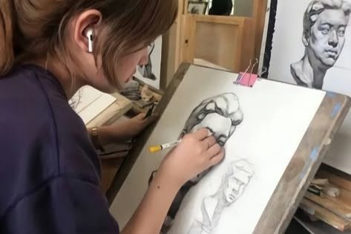
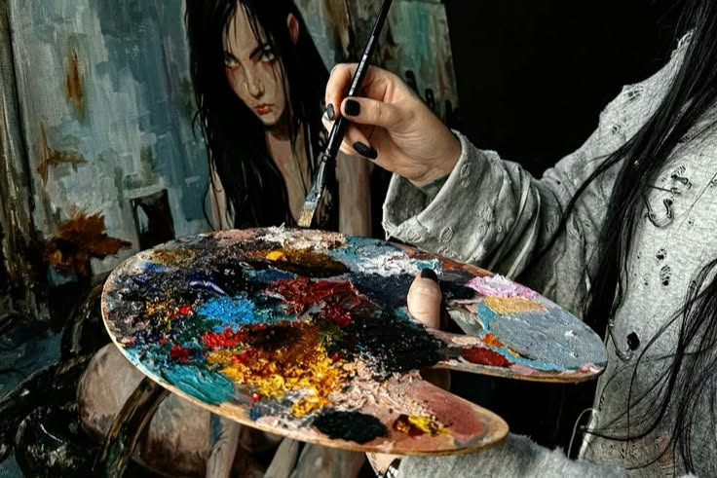
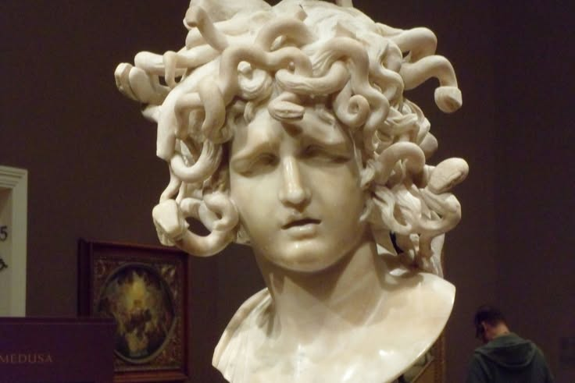
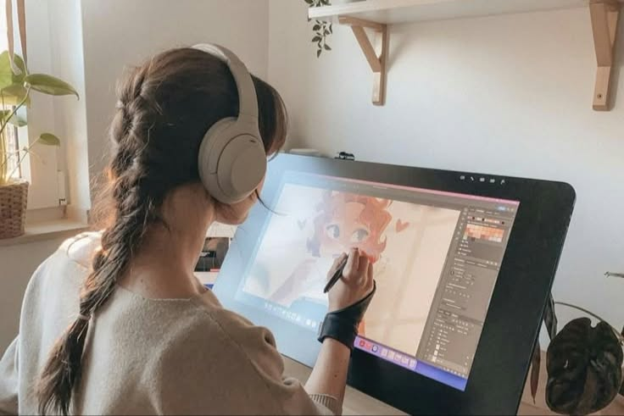
A Gallery of Art
Different Forms of Art
Drawing
Painting
Sculpture
Digital Art

Slide 5
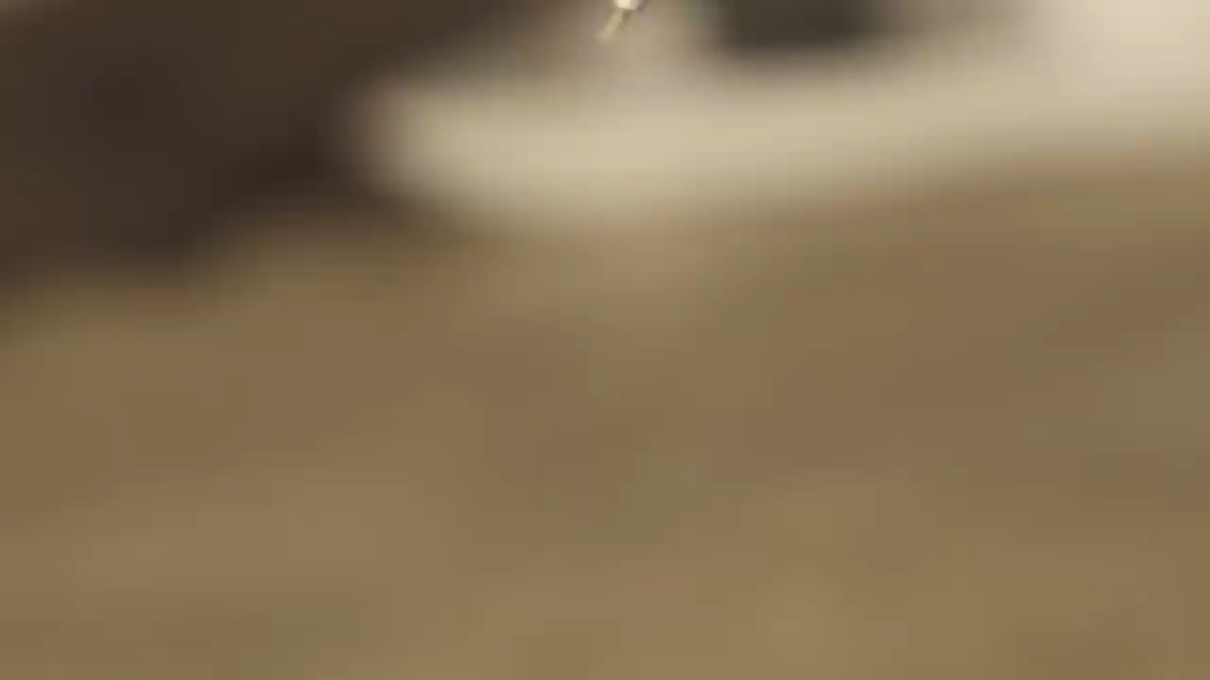
The Creative Process

Slide 6
Thank You!
“Art is not what you see, but what you make others see.”
-Edgar Degas
HOME
Explore the World of Art

