Slide 1
COMP30027 MACHINE LEARNING
TUTORIAL
Workshop - 4

Slide 2
Model Evaluation and Decision Trees
We'll cover evaluation metrics, baselines, decision trees, and data-splitting strategies.

Slide 3
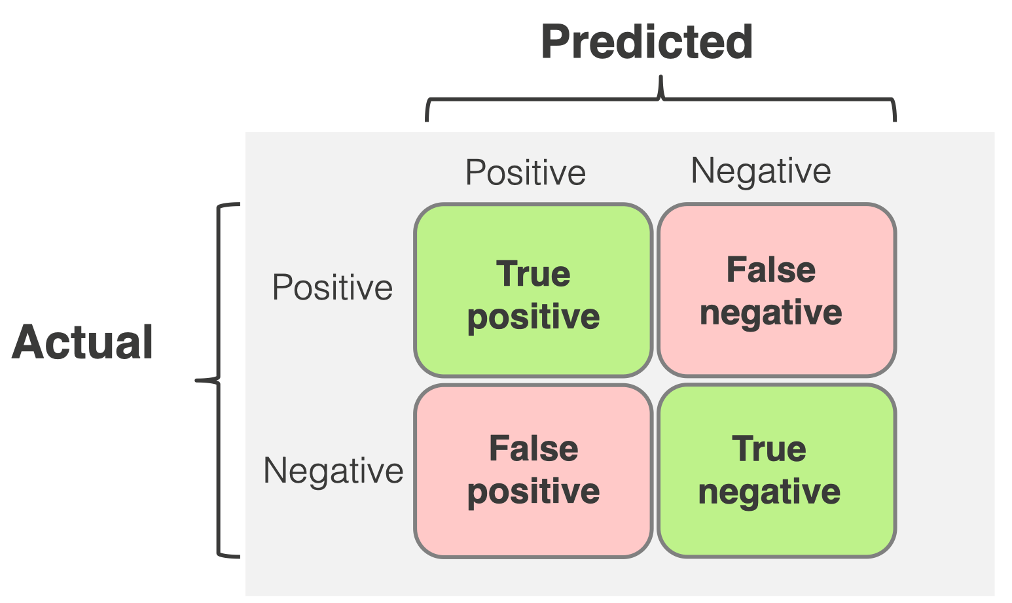
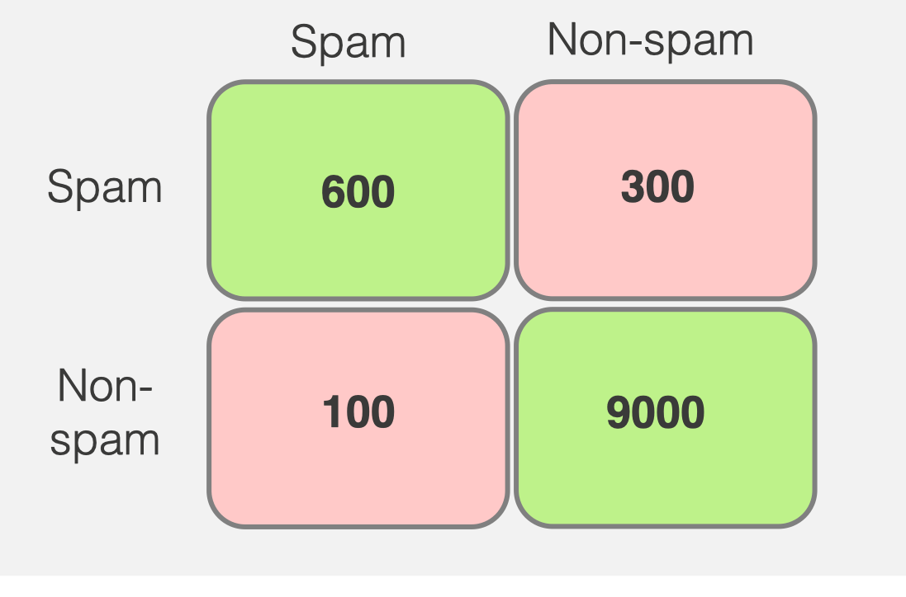
Understanding Classification Results
True Positive (TP): The model correctly predicts the positive class. For example, a spam email is correctly identified as spam.
False Positive (FP): The model incorrectly predicts positive class when it's actually negative. For Example, normal email is wrongly labelled as spam. (Also known as a Type I Error.)
False Negative (FN): The model misses the positive class—it predicts negative when it's actually positive. For example, a spam email is misclassified as not spam. (Also known as a Type II Error.)
True Negative (TN): The model correctly predicts the negative class. For example, a normal email is correctly identified as not spam.
https://www.evidentlyai.com/classification-metrics/confusion-matrix

Slide 4
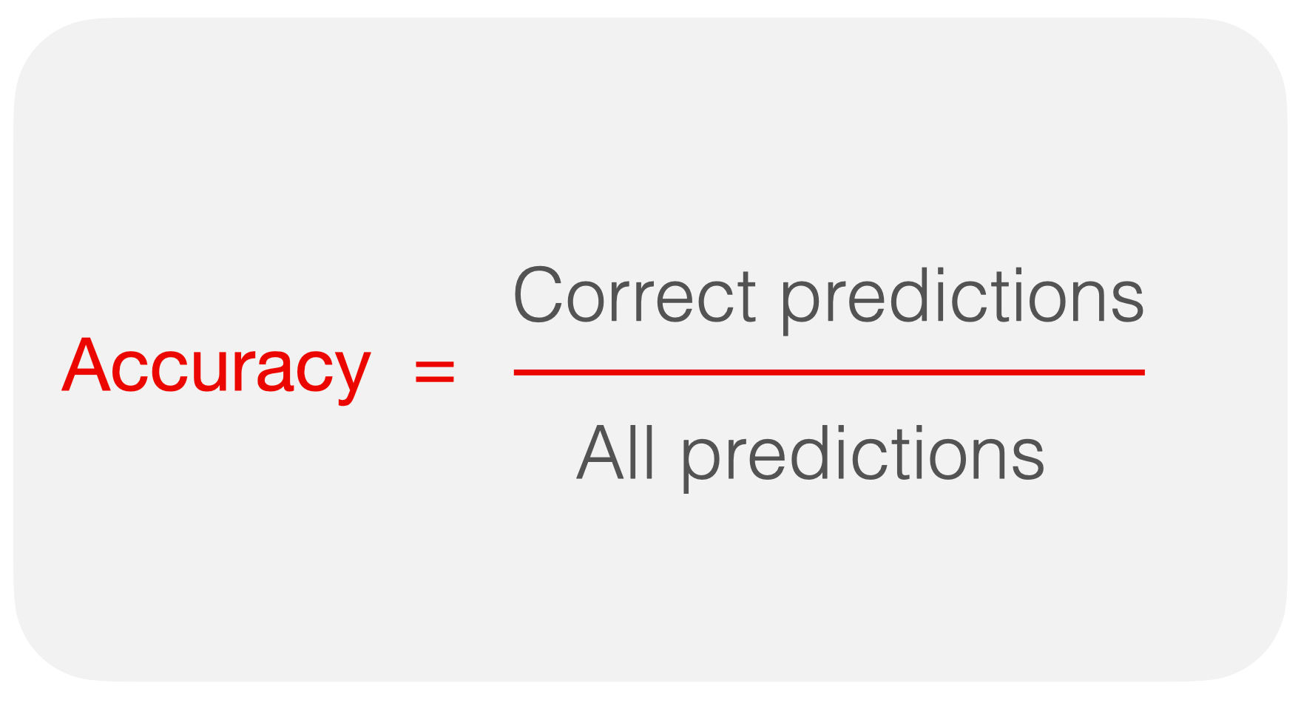
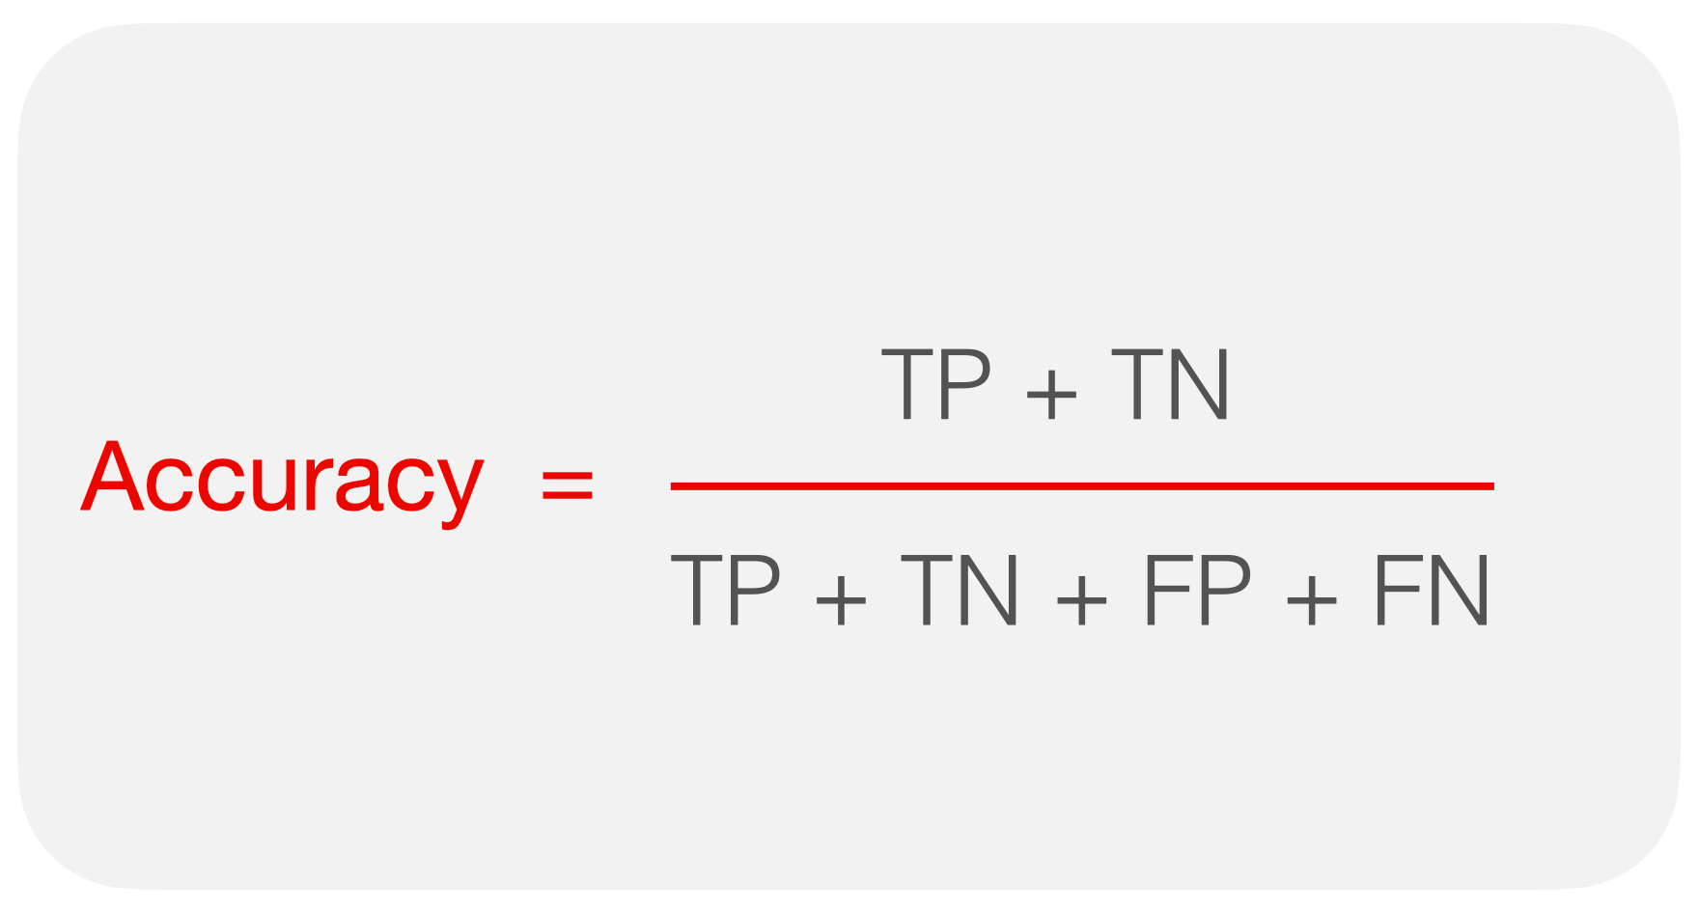

Understanding Model Evaluation Metrics
Fraud Not Fraud
0
100
Fraud
Scenario: Fraud Detection in Credit Card Transactions
You’re building a model to detect fraudulent transactions.
You have 100,000 transactions
Only 100 are actually fraudulent
That means:
99,900 are legitimate
100 are fraud
So, the class distribution is heavily imbalanced
0
99,900
Not Fraud
Even though the model achieves 99.9% accuracy, it fails to detect any fraudulent transactions. So, when the class distribution is highly imbalanced, accuracy is not a reliable evaluation metric

Slide 5
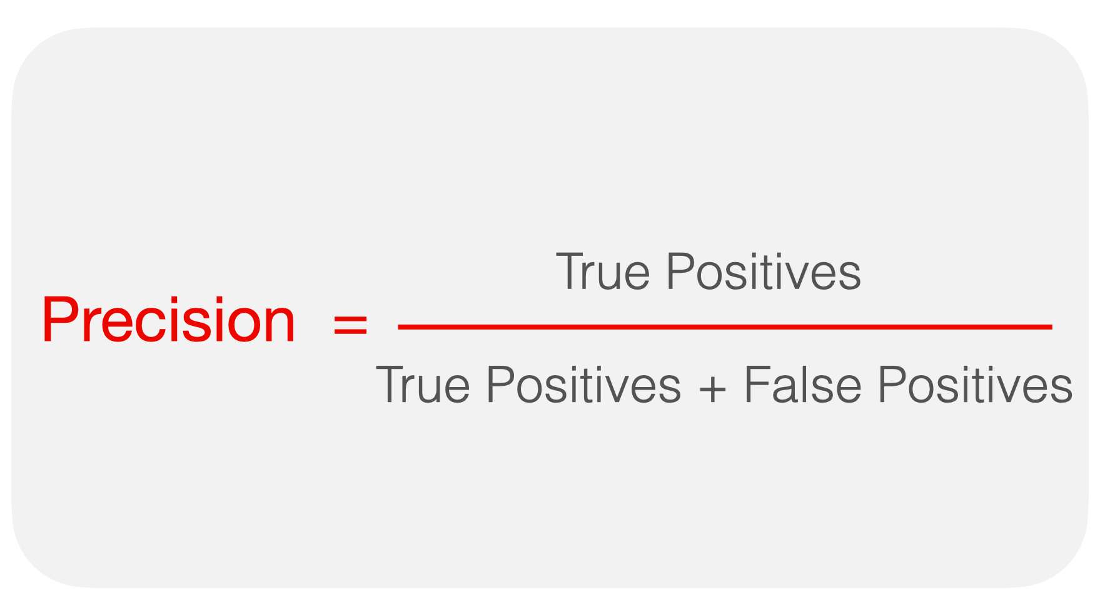
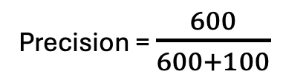
Understanding Model Evaluation Metrics
Predicted
Actual
Precision = $\frac{600}{600+100}$
https://www.evidentlyai.com/classification-metrics/confusion-matrix

Slide 6
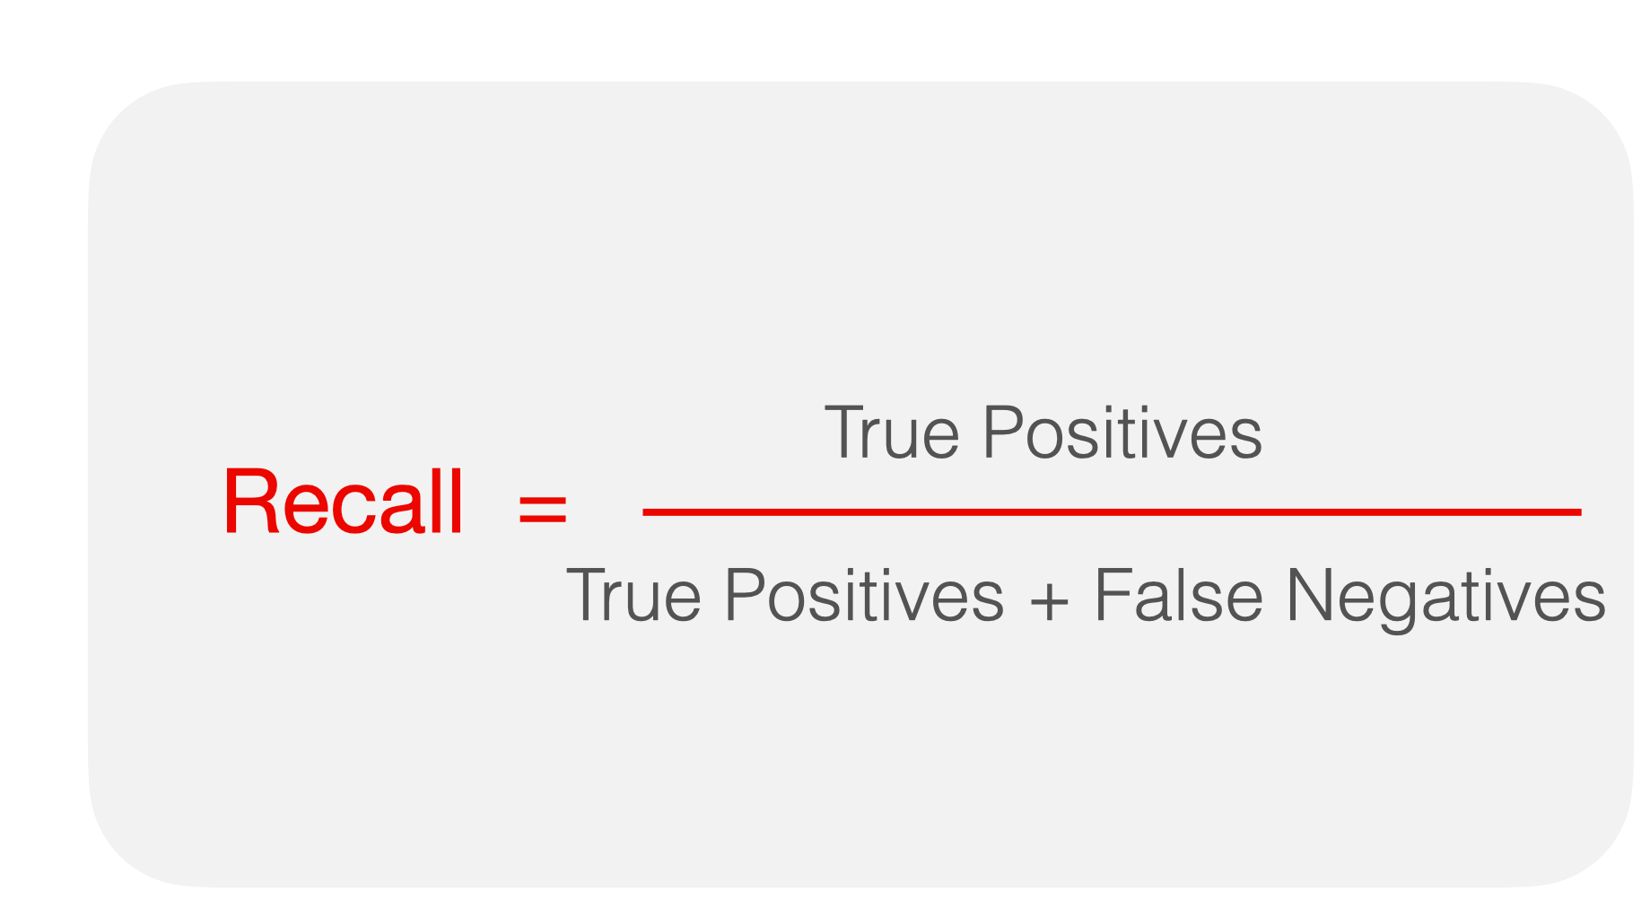
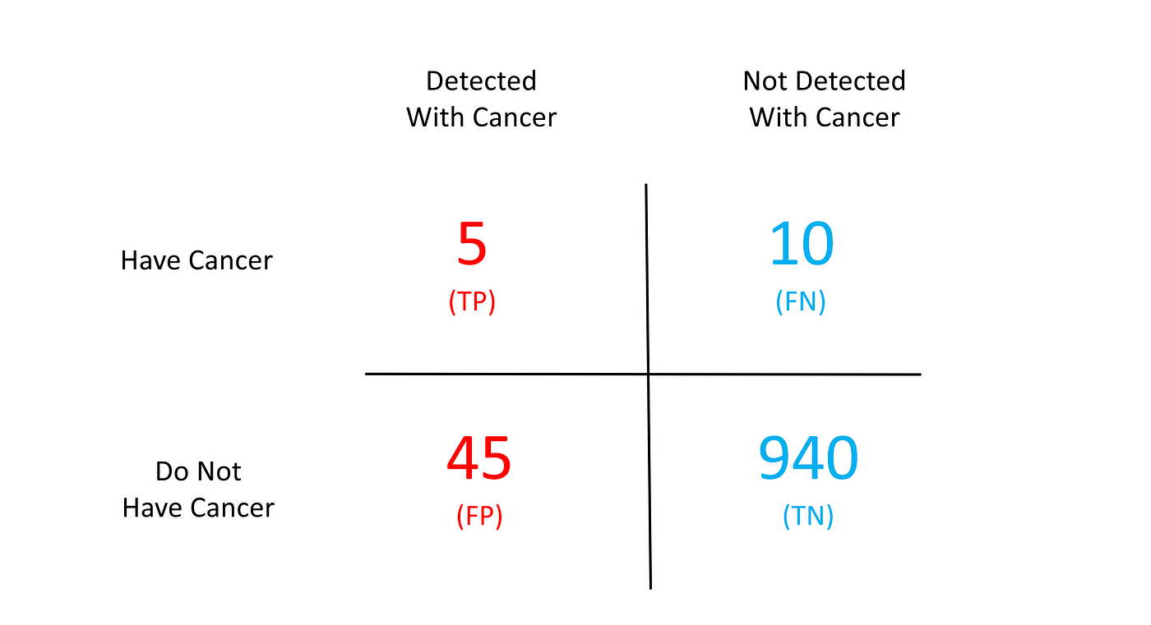
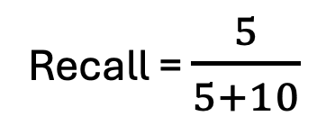
Understanding Model Evaluation Metrics
Recall = $\frac{5}{5+10}$
https://medium.com/x8-the-ai-community/understanding-ml-evaluation-metrics-precision-recall-2b3fb915b666

Slide 7
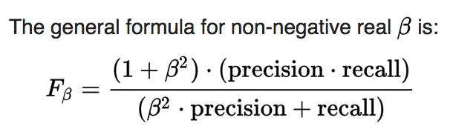
Understanding Model Evaluation Metrics
Beta (β) controls the balance between precision and recall:
β > 1: More weight on recall (sensitive to false negatives)
β < 1: More weight on precision (sensitive to false positives)
β = 1: Equal weight → This gives the F1-score

Slide 8
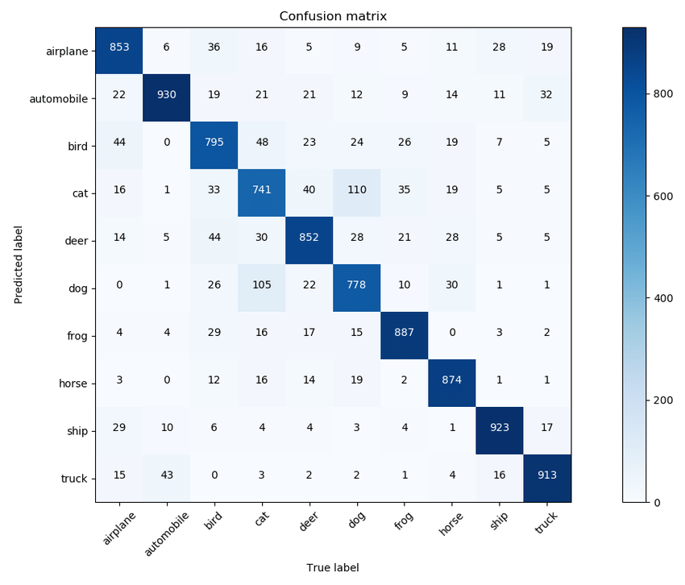
Understanding Model Evaluation Metrics
False Positive
True Positive
A confusion matrix is a table used to evaluate the performance of a classification model by comparing the predicted labels with the actual labels.
The highlighted green areas represent false positives for the aeroplane class, while the brown areas indicate false negatives. The dark blue section corresponds to the true positives for the aeroplane class in the confusion matrix.
False Negative
https://doi.org/10.48550/arXiv.2109.00573

Slide 9
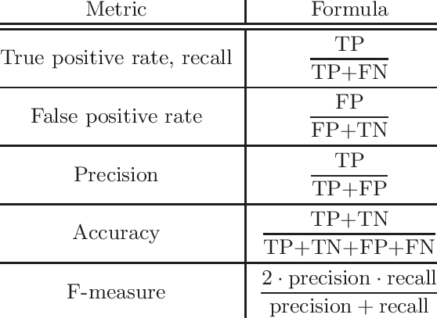
Q4
A confusion matrix is a summary of the performance of a (supervised) classifier over a set of development (“test”) data, by counting the various instances:
 | Predicted + | Predicted -
Actual + | 10 | 2
Actual - | 5 | 7
Calculate the precision, recall, and F-score (where β = 1) for this classifier.
Precision : 10/15 = 0.667
Recall : 10/12 = 0.833
F-score: 𝑃𝑅/ 𝑃+𝑅 =2∗0.667∗0.8330.667+0.833=0.741

Slide 10
Baseline vs Benchmark
Baseline: starting point for comparison
Benchmark: known standard or state-of-the-art that you compare your model against
Zero-R Rule (0-R)
One Rule (1-R )
CNN
Linear Regression
Random Forest
Zero-R (Majority Class)
One-R (Single Rule)
Always predicts the most frequent class. Simplest possible classifier. Implementation requires just a counter.
Generates one rule based on one feature. Finds the attribute with minimum error rate.

Slide 11
Training set:
ID | Outlook | Temp | Humid | Wind | Play
A | S | H | H | F | N
B | S | H | H | T | N
C | O | H | H | F | Y
D | R | M | H | F | Y
E | R | C | N | F | Y
F | R | C | N | T | N
Test set:
ID | Outlook | Temp | Humid | Wind | Play
G | O | M | N | T | ?
H | S | H | H | F | ?

Slide 12
Zero-R Rule (0-R)
Training set:
ID | Outlook | Temp | Humid | Wind | Play
A | S | H | H | F | N
B | S | H | H | T | N
C | O | H | H | F | Y
D | R | M | H | F | Y
E | R | C | N | F | Y
F | R | C | N | T | N
3
Test set:
It’s a tie, so you can choose either N or Y
ID | Outlook | Temp | Humid | Wind | Play
G | O | M | N | T | N
H | S | H | H | F | N

Slide 13
Outlook | Labels | Majority Label | Errors
S | N, N | N | 0
O | Y | Y | 0
R | Y, Y, N | Y (2) | 1 (1 N misclassified)
One-R Rule (1-R)
Step 1: Find the majority label and compute errors for each feature
Temp | Labels | Majority Label | Errors
H | N, N, Y | N (2) | 1 (Y is misclassified)
M | Y | Y | 0
C | Y, N | Y | 1 (1 N misclassified)
ID | Outlook | Temp | Humid | Wind | Play
A | S | H | H | F | N
B | S | H | H | T | N
C | O | H | H | F | Y
D | R | M | H | F | Y
E | R | C | N | F | Y
F | R | C | N | T | N
Humid | Labels | Majority Label | Errors
H | N, N, Y, Y | N (2) | 2 (2 Y misclassified)
N | Y, N | Y | 1 (1 N misclassified)
Outlook: 1 error
Temp: 2 errors
Humid: 3 errors
Wind: 1 error
Wind | Labels | Majority Label | Errors
F | N, Y, Y, Y | Y (3) | 1 (1 N misclassified)
T | N, N | N | 0
Here, both outlook and wind have the same number of errors, so we are randomly choosing outlook

Slide 14
Step 2: Create Final Rule Based on Best Feature (Outlook)
Outlook | Predict
S | N
O | Y
R | Y
Test set:
ID | Outlook | Temp | Humid | Wind | Play
G | O | M | N | T | ?
H | S | H | H | F | ?
Step 3: Make Final Prediction based on Best Feature (Outlook) from step 2
ID | Outlook | Prediction
G | O | Y
H | S | N

Slide 15
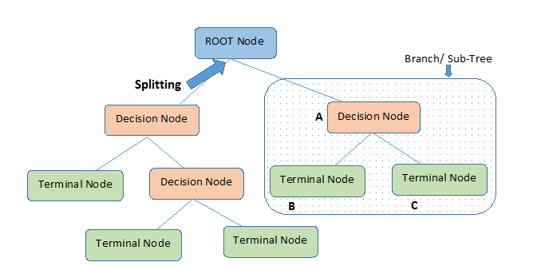

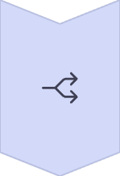

Decision Trees: Fundamentals
Tree Structure
Hierarchical model with nodes and branches. Each node represents a decision point.
Splitting Criteria
Uses information gain (used in ID3), Gain ratio, etc
Leaf Nodes
Terminal nodes that provide final predictions.
https://www.kdnuggets.com/2020/01/decision-tree-algorithm-explained.html

Slide 16
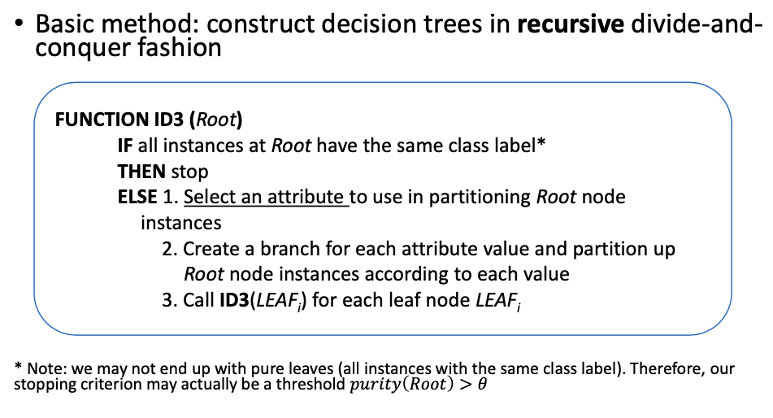
ID3 Decision Tree Implementation Algorithm
At each step, it:
Computes entropy of parent (how mixed the class labels are).
Computes information gain for each feature.
Chooses the feature with highest gain to split the data.
Repeats this process recursively on child branches.

Slide 17
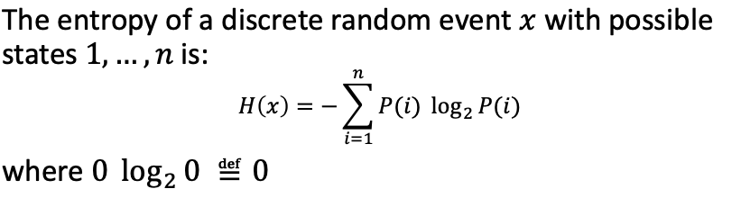
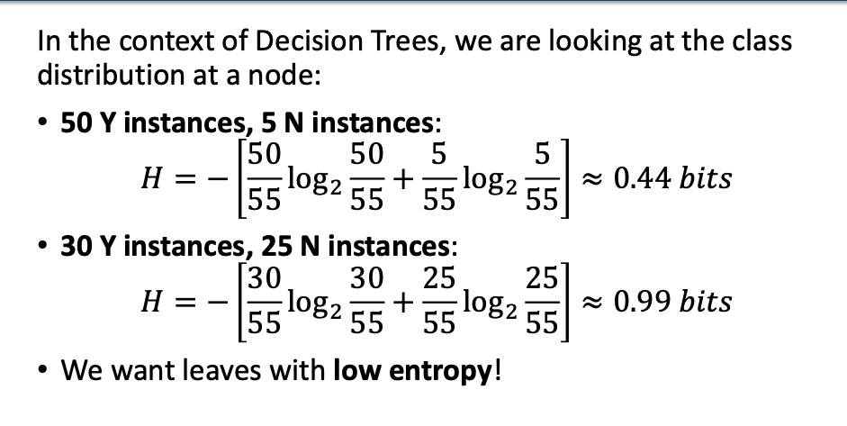
Entropy

Slide 18
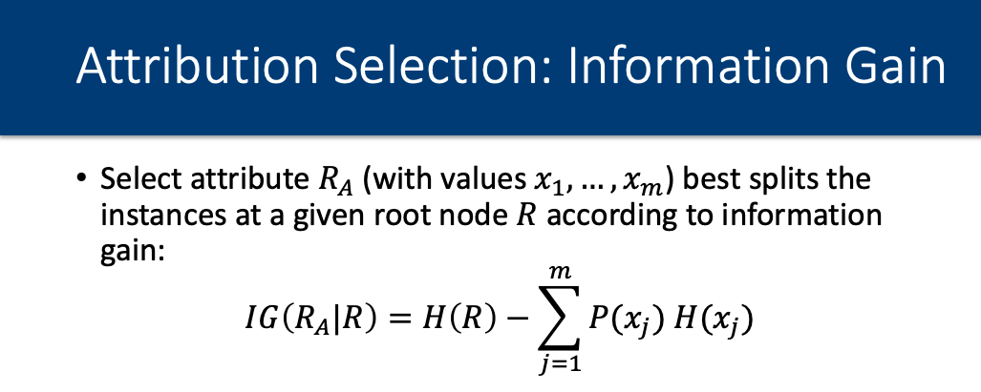

How do we choose the attribute to partition the
root node instances?

Slide 19
Q3
Classify the test instances using the ID3 Decision Tree method:
Using information gain as the splitting criterion
Training set:
ID | Outlook | Temp | Humid | Wind | Play
A | S | H | H | F | N
B | S | H | H | T | N
C | O | H | H | F | Y
D | R | M | H | F | Y
E | R | C | N | F | Y
F | R | C | N | T | N
Test set:
ID | Outlook | Temp | Humid | Wind | Play
G | O | M | N | T | ?
H | S | H | H | F | ?

Slide 20
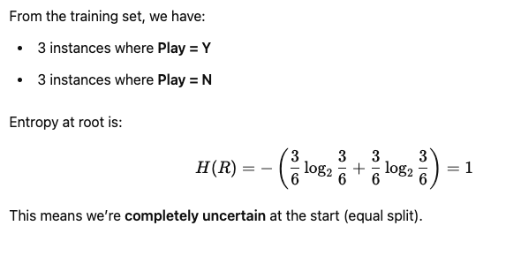
At each step, it:
Computes entropy of parent (how mixed the class labels are).
Computes information gain for each feature.
Chooses the feature with highest gain to split the data.
Repeats this process recursively on child branches.
Step 1: Calculate Entropy of Root (Target Class - Play)

Slide 21
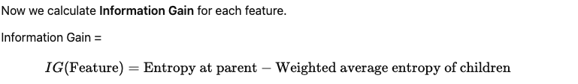
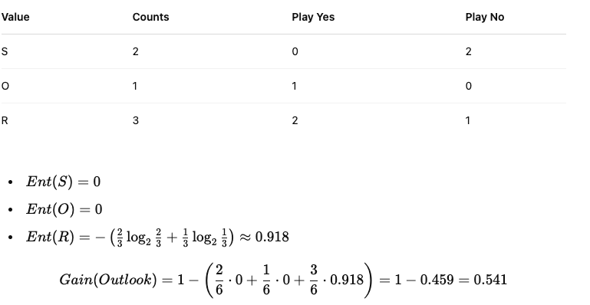

Step 2: Try Splitting on All Features
At each step, it:
Computes entropy of parent (how mixed the class labels are).
Computes information gain for each feature.
Chooses the feature with highest gain to split the data.
Repeats this process recursively on child branches.
Feature: Outlook

Slide 22
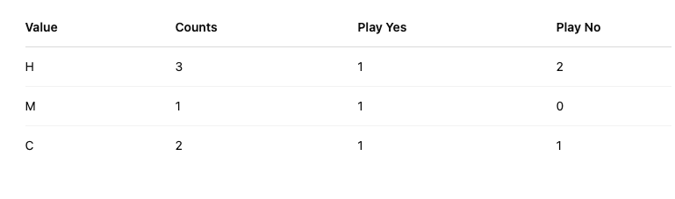
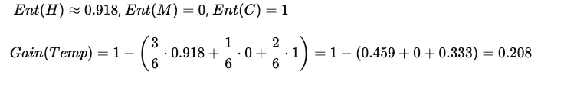
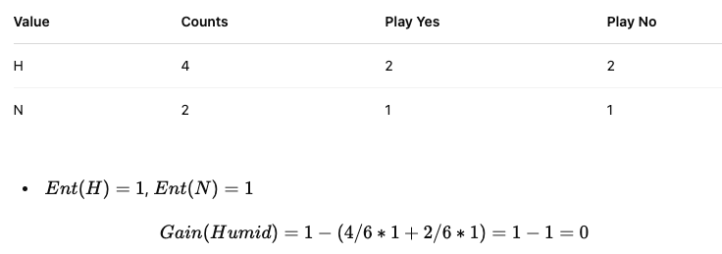
Feature: Temp
Feature: Humid

Slide 23
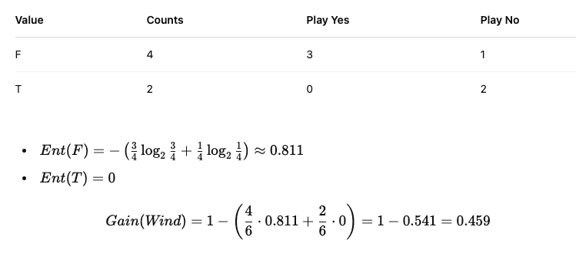
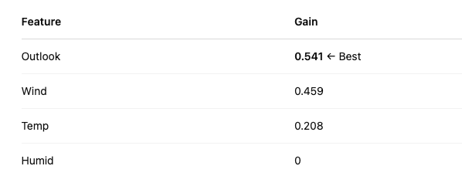
At each step, it:
Computes entropy of parent (how mixed the class labels are).
Computes information gain for each feature.
Chooses the feature with highest gain to split the data.
Repeats this process recursively on child branches.
Feature: Wind
Best Split: Highest IG

Slide 24
Build Tree (First Split: Outlook)
Yes = 3 No =3
OUTLOOK
S
R
O
N (F)
N (A,B)
Y (D, E)
Y(C)

Slide 25
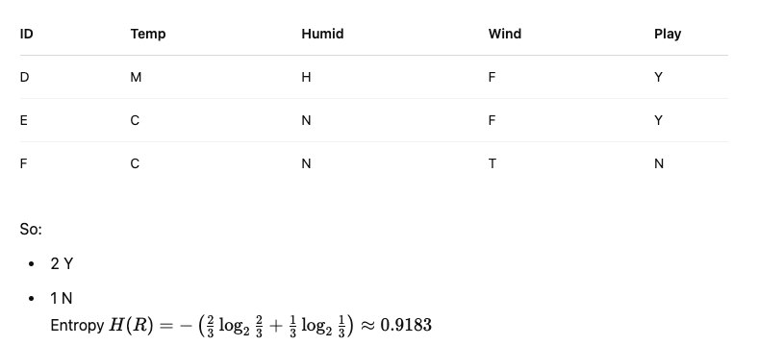
Step 1: Calculate Entropy of Root (Outlook = R)
Yes = 3 No =3
OUTLOOK
S
R
O
N (F)
At each step, it:
Computes entropy of parent (how mixed the class labels are).
Computes information gain for each feature.
Chooses the feature with highest gain to split the data.
Repeats this process recursively on child branches.
N (A,B)
Y (D, E)
Y(C)

Slide 26
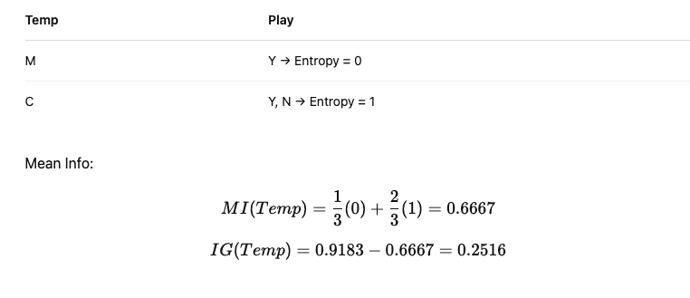
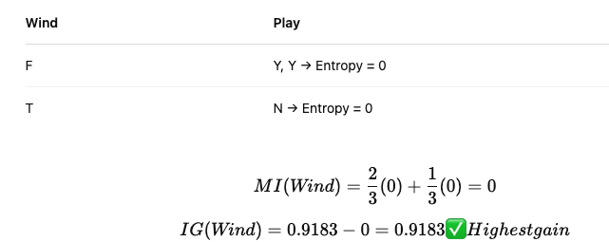
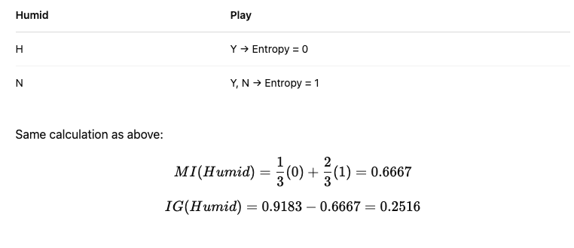
Step 2: Try Splitting on All Features
Feature: Temp
Feature: Wind
Feature: Humid
Best Split: Highest IG
Wind

Slide 27
Final Decision Tree (Second split = Wind)
ID | Outlook | Temp | Humid | Wind | Play
G | O | M | N | T | ?
H | S | H | H | F | ?
Yes = 3 No =3
OUTLOOK
S
R
O
Wind
N
Y
F
T
Y
N

Slide 28
Final Decision Tree
ID | Outlook | Temp | Humid | Wind | Play
G | O | M | N | T | Y
H | S | H | H | F | N
Yes = 3 No =3
OUTLOOK
S
R
O
Wind
N
Y
F
T
Y
N

Slide 29
Shortcomings of Information Gain
• Information gain tends to prefer highly-branching attributes
When using information gain, ID3 tends to prefer attributes with many distinct values, which can be misleading (e.g., ID has a unique value for each example — perfect split, but useless for generalization).

Slide 30

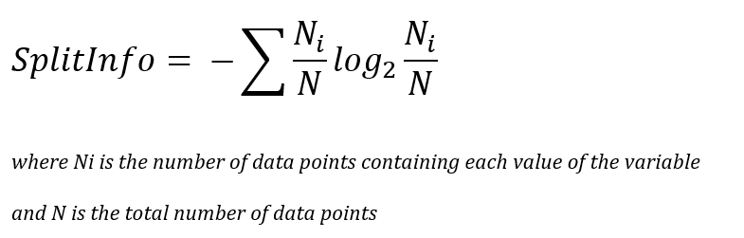
Gain Ratio
Gain Ratio (GR) reduces the bias for information gain towards highly-branching attributes by normalising relative to the split info

Slide 31
 | R | Outlook |  |  | Temp |  |  | Humid |  | Wind |  | ID
 |  | s | o | r | h | m | c | h | n | T | F | A | B | C | D | E | F
Y | 3 | 0 | 1 | 2 | 1 | 1 | 1 | 2 | 1 | 0 | 3 | 0 | 0 | 1 | 1 | 1 | 0
N | 3 | 2 | 0 | 1 | 2 | 0 | 1 | 2 | 1 | 2 | 1 | 1 | 1 | 0 | 0 | 0 | 1
Total | 6 | 2 | 1 | 3 | 3 | 1 | 2 | 4 | 2 | 2 | 4 | 1 | 1 | 1 | 1 | 1 | 1
P(Y) | 1/2 | 0 | 1 | 2/3 | 1/3 | 1 | 1/2 | 1/2 | 1/2 | 0 | 3/4 | 0 | 0 | 1 | 1 | 1 | 0
P(N) | 1/2 | 1 | 0 | 1/3 | 2/3 | 0 | 1/2 | 1/2 | 1/2 | 1 | 1/4 | 1 | 1 | 0 | 0 | 0 | 1
H | 1 | 0 | 0 | 0.9183 | 0.9183 | 0 | 1 | 1 | 1 | 0 | 0.8112 | 0 | 0 | 0 | 0 | 0 | 0
MI |  | 0.4592 |  |  | 0.7924 |  |  | 1 |  | 0.5408 |  | 0
IG |  | 0.5408 |  |  | 0.2076 |  |  | 0 |  | 0.4592 |  | 1

Slide 32
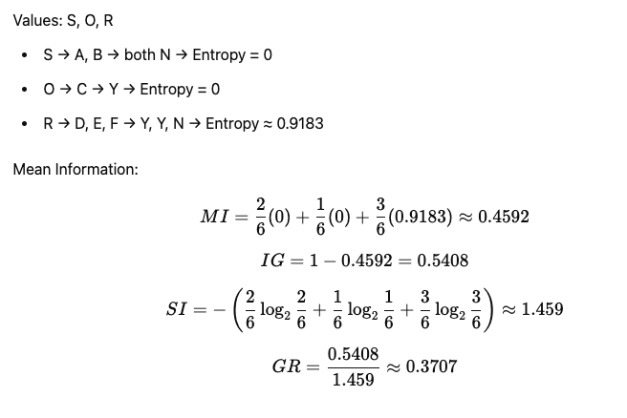
Step 2: Try Splitting on All Features
Feature: Outlook

Slide 33
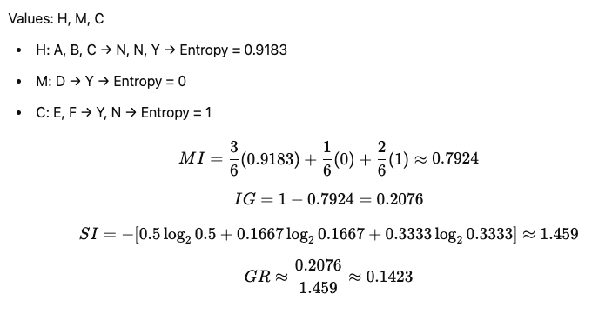
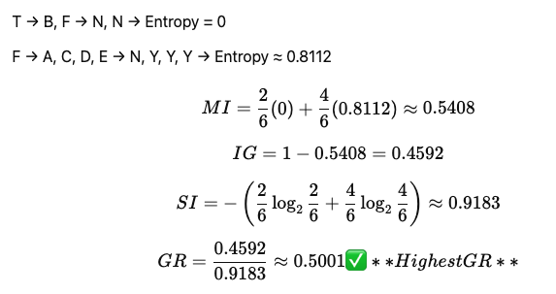
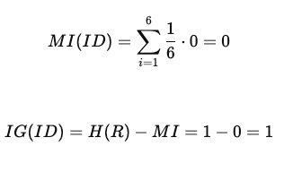
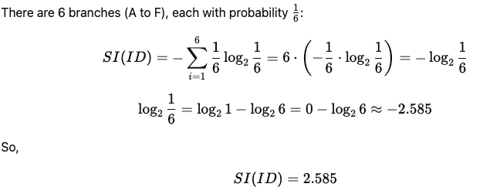
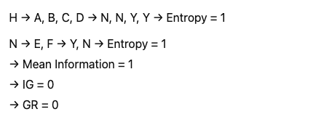

Step 2: Try Splitting on All Features
Step 2: Choose Root = Wind
Feature: Wind
Feature: Temp
Feature: ID
Feature: Humid

Slide 34
Build Tree (First Split: Wind)
Yes = 3 No =3
Wind
T
F
N (A)
N (F, B)
Y (C,D, E)

Slide 35
Step 3: Evaluate Attributes in Wind = F subset
ID | Outlook | Temp | Humid | Wind | Play
A | S | H | H | F | N
C | O | H | H | F | Y
D | R | M | H | F | Y
E | R | C | N | F | Y
Feature: Outlook
Value | Play | Entropy
s | N | 0
o | Y | 0
r | Y, Y | 0
Feature: Temp
MI = 0
IG = 0.8112
SI = −[¼log¼ + ¼log¼ + ½log½] = 1.5
GR = 0.8112 / 1.5 = 0.5408
2 h instances (1 Y, 1 N, ( H = 1 ))
1 m instance (Y, ( H = 0 ))
1 c instance (Y, ( H = 0 ))
𝑀𝐼=2/4(1)+1/4(0)+1/4(0)=0.5
⇒𝐼𝐺=0.8112−0.5=0.3112
Same instance distribution as Outlook, so the split information is also 1.5, and the Gain ratio is 𝐺𝑅(Temp∣Wind=𝐹)=0.31121.5≈0.2075

Slide 36

Step 2: Try Splitting on All Features
Feature: Humid
3 h instances (2 Y, 1 N, ( H = 0.9183 ))
1 n instance (Y, ( H = 0 ))
𝑀𝐼=3/4(0.9183)+1/4(0)=0.6887
⇒𝐼𝐺=0.8112−0.6887=0.1225
Feature: Id
Mean information is obviously still 0, so IG = 0.8112
Best Split: Highest GR
Outlook = 0.5408

Slide 37
Final Decision Tree (Second split = outlook)
ID | Outlook | Temp | Humid | Wind | Play
G | O | M | N | T | ?
H | S | H | H | F | ?
Yes = 3 No =3
Wind
T
F
N
OUTLOOK
S
R
O
Y
N
Y

Slide 38
Final Decision Tree
ID | Outlook | Temp | Humid | Wind | Play
G | O | M | N | T | N
H | S | H | H | F | N
Yes = 3 No =3
Wind
T
F
N
OUTLOOK
S
R
O
Y
N
Y

Slide 39

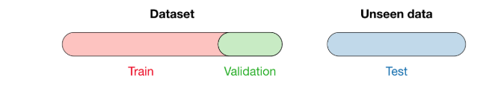

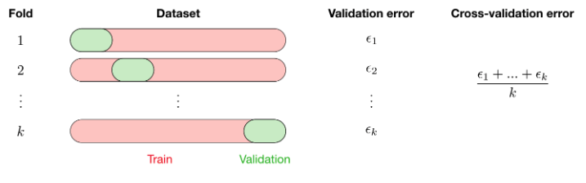
Data Splitting Techniques
Holdout
You split your dataset into two or three parts:
Training set: used to train the model
Validation set: used to optimize hyperparameters
Test set: used to evaluate the model's performance
K-Fold Cross-Validation
You split your dataset into k equal parts (folds) and perform k rounds of training/testing:
In each round:
Train on 𝑘−1 folds
Test on the remaining fold
Final score = average performance across all rounds
https://stanford.edu/~shervine/teaching/cs-229/cheatsheet-machine-learning-tips-and-tricks

Slide 40




Key Takeaways and Best Practices
Choose Metrics Wisely
Select evaluation metrics that match your problem domain and business objectives.
2
Always Use Baselines
Establish minimum performance thresholds with simple models for comparison.
Implement Proper Data Splits
Ensure train/validation/test splits reflect real-world data distribution and use cases.
Iterate and Improve
Use evaluation insights to refine models continuously. Monitor for drift in production.

