Slide 1
COMP30027 MACHINE LEARNING
TUTORIAL
Workshop - 5

Slide 2
Distance Measures, KNN & SVM
How to implement distance measures (Euclidean, Manhattan, etc.)
How to implement K-NN
How to implement SVM
Design decisions involved in K-NN and SVM classification

Slide 3
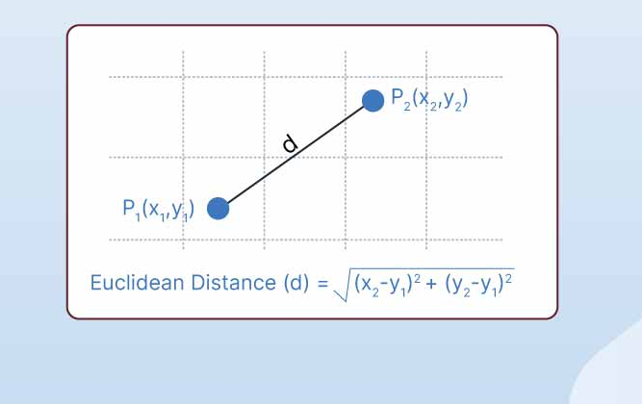

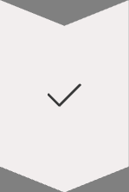

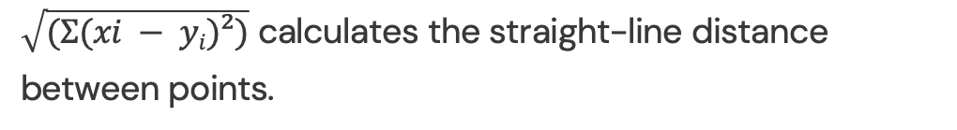
Euclidean Distance
Formula
$\sqrt{(Σ(xi − yi)²)}$ calculates the straight-line distance between points.
Best Use
Ideal for continuous numerical features
Limitation
Highly sensitive to feature scaling. Normalization is essential.

Slide 4
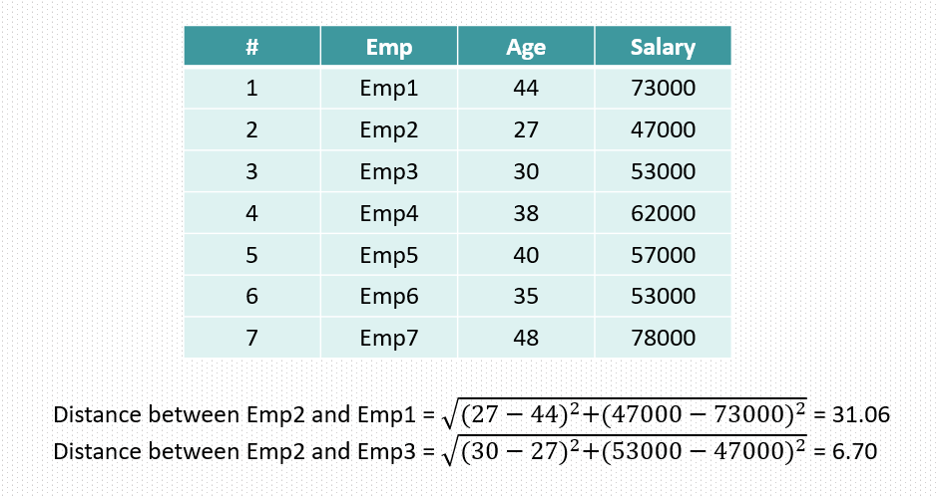
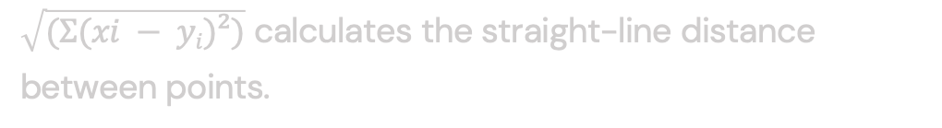
Euclidean Distance
Formula
$\sqrt{(Σ(xi − yi)²)}$ calculates the straight-line distance between points.
Best Use
Ideal for continuous numerical features
Limitation
Highly sensitive to feature scaling. Normalization is essential.

Slide 5
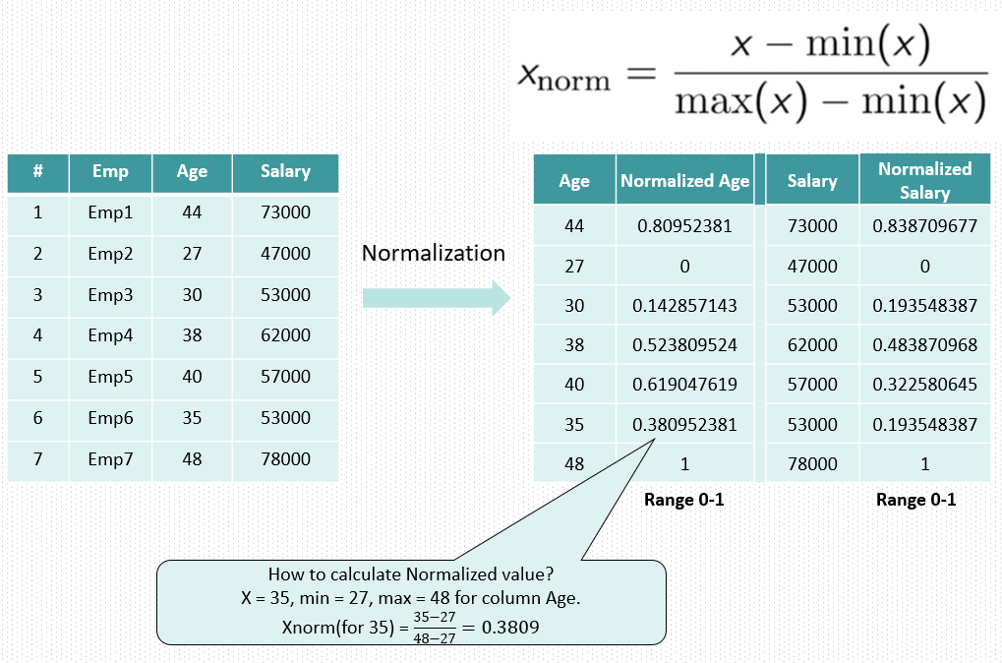
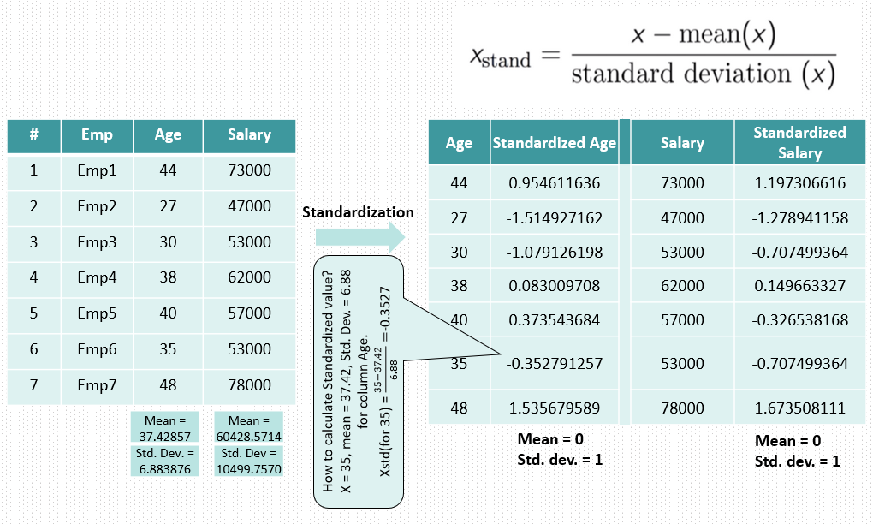
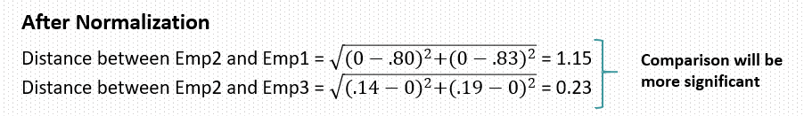
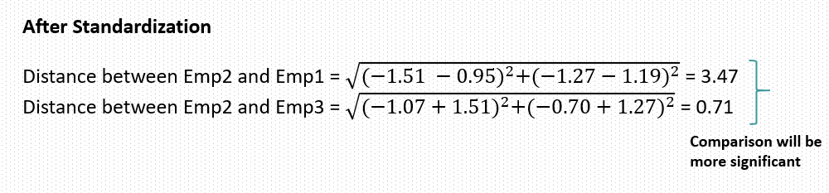
Feature Scaling Techniques
Standardization
Min-Max Normalization
https://ashutoshtripathi.com/2021/06/12/what-is-feature-scaling-in-machine-learning-normalization-vs-standardization/

Slide 6
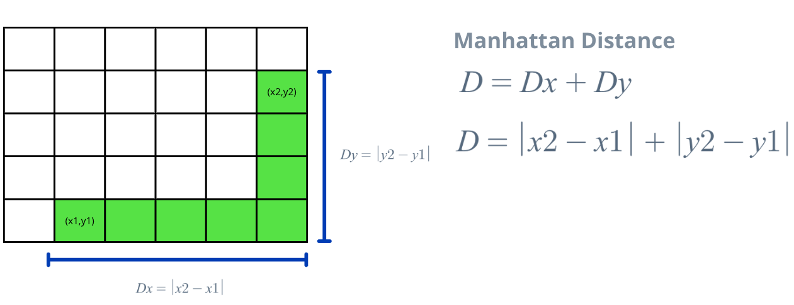
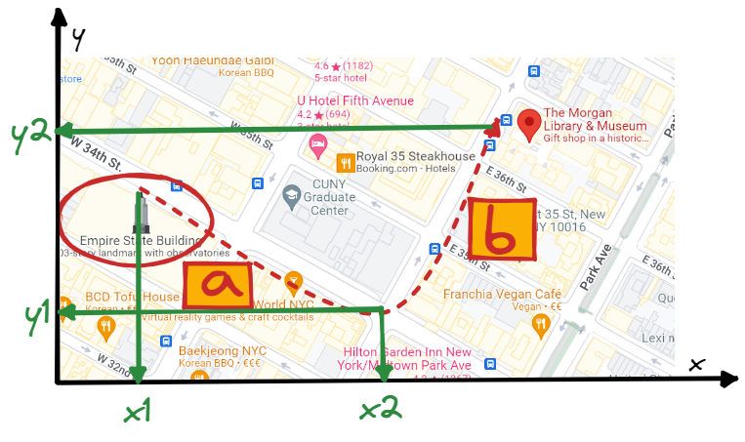
Manhattan Distance
What Is It?
Formula
Manhattan distance measures the sum of absolute differences between coordinates.
Σ|x_{i} - y_{i}| for all coordinates in the feature vectors.
It follows grid-like paths similar to navigating city blocks.

Slide 7
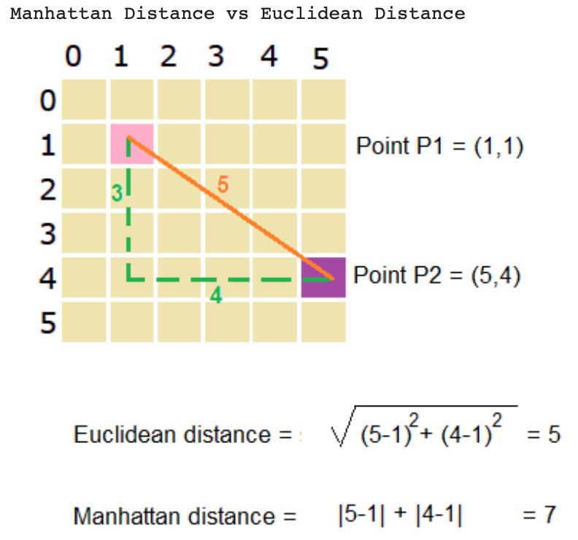

Slide 8
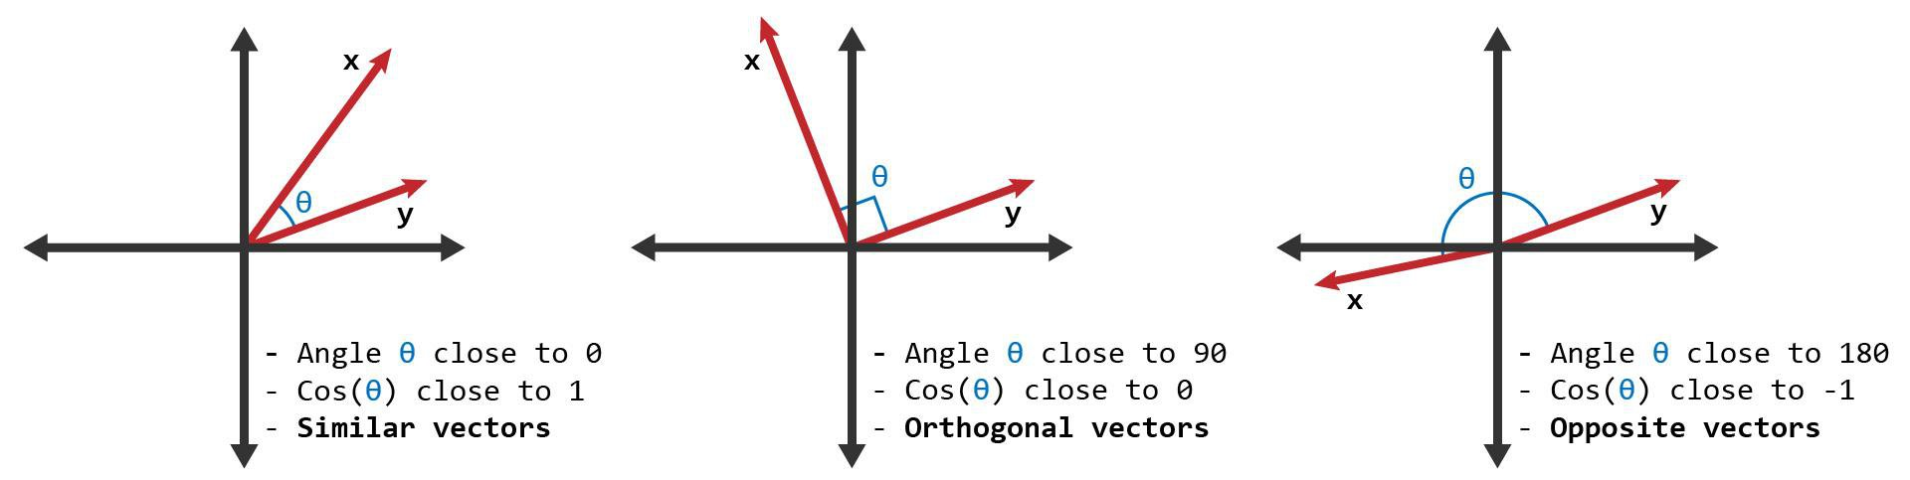


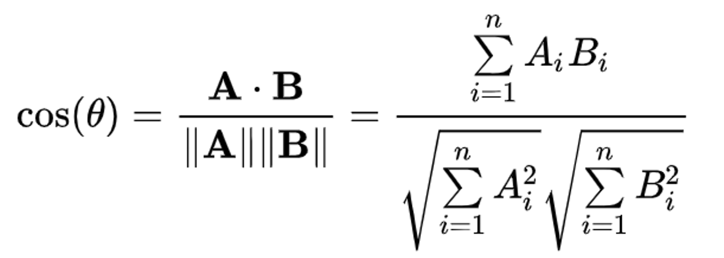
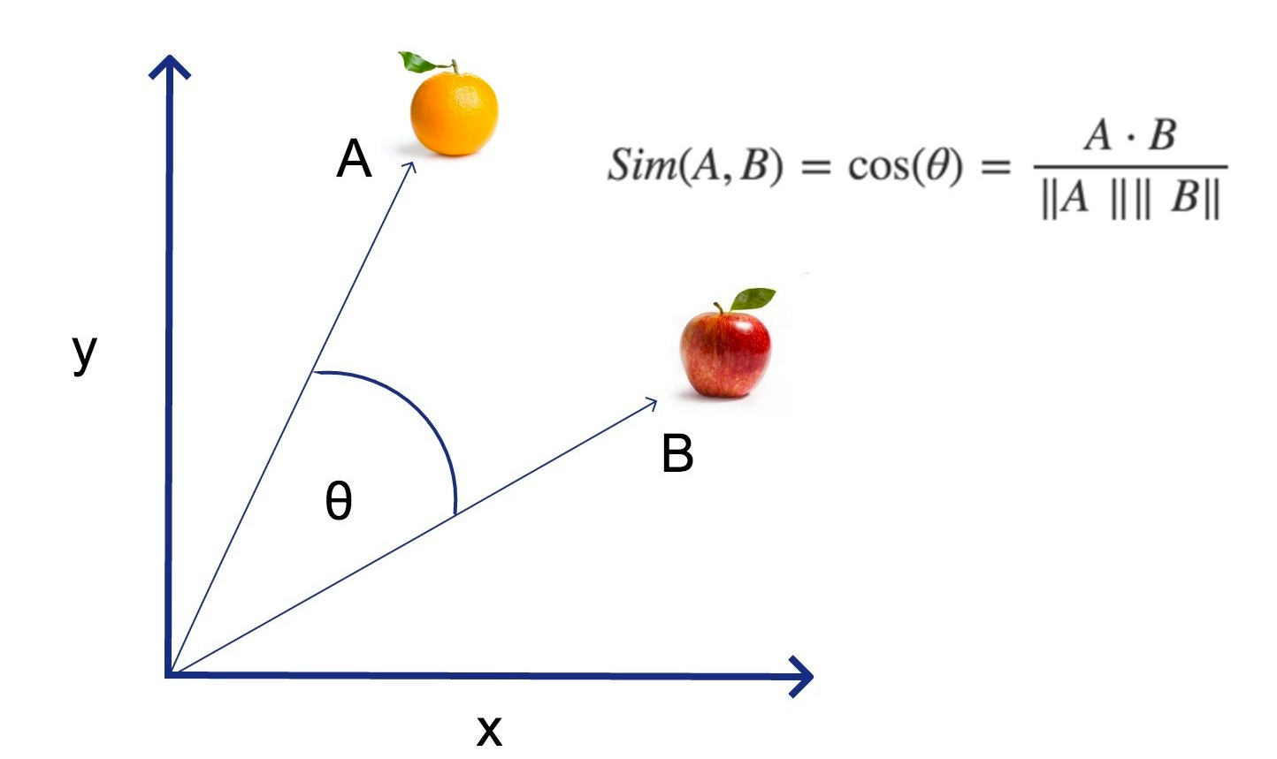

Cosine Similarity
Angle-Based Measurement
Formula Application
Measures the cosine of the angle between two non-zero vectors.
High-Dimensional Data
Excels with sparse vectors like TF-IDF representations.
https://businessanalytics.substack.com/p/cosine-similarity-explained
https://www.learndatasci.com/glossary/cosine-similarity/

Slide 9
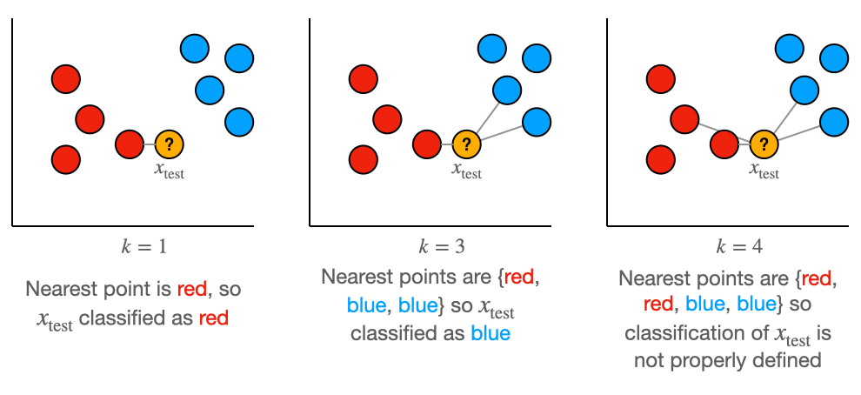
K-Nearest Neighbors
https://towardsdatascience.com/why-does-increasing-k-decrease-variance-in-knn-9ed6de2f5061/

Slide 10
K-Nearest Neighbors Overview
Classification
Predicts class based on majority vote of nearest neighbors
Regression
Predicts values using averages of nearest neighbors
Storage
Stores all training examples as reference points
K-NN is intuitive and versatile, requiring no training phase beyond storing examples. It's memory-intensive but highly flexible for various problem types.

Slide 11
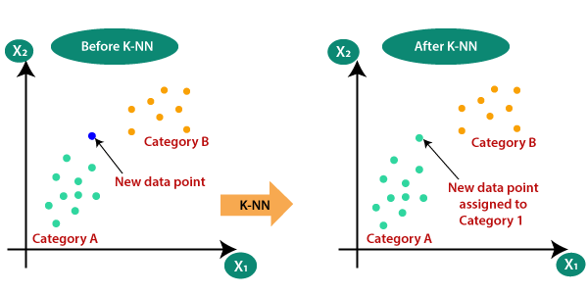
K-NN Implementation Steps
Choose Value of K
Select an optimal K value through cross-validation. K should be odd to avoid ties.
Calculate Distances
Compute distances between test example and all training examples. Use Euclidean, Manhattan, or Cosine metrics.
Find K Nearest Neighbors
Sort distances and identify the K closest training examples. This subset determines the classification.
Apply Voting Mechanism
Use majority or weighted voting to determine the predicted class. Return the result.
https://trendspider.com/learning-center/k-nearest-neighbors-knn/

Slide 12
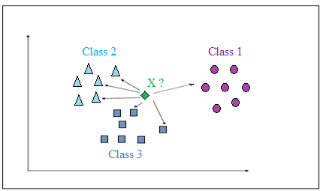
Majority Voting in K-NN
How It Works
Implementation
Challenges
Each of the K nearest neighbours casts one equal vote. The class with the most votes wins.
Count occurrences of each class among K neighbors. Return the most frequent class.
Ties can occur with even K values. Solution: use odd K or add tiebreaker rule.
Simple to implement and explain, requiring only vote counting.
All neighbors have equal influence regardless of distance.
https://www.researchgate.net/figure/The-Majority-Voting-KNN-K6_fig3_286477914

Slide 13
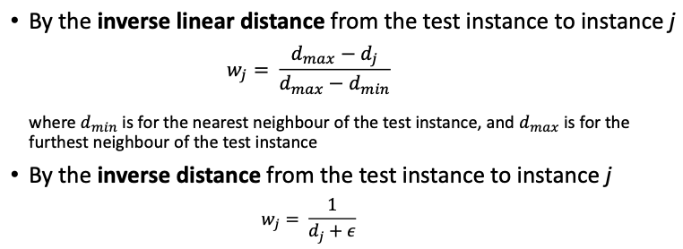
Weighted Voting Technique
Vote Calculation
Sum weights for each class; highest weighted class wins

Slide 14
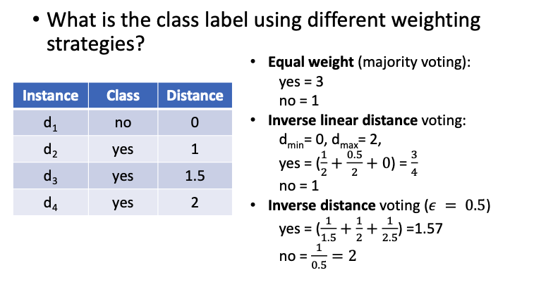

Slide 15
K-NN classification
Consider the following dataset
Training set:
Q1
Classify the test instances using 1-NN and 3-NN with various distance measures (Euclidean distance, Manhattan distance, cosine similarity). For 3-NN, consider both majority vote and weighted voting (cosine similarity can be weighted by simply summing the similarities of the 3 neighbours). Complete the tables below. How does the classification of each test instance change with different parameters?
APPLE | IBM | LEMON | SUN | CLASS
4 | 0 | 1 | 1 | fruit
5 | 0 | 5 | 2 | fruit
2 | 5 | 0 | 0 | computer
1 | 2 | 1 | 7 | computer
Test set:
APPLE | IBM | LEMON | SUN | CLASS
2 | 0 | 3 | 1 | ?
1 | 2 | 1 | 0 | ?

Slide 16
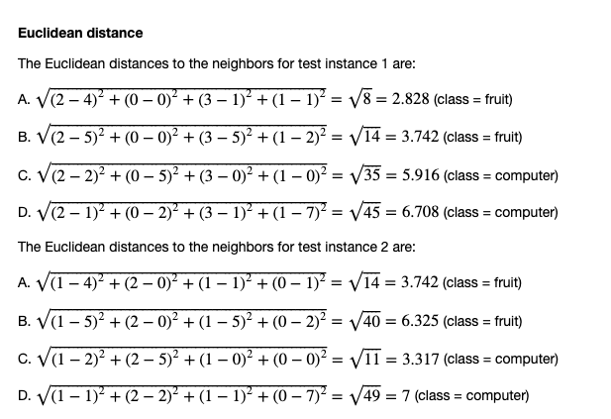

Slide 17
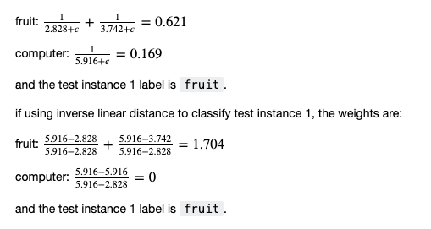
Inverse distance
Inverse linear distance

Slide 18
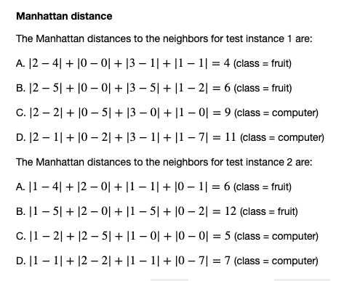

Slide 19
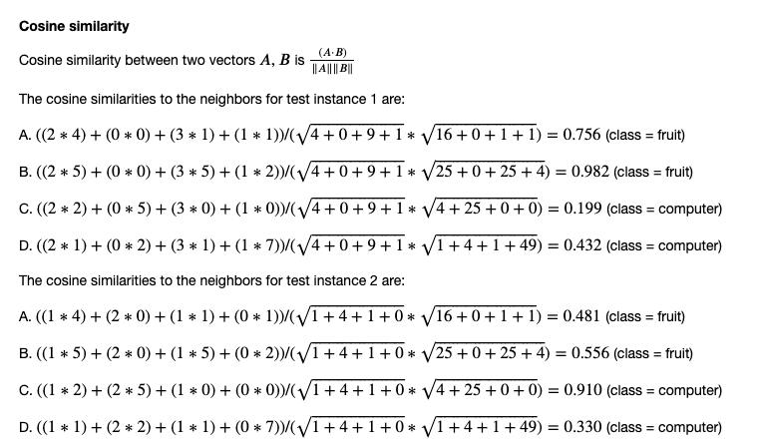
(cosine similarity can be weighted by simply summing the similarities of the 3 neighbours)
A value of 1 indicates perfect similarity,
0 indicates orthogonality (no similarity),
-1 indicates perfect dissimilarity.

Slide 20
Test instance 1
APPLE | IBM | LEMON | SUN | CLASS
2 | 0 | 3 | 1 | ?
Measure | K | Weight | Prediction
Euclidean | 1 | N/A | fruit
Euclidean | 3 | Majority vote | fruit
Euclidean | 3 | Inverse dist | fruit
Euclidean | 3 | Inverse linear dist | fruit
Manhattan | 1 | N/A | fruit
Manhattan | 3 | Majority vote | fruit
Manhattan | 3 | Inverse dist | fruit
Manhattan | 3 | Inverse linear dist | fruit
Cosine | 1 | N/A | fruit
Cosine | 3 | Majority vote | fruit
Cosine | 3 | Sum | fruit

Slide 21
Test instance 2
APPLE | IBM | LEMON | SUN | CLASS
1 | 2 | 1 | 0 | ?
Measure | K | Weight | Prediction
Euclidean | 1 | N/A | computer
Euclidean | 3 | Majority vote | fruit
Euclidean | 3 | Inverse dist | fruit
Euclidean | 3 | Inverse linear dist | computer
Manhattan | 1 | N/A | computer
Manhattan | 3 | Majority vote | computer
Manhattan | 3 | Inverse dist | computer
Manhattan | 3 | Inverse linear dist | computer
Cosine | 1 | N/A | computer
Cosine | 3 | Majority vote | fruit
Cosine | 3 | Sum | fruit

Slide 22
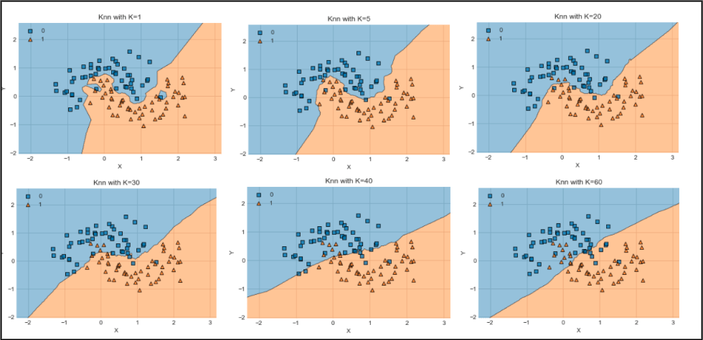
Impact of K Value
K directly controls decision boundary complexity. Lower K creates irregular boundaries sensitive to local patterns. Higher K produces smoother boundaries capturing general trends.
Small K Values (K=1, 3)
Large K Values (K=10+)
Finding Optimal K
Creates complex, highly flexible decision boundaries.
Creates smoother, more generalized boundaries.
Use cross-validation to test different K values.
Fits training data closely but risks overfitting to noise.
If the dataset has high class imbalance, setting k to a high value may make the classifier unable to recognize the rare classes.
https://neptune.ai/blog/knn-algorithm

Slide 23
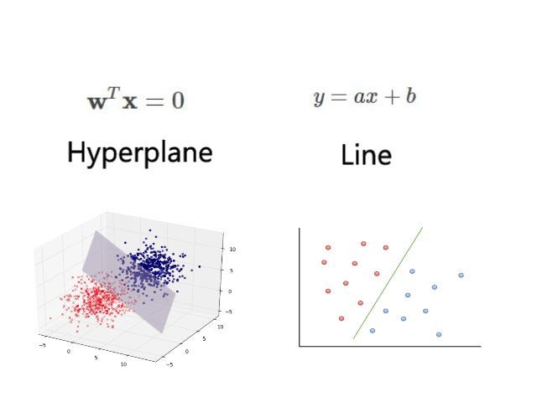
Support Vector Machines Introduction
SVM tries to find the best boundary (hyperplane) that separates data points of different classes.

Slide 24
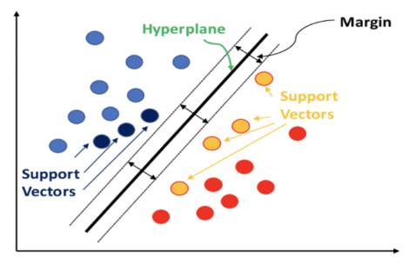
Hyperplane – Hyperplane is the decision boundary that aids in classifying the data points.
Support Vectors – Support Vectors are the data points that are on or nearest to the hyperplane and influence the position of the hyperplane.
Margin – Margin is the gap between the hyperplane and the support vectors.
Kernel function – These are the functions used to determine the shape of the hyperplane. Transforms data to handle non-linear classification.
https://datatron.com/what-is-a-support-vector-machine/

Slide 25
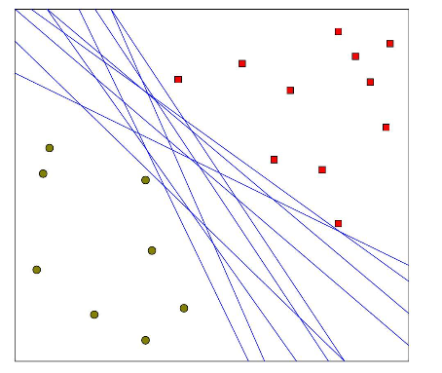
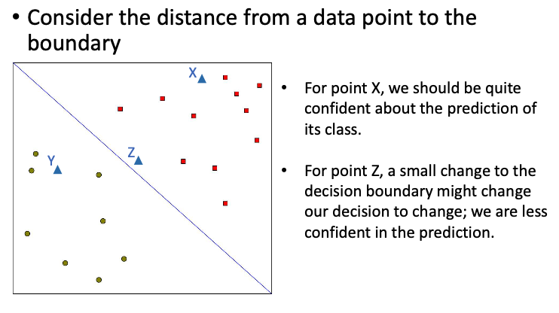
Support Vector Machines Introduction
Hyperplane Optimization
Finds optimal decision boundary with maximum margin

Slide 26
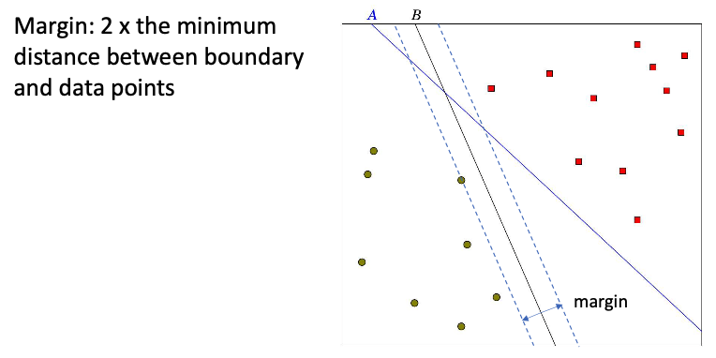
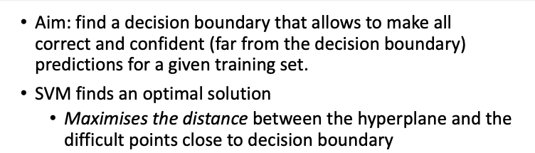
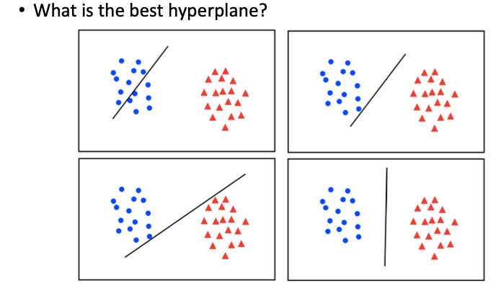
Hyperplane Optimization

Slide 27
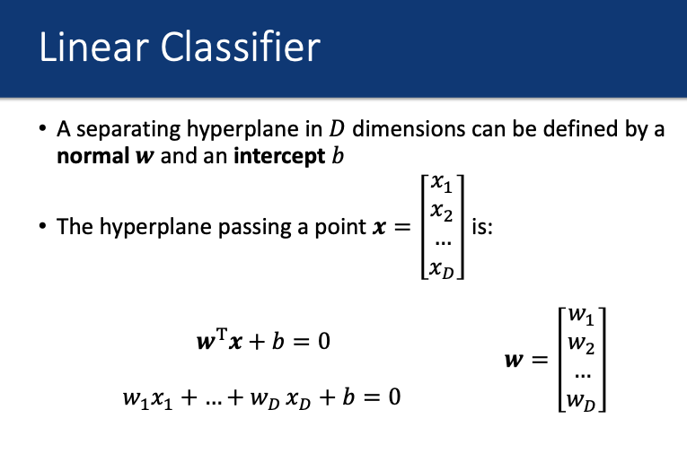
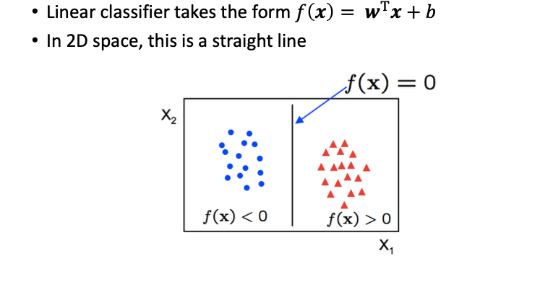
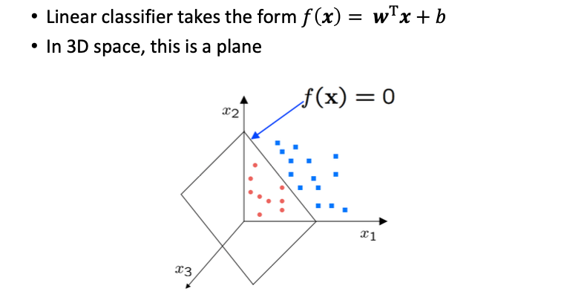

Slide 28




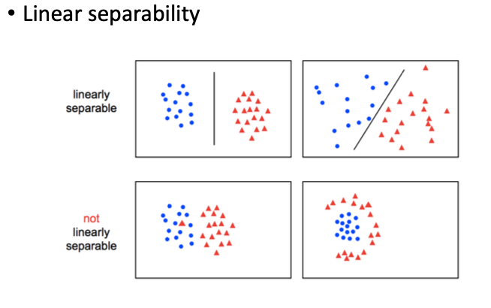
Linearly Separable Classification
Perfect Separation
Maximum Margin
Support Vectors
Robustness
Maximum margin provides better generalization.
Classes can be completely divided by a linear hyperplane.
SVM finds the widest possible gap between classes.
Only points nearest to boundary influence the result.

Slide 29
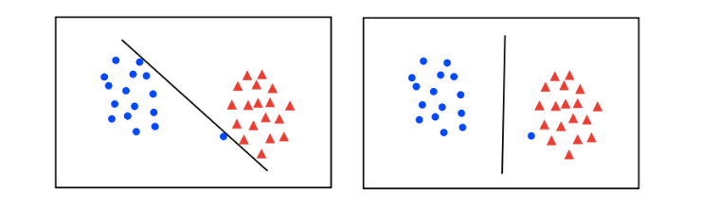
But What if Data is Not Linearly Separable?

Slide 30
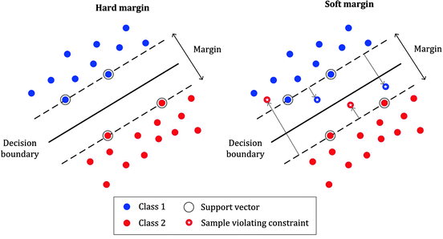
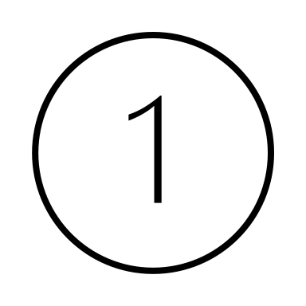
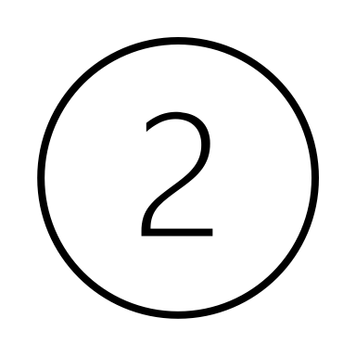
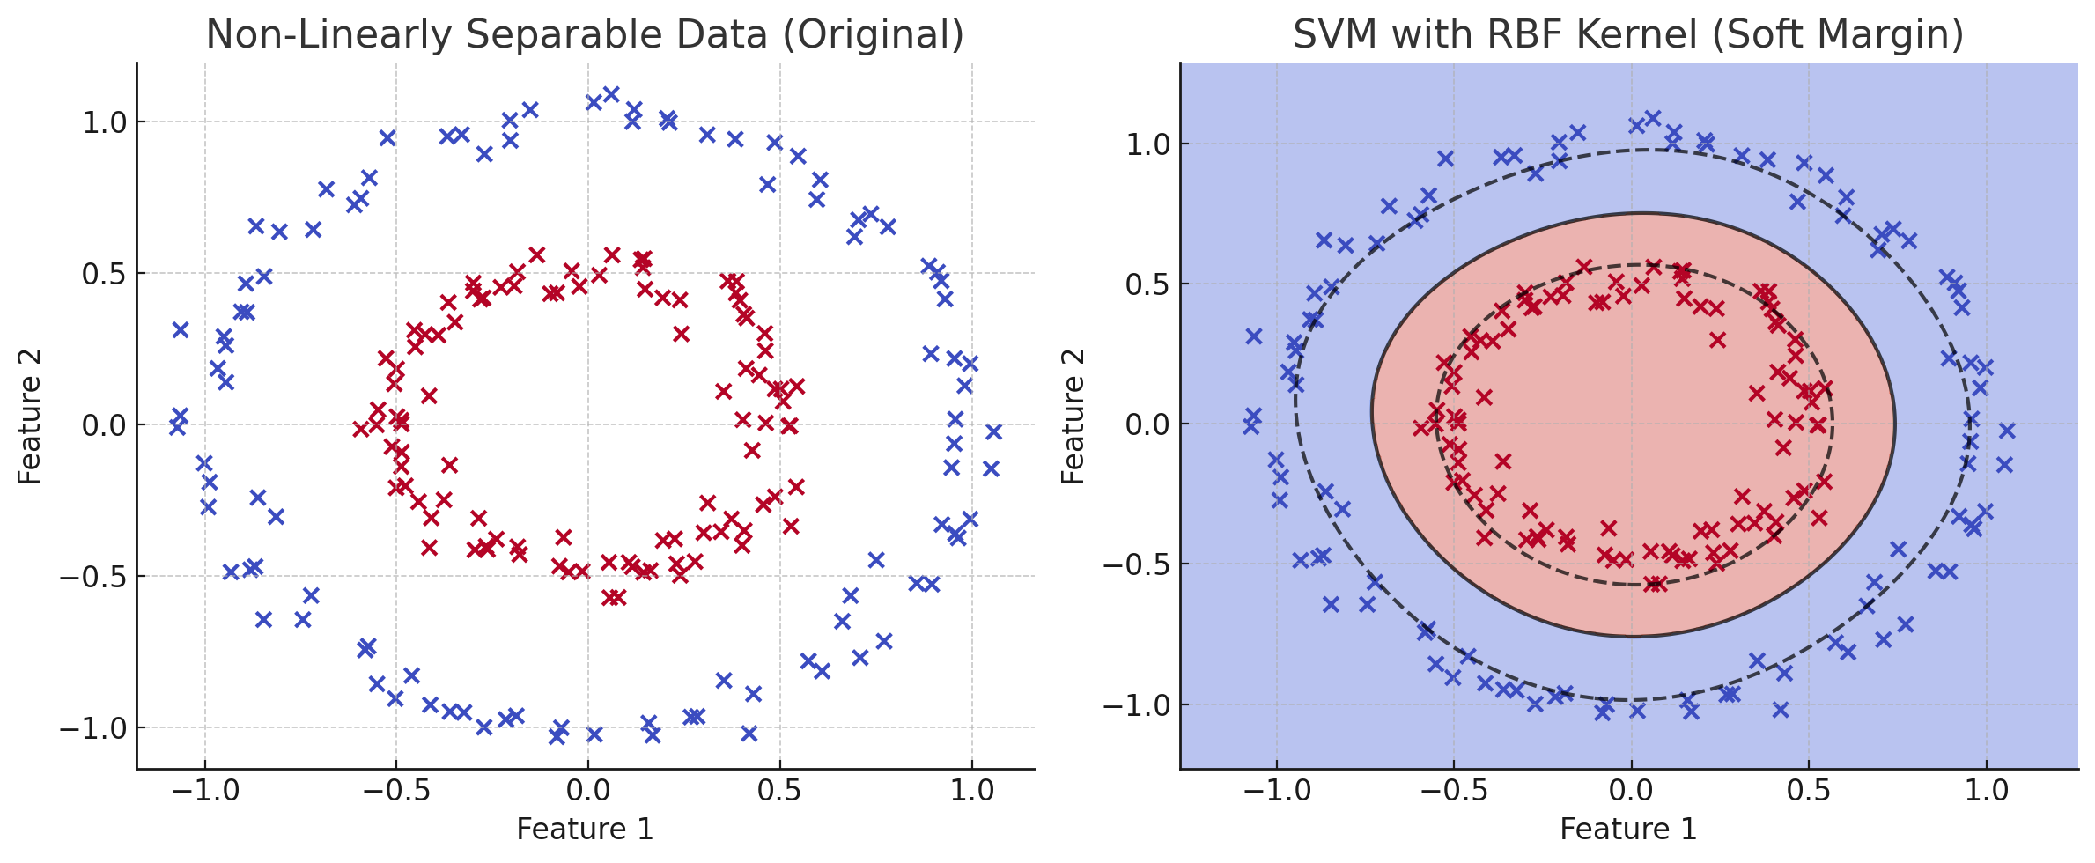
Two Solutions
Allow Soft Margin (C Parameter)
Introduce a soft margin to allow some misclassifications using the C parameter.
This lets the SVM tolerate overlap between classes while still finding the best possible boundary.
Use the Kernel Trick
Apply a non-linear kernel function to map the data into a higher-dimensional space where it becomes linearly separable.
Common kernels:
RBF (Gaussian)
Polynomial
Sigmoid
https://doi.org/10.1142/S1469026808002314

Slide 31
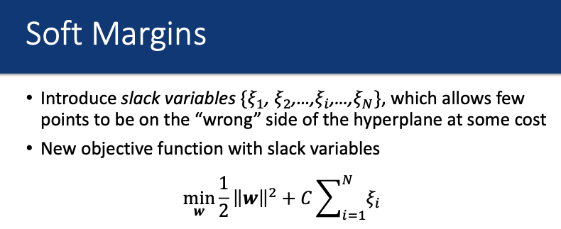
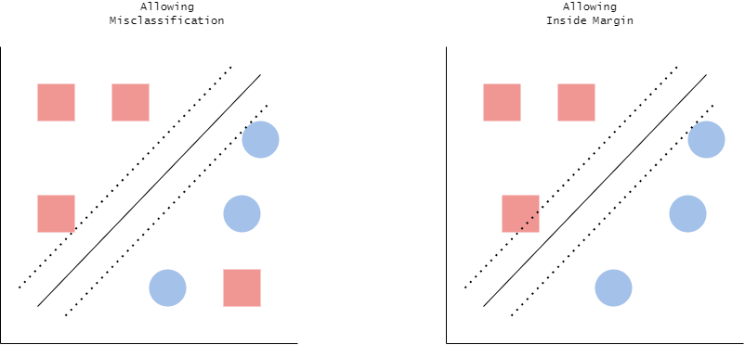
Soft margins
In real-world datasets, classes are often not perfectly separable. So, SVM allows some points to:
Be on the wrong side of the margin (i.e., lie within the margin boundaries as in Fig. B)
Even be misclassified (as in Fig. A)
Using Slack variables (ξ)
Slack Penalty
Slack Variable
“The extent to which a data point violates the margin or is misclassified”
“How much should we penalize violations of the margin?”
Fig. A
Fig. B
https://helenedk.medium.com/an-introduction-to-soft-margin-support-vector-machines-fec8420981af

Slide 32
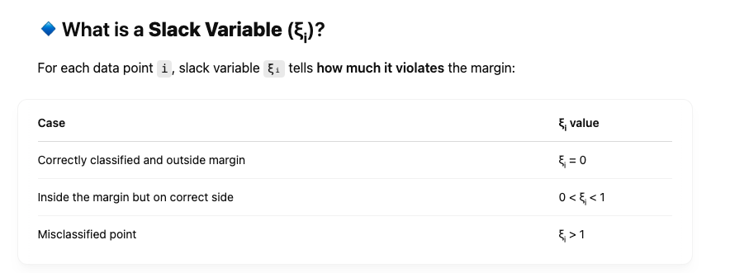
Slack Variables in SVM
Here, w is the normal vector to the hyperplane
||w|| controls the margin → smaller w → wider margin
SVM minimizes the norm of w to maximize the margin
C is a regularization parameter:
Low C → wider margin, more misclassifications
High C → narrow margin, fewer violations
ξ = 0
ξ > 1
0 <ξ < 1

Slide 33
Slack Penalty
C=0.1
Low Penalty
Large C → hard margin behaviour
Small C → soft margin behaviour (more forgiving)
Allows many violations, creating smoother boundaries
C=1.0
A hard margin requires perfect separation (no misclassified points).
A soft margin allows:
Some points to lie inside the margin.
Some points to be misclassified.
Balanced Penalty
Moderate trade-off between errors and margin width
C=10
High Penalty
Strict boundaries with fewer misclassifications allowed
C=100
Extreme Penalty
Nearly rigid separation, risking overfitting

Slide 34
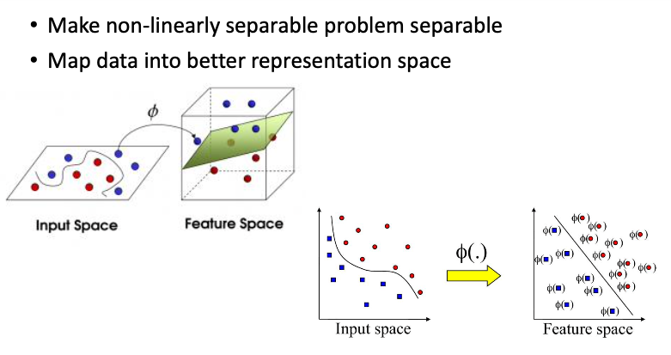
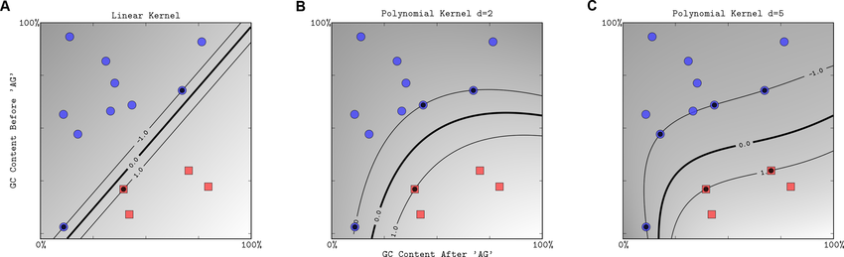
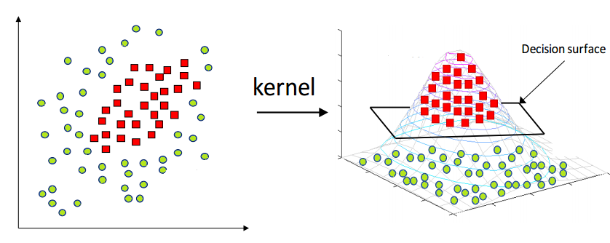
Kernal Methods
Transform the input data into a higher-dimensional space using kernel functions
Common kernels:
RBF (Gaussian): For circular or complex boundaries.
Polynomial: Captures curved decision boundaries.
Sigmoid: Similar to neural networks.
Polynomial Kernel
RBF kernel
https://itsudit.medium.com/svm-kernels-understanding-the-role-of-kernels-in-support-vector-machines-6bf1e702737a
https://medium.com/@abhishekjainindore24/svm-kernels-and-its-type-dfc3d5f2dcd8
https://blog.devgenius.io/machine-learning-algorithm-series-polynomial-kernel-svm-understanding-the-basics-and-applications-89b4b42df137

Slide 35
Q3
What does it mean for a classification dataset to be "linearly separable"? If a dataset isn’t linearly separable, an SVM learner has two major options. What are they, and why might we prefer one to the other?
If a dataset is "linearly separable," it is possible to completely separate the classes with a single hyperplane
If a dataset isn't linearly separable, the options for SVM are:
Soft margins
2. Kernel methods
Method | Purpose | Handles...
Soft Margin | Allow misclassifications by maximizing margin | Noisy or almost separable data
Kernel Trick | Transform data to separable space | Complex non-linear boundaries

Slide 36
Q6
What is the value of slack variables for data points that are correctly classified in SVMs? What should the slack penalty C be to make a soft-margin SVM function as a hard-margin SVM?
For data points that are correctly classified, the value of their slack variable is 0
Hard SVM don’t allow any mistakes or in other words the penalty rate for the mistakes is equal to infinity (∞). To make soft SVM to act like hard SVM the slack penalty C should be very large.

Slide 37
Q5
How do changes in data points affect the decision boundary of an SVM?
The support vectors are used to define the hyperplane that separates the classes. Changes in data points that are not support vectors have no effect on the decision boundary.
However, changes in the position or label of support vectors can have a significant impact on the decision boundary.
https://greitemann.dev/svm-demo

Slide 38
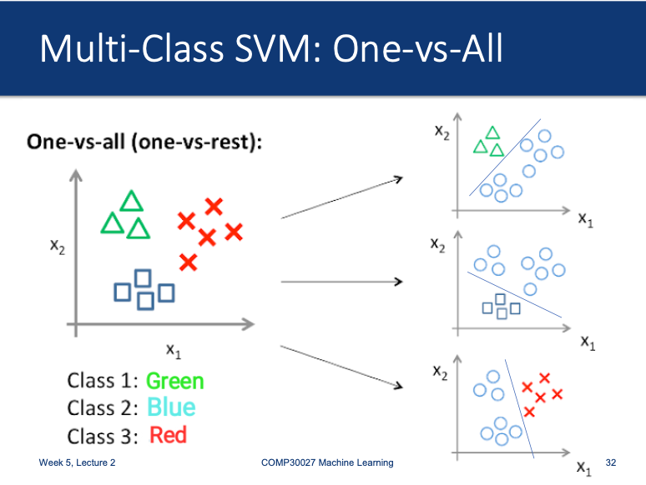
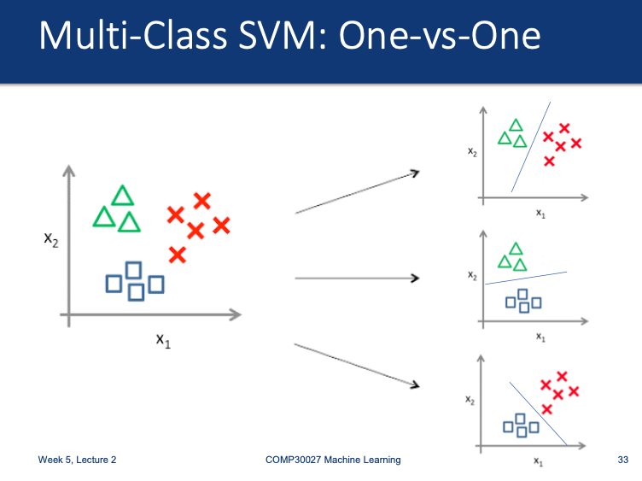
SVM is naturally binary, but we can use:
Multi-Class SVM

Slide 39
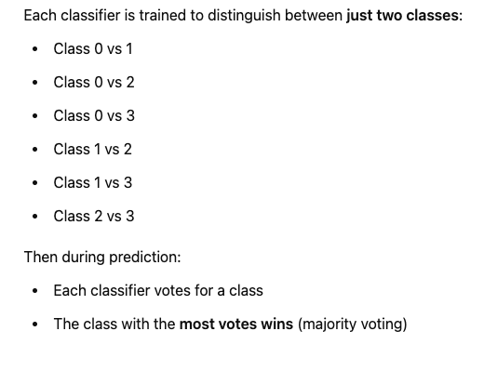

Q7
How many binary classifiers are needed to classify a dataset with 4 classes using one-vs-one method?

Slide 40
Advantages of SVMs
High-Dimensional Space
Generalization Power
SVMs maintain effectiveness with many features. They avoid the curse of dimensionality.
Maximum margin principle provides better theoretical guarantees. SVMs often outperform K-NN.
The algorithm focuses on support vectors rather than all data points.
They're less prone to overfitting with proper regularization.
Memory Efficiency
Only support vectors are stored after training. This makes prediction more efficient.
K-NN must store the entire training dataset.

Slide 41
Q4
Unlike other geometric methods such as K-NN, SVMs work better with large attribute sets. Why might this be true?
1. SVMs focus on the most important points (support vectors)
SVM builds a decision boundary using only the critical support vectors, not all the data.
In high dimensions, many features may be irrelevant or noisy, and SVMs ignore non-support points during decision making.
2. No need for prior feature selection; SVMs can implicitly capture the relationships between different features and can handle interactions between them without the need for explicit feature engineering. This means that SVMs can effectively learn from a large number of features without requiring a priori knowledge about which features are most important for the classification task.

