Slide 1
COMP30027 MACHINE LEARNING
TUTORIAL
Workshop - 6

Slide 2
Understanding
Parameters
Hyperparameters
Linear Regression
Gradient Descent
Error Analysis

Slide 3
Parameters vs Hyperparameter
Parameters
Hyperparameter
Parameters are learned from training data. They define the model's ability to make predictions and are saved as part of the trained model.
Hyperparameters are manually set before training begins and control how the model learns.
Unlike parameters, which are learned automatically, hyperparameters represent choices made by the data scientist about how the learning should proceed.
The same algorithm with different hyperparameter values can yield dramatically different models and prediction accuracy.

Slide 4
Model-Specific Parameters vs Hyperparameters
Algorithm
Parameters
Hyperparameters
Support Vector Machine
Support vectors, weights,
bias/intercept
C (regularization), kernel type, gamma
K-Nearest Neighbors
None (stores training data)
k (number of neighbours), distance metric, voting scheme
Decision Trees
Split thresholds, leaf values
Max depth, min samples per leaf, split criterion
Naive Bayes
Prior probabilities, feature likelihoods
Smoothing parameter (alpha)

Slide 5
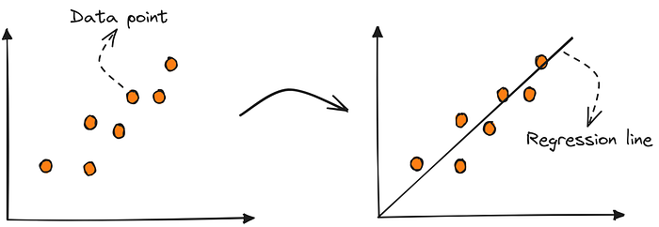
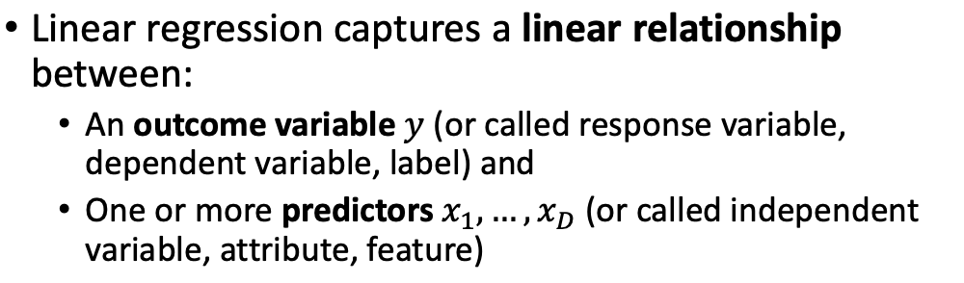
Linear Regression
https://pub.towardsai.net/machine-learning-the-first-step-is-to-understand-simple-linear-regression-30dde8b4739

Slide 6
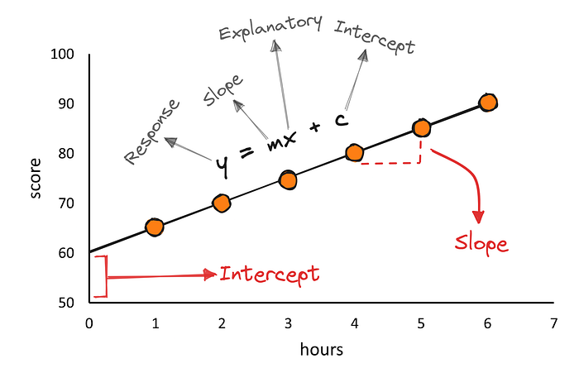
Linear Regression
Slope (m)
Model Equation
Represents the slope of the line, indicating how much y changes for each unit of x
y = mx + c, where m and c are parameters learned from data
Parameter Learning
Intercept (c)
m and c are optimized to minimize prediction error on training data
The y-intercept, showing the predicted value when x=0
https://pub.towardsai.net/machine-learning-the-first-step-is-to-understand-simple-linear-regression-30dde8b4739

Slide 7
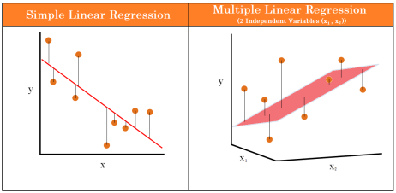
Linear Regression
https://thaddeus-segura.com/multiple-linear/

Slide 8
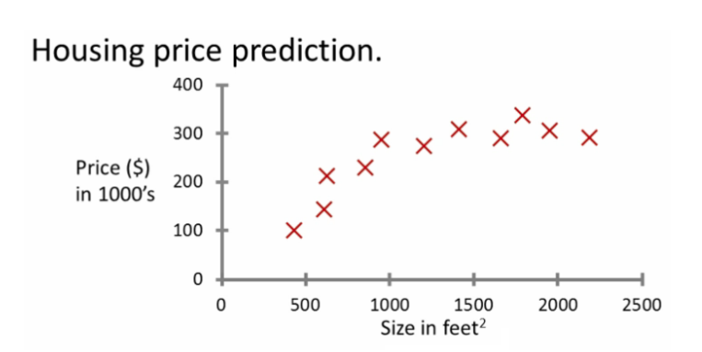
Linear Regression Example

Slide 9
This relationship can be represented as a straight line:
y = β₁ x + β₀
y (Dependent Variable) Price of house
x (Independent Variable) Size of house
β₁ and β₀ are model parameters
Linear Regression Example

Slide 10
This relationship can be represented as a straight line:
y = β₁ x + β₀
y (Dependent Variable) Price of house
x (Independent Variable) Size of house
β₁ and β₀ are model parameters
Linear Regression Example
Based on different values of β₁ and β_{0,}
we can fit have different lines to the data
We need to find β₁ and β₀ values of the straight line that best fits to the data. Solution: Least Squares Method

Slide 11
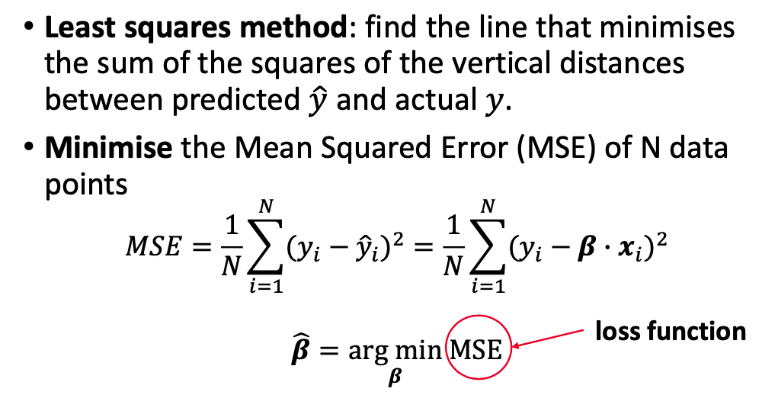
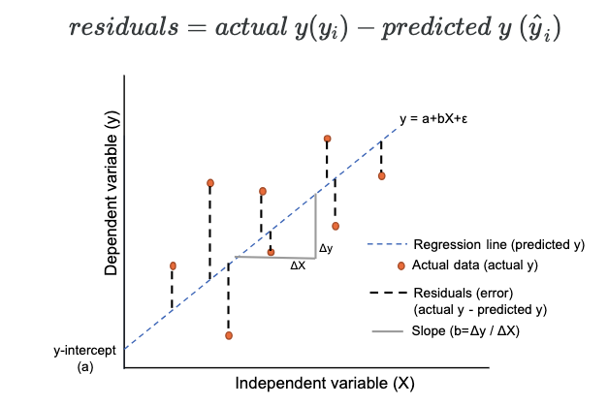
Fitting the Model- Least Squares Method
^
We need to find β₁ and β₀ values that have the lowest MSE. Solution: Gradient Descent
https://www.reneshbedre.com/blog/linear-regression.html

Slide 12
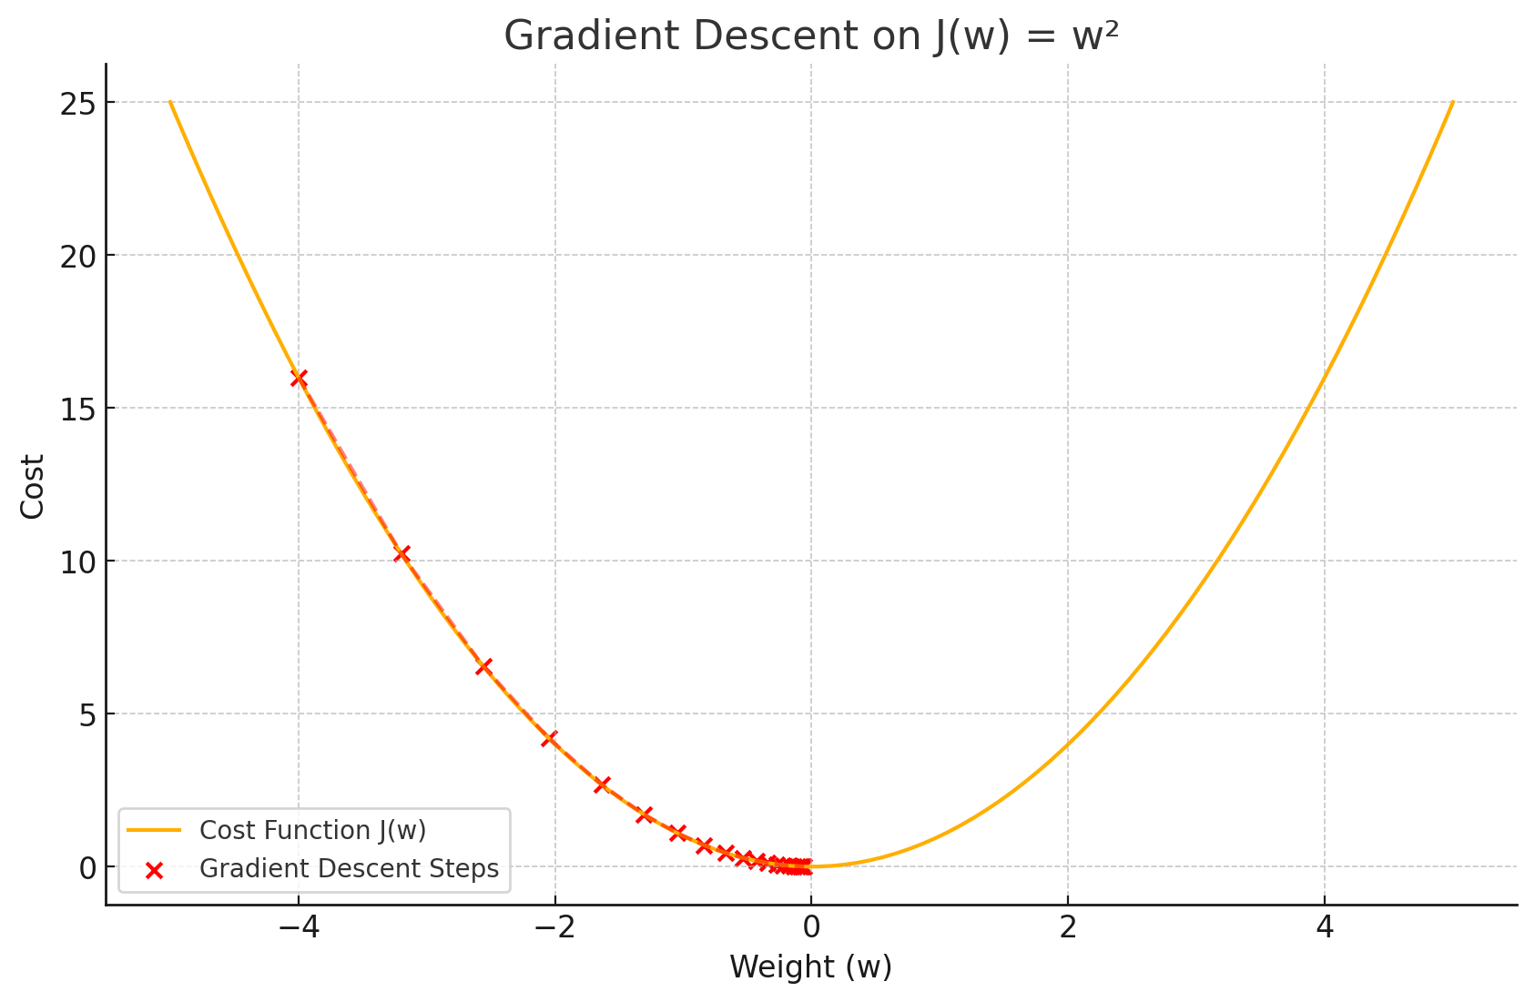
Gradient Descent
Gradient Descent is an optimisation algorithm used to find the best values of a model's parameters (like weights in linear regression) that minimise a loss function — basically, the error the model makes on training data.
We want to reach here; we want to know for what value of ‘w’, J=f(w) will assume the minimum value
This curve J=f(w) represents the values of loss function will assume for different values of w

Slide 13


Gradient Descent
The gradient is just the slope of the function — it tells us how steep the function is and in which direction to move to reach a minimum.
$$\frac{dJ}{dw}$$
Update rule:
gradient
learning rate (step size)
This curve J=f(w) represents the values of loss function will assume for different values of w

Slide 14
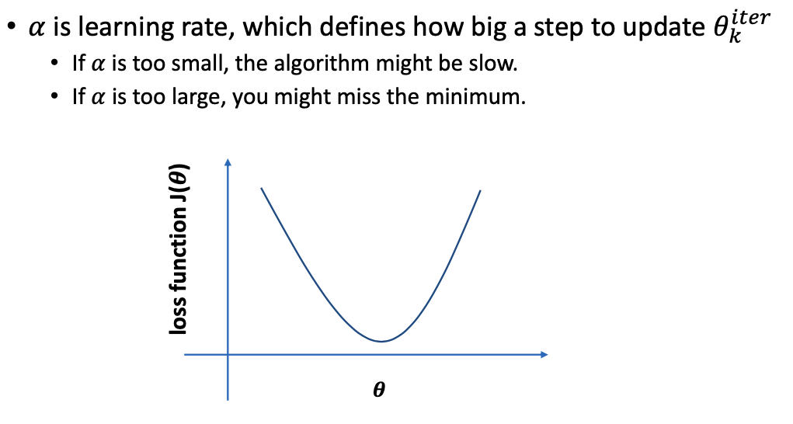
Gradient Descent
$$\frac{dJ}{dw}$$
Update rule:
gradient
learning rate (step size)
This curve J=f(w) represents the values of loss function will assume for different values of w

Slide 15

Gradient Descent: Iterative Parameter Optimization
Initialize Parameters
Start with random or zero values for parameters β₁ and β₀
Calculate predictions
^
Using current β₁ and β₀ compute y
Compute Gradient
Calculate partial derivatives of the error function with respect to each parameter
Update Parameters
J
θ: parameter (like weight)
α: learning rate (step size)
​: : slope (gradient) of the error
Learning rate α controls step size and affects convergence
Iterate Until Convergence
Repeat steps 2-3 until parameters stabilize or error is minimized
Convergence criteria is a hyperparameter that must be set beforehand

Slide 16
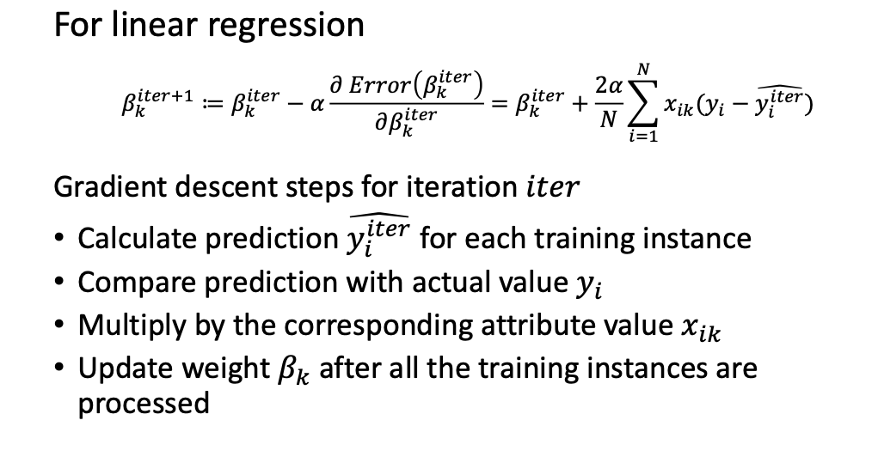
Gradient Descent: For Linear Regression

Slide 17
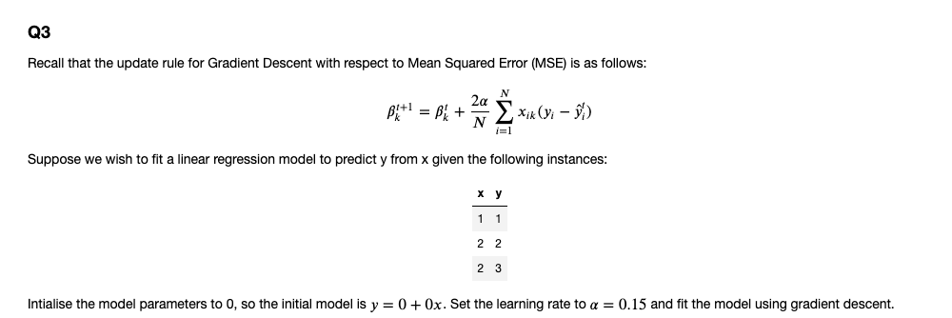

Slide 18
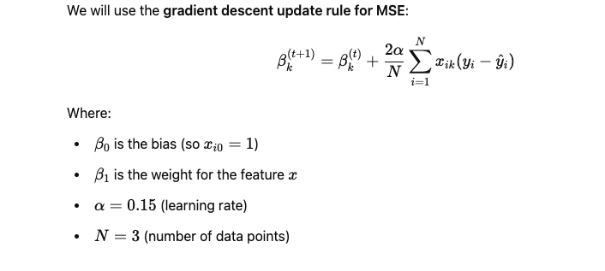



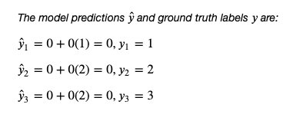
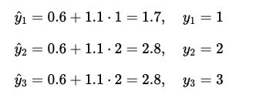
x | y
1 | 1
2 | 2
2 | 3
Step 2: Compute First Update
Step 1: Initialize parameters
New model after step 1:
Step 3: Compute New Predictions

Slide 19
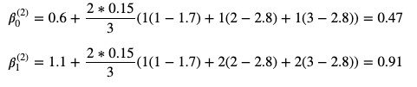

Step 4: Compute Second Update
New model after step 4:

Slide 20
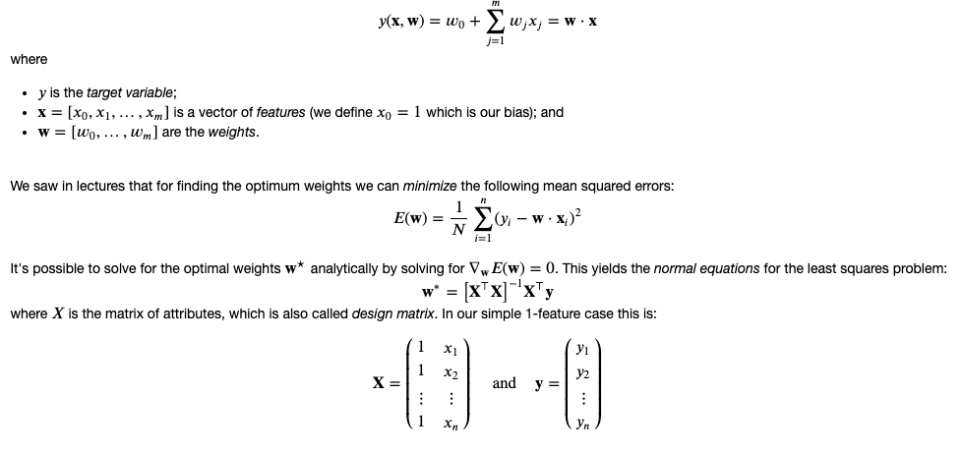
Analytical Solution

Slide 21
When to Use Linear Regression (And When Not To)
When to Use
When to Avoid
Data shows approximately linear relationships
Data exhibits clear nonlinear patterns
Features are independent
Significant outliers distort relationships when using MSE
Limited or no strong outliers present
You want a simple and interpretable model
When linear regression assumptions are violated, alternatives like polynomial regression or entirely different algorithms may be more appropriate.

Slide 22
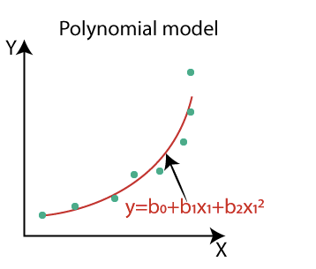
Polynomial Regression: Beyond Linear Relationships
When data exhibits clear nonlinear patterns, linear regression falls short. Polynomial regression extends the model by adding higher-degree terms.
Equation Form
Increased Flexibility
Overfitting Risk
y = β₀ + β₁x + β₂x² + β₃x³ + ... + βₙxⁿ + ε
Higher degree polynomials can fit more complex data relationships.
Too many degrees can create a model that memorizes training data.
https://medium.com/analytics-vidhya/understanding-polynomial-regression-5ac25b970e18

Slide 23
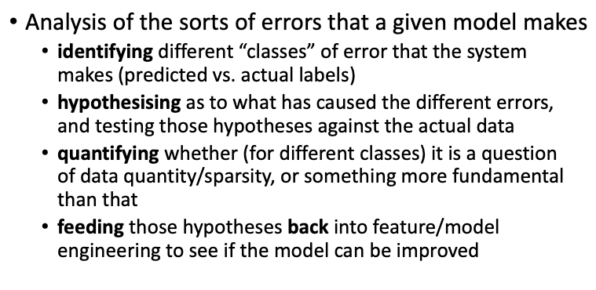
Error Analysis

Slide 24
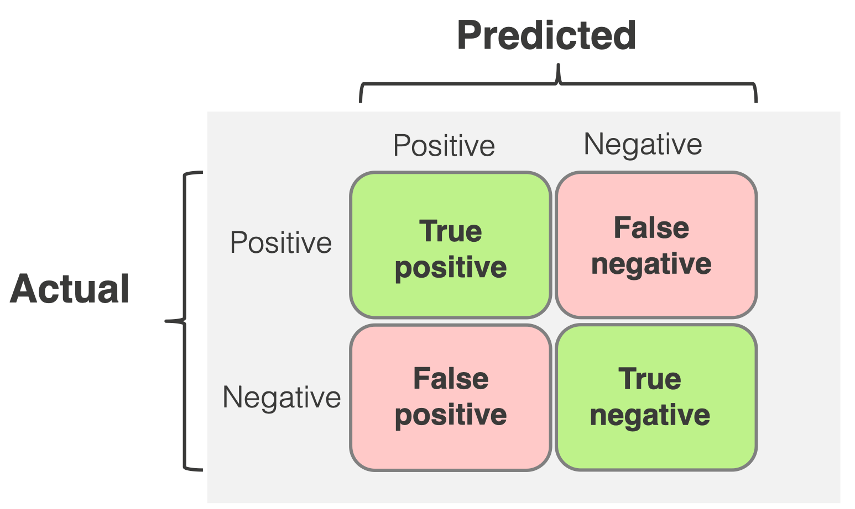
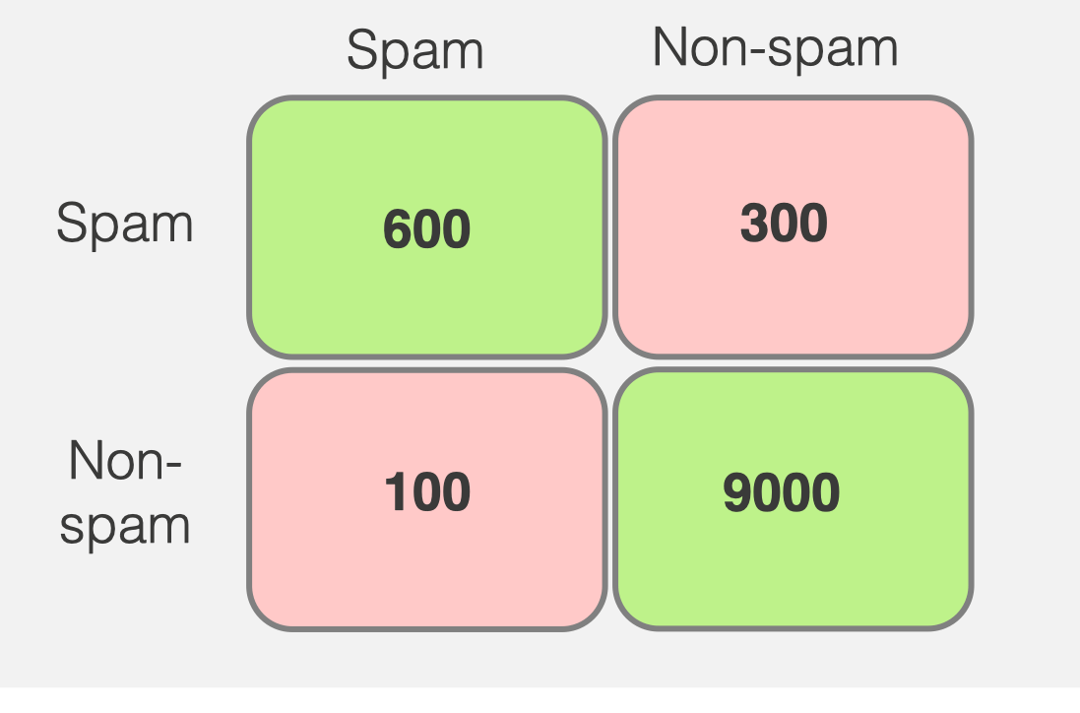
Q5
You are developing a model to detect an extremely contagious disease. Your data consists of 4000 patients, out of which 100 are known to have the disease. You achieve 96% classification accuracy.
Would you trust this model to identify patients with the disease, based on this accuracy result? Why or why not?
What type of error is most important in this task?
Name at least one appropriate evaluation metric that you would choose to evaluate your model.
Detected Disease
Detected No Disease
Have
Disease
0
100
No
Disease
0
3900

Slide 25
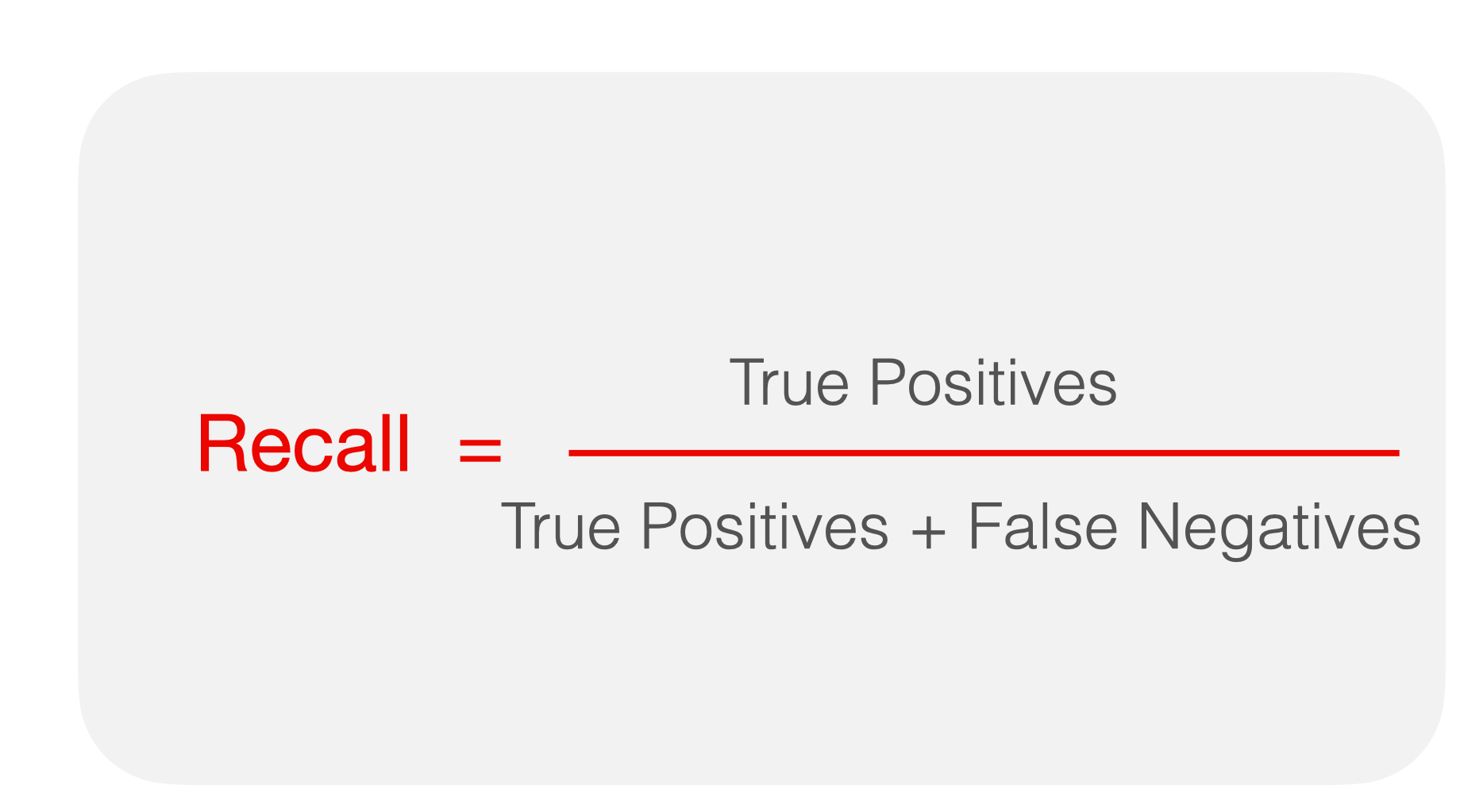
Q5 -Solution
You are developing a model to detect an extremely contagious disease. Your data consists of 4000 patients, out of which 100 are known to have the disease. You achieve 96% classification accuracy.
Would you trust this model to identify patients with the disease, based on this accuracy result? Why or why not?
What type of error is most important in this task? A Type II error, or false negatives, is the most critical error because undetected cases can continue to spread the disease to others, amplifying public health risks.
Name at least one appropriate evaluation metric that you would choose to evaluate your model. Recall
No, heavily
imbalanced class
Detected Disease
Detected No Disease
Have
Disease
0
100
No
Disease
0
3900

Slide 26
https://forms.gle/TF7QJ29ia3wSGnL98

