Slide 1
Quidditch
钱泽森

Slide 2
Outline
A minimized physical engine(Arena)
A minimized rendering framework(Scene), based on OpenGL 3.3 core
Some interface classes connecting the above two

Slide 3
Arena
std::vector< Ball * > balls_
std::vector< Wall * > walls_
const glm::vec3 g = glm::vec3(0, -9.8, 0)
const float mu = 0.01
void deduce (const float t)

Slide 4
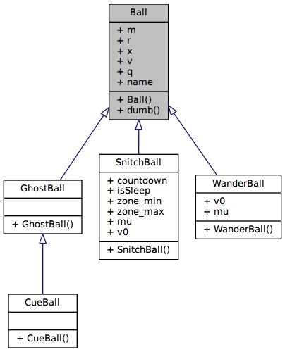

Slide 5
Collision Test
Check if any ball overlaps another
Check if they 're going to overlap even more
If so, collision happened. Do some math on the balls to reflect it.
Loop until no such collision is detected.

Slide 6
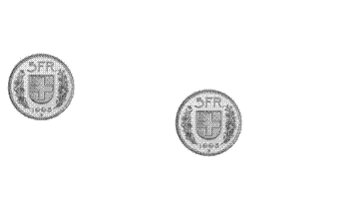
Use some vector library to ease your computation

Slide 7
Scene
std::vector< Renderable * > vector_
const View & view_
const Projection & projection_
void render ()

Slide 8
Libraries
GLM (GL Mathematics) to facilitate vector computation
GraphicsMagick (to load texture from image file)
SFML (to create OpenGL Context)

Slide 9
Details
The abstraction and implementation of the rendering components is up to you
Not covered

Slide 10
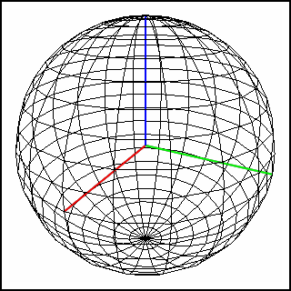
How to Draw a Sphere?
GluSphere()?
points not uniformly distributed

Slide 11
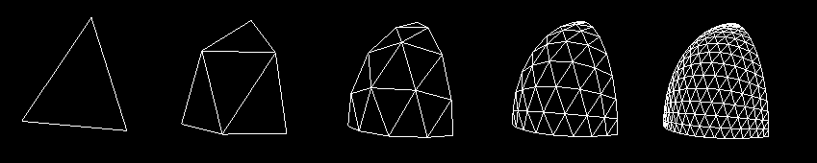
A more elegant way

Slide 12
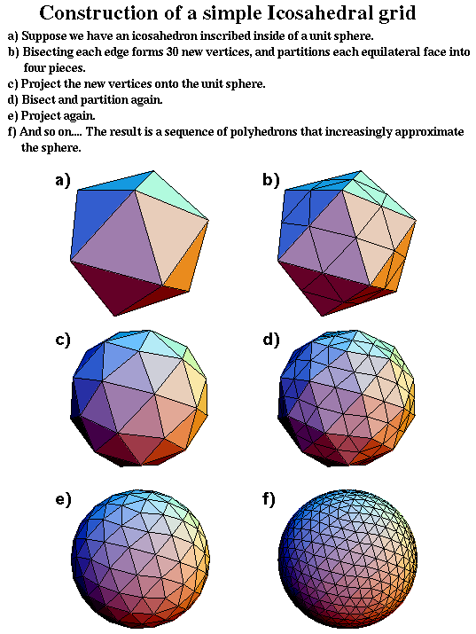

Slide 13
Thank you

