Slide 1

SKIN LESION CLASSIFICATION WITH CONVOLUTIONAL NEURAL NETWORKS AND TRANSFER LEARNING
DATASET : SKIN CANCER MNIST HAM:10000

Slide 2
RIA RAJPUT INFO 7390 SUMMER 2020 NUID : 001898189

Slide 3
PROBLEM STATEMENT
Skin cancer is the most common human malignancy, is primarily diagnosed visually, beginning with an initial clinical screening and followed potentially by dermoscopic analysis, a biopsy and histopathological examination. Automated classification of skin lesions using images is a challenging task owing to the fine-grained variability in the appearance of skin lesions.

Slide 4
OBJECTIVE
To perform Skin Cancer Malignancy classification using convolutional neural networks and comparing the accuracy of the model with the model trained using transfer learning technique.
To build a classification model using convolutional neural network and analyse the results.
To use the technique of transfer learning in order to fine tune the model accuracy and compare it with the previously built convolutional neural network classification model accuracy.

Slide 5
DATASET USED
SKIN CANCER MNIST : HAM10000
The HAM10000 ("Human Against Machine with 10000 training images") dataset, consists of 10015 dermatoscopic images which are released as a training set for academic machine learning purposes and are publicly available through the ISIC archive. This benchmark dataset can be used for machine learning and for comparisons with human experts.
It has 7 different classes of skin cancer which are listed below :
Melanocytic nevi
Benign keratosis-like lesions
Basal cell carcinoma
Actinic keratoses
Vascular lesions
Dermatofibroma
Melanoma

Slide 6
DIFFERENT JUPYTER NOTEBOOKS USED
SKIN_CANCER_MNIST_HAM10000_EDA_DATAPREPROCESSING.ipynb
DATA_MODELLING_CNN.ipynb
TRANSFER_LEARNING_MOBILENET_FINE_TUNING.ipynb
TRANSFER_LEARNING_MOBILENET_RETRAINING.ipynb

Slide 7
EDA AND DATA PREPROCESSING STEPS
Loading all important libraries
Creation of the data frame by joining the metadata csv file with the directory ‘base_skin_dir’ containing the folder bundle location
Creation of a dictionary of lesion types and images and giving labels to each of the lesion type on the basis of whether they are benign or malign. Benign lesions were given a value of 0 where as malign pigments were given a value of 1.
Mapping different attributes such as image id, dx to the path of the image, lesion type respectively.
Assignment of a category_id to each cell_type and verifying the same.
Performing basic EDA to explore the data further and fixing the color palette issue of the matplotlib library.
Analysis of all the patient data
Image analysis and using skimage library to read the images and convert them into array values
Normalizing color channel information and re tuning it to observe changes in images

Slide 8
DATA PREPROCESSING
Resized the images for the baseline model of CNN
Resized images for the retraining model i.e. transfer learning
Resized images for keras fine tuning model
Splitting the data into train, test and validation datasets

Slide 9
CONVOLUTIONAL NEURAL NETWORK (CNN)
Total number of layers used in order to build the model : 10 layers
Convolution2D layer with 16 filters
MaxPool2D layer with 2x2 pool_size
Convolution2D layer with 32 filters
MaxPool2D layer with 2x2 pool_size
Convolution2D layer with 64 filters
MaxPool2D layer with 2x2 pool_size
Flatten layer
Hidden Dense layer with 512 neurons
Dropout layer with droput_rate = 0.5
Output Dense layer with num_classes = 7 and activation function = softmax
Optimizer = Adam
Loss = categorical_crossentropy
metric = accuracy
MODEL FITTING : batch_size = 64, epochs = 30
MODEL BUILDING METHOD : Sequential
Training set accuracy : 77.85%
Test set accuracy : 76.6467%
Validation set accuracy : 77.5929%

Slide 10
HYPERPARAMETER TUNING CNN
Method Used : GridSearchCV from scikit-learn library
KerasClassifier instantiation
Hyperparameters taken into consideration : batch_size and epochs
Values of iteration for hyperparameters : batch_size = [10, 20, 30] , epochs = [10,25,40]
Best training set accuracy received at batch_size = 30 and epoch of 10
Best training set accuracy is equal to 75.25% which was lesser than the original baseline model

Slide 11
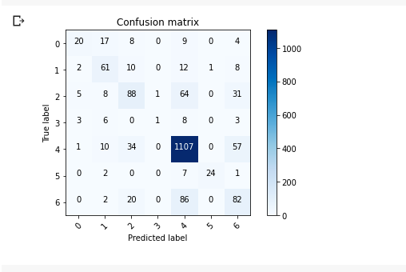
CONFUSION MATRIX PLOT

Slide 12
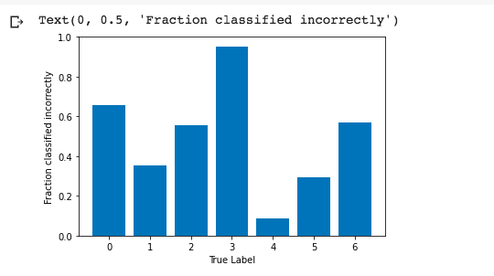
MISCLASSIFIED CLASSES OUTPUT

Slide 13
The most misclassified skin lesions are Basal cell carcinoma which has code 3, then second most mis sclassified type is Vascular lesions code 5 then Melanocytic nevi code 0 where as Actinic keratoses code 4 has least misclassified type.

Slide 14
TRANSFER LEARNING USING ImageNet AS AN INPUT ON MOBILENET ARCHITECTURE
Total number of layers = 87 layers
Weights = input = ImageNet
Last output layer = conv_pw_13_relu
Total number of parameters = 5856455
Total number of trainable parameters = 5820551
Total number of non trainable parameters = 35904
Training set batch_size and epochs = 32 and 10
Training set accuracy achieved = 73.65%
Fine tuning input layer = 81th layer
Fine tuning layer name = conv_dw_13
Fine tuning batch_size and epochs = 32 and 15
Fine tuning training accuracy = 79.06%

Slide 15
Validation set accuracy = 75.06%
Test set accuracy = 74.0519%
Accuracy results : One can see that maximum accuracy was achieved when the model was fine tuned, also the test set accuracy is lesser than the training set accuracy as well as the validation set accuracy which should ideally be the case as the model does not directly use the test set.

Slide 16
TRANSFER LEARNING USING ImageNet AS AN INPUT ON MOBILENET ARCHITECTURE (RETRAINING)
Total number of layers = 87 layers
Weights = input = ImageNet
Last output layer = conv_pw_13_relu
Total number of parameters = 5856455
Total number of trainable parameters = 5,834,567
Total number of non trainable parameters = 21,888
Training set batch_size and epochs = 32 and 3
Training set accuracy achieved before retraining = 65.37%
Training set accuracy achieved after retraining = 91.20%
Retraining batch_size and epochs = 32 and 15

Slide 17
Validation set accuracy : 75.05%
Test set accuracy : 74.0519%
Hence one can say that the test set accuracy is lesser than the validation set accuracy as well as from the training set accuracy, hence the model is performing properly.

Slide 18
BEST PERFORMING MODEL
According to all the observations, the model performing the best is the MobileNet architecture trained on the pretrained IMAGENET input data where the complete model is retrained performs the best as compared to the baseline CNN and fine tuned DCNN with ImageNet.
The highest accuracy received is equal to 91.20% after the MobileNet model was retrained which is an excellent result.

Slide 19
THANKYOU!

